Slide 1
Xeto-Native AI Agents
Technical Track
James Gessel

Slide 2
Xeto-Native AI Agents
ONTOLOGY MEETS INTELLIGENCE

Slide 3
What do these products have in common?
Memory foam mattress
Contact lenses
Adaptive cruise control
Iphones
Thermo molded ski boots
Standing desks
For decades we have adapted to machines.
We write nonsense and call it code
We act like scientists and study charts
We train operators to use clunky, outdated software
We click more than 9,000 times per day!
Its time machines adapted to us.

Slide 4
Meet Joe.
It came on fine this morning, but its always flaky on startup. ACME’s comin’ out tomorrow to take a look.
Mornin Joe.
How’s that AHU?

Slide 5
Meet Joe.
how do we get machines
to speak like Joe?
Joe provides
history, judgement, Planning, and decision making.
Not time series data.
So natural its boring.
This is exactly what we want.

Slide 6
Lets talk AI & LLMs
LLMs have (almost) entirely bridged the gap in communication.
Ask anything, get back a response in exactly the way you best learn.

Slide 7
Let’s talk llms
Should I implement a DAT reset on my AHU?
LLM
LLM
AGENT
+ Reasoning
+Reasoning
+ Tools
+ Context
Word | Prob %
Yes… | 52%
It depends… | 46%
No… | 2%
What is an ahu
… reasoning
What is a dat reset
I see this feeds downstream vavs
What does ASHRAE say
I see there are 63 zones…
What are pros/cons
7 zones seem to struggle with temp
Should the user implement
DAT reset will affect comfort
Yes, this is a common measure and a great way to optimize and improve efficiency.
While DAT resets are a great idea, there are certain considerations to take into account…
My analysis shows 7 downstream zones struggle to meet temp setpoint. Based on the circumstances, I suggest…

Slide 8
Context is everything.
Everything is there – but the pieces are scattered.
System | Offers | Lacks
BAS | Real-time data, automation | Interpretation
Analytics | Historical analysis, visualization, reporting | Digestible insights
Joe | Judgement, planning, decisions, context | Scalability, omnipotence
Xeto | Classification, relationships | Analysis
Engineer | Systems expertise | Immersion, context
LLM | Digestible insights, natural communication | Context, data
RAG/KB | Fine-tuned custom knowledge bases, quick access | Context, real time data, relationships
standard
We need a platform that can pull everything together.

Slide 9
ONTOLOGENCE (noun)
The fusion of ontology, human insight, and artificial intelligence to form contextually-aware digital intelligence.
The capacity of a system to infer, adapt, learn, and operate based on deep contextual knowledge defined through relationships, classifications, and metadata.

Slide 10
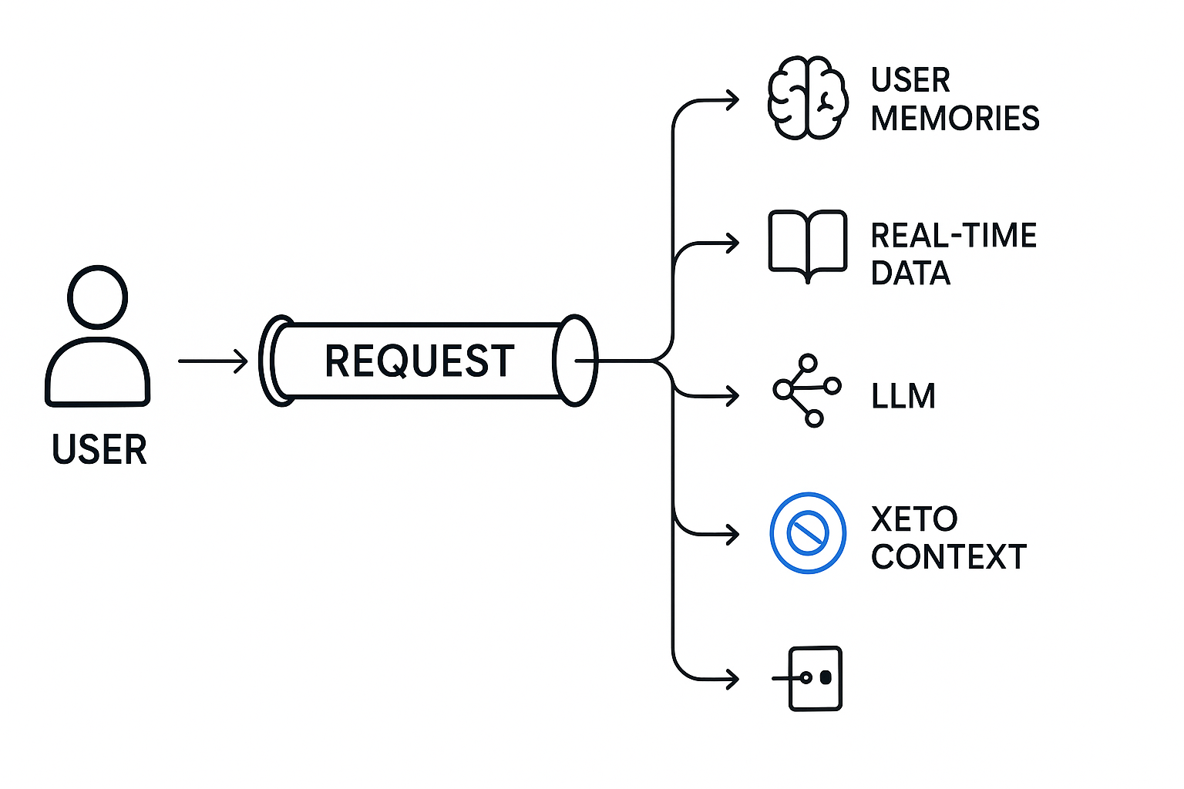
Lets ask the question. Why xeto?
Native & Framework-Free – Built for Haystack environments.
On-Prem & Secure – No external systems reaching into your network. Lightweight models can run locally.
Context-Aware – Understands your actual workflows, data, and ontology. Learns from you as you use it.
App-Specific – Prioritizes your tags and definitions over generic ones.
Purpose-Built – and tailored for Haystack environments
Smart Recall & Transfer Learning – Instantly finds and compares similar entities.
Same Workflow, New Tool – Build agents easier than building fdd analytics.
Why not…
Langchain?
Crew AI?
Autogen?
Haystack? (not PH…)

Slide 11
Imagine a world where joe can scale himself by building
Digital Joe
In 5 minutes.
With 0 lines of code.
With 0 technical skills.

Slide 12
ONTOLOGENT AI
A no-code framework for building ontologent AI agents that understand and act through meaning, built with native Xeto technology.
demo & technical overview

Slide 13
AI AGENTS IN HAYSTACK APPLICATIONS
AGENT | USE CASE
The Sparkitect | Sparks that build themselves
Schedutron | Resisting schedule changes is futile
Chilluminati | Behind every optimized chiller is… them…
The Dampire | Hunt down rogue dampers
Tagatha Christie | Resolve tagging mysteries
Wattson | Deduce energy waste before it even happens
Obi-Watt Kenobi | Brings balance to the… floors?
Notorious PID | Drops fire loops
chAHUbacca | What is that sound
Snoop Log | Light up those hidden details
Optimus Prim(ary loop) | Self explanatory
Flow Rida | Get that airflow down low low low
Ferris Bueler’s Data Off | Don’t let your sensors miss school
Equippopotamus | Running out of ideas here
Point Fiction | Synthetic points are kinda fiction
Harry Pointer | Uhh… obliviate
Arcademy Awards | This year’s best arcs

Slide 14
Final takeaways
AI is here to stay. But so are you.
ONTOLOGENCE
Is the concept of
taking the “artificial” out of AI
by combining
You + data + LLM
You understand your building.
AI does not.
AI is omnipotent.
You are not.
Both of you do what you’re good at.
Watch and learn from each other.
Don’t fight it. Embrace it.
Digitize yourself.

Slide 15
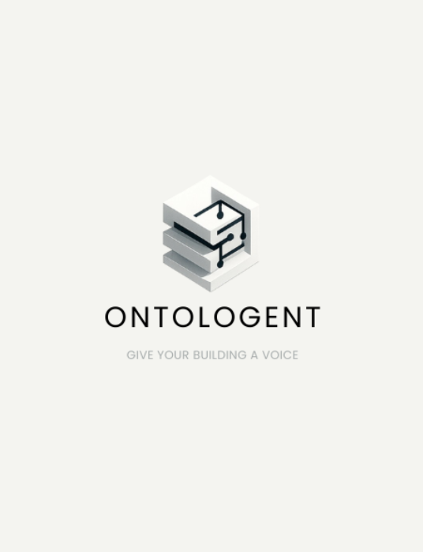
THANK YOU
James Gessel
801-678-4396
james@ontologent.ai
ontologent.ai

