Slide 1
Haystack 5 and Xeto
General Session - 6 May 2025
Brian Frank

Slide 2
Intro
Haystack 5
Xeto
RDF
Haxall
Xeto.dev

Slide 3
What is Data Modeling?

Slide 4
What is Data Modeling?
Three layers…
Meta Model: description language itself
Domain Model: ontology for domain specific concepts
Instance Model: specific instances of the concepts

Slide 5
Data Modeling Stack
Instance Model
Your Building
Your Building
Your Building
Domain Model
Haystack 4
Haystack 5
Brick
Meta Model
Defs
Xeto
RDF

Slide 6
Compare Meta Models
Excel
JSON Schema
RDF/SHACL
Defs (Haystack 4)
TypeScript
Xeto (Haystack 5)

Slide 7
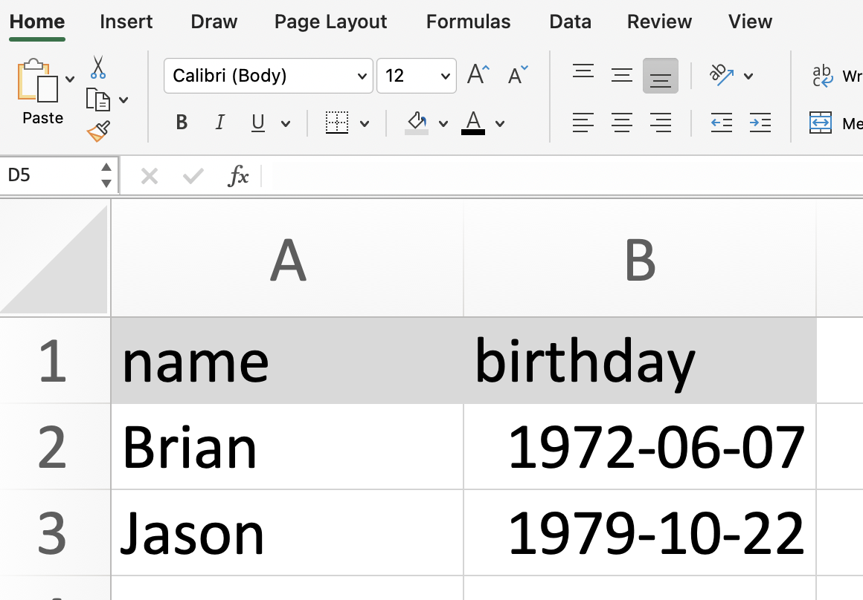
Excel

Slide 8
JSON Schema
{ "$schema": "http://json-schema.org/draft-07/schema#",
"title": "Person", "type": "object",
"properties": {
"name": { "type": "string" },
"birthday": { "type": "string", "format": "date"}
},
"required": ["name", "birthday"]
}
{"name":"Brian", "birthday":"1972-06-07"}
{"name":"Jason", "birthday":"1979-10-22"}

Slide 9
RDF/SHACL
ex:Person a rdfs:Class .
ex:name a rdf:Property ;
rdfs:domain ex:Person ;
rdfs:range xsd:string .
ex:birthday a rdf:Property ;
rdfs:domain ex:Person ;
rdfs:range xsd:date .
ex:PersonShape a sh:NodeShape ;
sh:targetClass ex:Person ;
sh:property [
sh:path ex:name ;
sh:datatype xsd:string ;
sh:name "name" ;
sh:minCount 1 ;
sh:maxCount 1 ;
] ;
sh:property [
sh:path ex:birthday ;
sh:datatype xsd:date ;
sh:name "birthday" ;
sh:minCount 1 ;
sh:maxCount 1 ;
] .
ex:brian a ex:Person ;
ex:name "Brian" ;
ex:birthday "1972-06-07"^^xsd:date .
ex:jason a ex:Person ;
ex:name "Jason" ;
ex:birthday "1979-10-22"^^xsd:date .

Slide 10
Defs (Haystack 4)
def: ^person
is: ^entity
---
def: ^name
is: ^str
tagOn: ^person
---
def: ^birthday
is: ^date
tagOn: ^person
name: "Brian"
birthday: "1972-06-07"
---
name: "jason"
birthday: "1979-10-22"
ver: "3.0"
name, birthday
"Brian", 1972-06-07
"Jason", 1979-10-22

Slide 11
Type Script
interface Person {
name: string
birthday: Date
}
Person { name:"Brian", birthday:Date("1972-06-07") }
Person { name:"Jason", birthday:Date("1979-10-22") }

Slide 12
Xeto
Person: {
name: Str
birthday: Date
}
Person { name:"Brian", birthday:"1972-06-07" }
Person { name:"Jason", birthday:"1979-10-22" }

Slide 13
Text Files
Entire software industry is built around text files
Programming languages are text files
Ontologies are text files
Data often stored in custom formats, but almost always has text interchange formats
Input and output for LLMs
Human collaboration is entirely based on text diffs
GitHub and pull requests
Increasing levels of abstraction expressed in text

Slide 14
Xeto as Transpiler
Xeto provides higher level of abstraction
Compile Xeto to JSON Schema
Compile Xeto to RDF/SHACL
Just like high level programming language can target different machine instruction sets
Allows Xeto ontologies to be used as a RDF ontology
Allows Xeto types to be use for Open APIs (Swagger)
Stub types into programming languages

Slide 15
Haystack 5 Stack
Your Building
Your Building
Your Building
Haystack 5
Xeto
JSON Schema
RDF

Slide 16
Xeto

Slide 17
What is Xeto?
Meta model for ontologies and data
Like a programming language for data only
Works with Haystack, JSON, and RDF
Define the ontology itself
Define reusable templates: VAV + nameplate data + semantic points + BACnet addresses
Validate data models
Share templates/app profiles in the cloud

Slide 18
Specs
Spec define types/classes and tags
Specs can model a scalar value (Date) or an entity type (Room)
Specs are always packaged into a library
Spec identified with a qualified name or qname:
ph::Room
ph.points::DischargeAirTempSensor

Slide 19
Libs
Global namespace of dotted names
Package metadata, specs, instance data, and resource files into a single zip file
Versioned and well defined dependencies
Naming:
sys.*: core definitions
ph.*: project haystack ontology
cc.*: community contributions
organizations can register prefix on xeto.dev
com.*, gov.*, io*, etc: domain owners

Slide 20
Templates
Predefined unity controllers completely modeled
Attributes for nameplate data (dimensions, temp range, power ratings, etc)
Points mapped to ph.points
Point addressing via ph.protocols (BACnet & Modbus)
Resource links to cutsheets, manuals, etc
Remove cost from building modeling!

Slide 21
Acuvim Electric Meter
Acuvim2ElecMeter : AcElecMeter {
attrs: {
TempRatedMinOperatingAttr { val: -25°C }
TempRatedMaxOperatingAttr { val: 70°C }
}
points: {
ElecAcFreqSensor {
ModbusAddr { addr: "16384", encoding: "f4" }
BacnetAddr { addr: "AI1" }
}
ElecAcPhaseVoltSensor {
phaseVolt: "L1-N"
ModbusAddr { addr: "16386", encoding: "f4" }
BacnetAddr { addr: "AI2" }
}

Slide 22
Validation
Validation: correct vs complete
Correct: every entity defines its type via "spec" tag
Complete requires knowledge of applications
Applications define their data requirements via specs
Example: Guideline 36 requires specific points from a VAV for control application
Sanity check for LLM output

Slide 23
RDF

Slide 24
RDF Ontologies for Buildings
Brick: roughly the same domain (xeto lib to map ph entities to brick classes)
Real Estate Core: business admin, spaces
ASHRAE 223p: low level topology, but not geometry
Other domains: BIM, simulation, etc

Slide 25
RDF (Resource Description Format)
RDF technology stack
Elegance of the triple {subject / predicate / object}
Jason's / birthday / 1979-10-22
SPARQL: query language
OWL vs SHACL
Verbose/awkward as source of truth
Good as interchange format
Great at combining ontologies

Slide 26
RDF Triples
@prefix rdf: <http://www.w3.org/1999/02/22-rdf-syntax-ns#>.
@prefix ex: <https://example.com/schema#>.
ex:jason a ex:Person ;
ex:name "Jason" ;
ex:birthday "1979-11-22 .
ex:jason rdf:type ex:Person
ex:jason ex:name "Jason"
ex:jason ex:birthday "1979-11-22"
https://example.com/schema#jason http://www.w3.org/1999/02/22-rdf-syntax-ns#type https://example.com/schema#Person
https://example.com/schema#jason https://example.com/schema#Person "Jason"
https://example.com/schema#jason https://example.com/schema#Person "1979-11-22"

Slide 27
Combining Ontologies via RDF
ex:room-204
is ph:Room
is rec:ConferenceRoom ;
ph:siteRef: ex:my-building ;
ph:airRef: ex:vav-204 ;
brick:isFedBy ex:vav-204 ;
rdfs:label "Room 204" ;
.

Slide 28
Haystack 5

Slide 29
Haystack 5
Replace meta model: defs -> xeto
Breaking changes are on the table
Many new features already only in xeto
ph.points: standard points
ph.points.elec: electrical point modeling
ph.attrs: attributes for nameplate data
ph.protocols: BACnet, Modbus addressing

Slide 30
Equip Templates
Acuvim2 electric meter (Modbus & BACnet)
AcuRev electric submeter (Modbus)
Siemens Apogee PTEC VAVs (BACnet)
ABB VFD (BACnet)
Grizzl-E Level 2 EVSE
Siemens Helio Flex Level 3 EVSE

Slide 31
Contributing
WG #1072 Xeto: meta model (Tue 11a ET)
WG #837 Labs: domain model (Thu 3p ET)
Continue to use forum for proposals
GitHub xeto: sys.* and ph.* libs
GitHub xeto-cc: community contributions cc.*

Slide 32
Haxall

Slide 33
Haxall
SkyFoundry open source reference implementation
Full stack runs on Java VM
Subset runs in JS (NodeJS, browser); now available as NPM module
Xeto engine
Command line interface tools
https://haxall.io/

Slide 34
Haxall – Xeto Subsystem
Pods: xeto, xetoEnv, xetoc, xetoTools, xetoDoc
Reflection APIs: repo, libs, specs
Compiler
Instantiation
Validation
Conversions: JSON, RDF, haystack formats
Java, JavaScript, and TypeScript bindings

Slide 35
Xeto Components
Non project-haystack ontologies
sys.comp: very basic normalization layer for block based programming with links
Ion: user interface toolkit for xeto.dev and Haxall Plus
hxControl: new Haxall based control engine
231p: CDL (control description language)
Manufacturer specific block libraries

Slide 36
ASHRAE 231P
CDL - Control Description Language
Specifies a standard library of component function blocks
Defined in Modelica
Development of standardized control sequences for Guideline 36
We have developed a Modelica to Xeto compiler
Haxall based control engine to execute it

Slide 37
https://xeto.dev/

Slide 38
Xeto.dev
Cloud repository of Xeto libraries
NPM for Xeto – crowdsourcing!!
Online documentation, LLM powered search
JSON protocol to query/download/upload libs
Branding: project-haystack.org vs xeto.dev
Alpha testing this summer

Slide 39
Haxall Plus

Slide 40
Haxall Plus
Haxall + Ion UI
User interface tools for working with Xeto
Build models with Xeto templates
Integrate with Haxall connectors (MQTT, SQL Modbus, Haystack, Sedona, BACnet*, SNMP*, OPC*)
Validate against spec tag or app profile specs

Slide 41
Demo Time

