Slide 1

From Chaos to Clarity: Turning PDF Documentation into Structured Device Data
TECHNICAL TRACK – Session 1
Trevor Adelman
Xetobase

Slide 2
The Problem
Manufacturers publish critical device data in complex PDFs…it’s not their fault, there's just a lot of info
Finding device information and communication protocol data (BACnet, Modbus) is tedious and manual
Lack of structure means a barrier to integration and lots of time consumed just knowing before actually doing.

Slide 3
The Goal
Extract structured, machine-readable data
Easily transition to semantic tagging (Haystack or anything else)
In turn enables faster device onboarding into BAS/BMS systems

Slide 4
Why Structure Matters
Faster deployment and integration of smart device into building controls and automation systems
Makes for reliable analytics and fault detection
Ideally drives open, interoperable ecosystems with easily shared resources

Slide 5
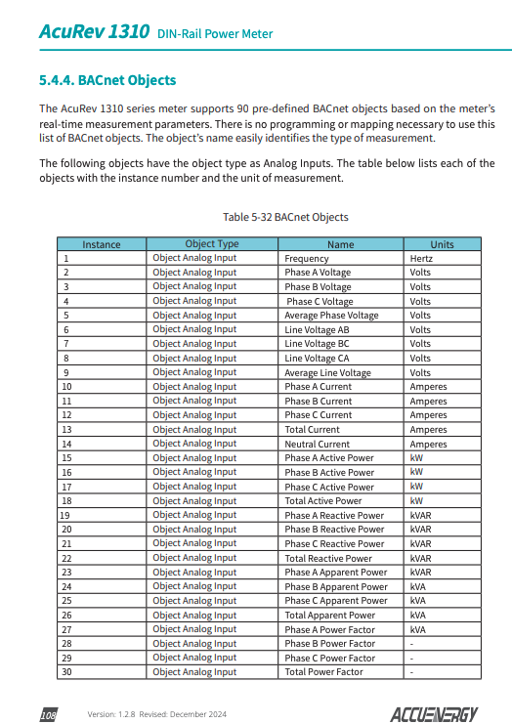

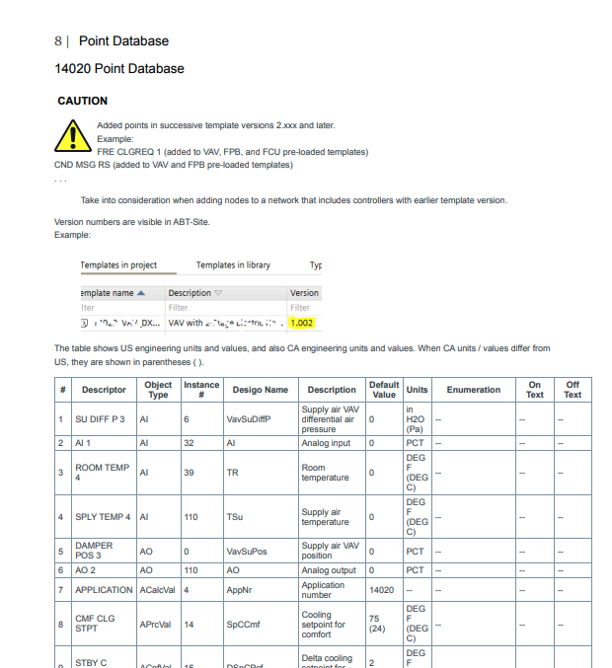
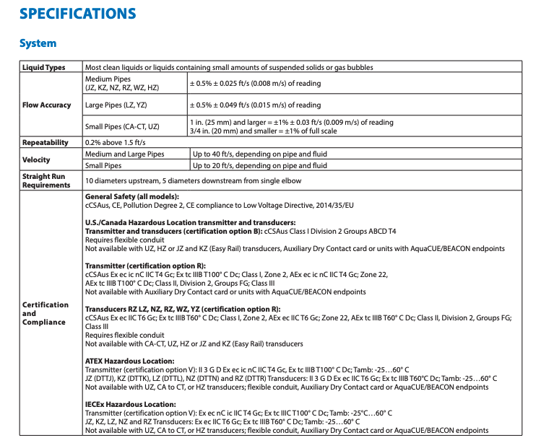
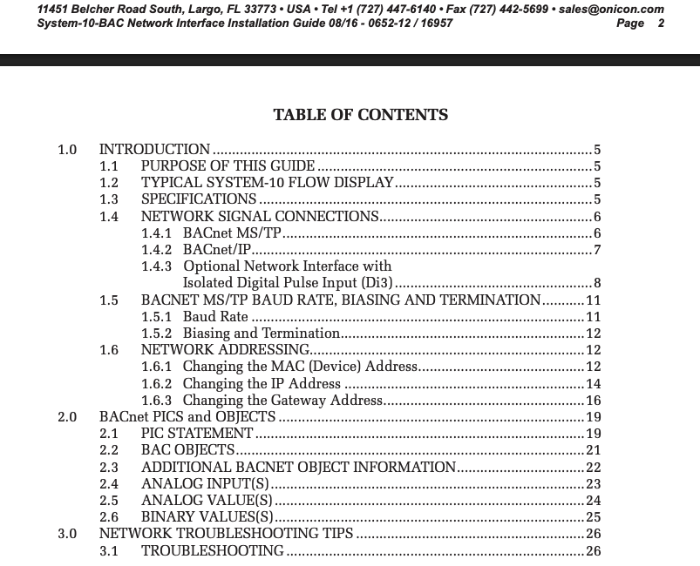
The Chaos: A Typical PDF

Slide 6
The Old Way: Manual and Painful
Manually reading 100+ page PDFs
Copy-paste into spreadsheets
Prone to human error
Extremely slow — hours and sometimes days per device

Slide 7
Early Automation Attempts
Tesseract OCR (2005): extracted text from scanned documents
  Struggled with images, formatting, tables, and mixed content
Basic Regex/Scraping: fragile, broke on layout changes
Required software dev on top of domain expertise
Result: still messy, partial, lots of manual cleanup

Slide 8
Enter the Large Language Models (LLM)
How it started (ChatGPT)
  Limited to text input and text output
  Limited sized context windows meant short, frustrating conversations
  SO. MUCH. HALLUCINATION.
Where it’s at now
  Most models now support multi-modal input and output
    We are specifically focused on “vision” input
  Context windows climb into the multi-million token range
  Hallucination still possible, but significantly reduced with good prompt engineering

Slide 9
LLM Usage Reimagined
Initial Issues
  LLM’s are great at talking, but human readable language is prone to hallucination
  LLM’s do not know how to say “I don’t know” and will instead make things up
I know the tool is powerful, how can we leverage it?

Slide 10
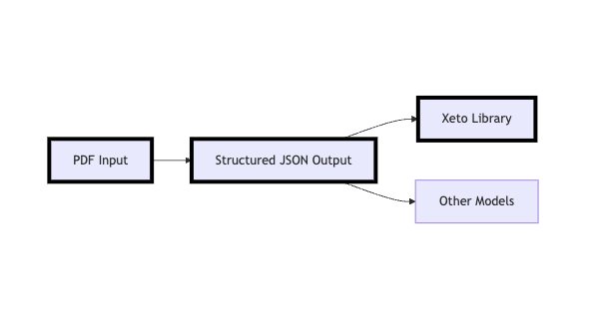
LLM Usage Reimagined
Using defined JSON structures as the middleman to where we want really want to get – a modelled device

Slide 11
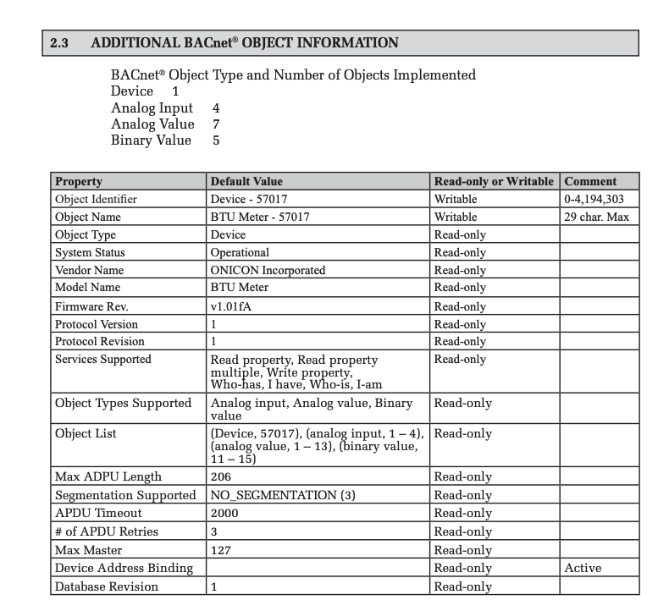
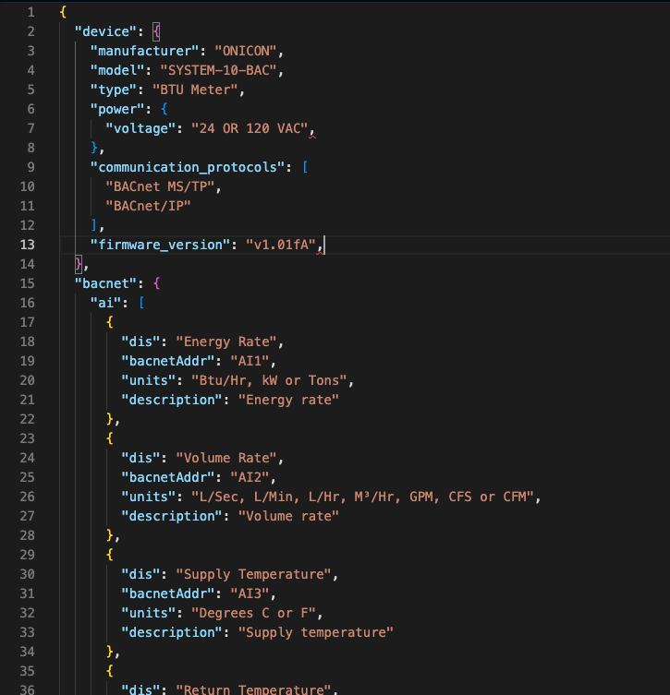
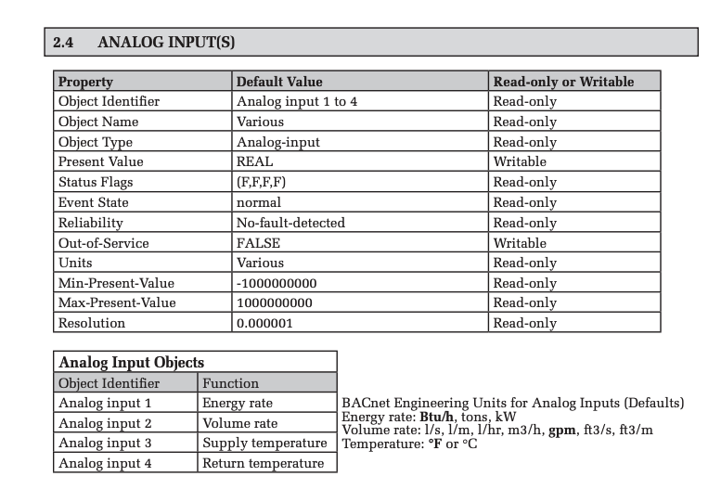

The New Input and Output

Slide 12
Why JSON?
Easily readable for human-in-the-loop review
Vast majority of languages have a JSON toolkit allowing conversion from JSON to your implementation needs
In our case that means a compilable Xeto library

Slide 13
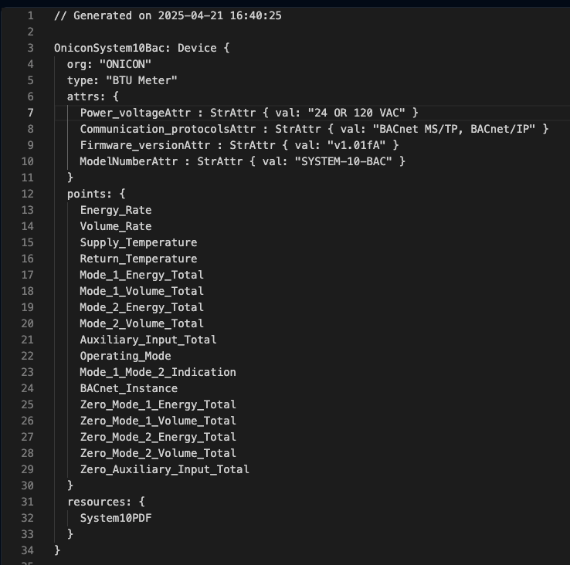
JSON to Xeto

Slide 14
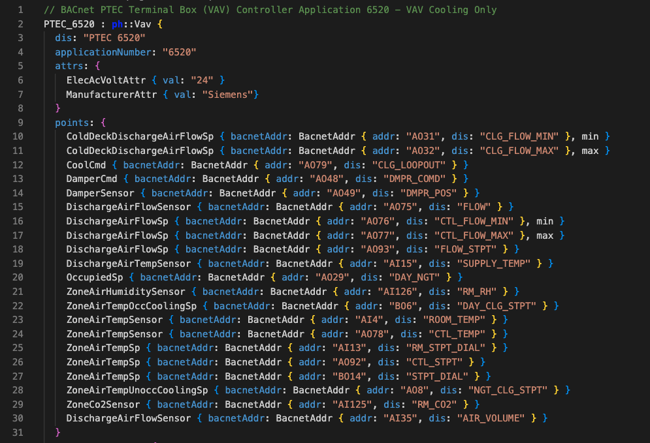
Xeto With Haystack

Slide 15
Demo Time!
🤞🤞🤞

Slide 16
The Disclaimer
LLM’s in their current state should be considered efficiency tools, not a magic wand
Even with strict structure definitions, everything that comes out of an LLM should be treated as something in need of critical hands-on review

Slide 17
The Next Steps
Documentation Aggregation Stage
  Entire product lines in one repository
  Both raw JSON as well as compiled xetolibs
Community Effort
  https://github.com/Project-Haystack/xeto-cc
  Interest in open source tooling?
Non-BAS related documentation?

Slide 18
The Dream
The tip of the iceberg of LLM usage
  Speed and cost decreasing with every released model
  Competent models using ~1GB of memory locally
  Quickly growing context windows, already capable of massive input sizes
Other inputs?
  What is your dream output from an entire controls drawing?
    Site/space/system ontology models?
    Equipment specific xetolibs?
    Complex equipment system modelling?
It’s not just a chatbot - create reusable tools for your projects based on your project workflows.

Slide 19
The End
Thank you for listening!
Want to dive deeper into PDF extraction and what’s possible with LLM workflows?
Trevor Adelman
trevor@xetobase.com

