Slide 1

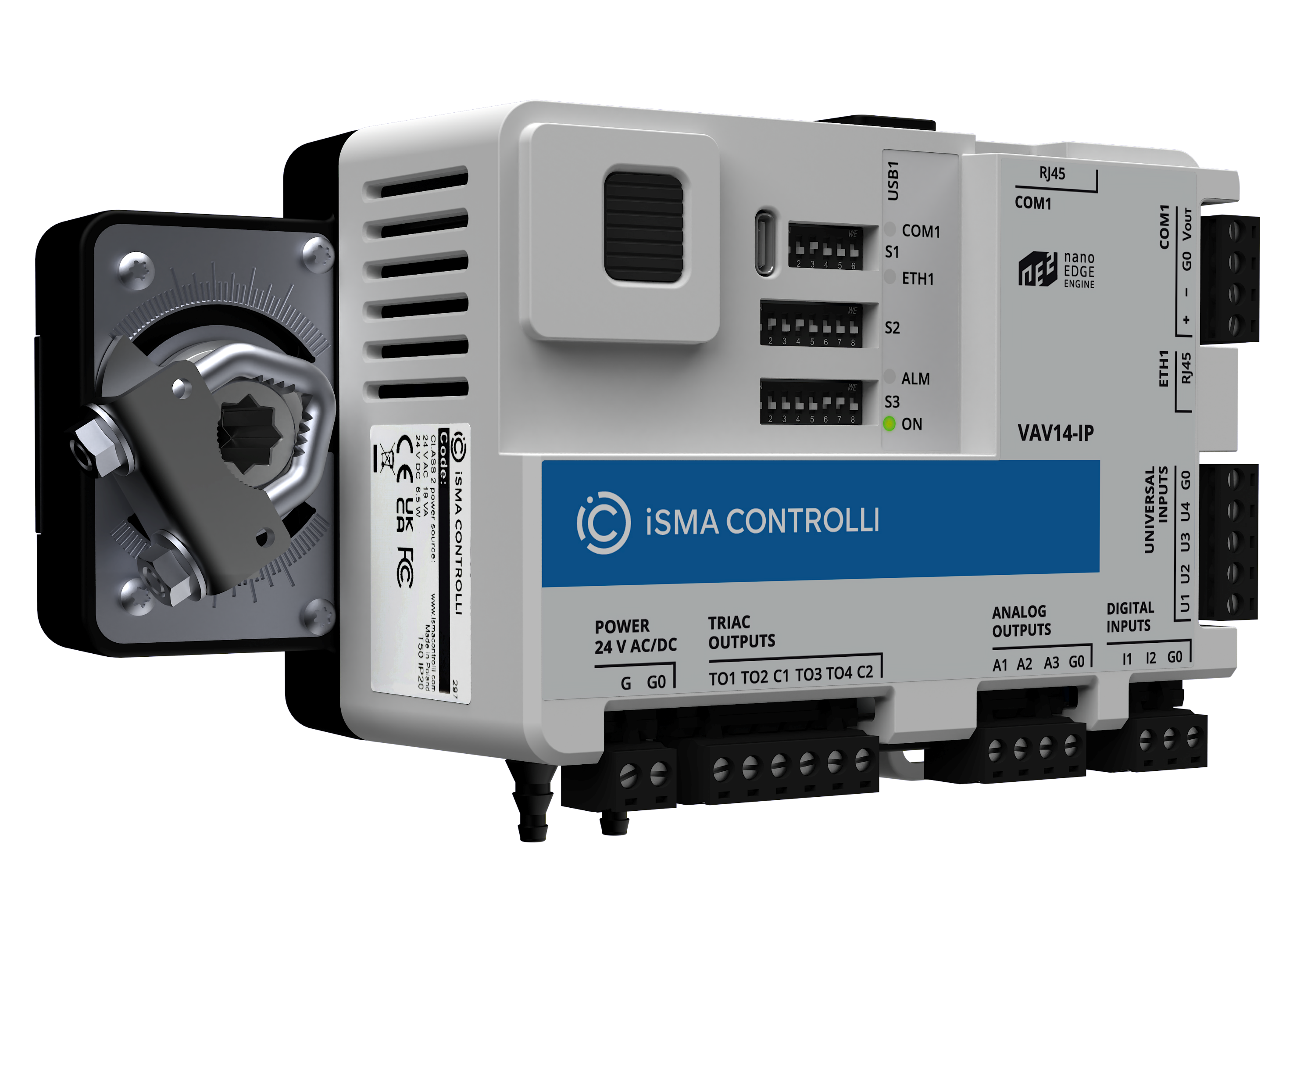
VAV14-IP
Smart at the Edge.
Pawel Szarmanski
Solution Product Manager
ic.tech

Slide 2


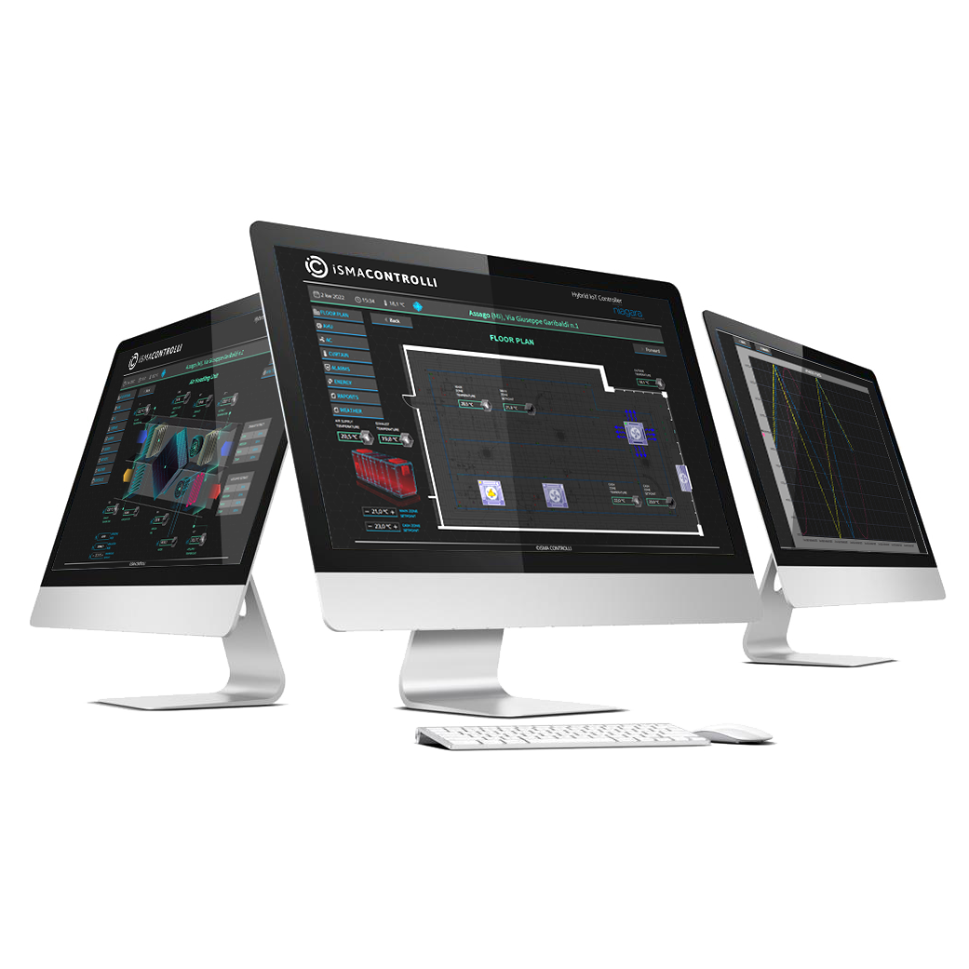
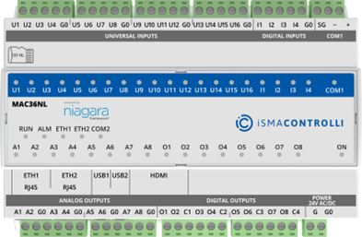
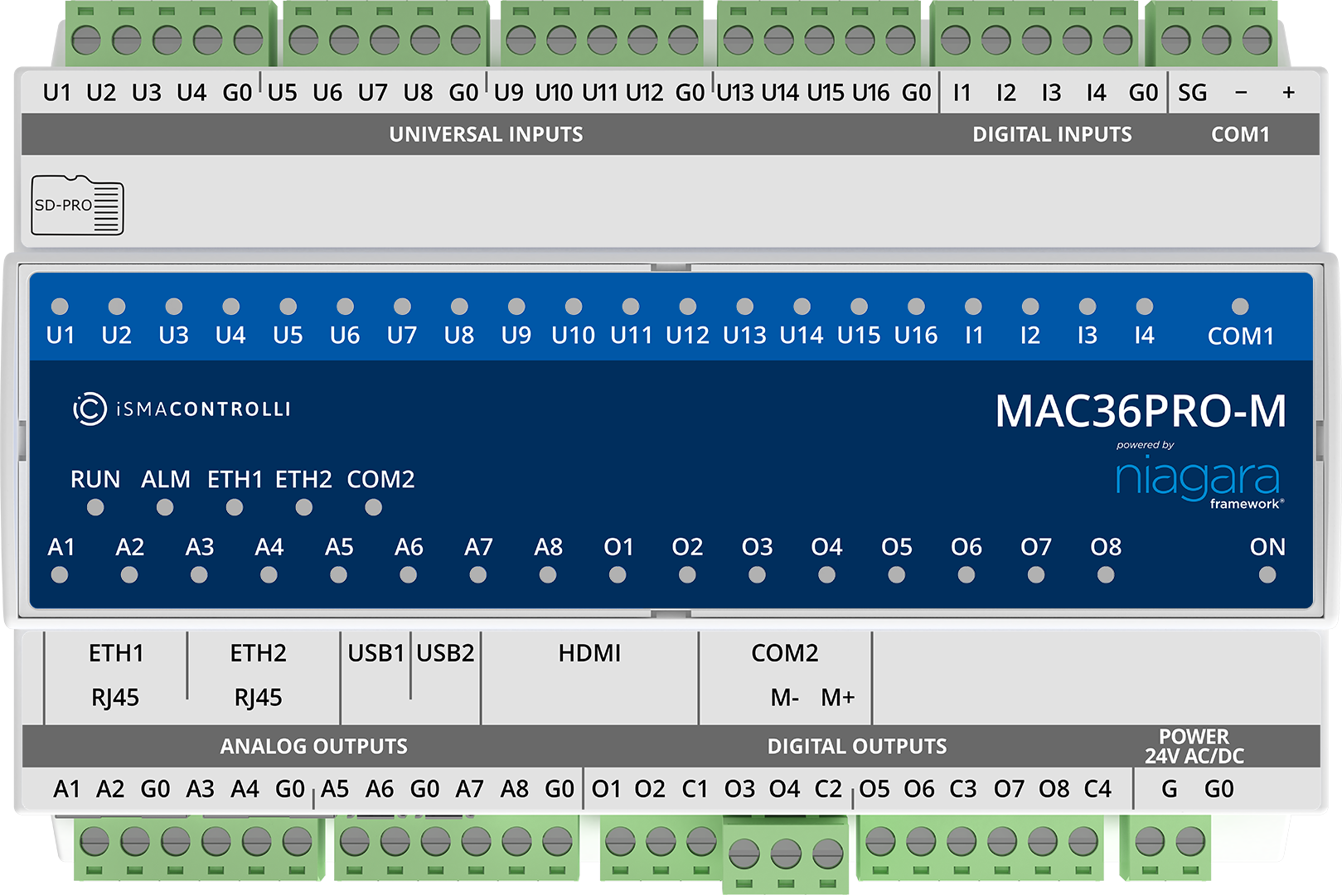
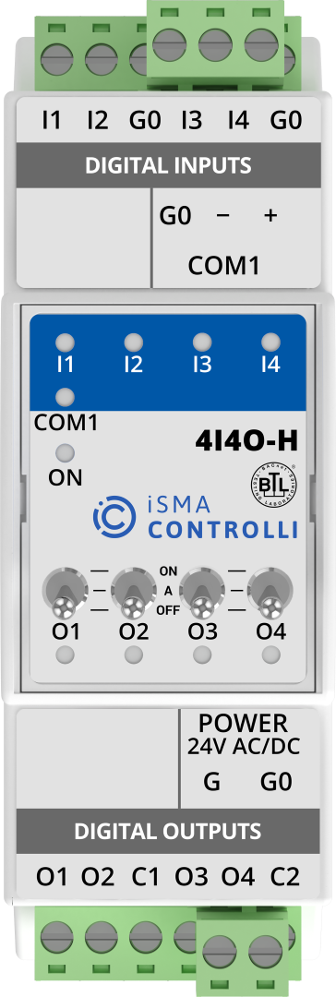
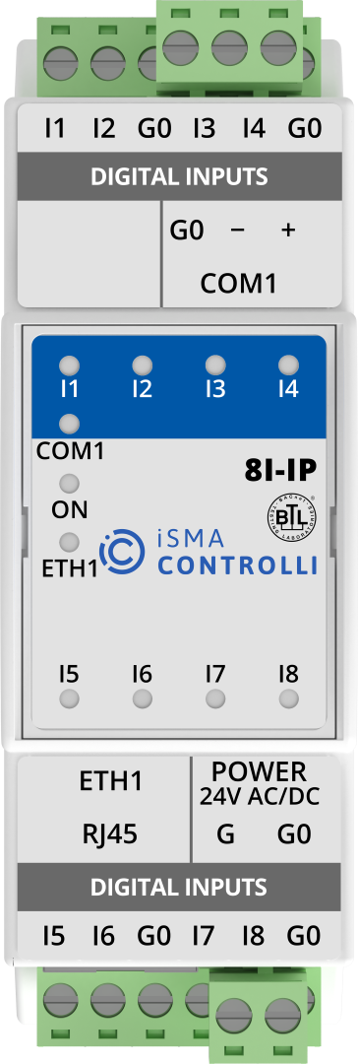
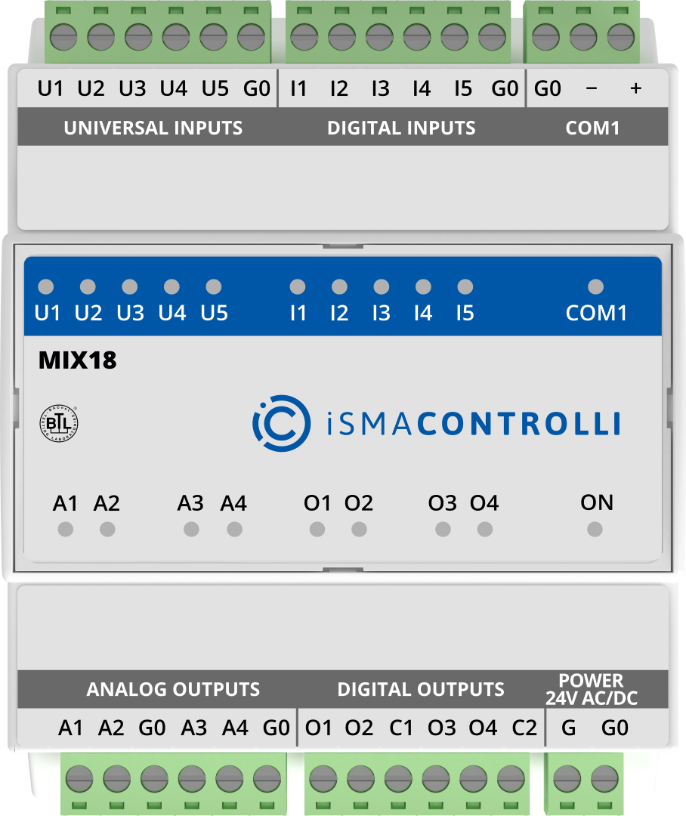
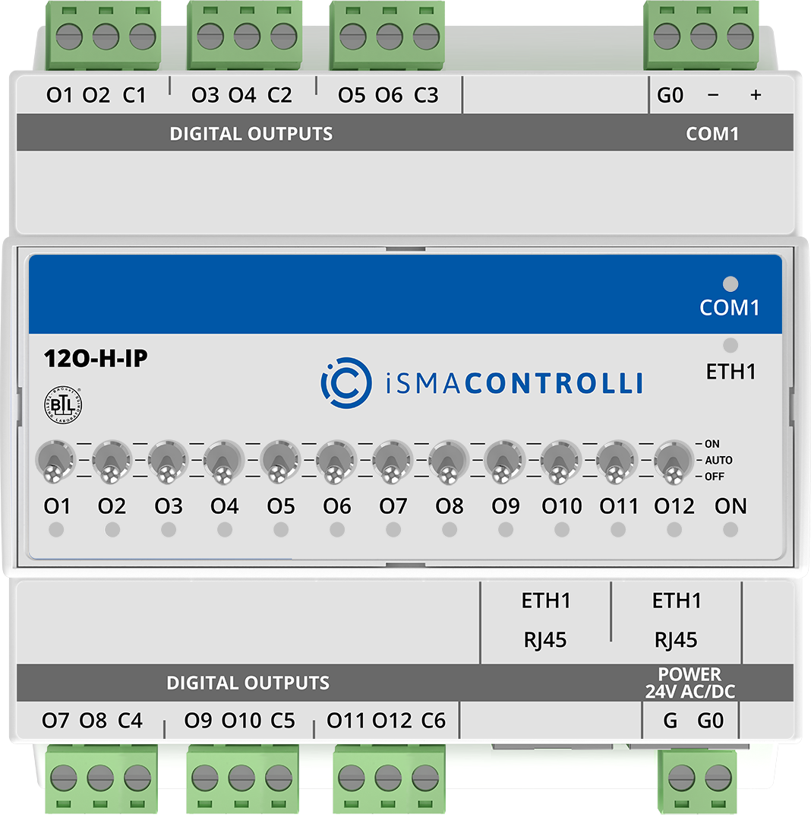

System architecture
Small to large BMS
  Analytics Software
  Supervisor Software
Multiprotocol I/O Modules
Master Controllers
  MAC36PRO
MINI
MIX
MAX
RS485 or IP

Slide 3
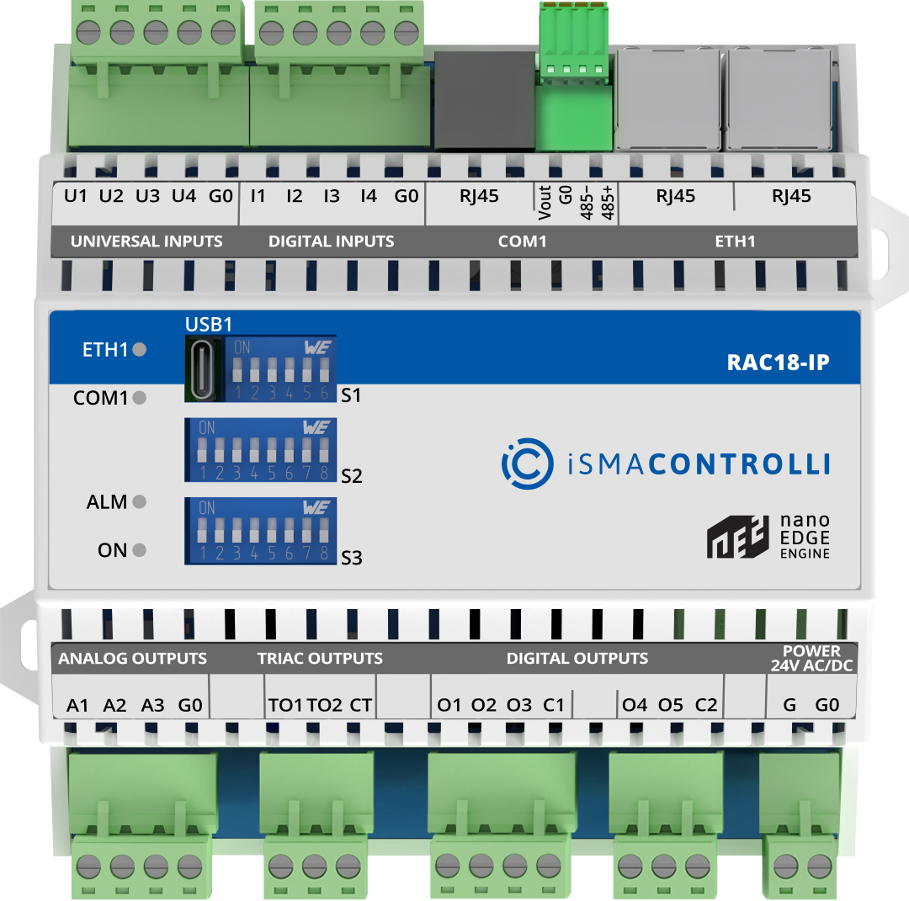

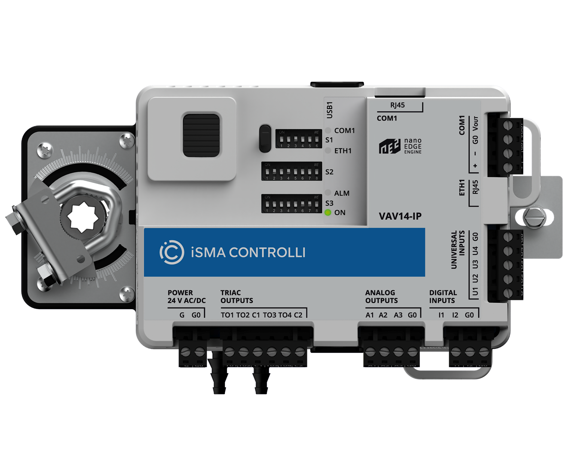
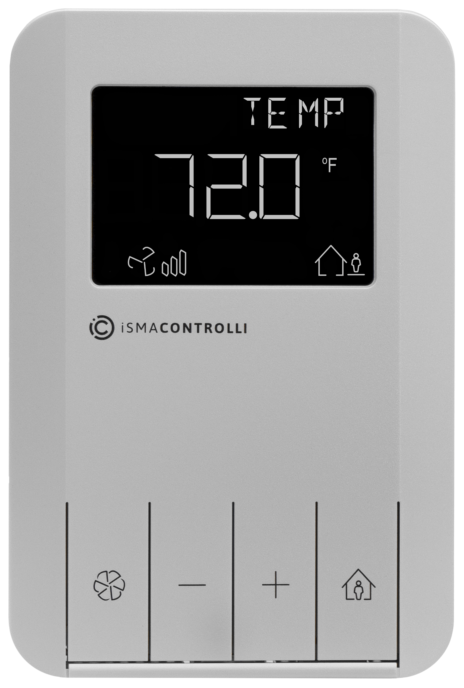
System architecture
Small to large BMS
  Analytics Software
  Supervisor Software
Multiprotocol I/O Modules
Master Controllers
  MAC36PRO
MINI
MIX
MAX
RS485 or IP
  IP
  BACnet IP or Modbus TCP/IP
  RAC18-IP
MINI
MIX
MAX
Unitary Controllers
  VAV14-IP
CP

Slide 4

System architecture
Small to large BMS
  Analytics Software
  Supervisor Software
Multiprotocol I/O Modules
Master Controllers
  MAC36PRO
MINI
MIX
MAX
RS485 or IP
  IP
  BACnet IP or Modbus TCP/IP
  RAC18-IP
MINI
MIX
MAX
Unitary Controllers
  VAV14-IP
CP

Slide 5



What is Smart?
Technology
Hardware
Software
Notes:
I/O types: 4 UI, 2DI, 3AO,4TO

Slide 6
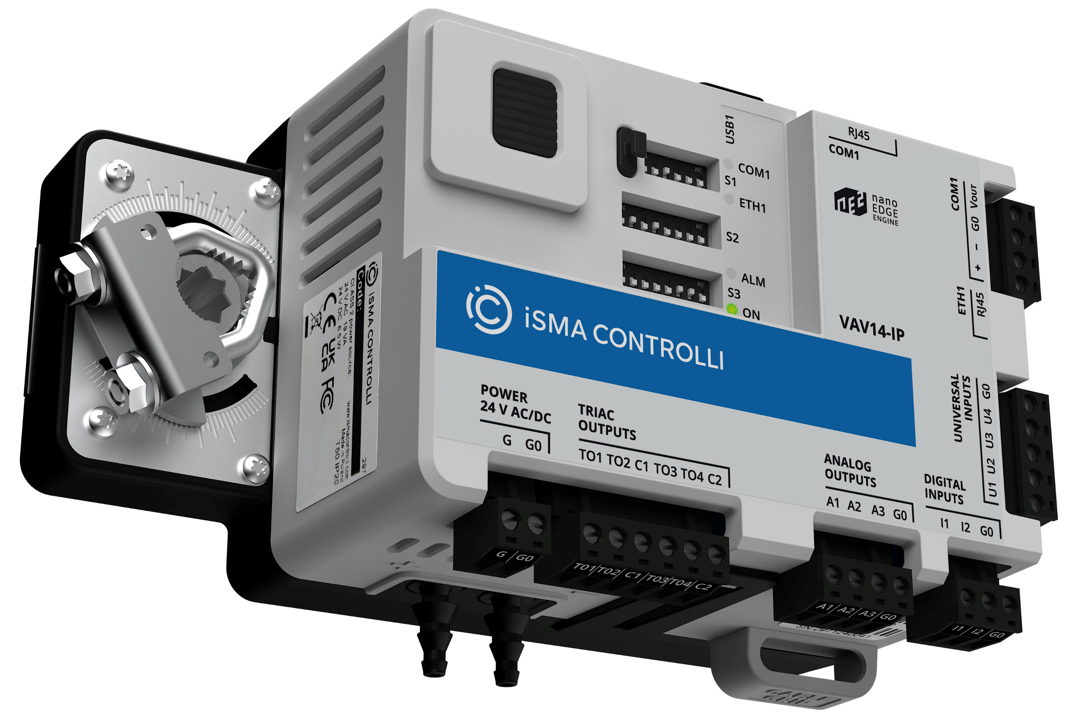




VAV14-IP: Technologies
IP Connectivity
Notes:
I/O types: 4 UI, 2DI, 3AO,4TO

Slide 7
VAV14-IP: Technologies
IP Connectivity
Data Interoperability
Notes:
I/O types: 4 UI, 2DI, 3AO,4TO

Slide 8

VAV14-IP: Technologies
IP Connectivity
Data Interoperability
Embedded platform based on a microcontroller
Notes:
I/O types: 4 UI, 2DI, 3AO,4TO

Slide 9
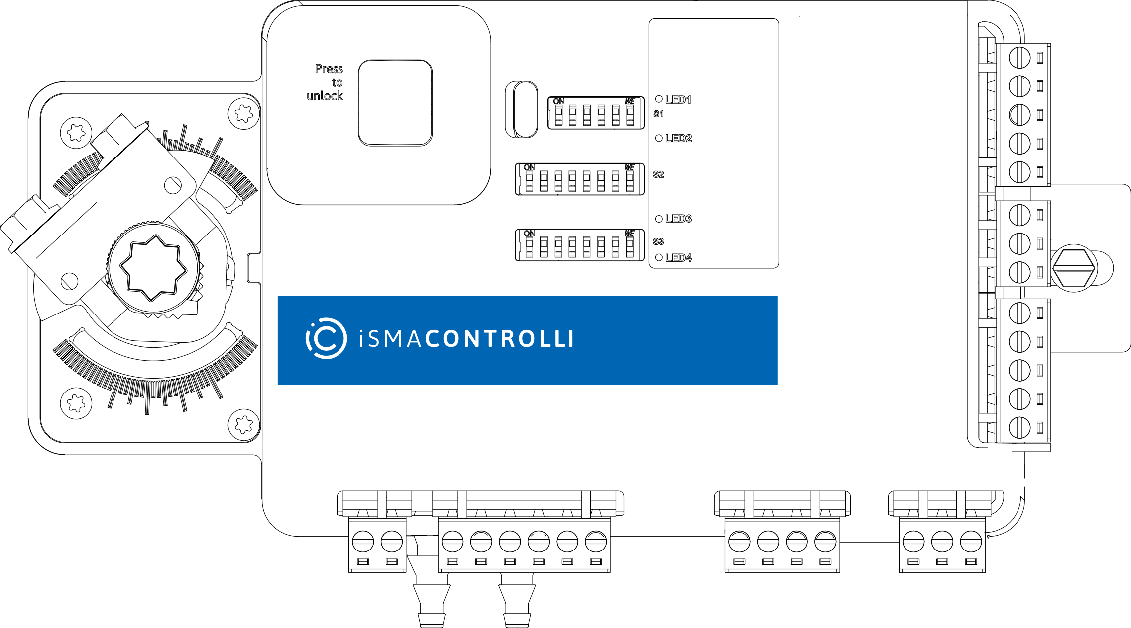
VAV14-IP
Smart Hardware
Notes:
Lorenzo
VAV12-IP
1 x IP - 2 x RJ45 socket in switch configuration with failsafe functionality in case of lack of power (for Modbus TCP or BACnet IP and iFnet) for programming and the BMS
1 x RS-485 - 1 x RJ45 socket + 4 pin spring connector (for Modbus RTU / ASCII or BACnet MS/TP with 24 VAC power supply) for the room sensor (max 4 room panel)
VAV12
x RS-485 - 3 pin screw connector (for Modbus RTU / ASCII or BACnet MS/TP and iFnet) for programming and the BMS
1 x RS-485 - 1 x RJ45 socket + 4 pin spring connector (for Modbus RTU / ASCII or BACnet MS/TP with 24 VAC power supply) for the room sensor (max 4 room panel)

Slide 10
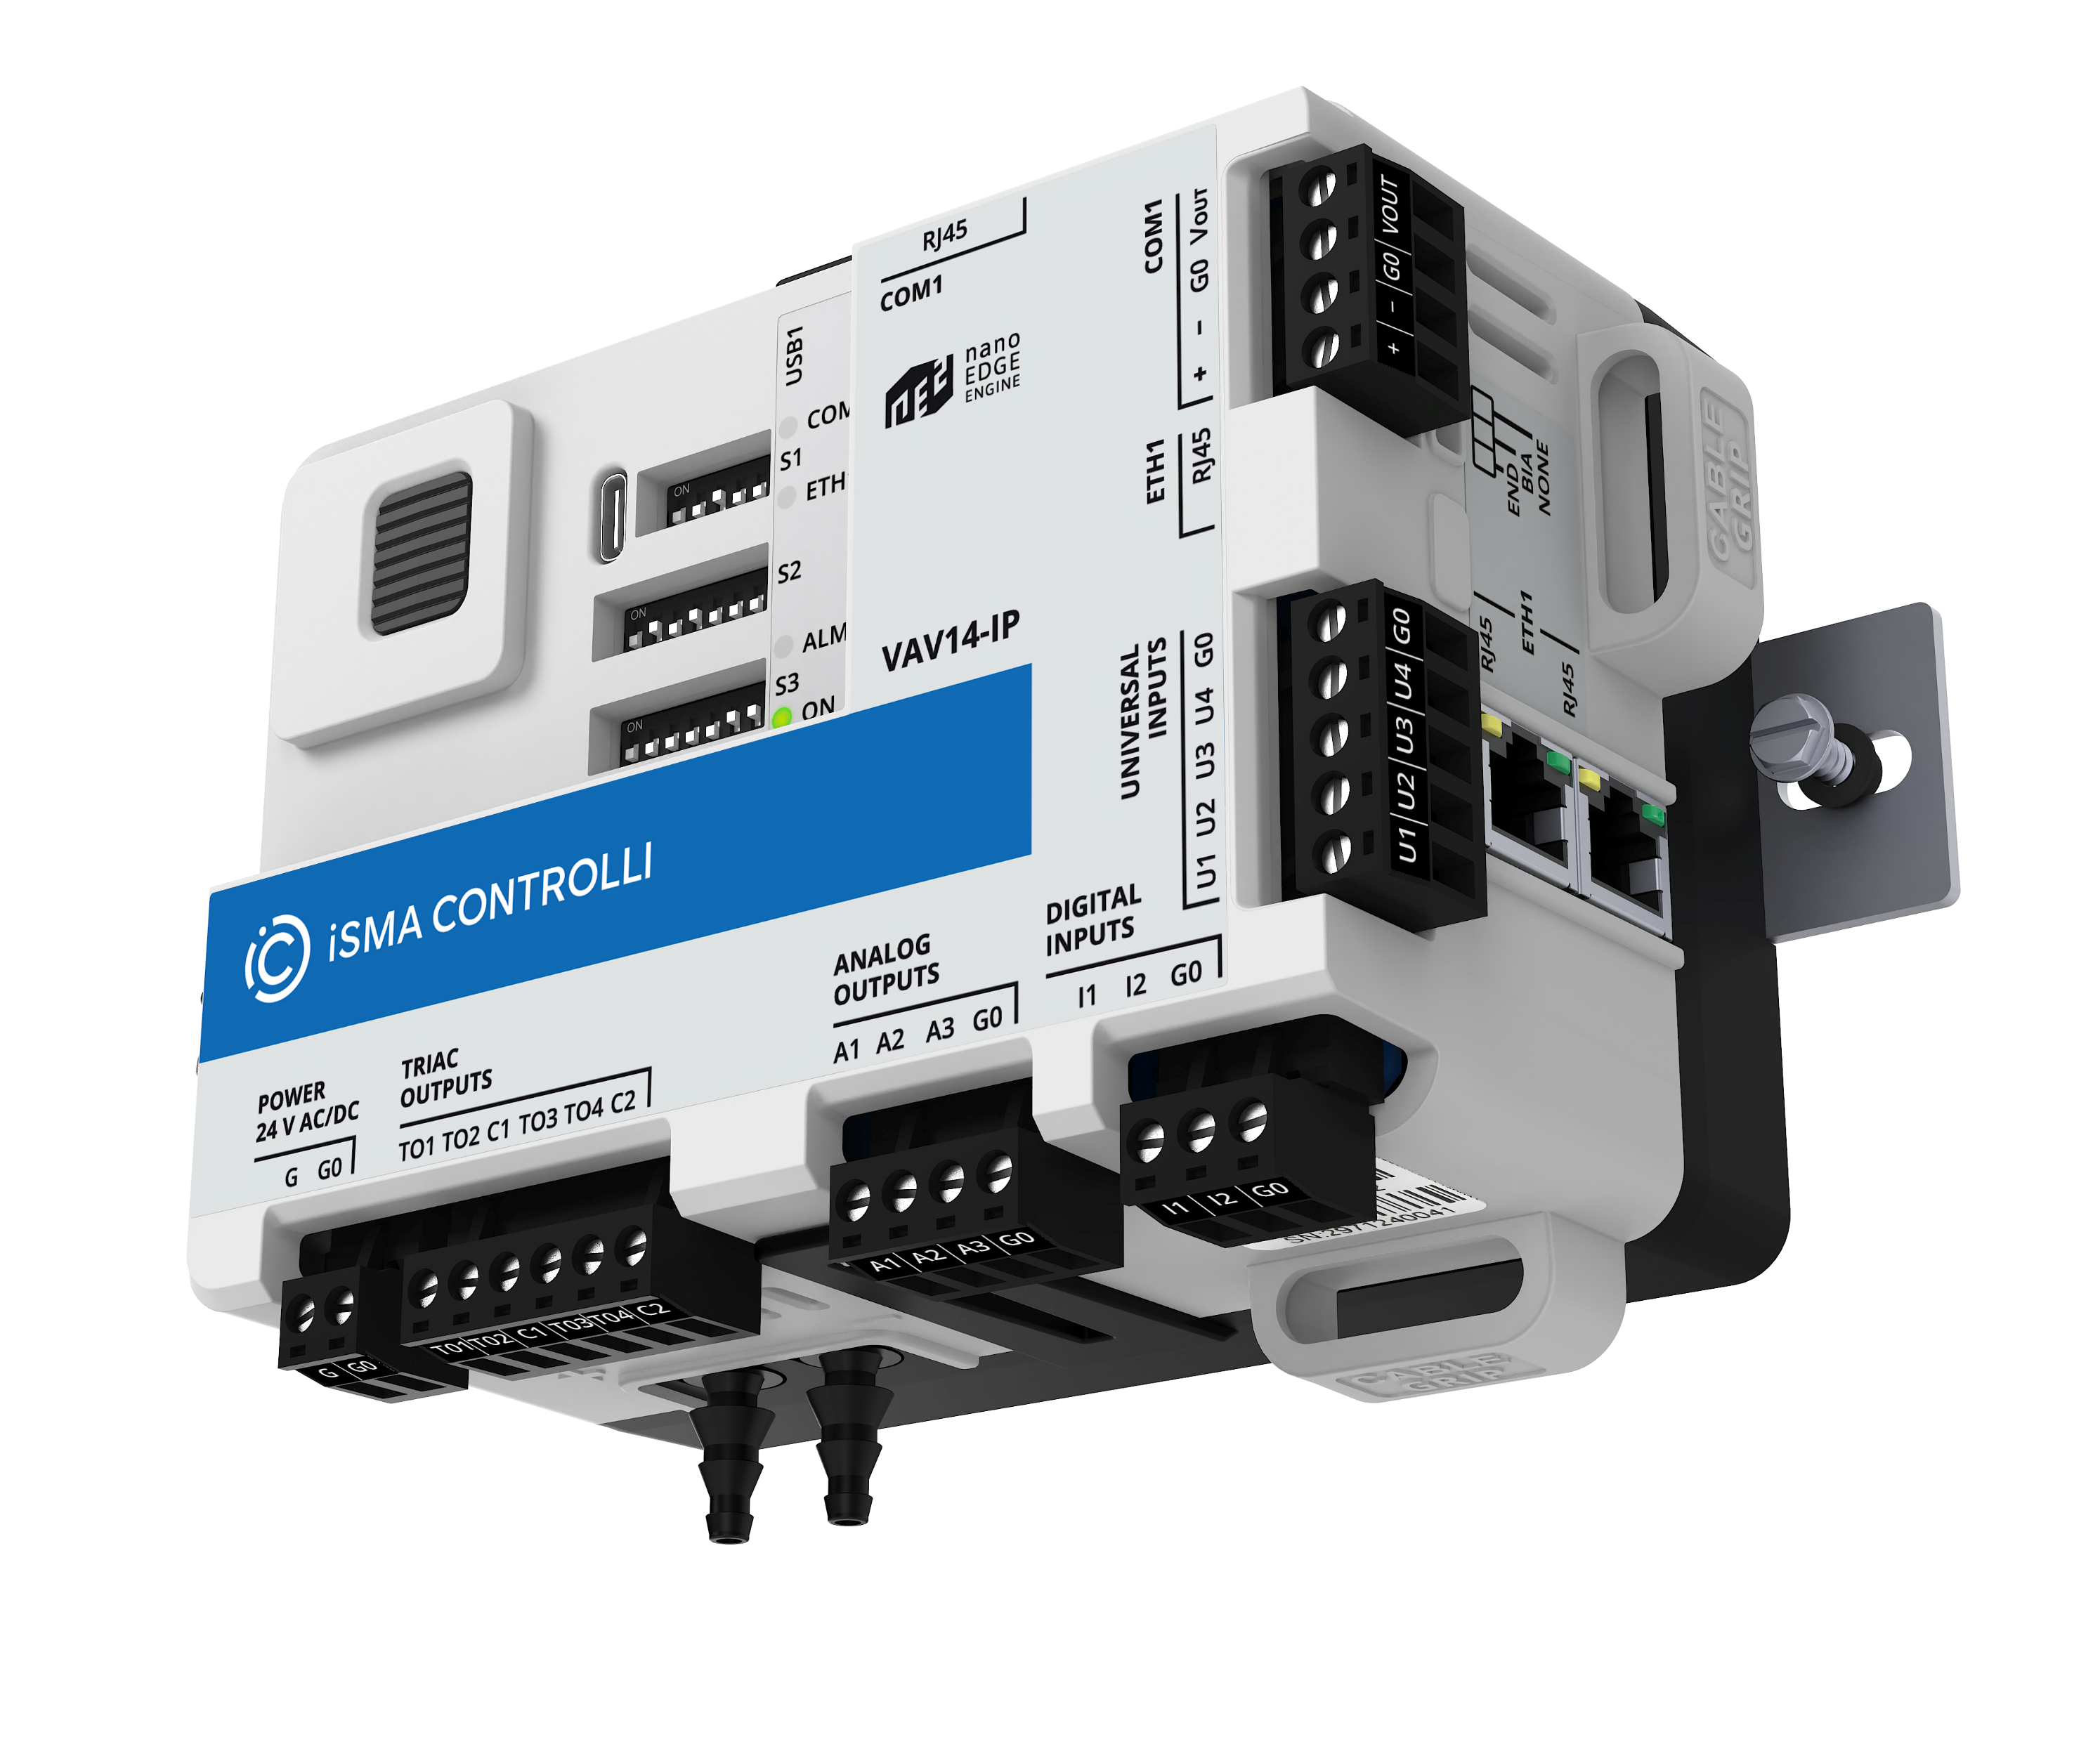
VAV Controller
Features Overview
Key hardware features
01 Compact design with 13 on-board I/O and differential pressure
sensor
Notes:
I/O types: 4 UI, 2DI, 3AO,4TO

Slide 11
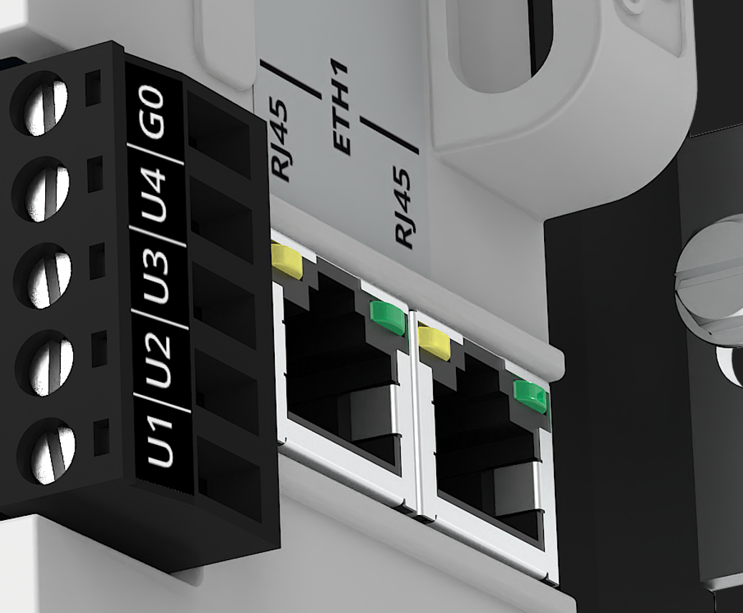
VAV Controller
Features Overview
Key hardware features
01 Compact design with 13 on-board I/O and differential pressure
sensor
02 Two-port Ethernet switch with a fail-safe mechanism
Notes:
Daisy-chaining controllers on the IP network without a need for external switch with a built-in failure protection to maintan communication on the network.

Slide 12
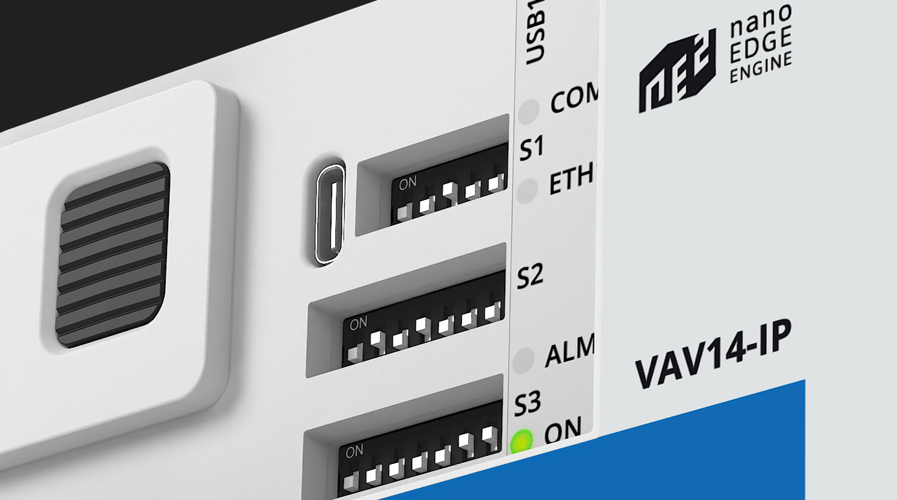
VAV Controller
Features Overview
Key hardware features
01 Compact design with 13 on-board I/O and differential pressure
sensor
02 Two-port Ethernet switch with a fail-safe mechanism
03 USB-C port
Notes:
USB-C port Facilitates local programming and configuration by emulating static IP port and powers up the controller

Slide 13
VAV Controller
Features Overview
Key hardware features
01 Compact design with 13 on-board I/O and differential pressure
sensor
02 Two-port Ethernet switch with a fail-safe mechanism
03 USB-C port
04 DIP switches
Notes:
Configuration of the initial parameters and built-in control application

Slide 14

VAV Controller
Features Overview
Key hardware features
01 Compact design with 13 on-board I/O and differential pressure
sensor
02 Two-port Ethernet switch with a fail-safe mechanism
03 USB-C port
04 DIP switches
05 Integrated damper actuator
Notes:
On-board damper actuator with torque capacity of 4 Newton-meters 35.4 inch-pounds ensuring precise airflow modulation while maintaining low energy consumption.

Slide 15
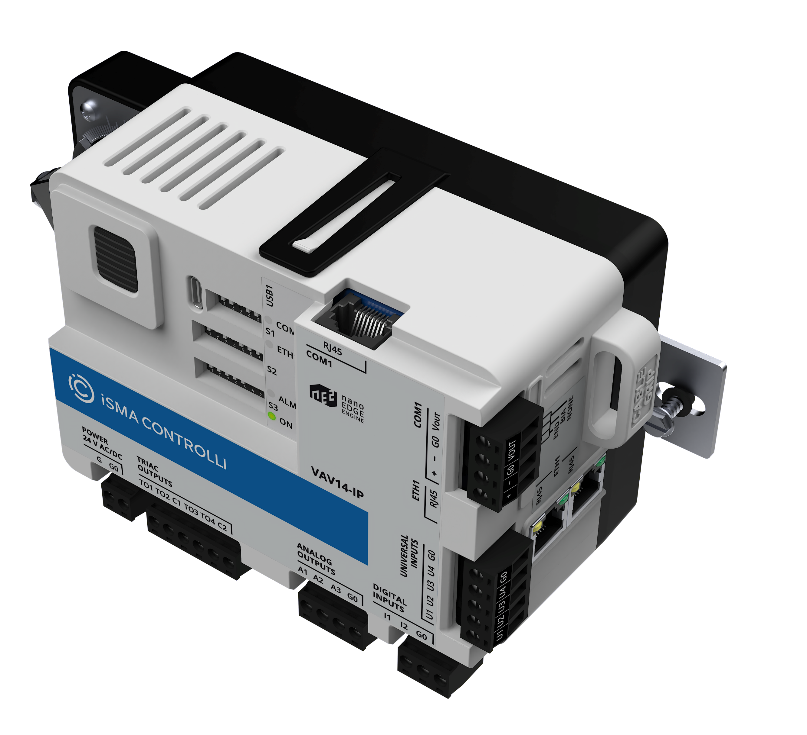
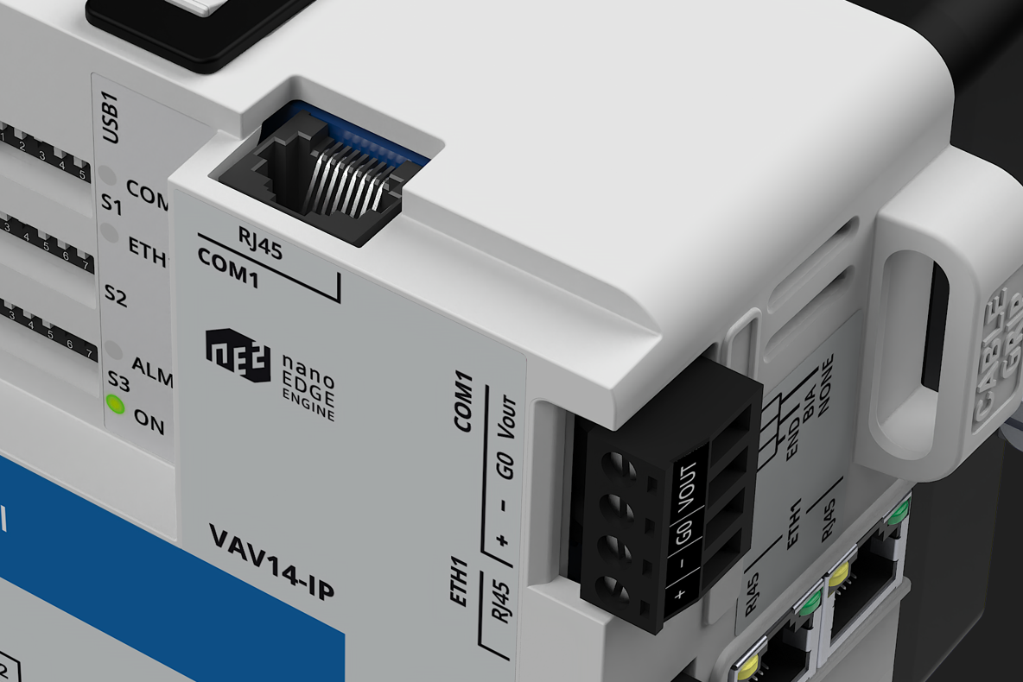
VAV Controller
Features Overview
Key hardware features
01 Compact design with 13 on-board I/O and differential pressure
sensor
02 Two-port Ethernet switch with a fail-safe mechanism
03 USB-C port
04 DIP switches
05 Integrated damper actuator
06 COM port supporting BACnet MS/TP and Modbus RTU
with 24V DC power output (5W)
Notes:
The VAV controller offers integration not only over an IP network but also through an onboard COM port with BACnet MS/TP and Modbus RTU support.

Slide 16
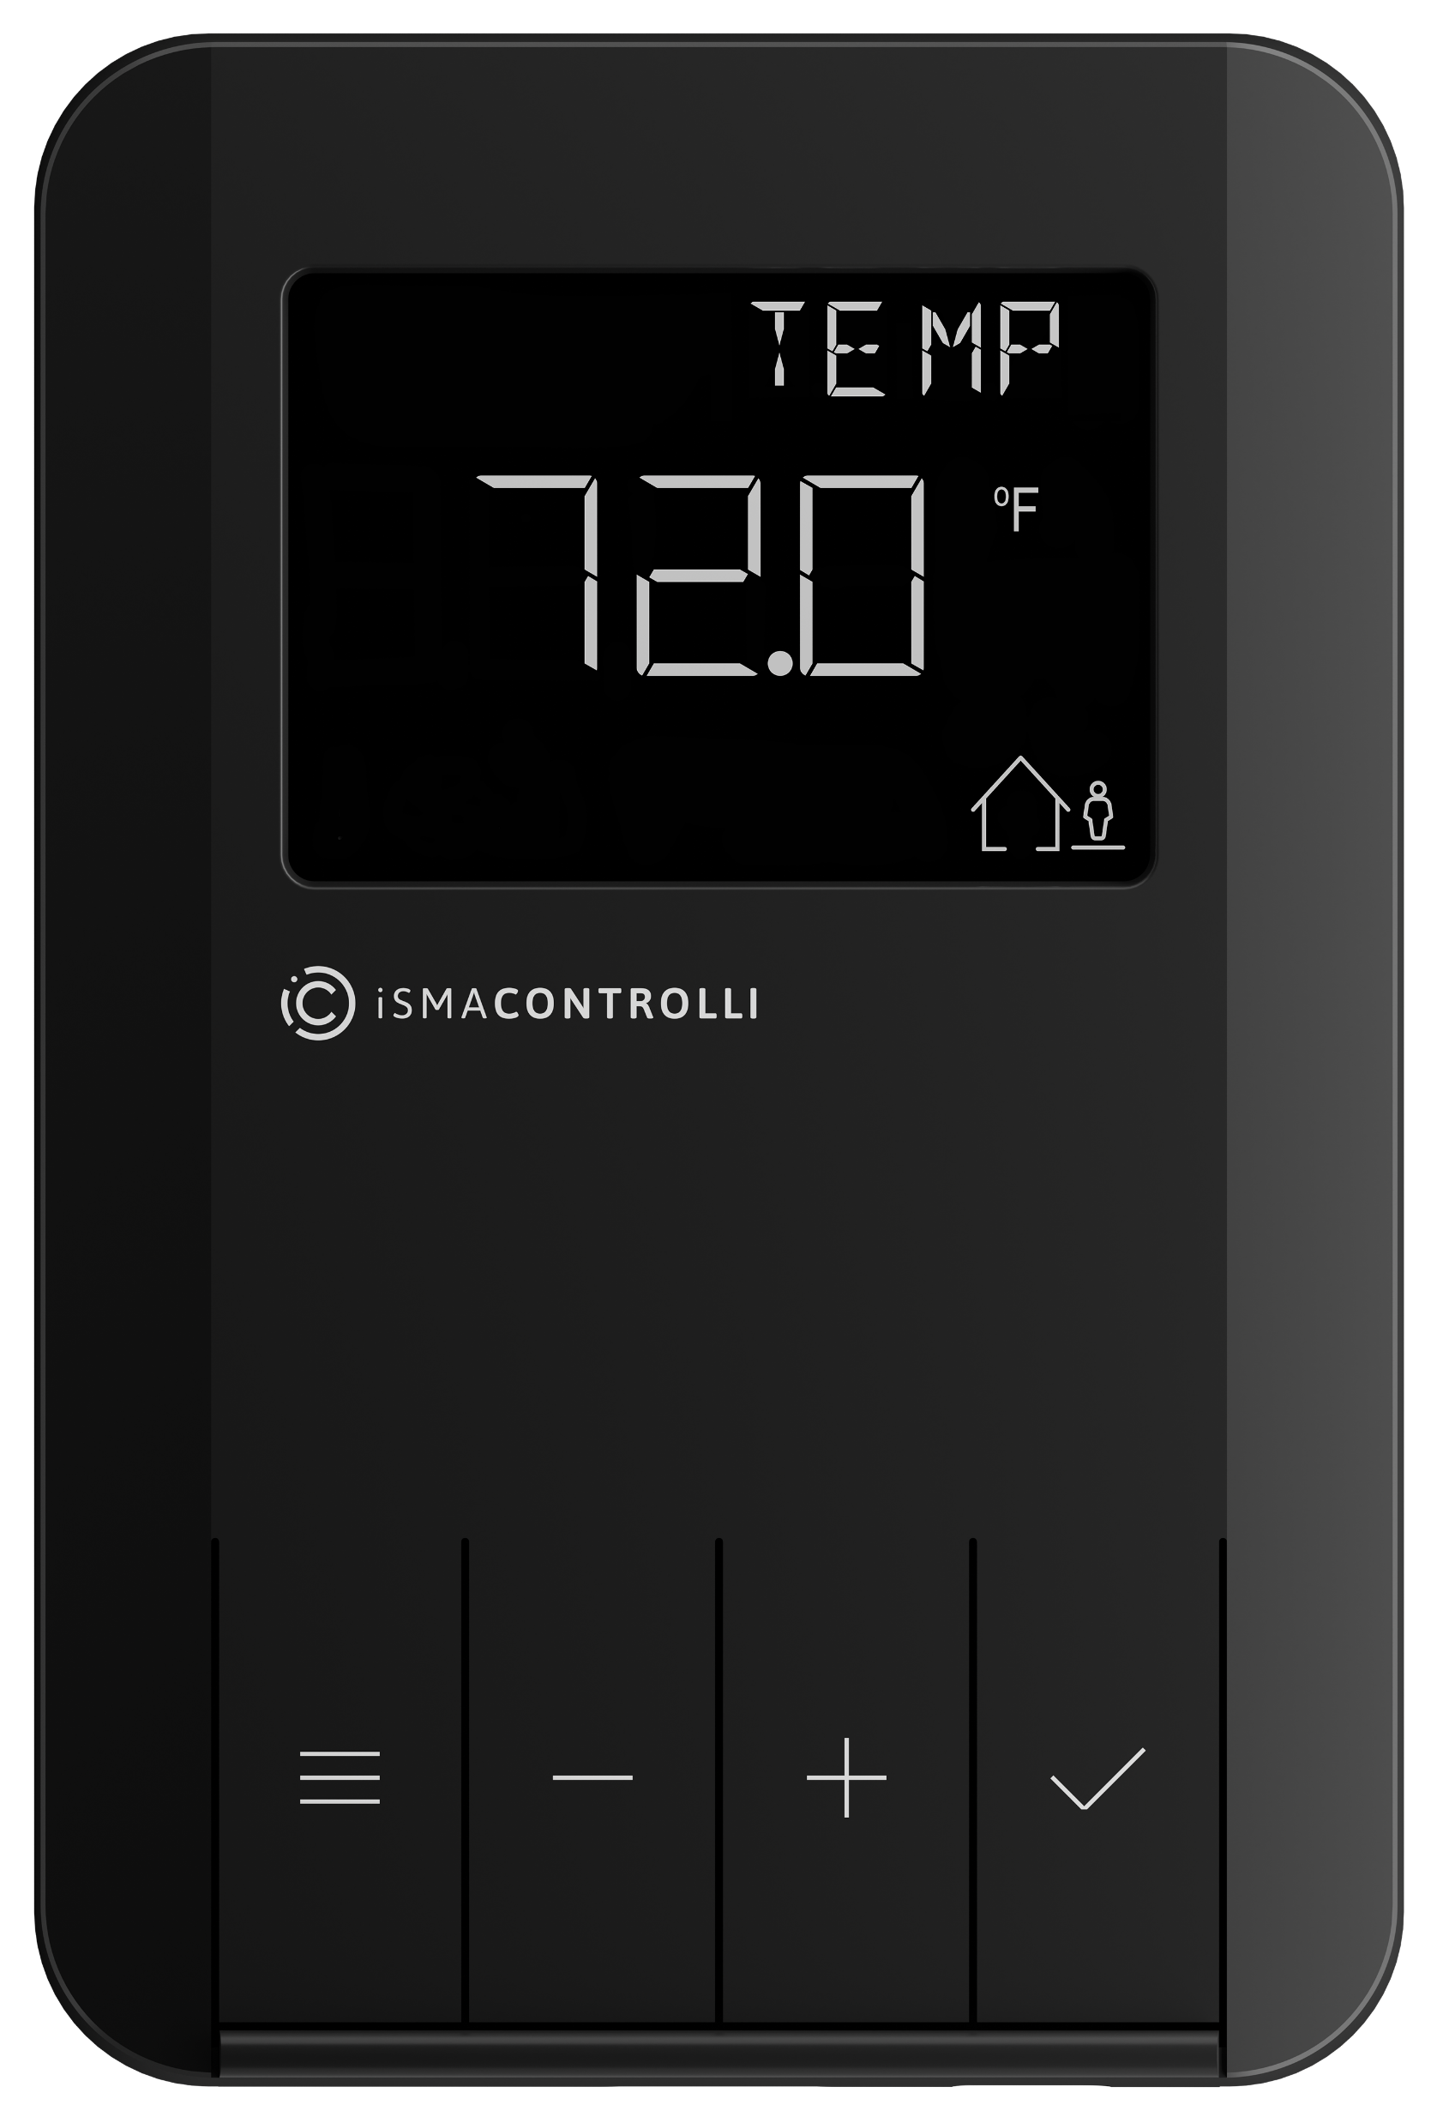
VAV Controller
Features Overview
Key hardware features
01 Compact design with 13 on-board I/O and differential pressure
sensor
02 Two-port Ethernet switch with a fail-safe mechanism
03 USB-C port
04 DIP switches
05 Integrated damper actuator
06 COM port supporting BACnet MS/TP and Modbus RTU
with 24V DC power output (5W)
07 Plug and play Control Point space sensor
Notes:
The CP wall panels can measure temperature, humidity, and CO2 and communicate it to the controller. They are powered directly from the controller and communicated using BACnet MS/TP. Thanks to a smart plug on both VAV and CP panels, installation takes seconds with a single RJ45 cable. CP Panel enables commisioning of a single VAV controller directly from the panel.

Slide 17

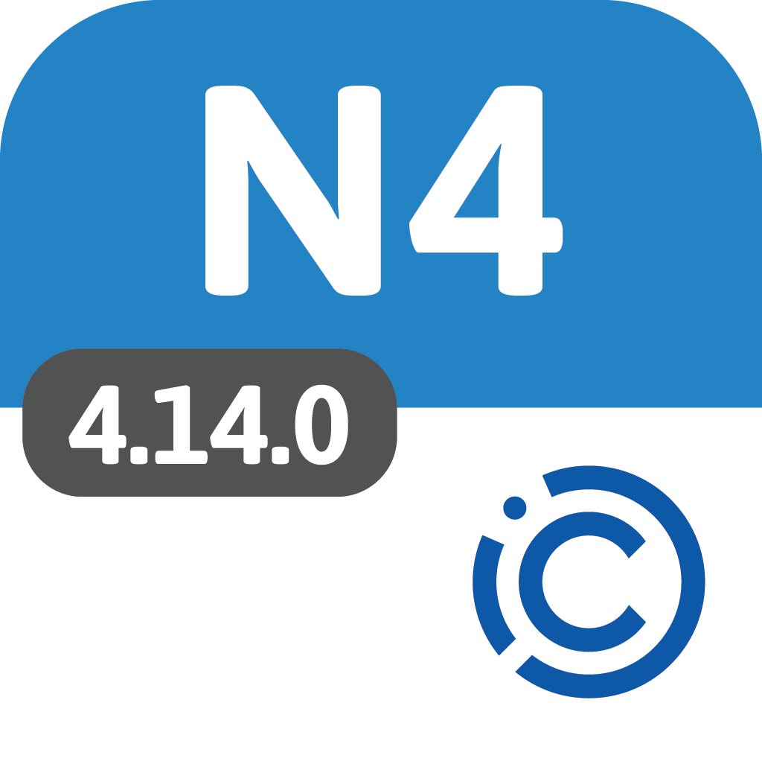

VAV14-IP
Smart Software

Slide 18
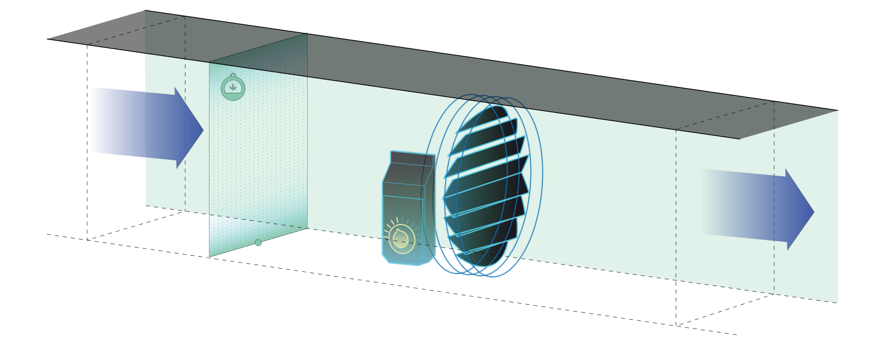
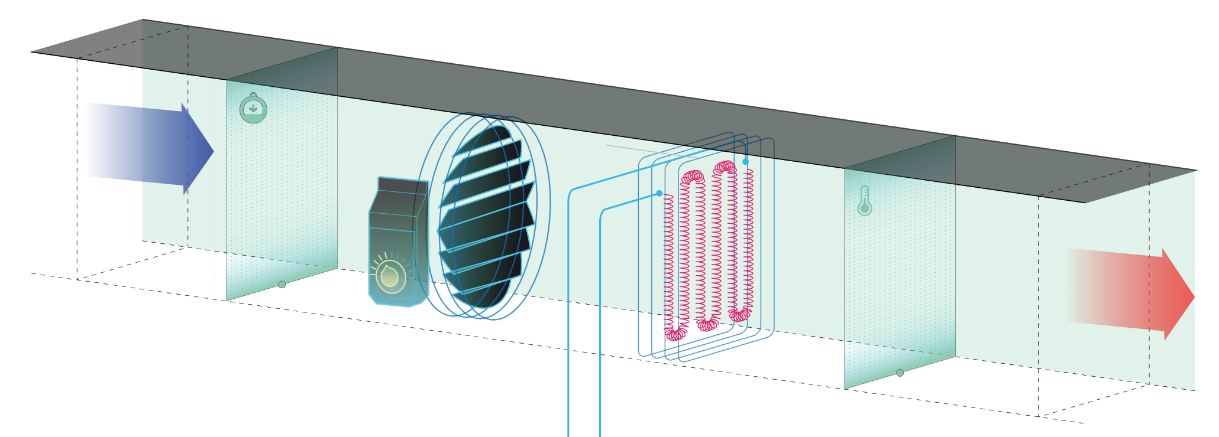
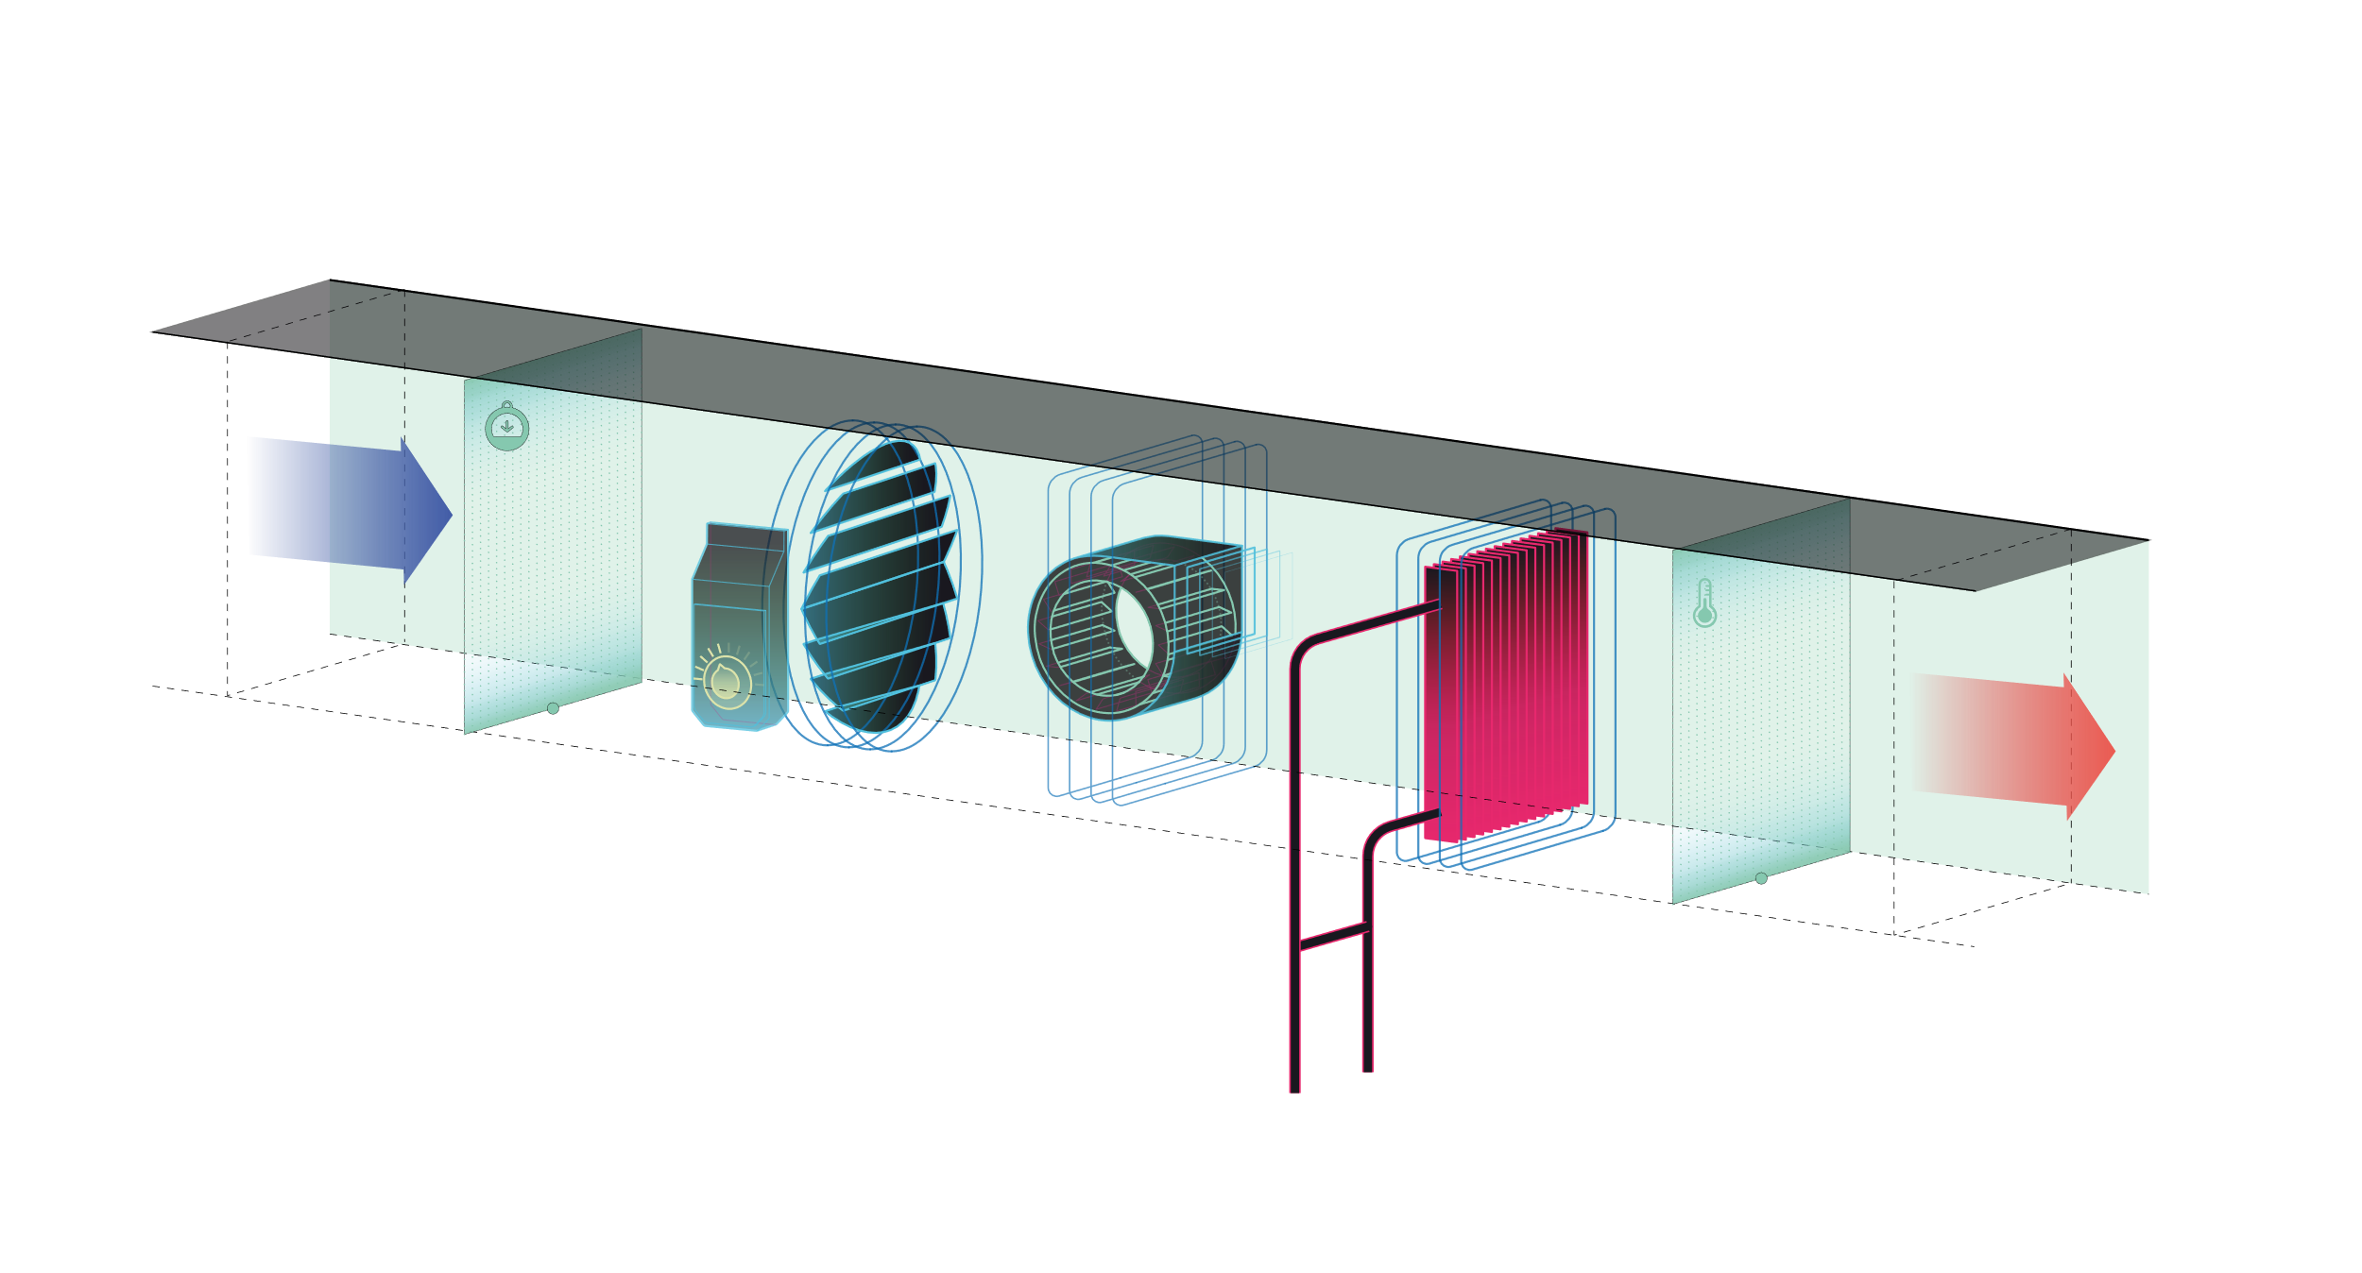
Efficient application for VAV boxes
Configuration options
01 VAV cooling
02 VAV cooling / heating
03 VAV cooling with electrical reheater
04 VAV cooling with water reheater with optional perimeter
05 VAV cooling with 2 staged electric reheater with optional perimeter
06 Series fan powered VAV cooling with water reheater with optional
perimeter
07 Series fan powered VAV cooling with 2 staged electric reheater
with optional perimeter
08 Parallel fan powered VAV cooling with water reheater with optional
perimeter
09 Parallel fan powered VAV cooling with 2 staged electric reheater
with optional perimeter
VAV cooling
VAV cooling with electrical reheater
Series fan powered
VAV cooling with water reheater with optional perimeter
Support for 216 VAV box types

Slide 19



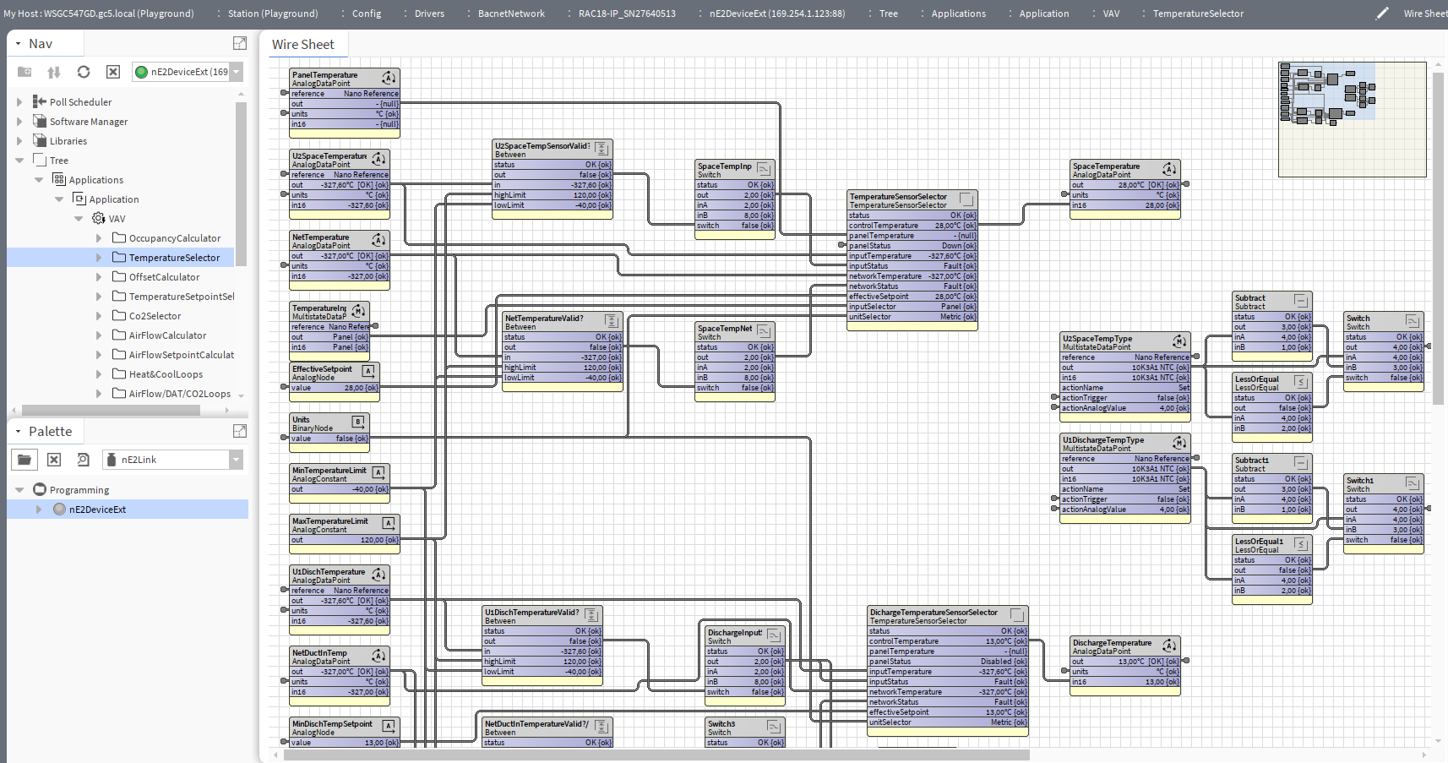
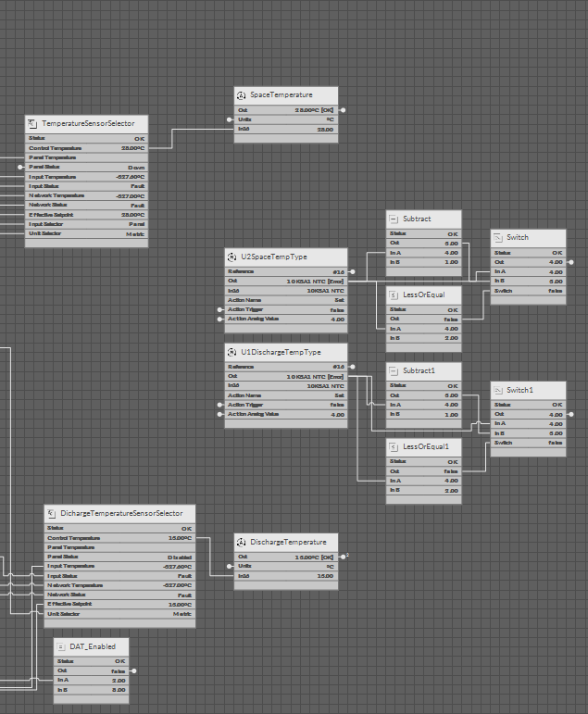
Configurable and freely programmable
Both tools work simultaneously

Slide 20
iSMA CONTROLLI enables installers and system integrators with unique tools and software for configuring, commissioning,, and balancing the VAV14-IP Controller.

Slide 21
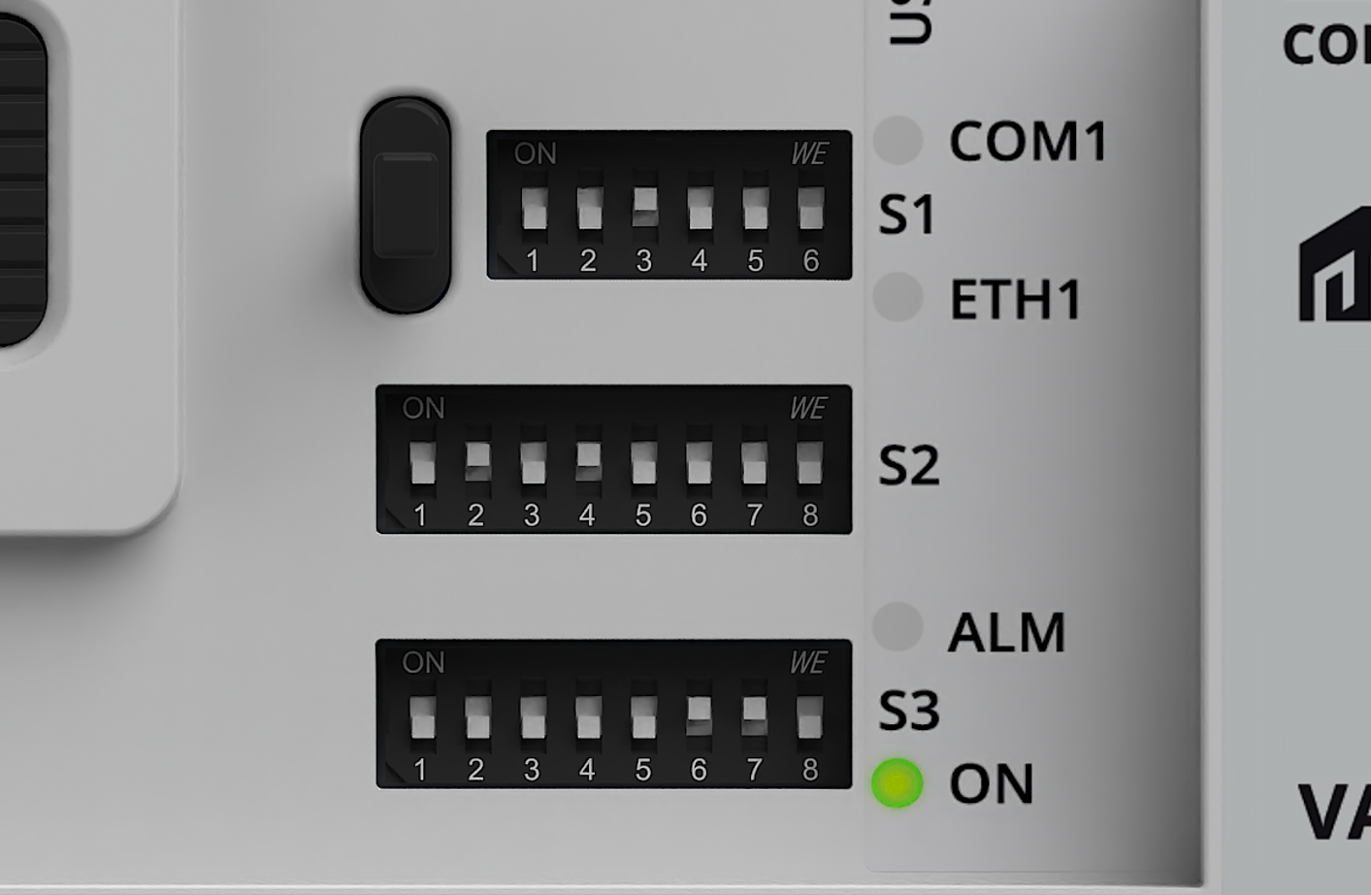
OPTION 1
Quick-Setup Using DIP switches
Initial Configuration of the controller
Notes:
S1
Bit 1: Units selection (Imperial/Metric)
Bit 6: Factory Settings
S2
IP address last octet 192.168.1.x
S3
Bit 1: Setting configuration from DIP switches or BMS
Bit 2-7 Initial Application Settings
VAV / VVT
Reheater type
Fan type
Perimeter type

Slide 22
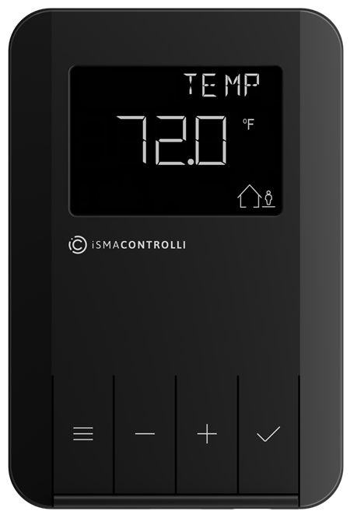
OPTION 2
Directly from the Control Point panel
VAV application
flow settings
balancing

Slide 23
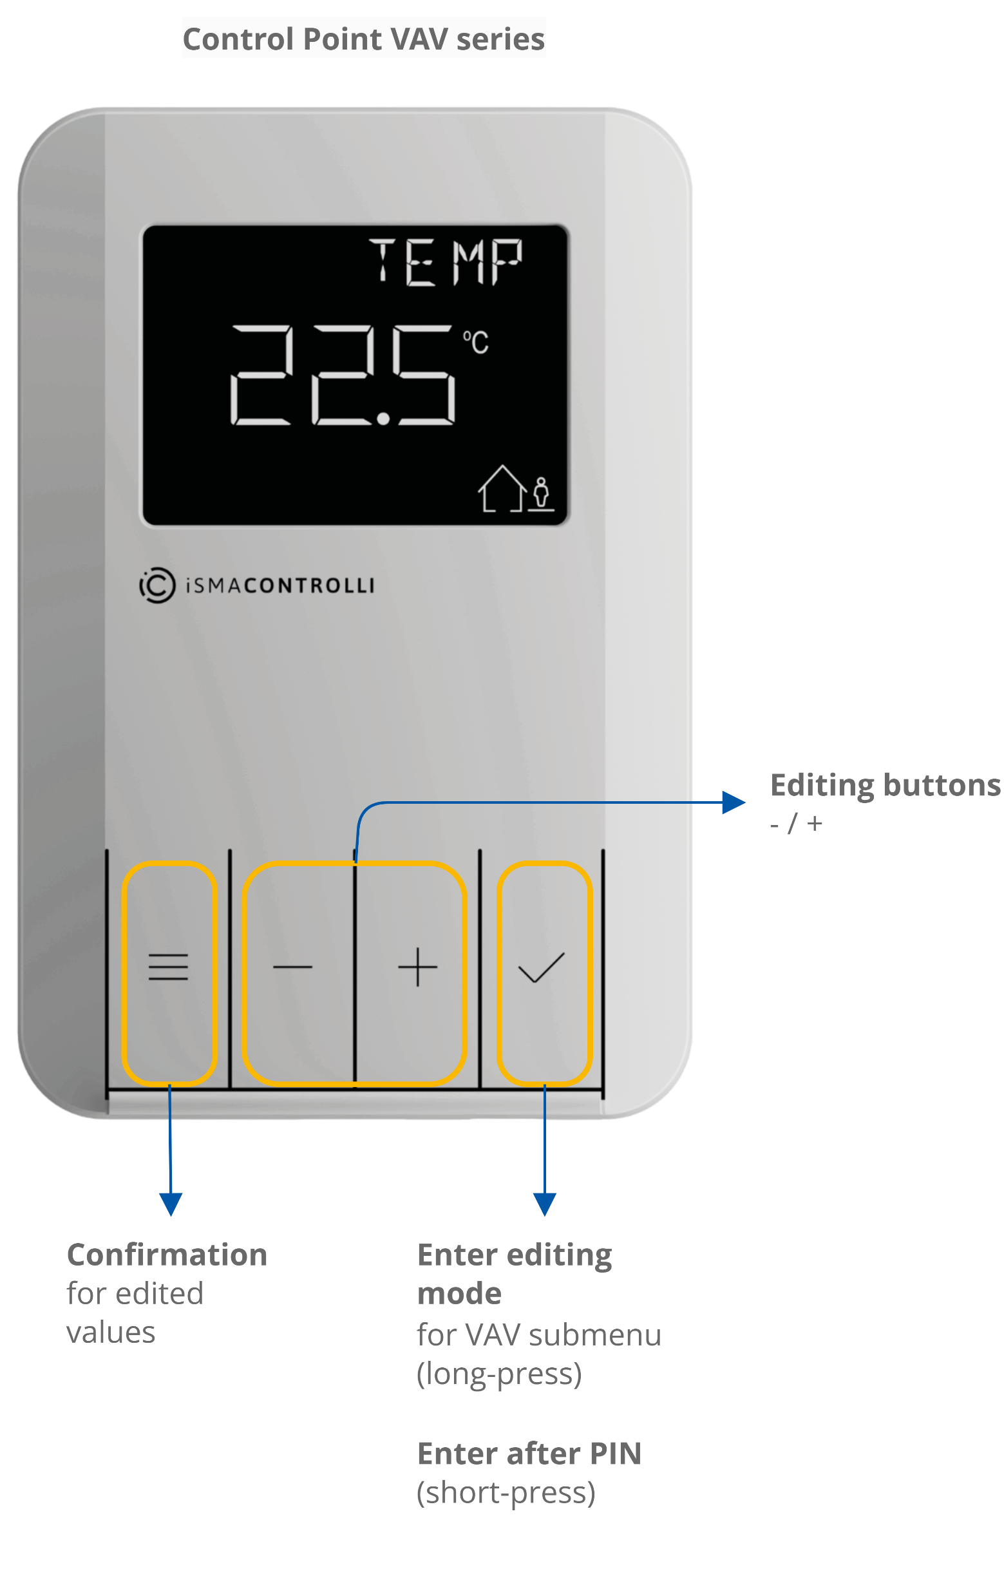
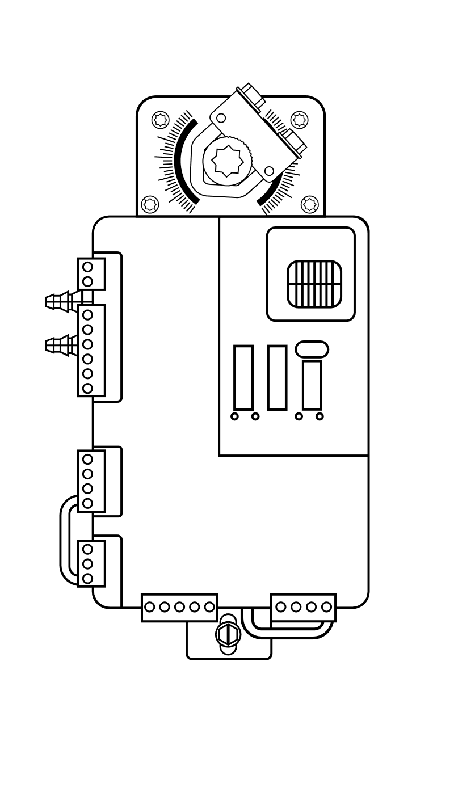
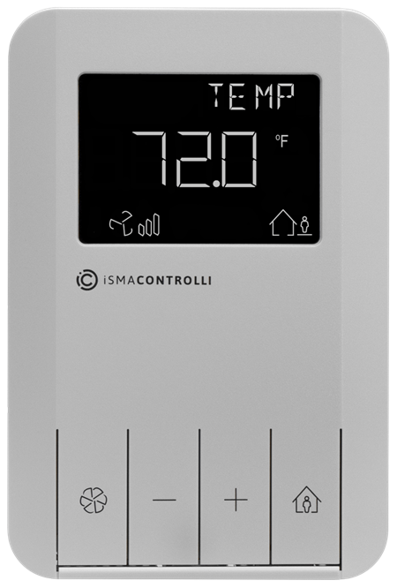

VAV Controllers
Room panel for VAV
BACnet IP network
Smart plug
Quick-Connection

Slide 24
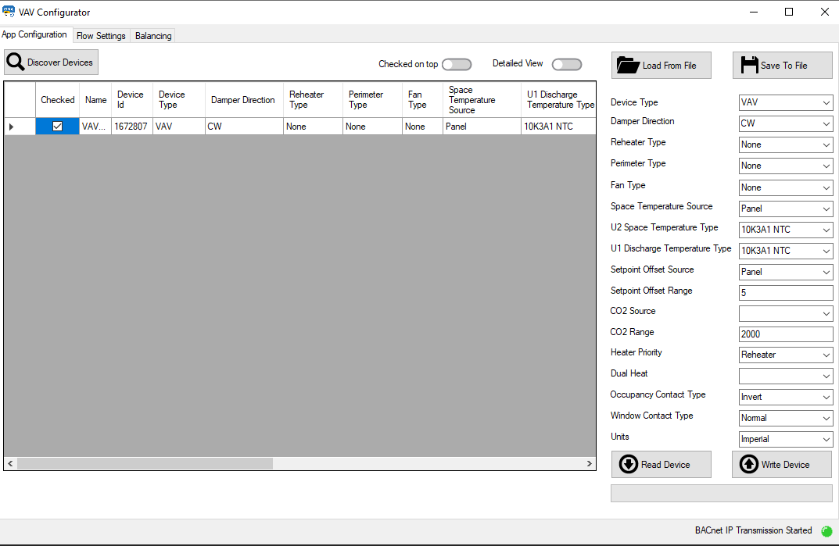

VAV Controllers
Room panel for VAV
BACnet IP network
Smart plug
Quick-Connection
USB-C

Slide 25

OPTION 3
iSMA Configurator
iC Device Manager
VAV application
flow settings
balancing

Slide 26
VAV Balancing
iSMA Configurator supports multiple controllers on the IP network
IP network

Slide 27

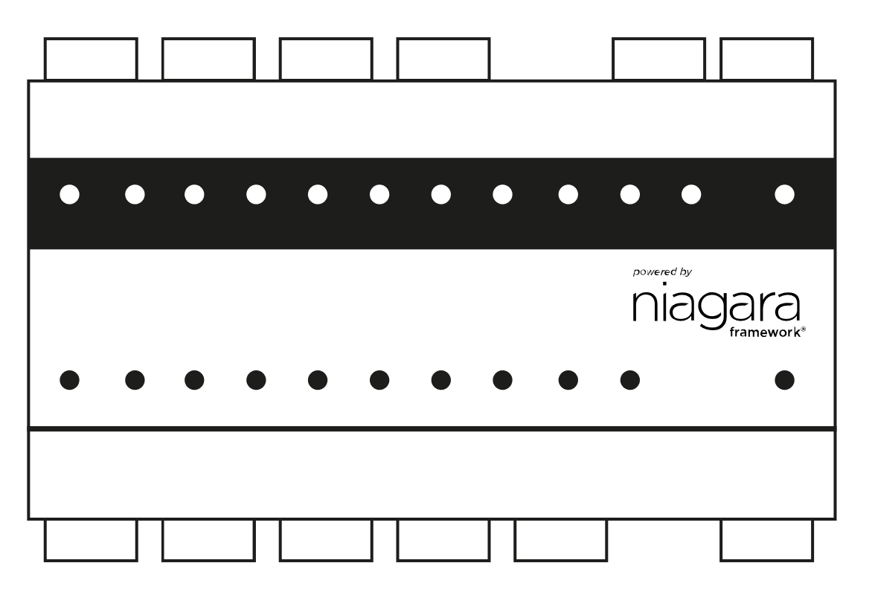
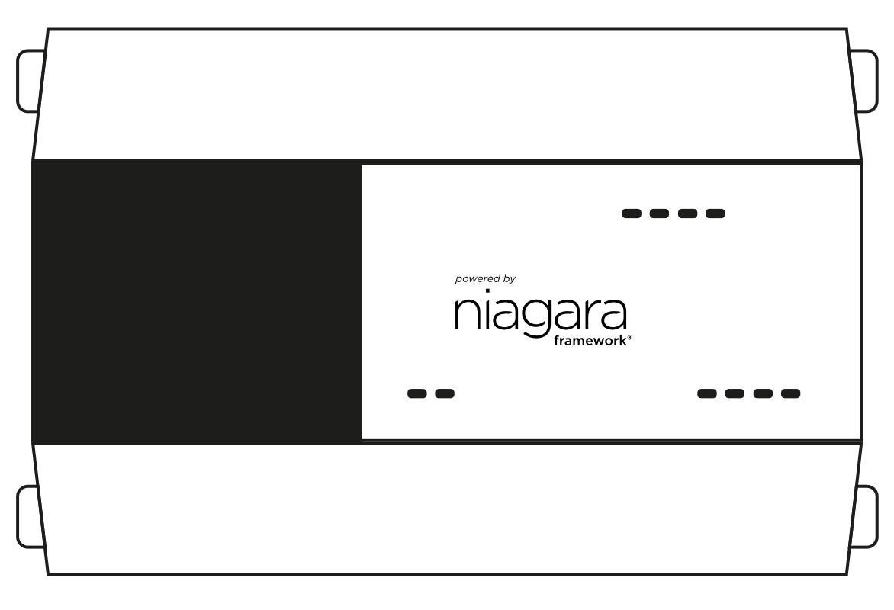
VAV Balancing
iC Device manager supports multiple controllers on the IP network
IP network
Niagara Workbench
MAC36PRO
JACE-9000

Slide 28
Where smart hardware meets smart technology
S1 Bit 1 changes the unit from Metric to Imperial
Notes:
1. Temperature: Celcious to Fahrenheit
2. Air Flow: Litres per second to Cubic feet per minute

Slide 29
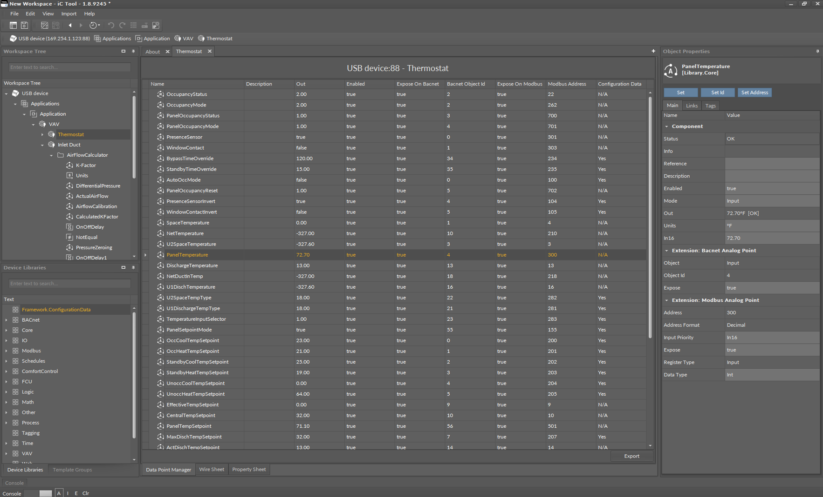
Notes:
I/O types: 4 UI, 2DI, 3AO,4TO

Slide 30
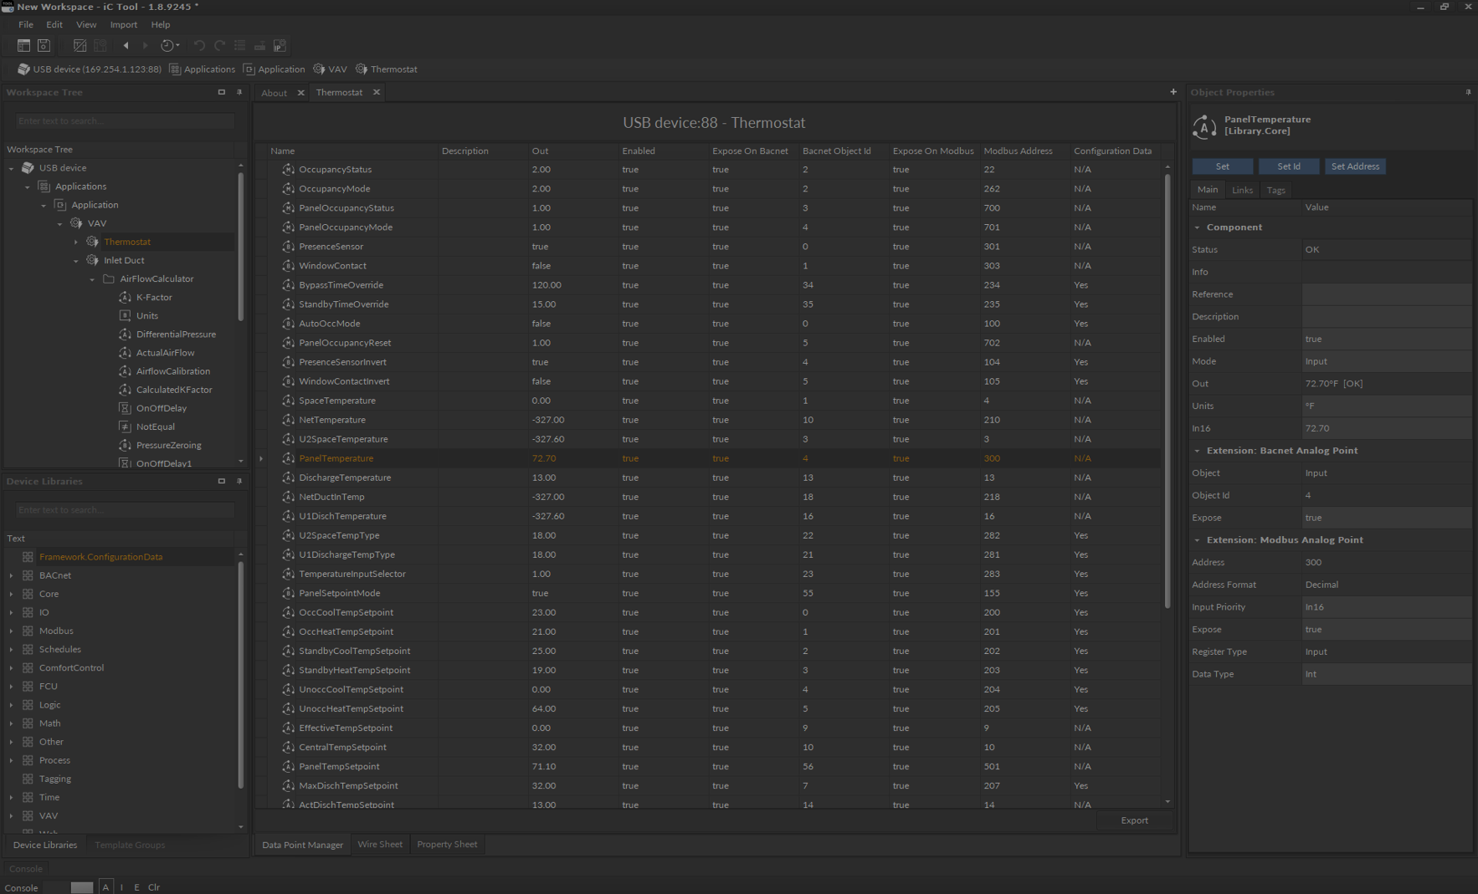
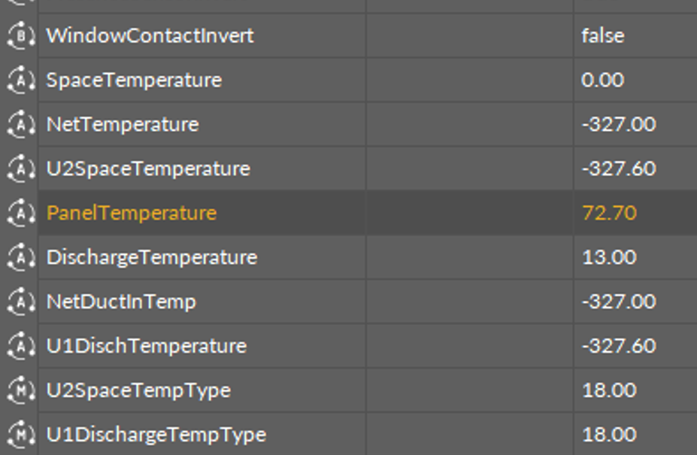
Notes:
I/O types: 4 UI, 2DI, 3AO,4TO

Slide 31
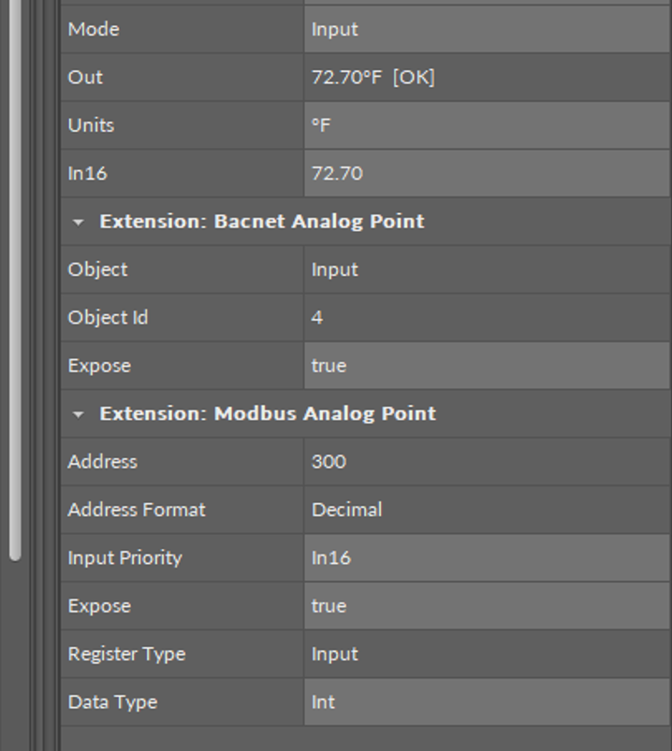
Notes:
I/O types: 4 UI, 2DI, 3AO,4TO

Slide 32
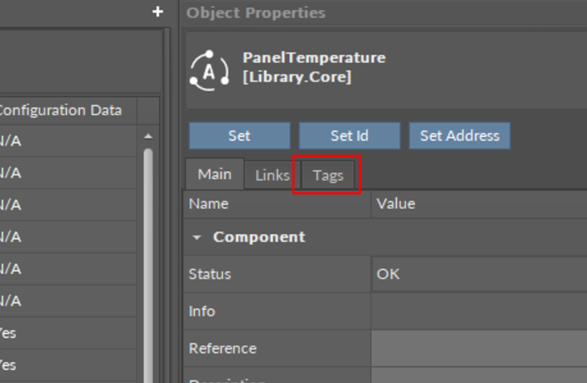
Notes:
I/O types: 4 UI, 2DI, 3AO,4TO

Slide 33
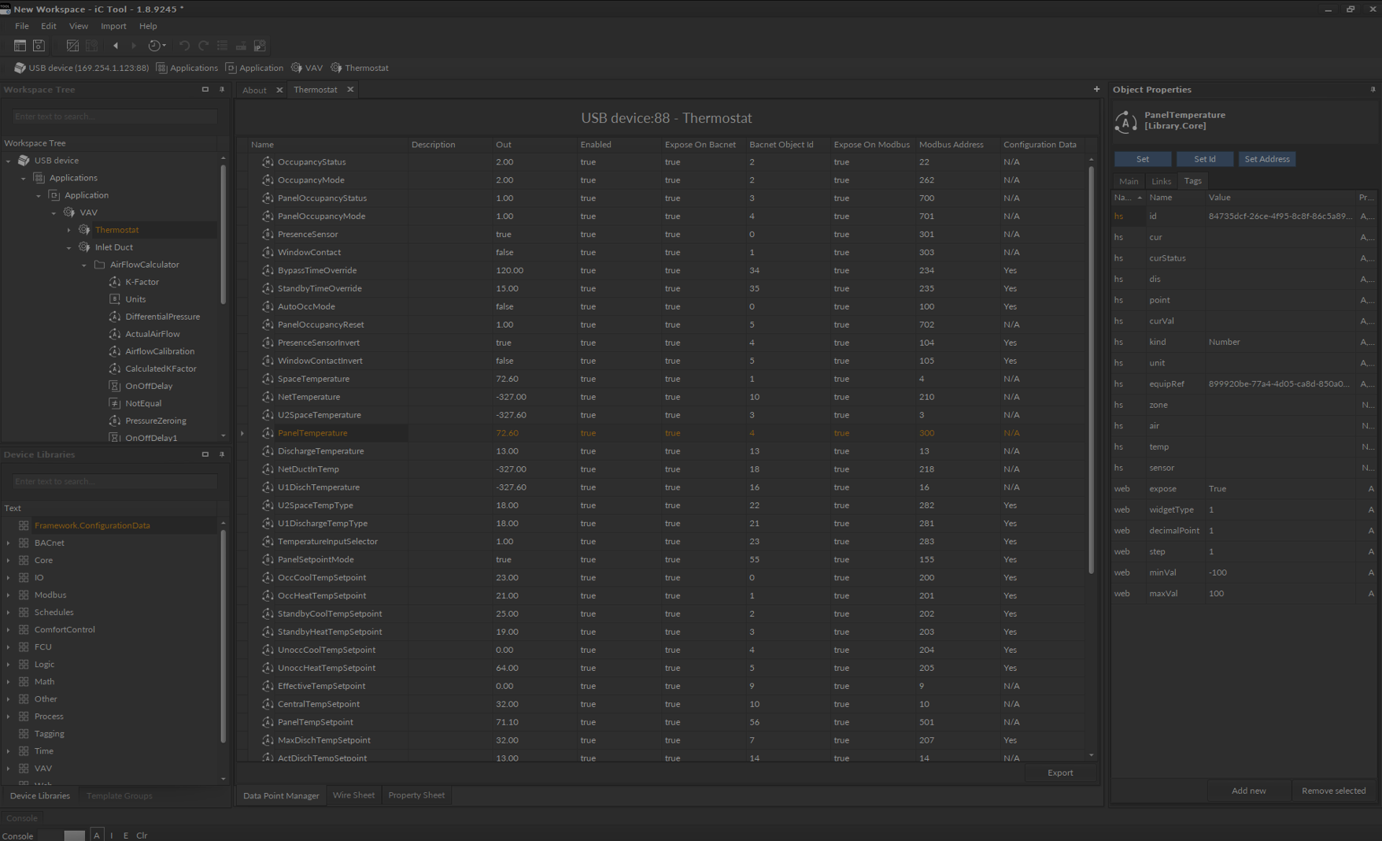
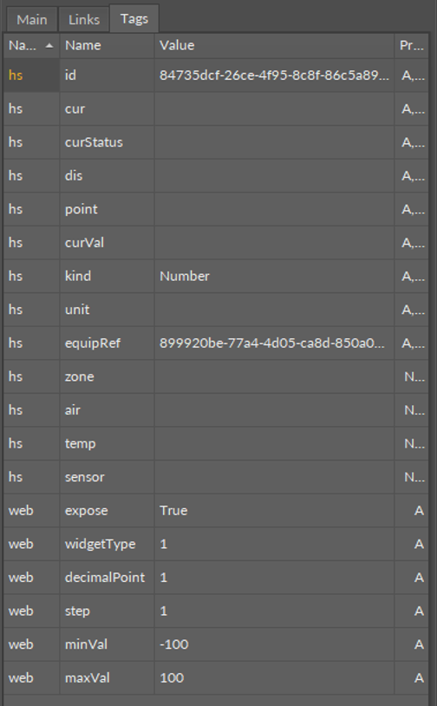
Notes:
I/O types: 4 UI, 2DI, 3AO,4TO

Slide 34
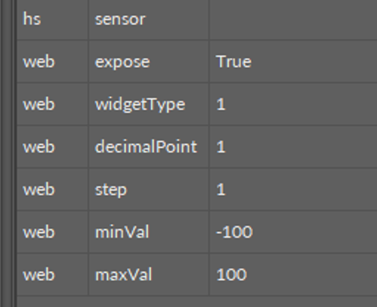
Notes:
I/O types: 4 UI, 2DI, 3AO,4TO

Slide 35

VAV14-IP
Smart at the Edge.
Thank You
Pawel Szarmanski
iSMA CONTROLLI S.p.A.
Via Carlo Levi, 52
16010 Sant'Olcese (GE), Italy
+39 010 73 06 1
info@ismacontrolli.com

