Slide 1
OEM Use Cases for Harnessing Haystack
BUSINESS TRACK – Session 1
Julio Londono
Sales Manager, Americas
J2 Innovations, a Siemens Company

Slide 2
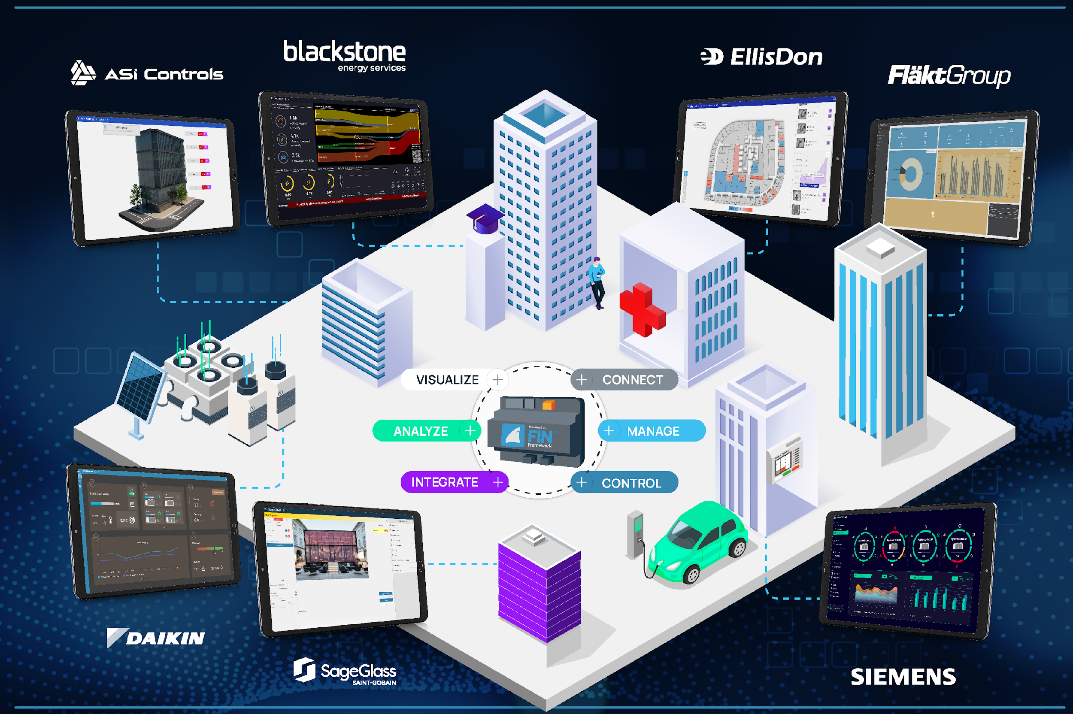
Leveraging the Power of Haystack on Different Markets and Applications

Slide 3
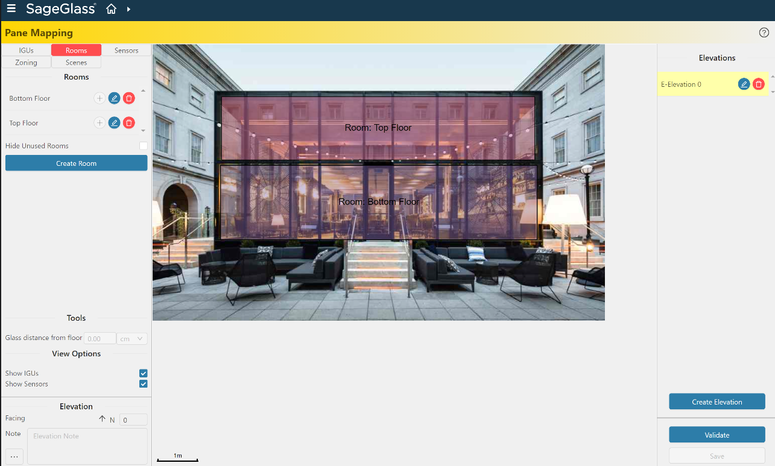
SageGlass, USA
“Improving how people experience buildings is the fundamental driver behind making buildings smart, comfortable and efficient.”
Notes:
Design BIM-> manufacturing -> control
Design BIM-> manufacturing -> control
SageGlass develops electronically tintable smart glass (also called dynamic glass),
for use in building windows, skylights and curtainwalls, that can be electronically
tinted or cleared to optimize daylight and improve occupant comfort in buildings
Haystack is used to take interior and exterior input such as building orientation,
façade and rooftop sky sensors, occupancy, building zones, glass type, window size and arrangement,
time of day/season, sun angle and sky conditions, and then create a flexible and scalable application.
Taking data from hardware and sensors, it is simple to set up logic workflows and schedules
telling the glass to behave a certain way if a certain set of conditions are met. For example,
considering sunrise and sunset timings, plus weather conditions, to tint the glass at a certain time,
day or season. Again, this function allows the glass to maximize comfort and efficiency with minimum effort.

Slide 4
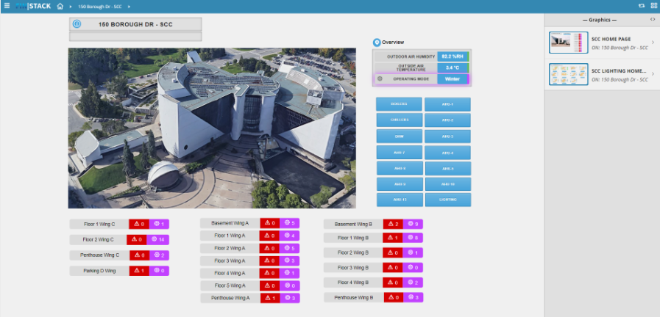
City of Toronto, Canada
Need to align an array of new and legacy BAS brands across its real estate portfolio to make implementation and management simpler and more efficient.
Notes:
As a government organization all procurement is competitively bid,
and it was essential that the platform chosen was effectively ‘vendor agnostic’
and could be used to integrate the City’s new and legacy systems.
A further collaboration and additional project will involve utilization
of FIN's historical database for enhanced analytics, leveraging the
built-in metadata to identify efficiencies over time.

Slide 5
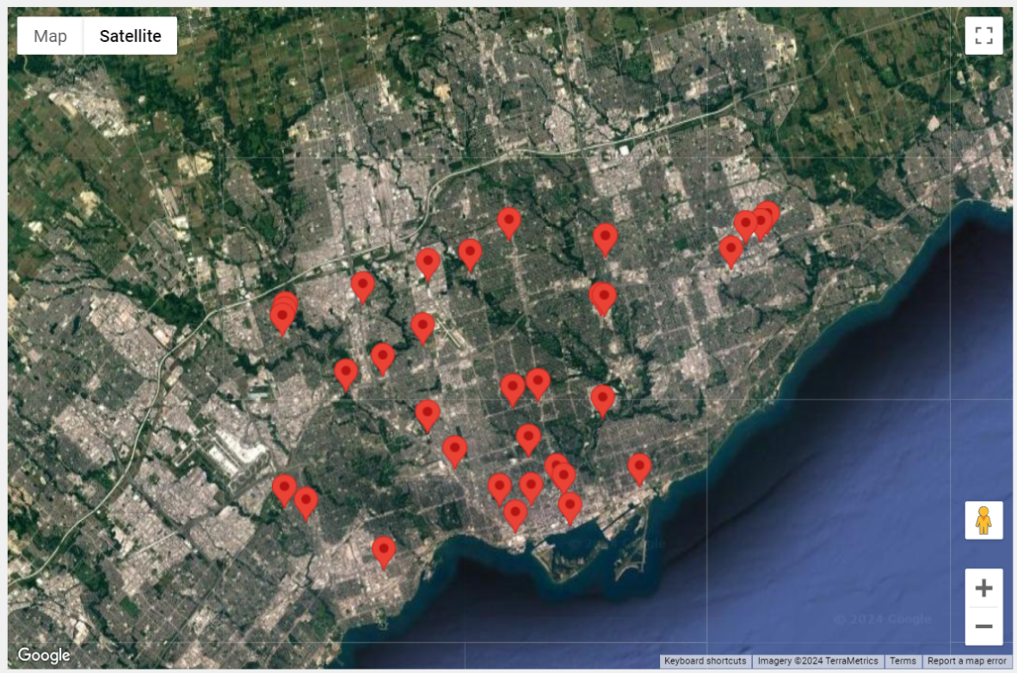
City of Toronto, Canada
Haystack allows to have a fluid Integration between multiple vendors and different vintage technologies.
As of January 1, 2024, 38 buildings had been fully integrated, with four more to be completed in Q1 2025.

Slide 6
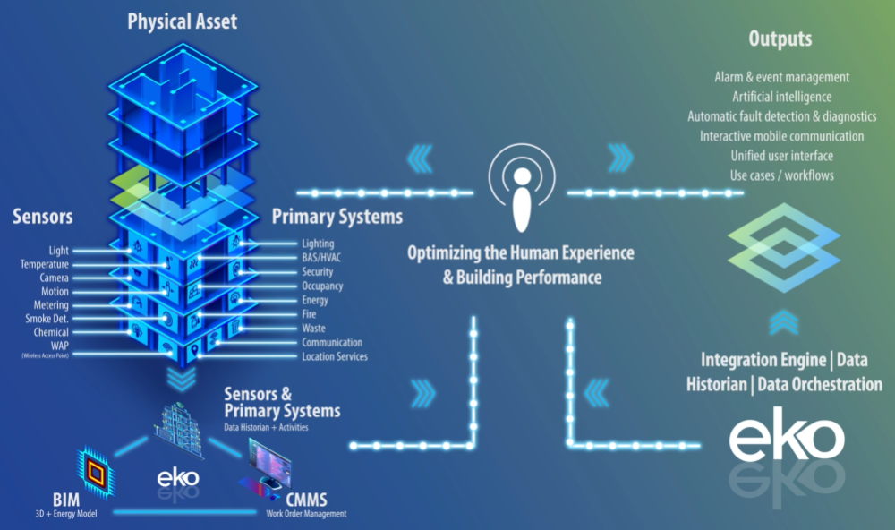
EllisDon, Canada
EKO Digital Twin
“Digital twins can look at a building from a holistic perspective”
Notes:
EKO empowers our clients to fully utilize their data – introducing a level of smart simplicity
thanks to the advanced technology it is built on.
EKO is a digital twin platform that creates a virtual “living” replica of the built environment
by integrating data from all primary building systems, customer-facing systems,
the building information model (BIM) and the computerized maintenance management system (CMMS).

Slide 7
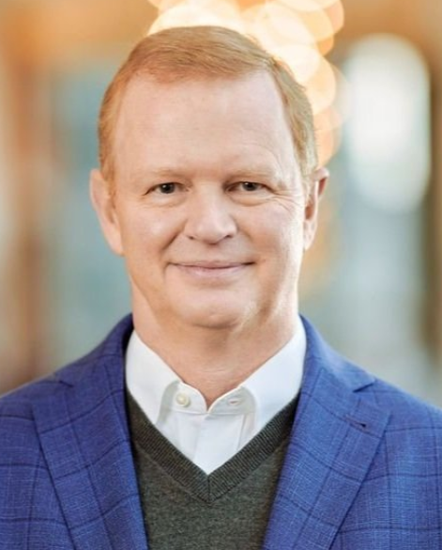
EllisDon, Canada
EKO Digital Twin
“We build the building, we operate the building, and we have all this intellectual capital throughout the organization in terms of our employees and team members that have these skillsets that we can leverage with the tool.”
“But really at the end of the day, is the ability to take the information that we make available and use that information for a positive result.”
Robert Barnes
Senior Vice President, Energy & Digital Services,
EllisDon.
Notes:
“As you connect more within the building, you make available a tremendous amount of data
about how the building is performing and how the specific systems on the building are
performing and interacting. The question becomes, what do you do with the data?
How do you leverage that data to drive an ROI or profitability”

Slide 8
EllisDon, Canada
EKO Digital Twin
“You can’t be GREEN unless you’re SMART.™”
Code Coordination
Staff Safety & Duress
Energy Demand Prediction
Energy Consumption Optimization
Energy Source Selection

Slide 9
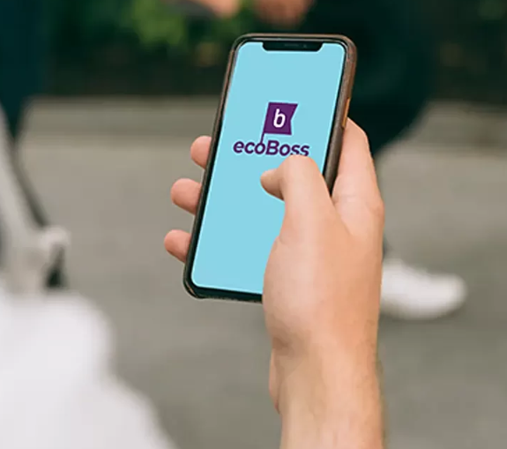
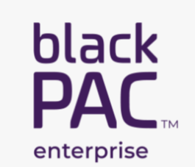
Blackstone Energy Services, Canada
Blackstone’s Goal: to deliver responsible solutions that help clients save, sustain, and thrive through customized strategies for energy and carbon reduction.
Blackpack DERMS: Distributed Energy Resource System
Notes:
Intro to BlackStone:
Blackstone’s Goal: to deliver responsible solutions that help clients save, sustain, and thrive through customized strategies for energy and carbon reduction.
Optimizing energy procurement, improving energy efficiency, and implementing effective emission reduction strategies
Intro to BlackPak:
Blackpack DERMS: Distributed Energy Resource System
Streamline Operations and save money
Realtime visibility within the energy and carbon portfolio
This solution offers secure remote access and a way to manage multi-site customers who want to view aggregated data and perform comparative analytics across all their sites,
Blackstone’s blackPAC is a distributed, scalable, and secure enterprise energy and carbon management solution, ideal for smart buildings and smart grids. It effectively manages energy, emissions data, building system performance, and distributed energy resources.

Slide 10
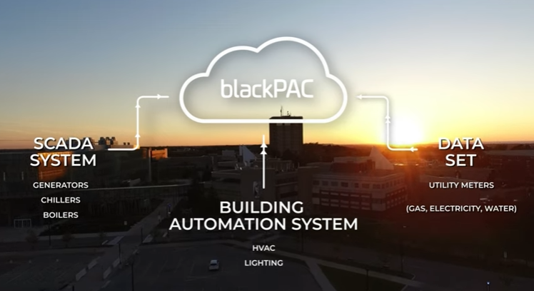
Blackstone Energy Services, Canada
Brock University Use Case
“We want to be known as leaders in carbon reduction,
and leaders in sustainability”
Scott Johnstone, SVP Infrastructure and Operations, Brock University.
How to make sense and use of disparate data coming from a 3M SQFT, 32 buildings campus, with 200k points of data stored every minute?
Notes:
Intro to BlackStone:
Blackstone’s Goal: to deliver responsible solutions that help clients save, sustain, and thrive through customized strategies for energy and carbon reduction.
Optimizing energy procurement, improving energy efficiency, and implementing effective emission reduction strategies
Intro to BlackPak:
Blackpack DERMS: Distributed Energy Resource System
Streamline Operations and save money
Realtime visibility within the energy and carbon portfolio
Brook University: Sustainability Goals
Using Data to Drive Decarbonization
Turn Data into Information, from:
SCADA System
BMS System
Data set, Utility Meters

Slide 11
Blackstone Energy Services, Canada
Notes:
Intro to BlackStone:
Blackstone’s Goal: to deliver responsible solutions that help clients save, sustain, and thrive through customized strategies for energy and carbon reduction.
Optimizing energy procurement, improving energy efficiency, and implementing effective emission reduction strategies
Intro to BlackPak:
Blackpack DERMS: Distributed Energy Resource System
Streamline Operations and save money
Realtime visibility within the energy and carbon portfolio
Brook University: Sustainability Goals
Using Data to Drive Decarbonization
Turn Data into Information, from:
SCADA System
BMS System
Data set, Utility Meters

Slide 12
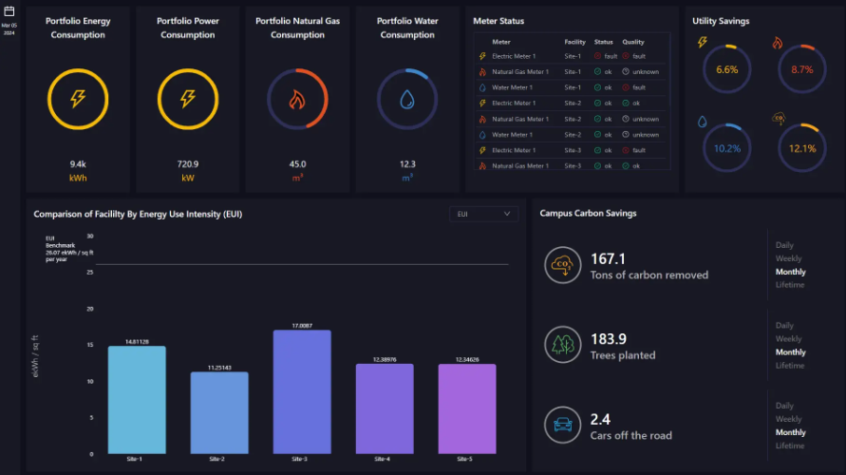
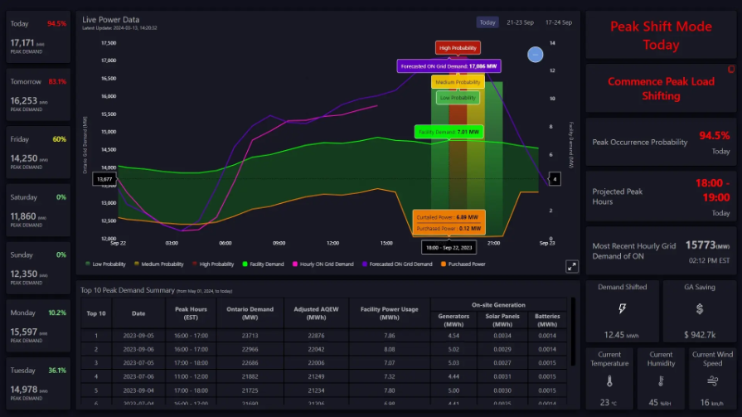
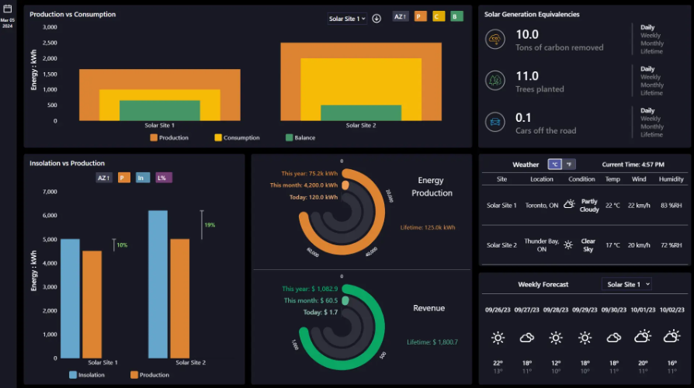
Blackstone Energy Services, Canada
Brock University Use Case
“blackPAC uses Haystack to collect and homogenize all that data into one spot and then convert all this data into information, usable and valuable information.”
Mary Quintana
Director, Asset Management and Utilities, Brock University.
Notes:
How to make sense and use of data coming from a 3M SQFT, 32 buildings campus, with 200k points of data stored every minute?
Specially when this data comes from multiple disparate sources: SCADA, BMS, DATA SET.
BlackPAK uses Haystack to collect and homogenize all that data into one spot and then convert all this data into information, usable and valuable information.

Slide 13
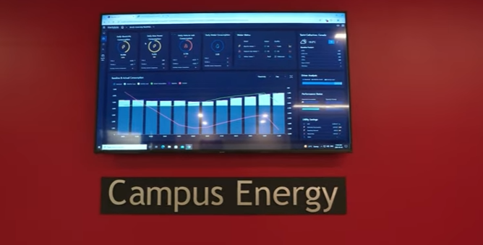
Blackstone Energy Services, Canada
Brock University Use Case
How do you get the community to care about energy consumption?
Public-facing dashboards allow for the human factor. By communicating how we are performing in real-time, we can teach the community about sustainable behaviors.
Notes:
How do you get the community to care about Energy consumption?
BlackPAC connects a massive dataset and 32 buildings throughout the Brock University campus,
which allows them to manage & visualize their energy use while acting as a central nervous system for decarbonization efforts.

Slide 14
Thank You!
BUSINESS TRACK – Session 1
Julio Londono
Julio.londono-Garcia@J2Innovations.com

