Slide 1
Realizing the Interoperability Dream Validating that Applied Metadata Enables Specific Use Cases is Key to the Promise of Interoperability
General Session 1
Nick Gayeski, PhD
Co-Executive Director, Project Haystack
Notes:
This presentation will be about the importance of validating that Haystack metadata is applied correctly within a building/software/application to fulfill a use case, and the many ways in which this unlocks value for clients and enables interoperability among applications and between use cases. While I won't present live examples, I will speak to three categories, integrator applied tags, manufacturers' device native tags, and application embedded tags, and how validation is applicable to all three types and enables interoperability to fulfill new use cases. While I think this works in the technical track, it isn't going to be deeply technical.

Slide 2
Years ago, owners started to ask me… Our integrator applied Haystack tags. Can we get a discount on onboarding?

Slide 3
A decade ago, being Haystack ‘tagged’ meant marker tags were applied
Are the applied tags:
Complete
Accurate
Sufficient for my application
These help:
Documentation
Training
Specifications
Tools

Slide 4
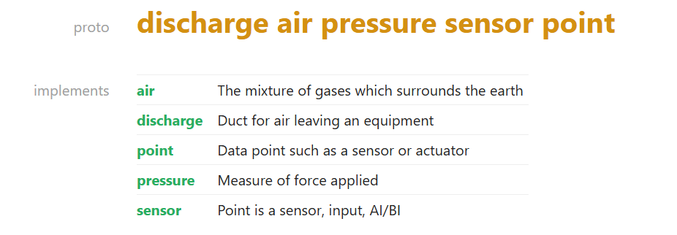
Haystack 4“Protos” defined better expectations
For interoperability, we need to use the same terms, the same way, for the same things
Protos define expected metadata to for a ‘thing’ such as an equipment or point

Slide 5
But, Flexibility in an Open Ecosystem allows people to apply only what they need
Use Case 1
Needs tags A, B
Applying only the tags you need has made Haystack easy to adopt
Protos create more clarity, but also more rigidity
Use Case 2
Needs tags A, C, D

Slide 6
And, Extensibility in an Open Ecosystem enables people to add tags and represent new concepts
Vendor 1
‘Extended’ Tags A, B
Extending tags allows vendors to meet new use cases quickly
Working groups formalize Haystack additions
But, slow, volunteer effort.
Vendor 2
‘Extended’ Tags C, D

Slide 7
Competing Objectives
Maintain Flexibility, Extensibility, Ease of ‘Getting Started’
Ensure Standard Usage and Enable Interoperability

Slide 8
Meanwhile… owners still ask Can we get a discount on onboarding?

Slide 9
Haystack Connect Throwback!

Slide 10
Validate Existing Metadata Relative to a Need
How do we check whether existing metadata can support a new use case?
New Application
Needs:
Protos W, X, Y
Tags B, C
Device 1
Tags A, B
Device 2
Tags A, C
Application 1
Protos W, X, Y
Application 2
Protos Y, Z
Site with Haystack Metadata

Slide 11
Validate Existing Metadata Relative to a Need
New Application
Needs:
Protos W, X, Y
Tag sets B, C, D
Missing D
Device 1
Tags A, B
Device 2
Tags A, C
Application 1
Protos W, X, Y
Application 2
Protos Y, Z
Site with Haystack Metadata

Slide 12
Validate Existing Metadata Relative to a Need
New Application
Needs:
Protos: M, N, O, P, Z
Tag sets E, F, G
Missing… a lot.
Device 1
Tags A, B
Device 2
Tags A, C
Application 1
Protos W, X, Y
Application 2
Protos Y, Z
Site with Haystack Metadata

Slide 13
New Application Metadata Feeds the Next
Next Application
Protos W, X, Y, Z
Tags A, B, C, D
Device 1
Tags A, B
Device 2
Tags A, C
Application 1
Protos W, X, Y
Application 2
Protos Y, Z
New Application
Protos W, X, Y
Tags B, C, D
Site with Haystack Metadata

Slide 14
Defining Expectations: Specs & Validation
Specs Xeto specifications or *specs* are used to define data types.
Define new scalar types or record types. Add schema like constraints to your data types. Specs can be used to generate statically typed data, define ontologies, or validate untyped data such JSON.
Validation Xeto features enable validating data against specs.
Xeto includes many features for validating data. Validate data using constraints such as min/max, cardinality, nominal and structural typing, and graph reference checking. Xeto can validate JSON data out of the box, or compile into JSON Schema and OpenAPI definitions.

Slide 15
Specs Make Clear which Metadata a Device or Application “Needs” and “Has”
New Application
Needs:
Protos W, X, Y
Tags B, C
Needs Metadata for Spec 1
Device 1
Tags A, B
Device 2
Tags A, C
Application 1
Protos W, X, Y
Application 2
Protos Y, Z
Adheres to Spec 2
Adheres to Spec 3
Site with Haystack Metadata

Slide 16
Maintain Flexibility, Extensibility, Ease of ‘Getting Started’
Ensure Standard Usage and Enable Interoperability

Slide 17
Spec Repositories in an Open Ecosystem
Project Haystack
Maintain Haystack specs
Expand via community
Validate contributed spec’s
Grant 3rd party rights to create specs
Spec Repository
Library of Xeto Specs
Contributors may include OEM, Integrators, Consultants
Validation App
Certified Haystack Validation Tool
Contribute
Consume

Slide 18
Spec Repositories in an Open Ecosystem
Project Haystack
Maintain Haystack specs
Expand via community
Validate contributed spec’s
Grant 3rd party rights to create specs
Spec Repository
Library of Xeto Specs
Contributors may include OEM, Integrators, Consultants
Validation App
Certified Haystack Validation Tool
Contribute
Consume
Contribute & Consume
Contribute & Consume
Contribute & Consume
Validate
OEMs
Hardware or Software
Contribute specs
Extend data types
Built-in validation
Consultants
Use existing specs to fulfill owner requirements
Contribute specs to define new requirements
Integrators
Use tools, services, OEM products to deliver solutions
May contribute specs of their own to fulfill use cases

Slide 19
Spec Repositories in an Open Ecosystem
Project Haystack
Maintain Haystack specs
Expand via community
Validate contributed spec’s
Grant 3rd party rights to create specs
Spec Repository
Library of Xeto Specs
Contributors may include OEM, Integrators, Consultants
Validation App
Certified Haystack Validation Tool
Contribute
Consume
Contribute & Consume
Contribute & Consume
Contribute & Consume
Validate
OEMs
Hardware or Software
Contribute specs
Extend data types
Built-in validation
Consultants
Use existing specs to fulfill owner requirements
Contribute specs to define new requirements
Integrators
Use tools, services, OEM products to deliver solutions
May contribute specs of their own to fulfill use cases
Interoperable Architectures
Interoperable Products
Validated Solutions
End Users
Confidence in metadata investments
Validation of interoperability
Faster and cheaper enablement

Slide 20
Can we get a discount on onboarding?
Let’s Check!

Slide 21
Owner and End User Value
Confidence that investments will result in reusable metadata
Validation that metadata projects yielded expected results
Products with metadata specs that meet the requirements for expected uses
Applications quickly enabled from validated, existing metadata infrastructure
Flexible, incremental, creation of metadata in an open ecosystem

Slide 22
Owner and End User Value
Confidence that investments will result in reusable metadata
Validation that metadata projects yielded expected results
Products with metadata specs that meet the requirements for expected uses
Applications quickly enabled from validated, existing metadata infrastructure
Flexible, incremental, creation of metadata in an open ecosystem
Better Solutions, Deployed Faster at Lower Cost

