Slide 1
Energy Analyst - Using Haystack for Real Time Grid Integration
Business Track
Philip Buonomo – VP Product Development, Intellastar

Slide 2
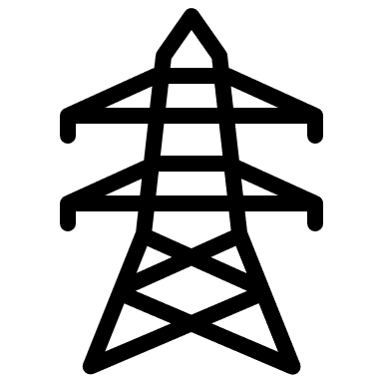
ISO/RTO
Grid APIs
Customer Cloud
Intellastar T350
Energy Analyst
EV Xeto Lib
OCPP
Energy Metering
Xeto Lib
Modbus, BACnet, etc
Generation Xeto Lib
M
Solar Xeto Lib
Battery Xeto Lib
HVAC Xeto Lib
Modbus, BACnet, etc
Sunspec
Modbus

Slide 3
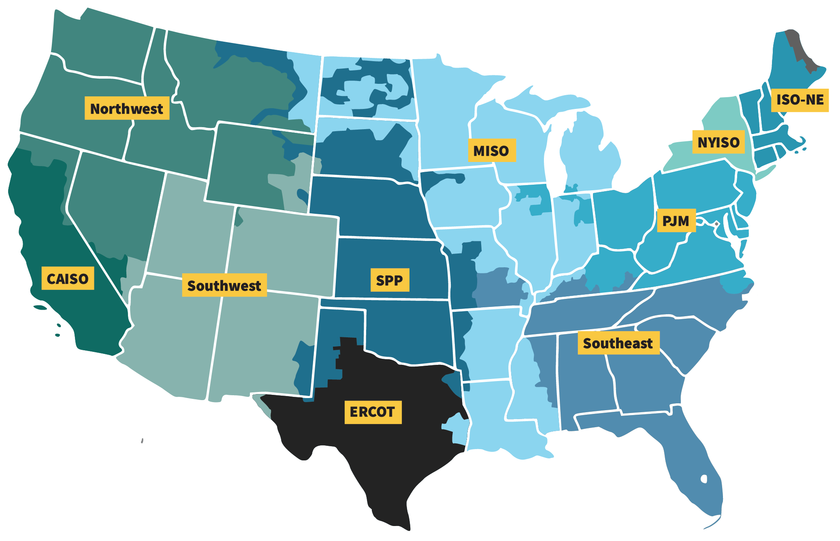
Energy Markets 101
ISO / RTO | Areas Served | Approximate Peak Demand | Approximate Customers
PJM | Mid-Atlantic and Midwest | 165,492 MW | 65 million
MISO | Midwest and Southern U.S. | 127,125 MW | 42 million
CAISO | California | 50,270 MW | 32 million
NYISO | New York State | 32,076 MW | 19.8 million
ISO-NE | New England states | 28,130 MW | 14.8 million
ERCOT | Most of Texas | 80,200 MW | 26 million
SPP | Central U.S. | 51,000 MW | 18 million

Slide 4
Energy Markets 101
Day-Ahead Markets: In the day-ahead market, electricity is traded one day before it is actually consumed.
Real-Time Markets: The real-time market operates on a much shorter interval, typically every five to fifteen minutes, to ensure continuous balance and address fluctuations in demand or supply.
Capacity Markets: Capacity markets ensure that there is sufficient generation capacity available to meet peak demand in the future.
Locational Marginal Pricing (LMP): LMP is a pricing mechanism that reflects the value of energy at different locations, considering the cost of delivering electricity, transmission congestion, and losses.

Slide 5
Energy Value Stacking
Strategy | Objective | Common Use Case
Day-Ahead Market Optimization | Reduce procurement costs by buying in advance | Facilities with energy procurement flexibility
Real-Time Price Response | Adjust load in response to 5–15 min price updates | High-load facilities with automation systems
Capacity Management (ICAP/5CP/4CP) | Reduce future year capacity obligations during peak intervals | Predictive load shedding during peak forecasts
Demand Response (Emergency/Economic) | Earn revenue or savings by curtailing load during grid stress | Industrial or commercial buildings with curtailable load
Load Shifting via TOU Tariffs | Shift usage from on-peak to off-peak periods | Manufacturing or HVAC load optimization
Participation in Deregulated Markets | Negotiate better contracts, reduce risk | Large buyers in deregulated states
Renewable & Storage Dispatch | Maximize use of DERs to avoid grid purchases | Sites with solar PV, battery storage, or EV infrastructure
Virtual Power Plant Aggregation | Monetize DER coordination through market participation | Multi-site portfolios or large campuses with DERs

Slide 6
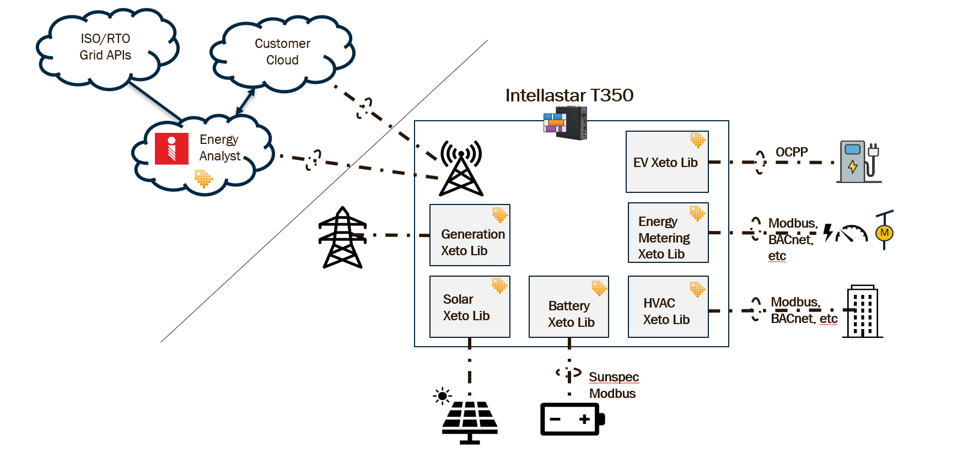
How we Use Haystack
Model-driven controls and automation
Model-driven analytics, user experience, and APIs
Model-driven data ingestion & normalization
6

Slide 7
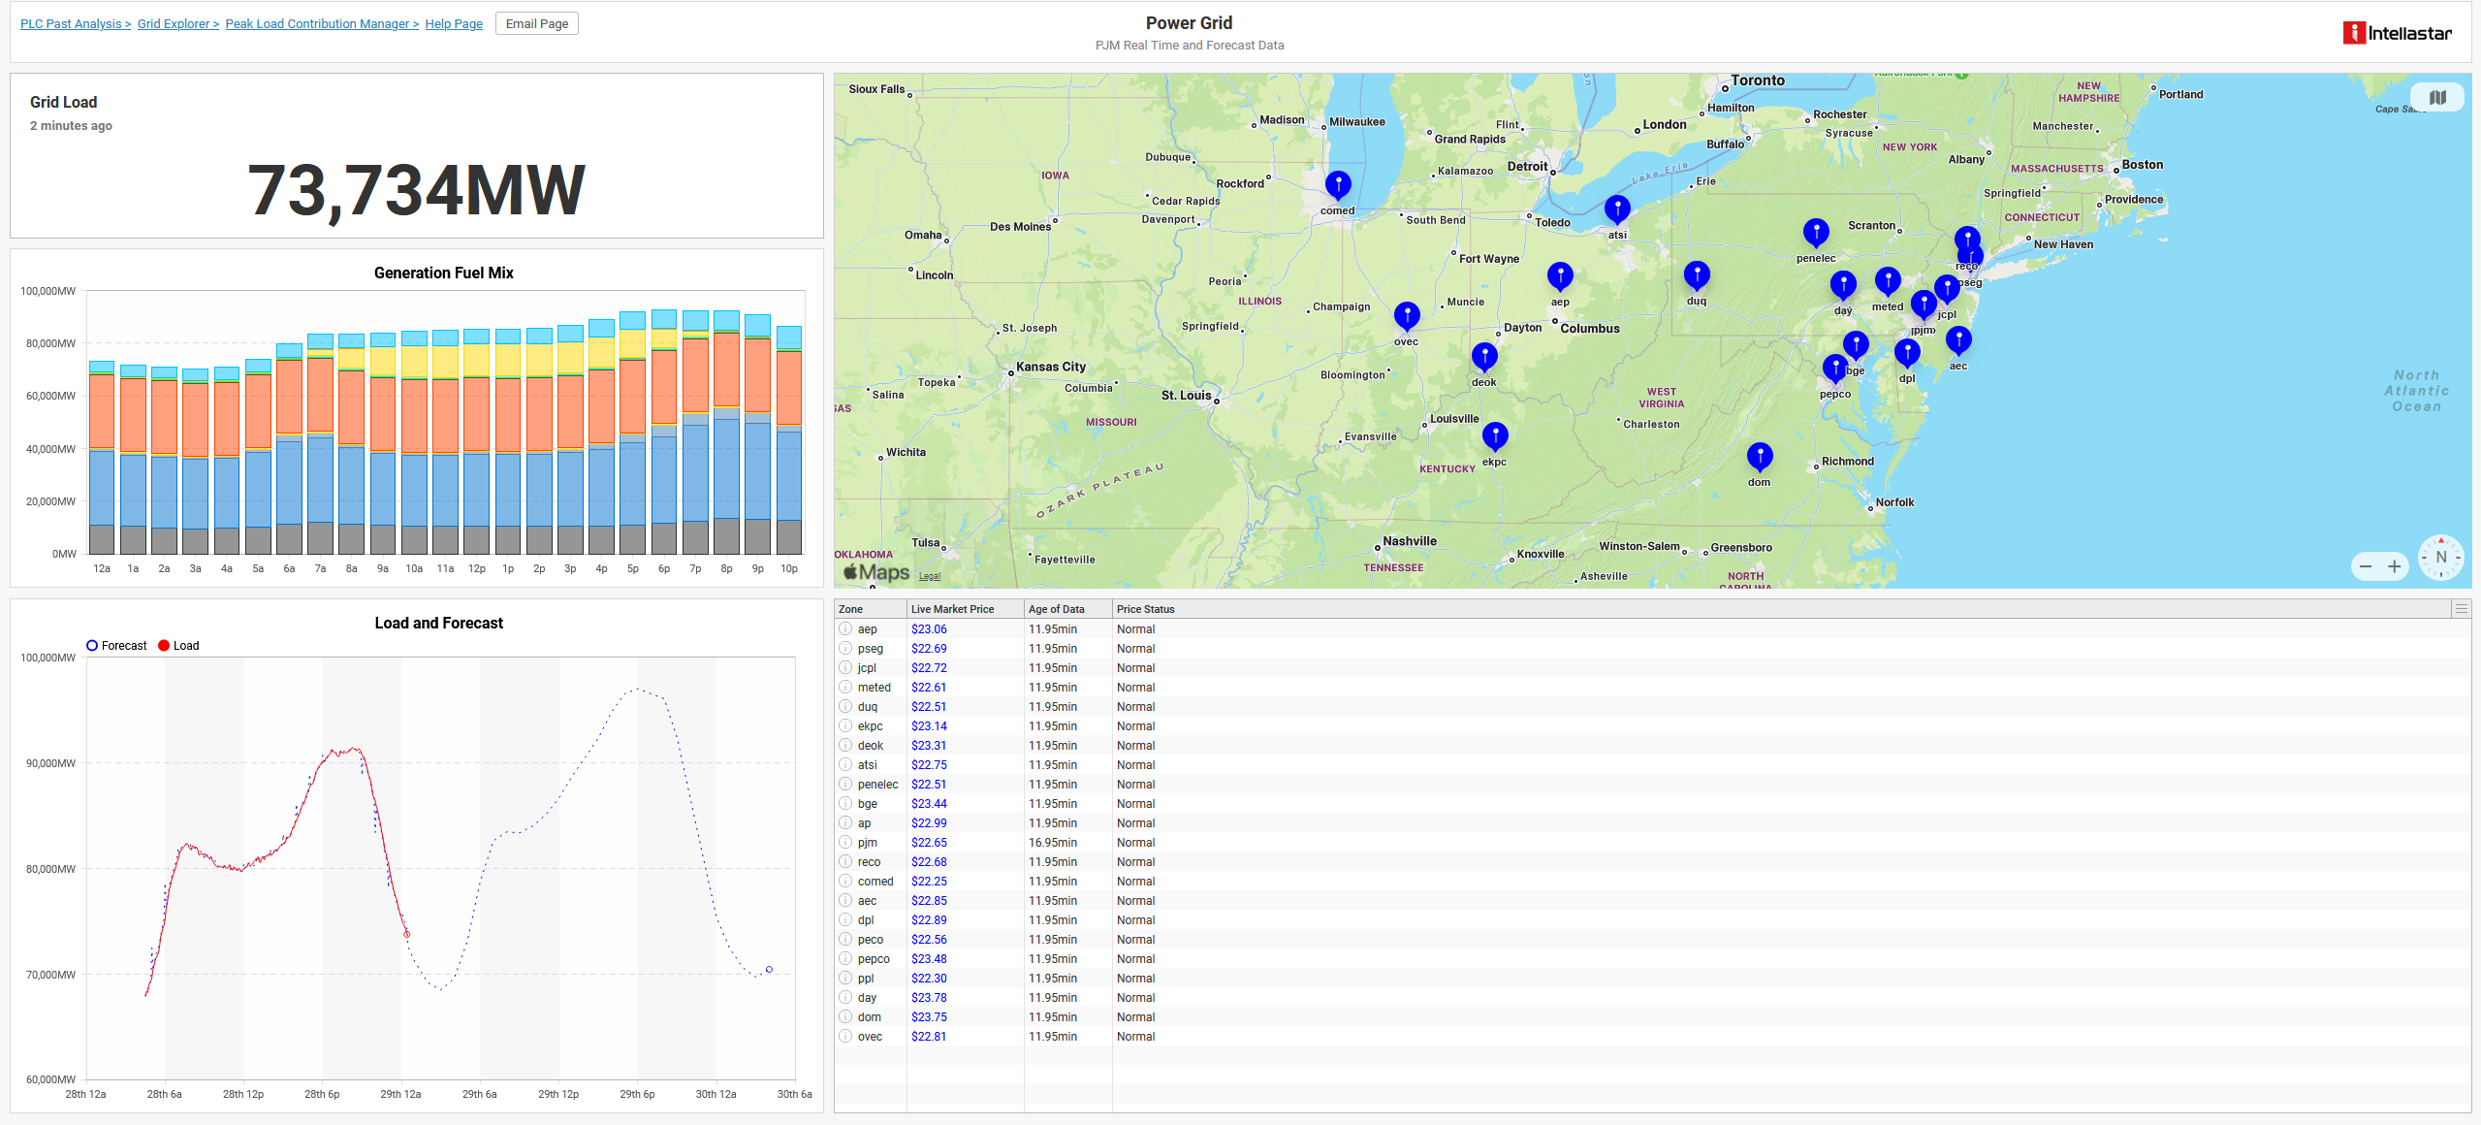
Grid Integration

Slide 8
Energy Analyst Benefits at Scale
Economic Impact: Reduced utility spend, avoided capital expenses, better rate plans, or revenue from grid services.
Carbon Reduction: Emissions avoided through reduced usage, smarter procurement, or participation in demand response.
Risk Avoidance: Fewer unplanned outages, improved uptime, and reduced exposure to volatile energy markets or compliance penalties.

Slide 9
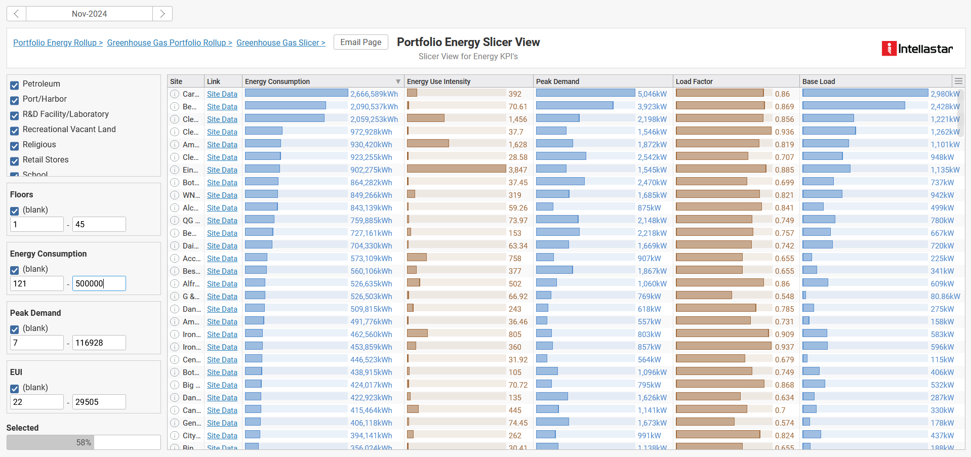
Portfolio Asset Management

Slide 10
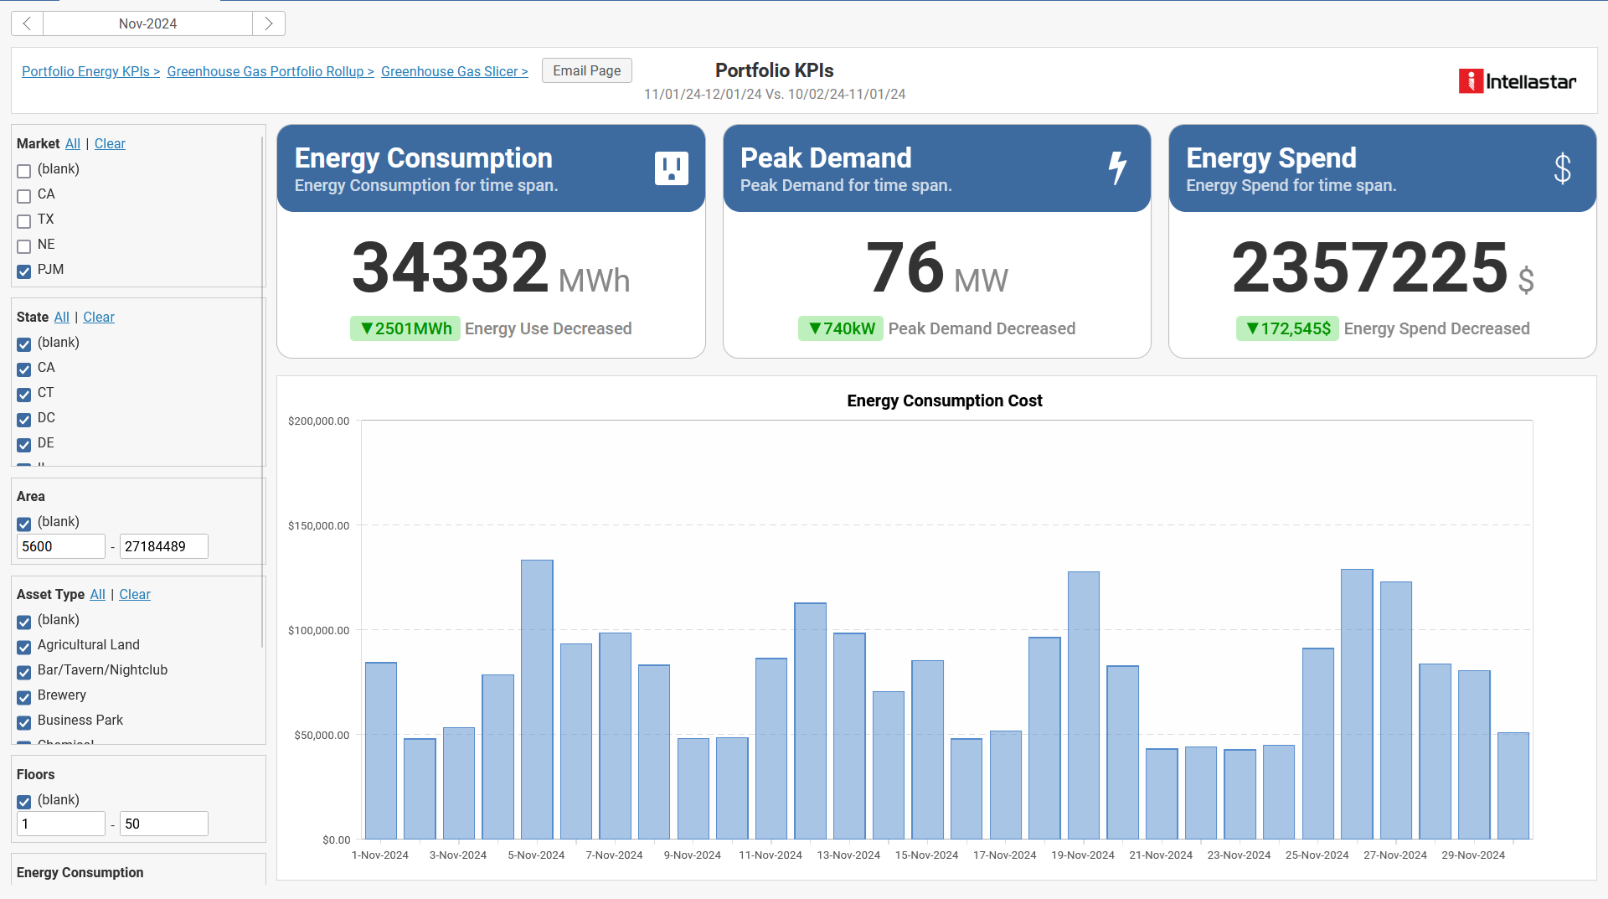
Portfolio Rollup

Slide 11
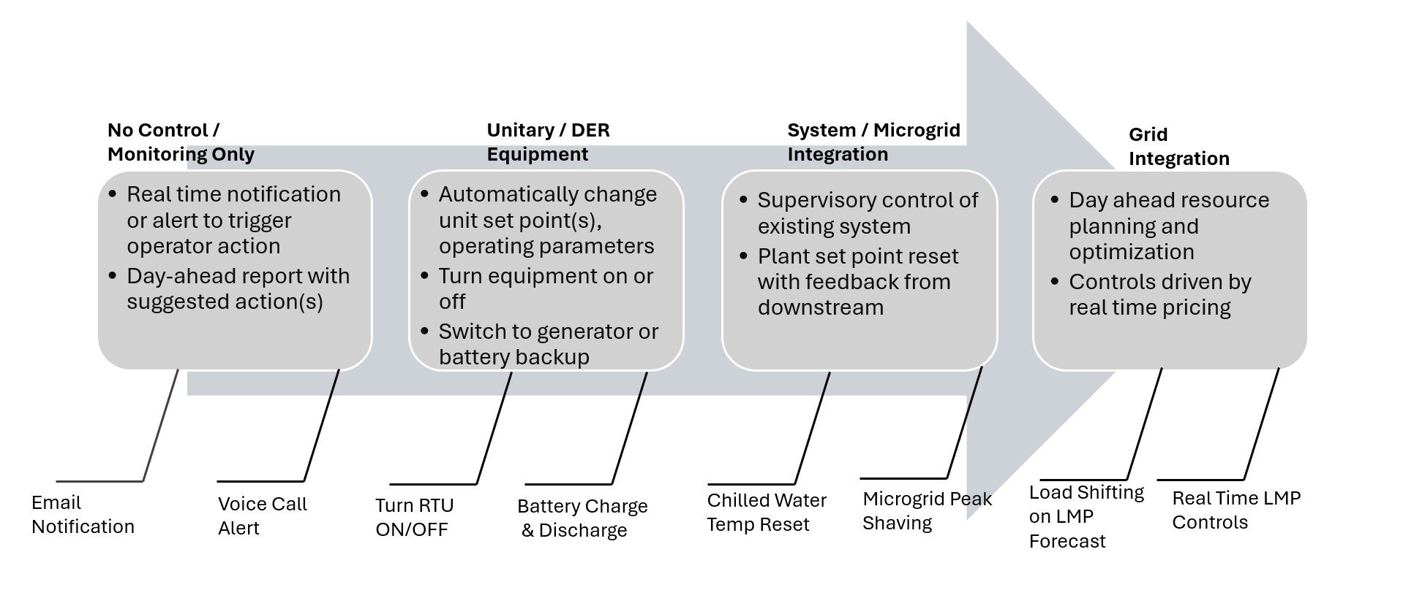
Edge Control / Automation

Slide 12
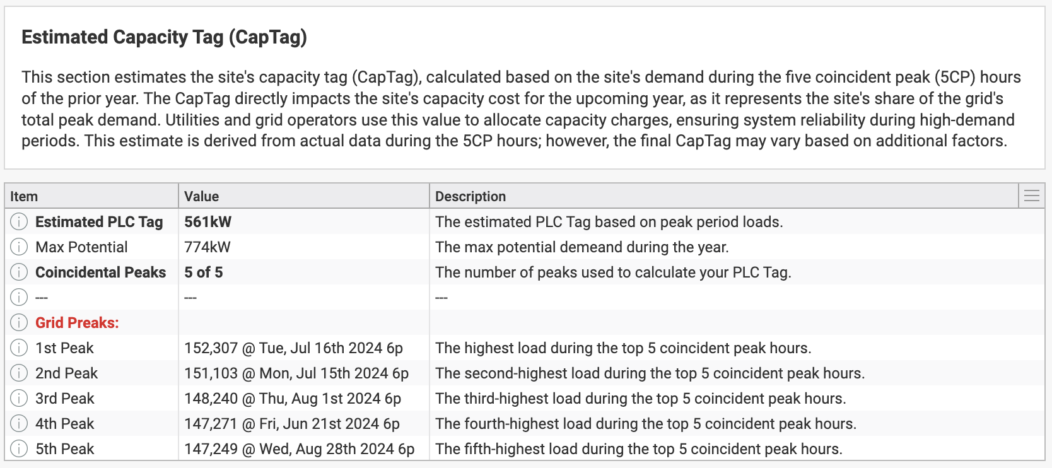
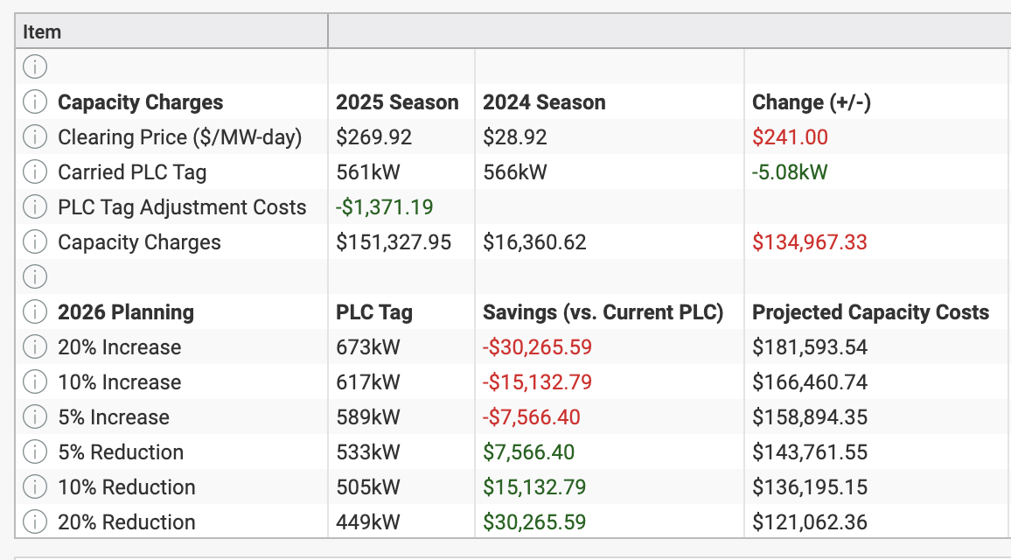
Economic Impact: PLC Reduction
What is PLC (Peak Load Contribution)?
Determines a site’s share of grid demand during peak periods
Directly impacts capacity charges for the upcoming year
Why It Matters?
Higher PLC → Higher Costs
Lower PLC → More Savings
Haystack modeling of assets to identify optimal strategy for PLC reduction and use stock library of automated controls.
© 2025 Intellastar Intellectual Property

Slide 13
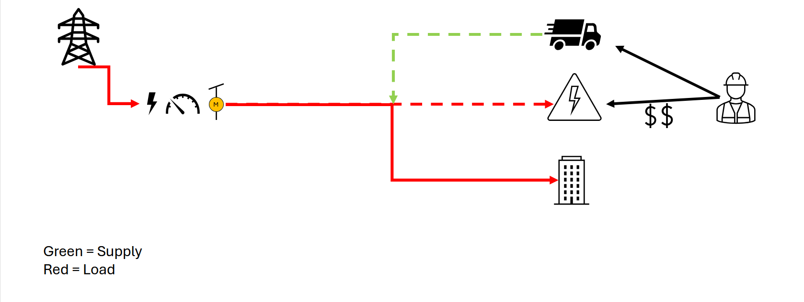
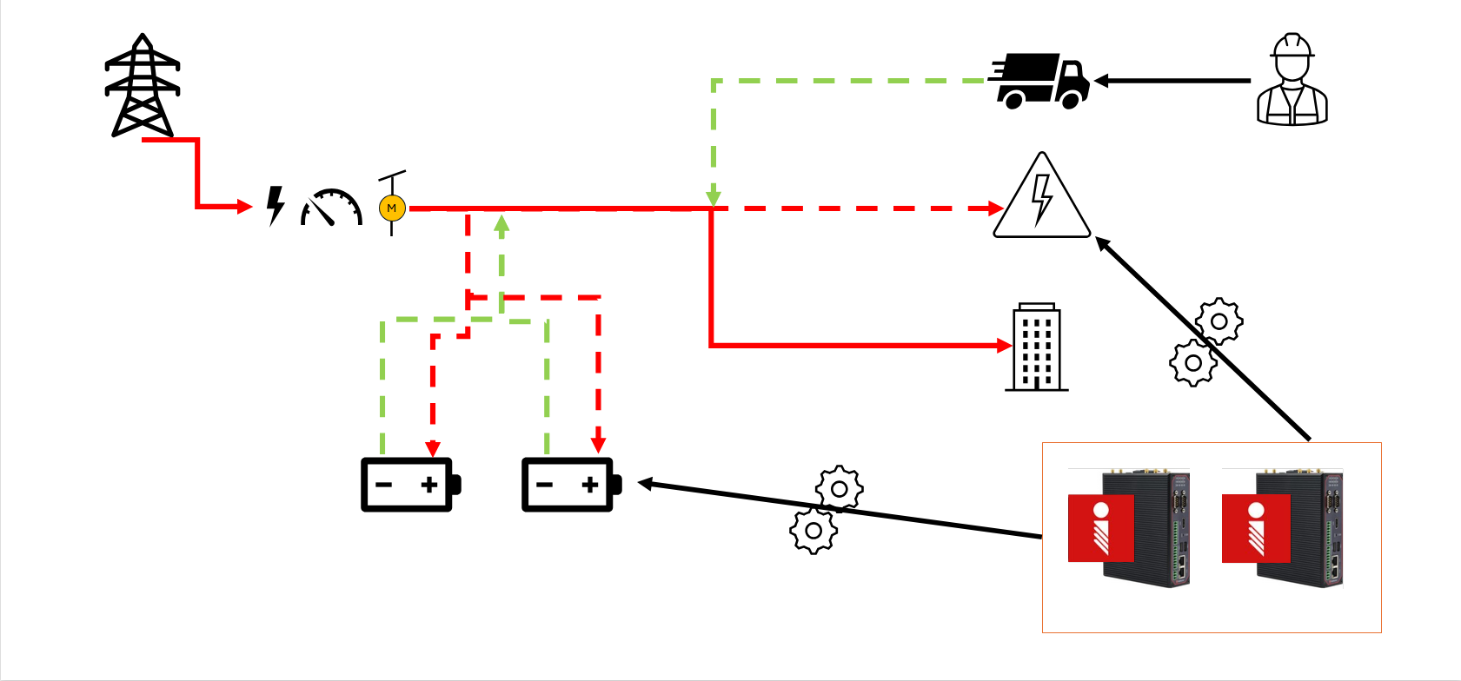
Risk Avoidance: Feeder Protection
Before
After

Slide 14
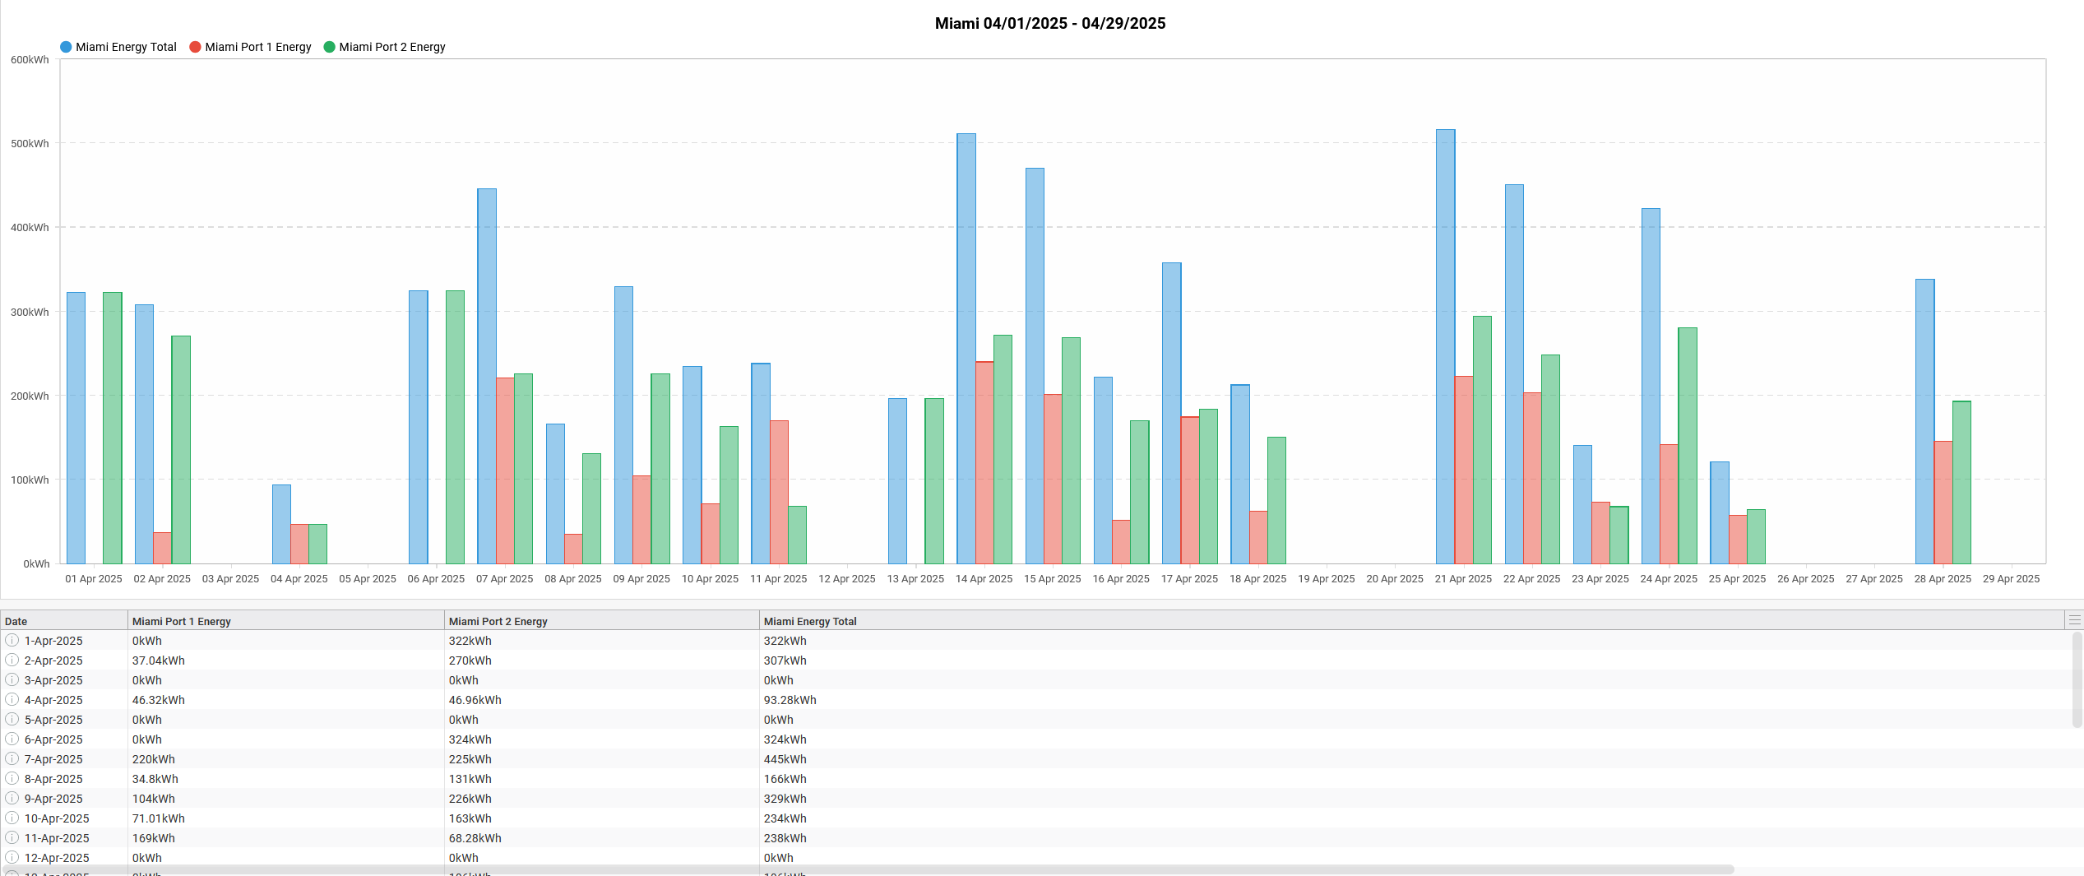
Economic Impact: Generator Utilization

Slide 15
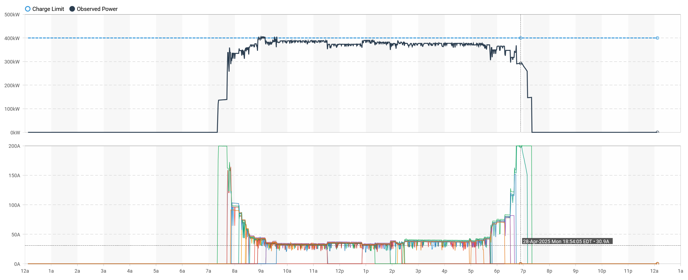
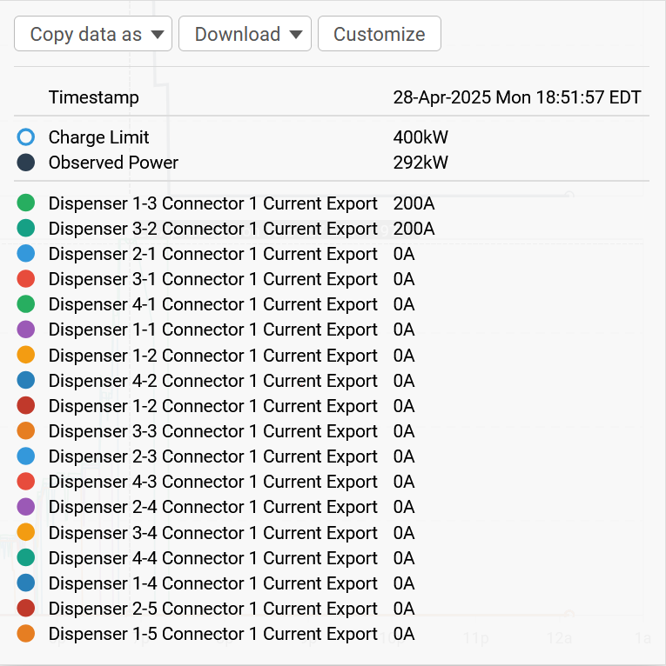
All of the Above - EV Chargers

Slide 16
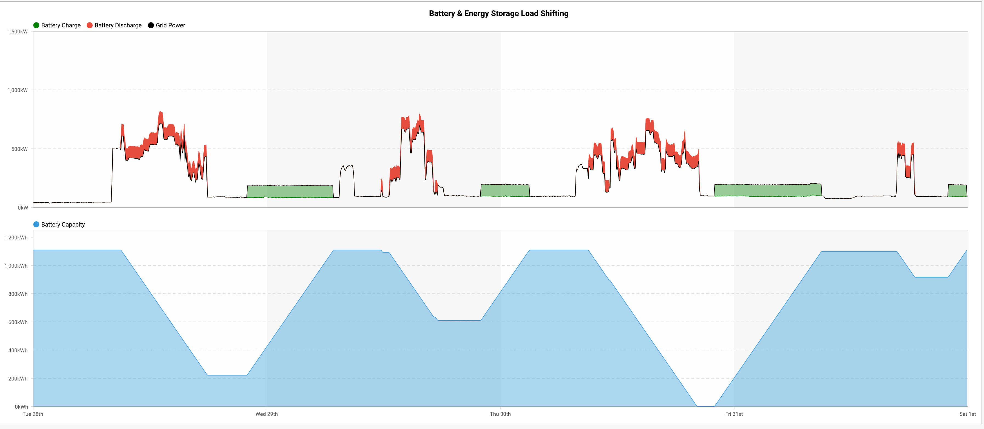
Economic Impact: Load Shifting

Slide 17
Questions?
Thank you Haystack Connect 2025!

