Slide 1

Coming Era of More Standard and Collaborative Controls Retrofit and Commissioning Workflows
TECHNICAL TRACK – Session 2 | National Ballroom A
Kevin Mamajek

Slide 2
Before We Begin
Quick Review and a word from our sponsors

Slide 3
Data Modeling using tags
Tags are simply meta data applied to Niagara components
Applying dictionary tags to the components in the station’s creates a data model.
Tags can be implied via a smart dictionary or direct
Tag components
  Dictionary (xx:), Tag name (foo) combined Tag ID (xx:foo)
  Can be a marker or value tag
Data Modeling terms
  Vocabulary = Naming
  Taxonomy = Classification
  Ontology = Relationships
  Query = Search
Notes:
Tags assign additional information to objects in order to make the objects more accessible and flexible for search and system design. Tags also facilitate the design and use of hierarchical organization in a stations user interface, whether you are working with an Enterprise Supervisor station or a single controller station.
When you add tags to station objects using standard Tag Dictionaries, other applications can discover station content without having to understand the naming convention used by the installer or system integrator. Simply put tags or meta data help create a standard naming and relationship convention.

Slide 4
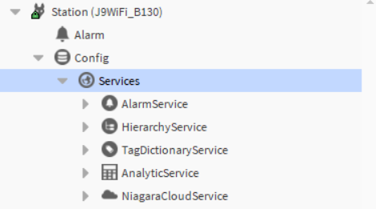
Services
Tag Dictionary Service
  Tag Dictionaries
Hierarchy Service
  Hierarchies
Analytic Service
  Alerts
  Definitions
  Pollers
Search Service
Px Pages
Niagara Cloud Service
Fun Fact: Niagara 4 from the inception uses tags internally
Notes:
When a default Niagara station template is used you will find that the Hierarchy, Search and Tag Dictionary services are already installed.
For my presentations I will be also adding the Analytic and Dashboard services. As we will be using all of them.

Slide 5
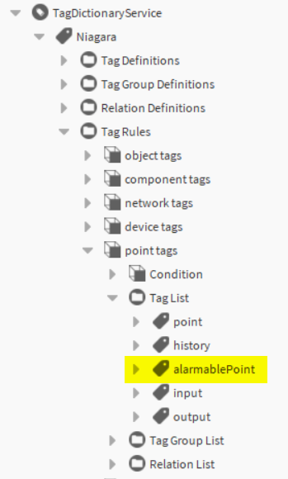
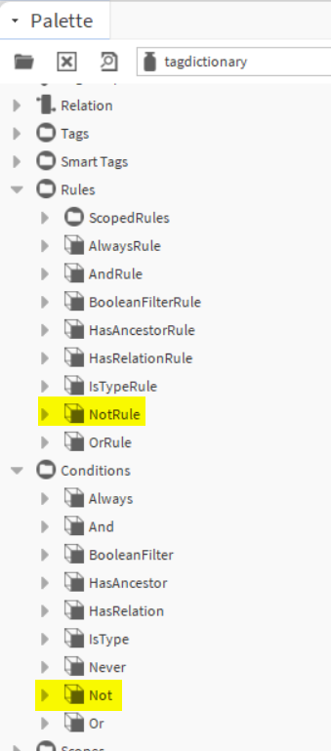
What’s new in the n: tag dictionary
n:alarmablePoint
  An implied tag added to a
  control:ControlPoint with an Alarm:AlarmSourceExt
Not Condition
  Rules/ScopedRules : ScopedNotRule
  Rules : NotRule
  Conditions : Not
Notes:
The Niagara tag dictionary is always your 1st pre installed dictionary and is mainly comprised of smart tags and relations that are implied to components automatically.
In the upcoming release of Niagara 4.14 you will have two additional items to add to your tool box.
n:alarmablePoint marker tag : this tag is implied and added to a type class of … control:ControlPoint with a … child Alarm:AlarmSourceExt
We also have a Not rule and Not to give you more flexibility when defining your Hierarchies.

Slide 6
Haystack 4 | h4:
Changes from Haystack 3 to Haystack 4
  Of the 230 Haystack 3 tags 50 have been modified
  https://project-haystack.org/doc/docHaystack/Changes3to4
Direct Haystack 3 tags can be migrated to Haystack 4
  These are only for direct tags, hs: tags remain in place
The implied h4:id tags use the nspace ID vs the hs:id handle ord
Notes:
Niagara has had the Haystack 3 tag dictionary since version 4.4 and as of 4.13 we have introduced the Haystack 4 tag dictionary.
Some of the notable features and changes are;
The use of Nspace ID vs the hand ord for the haystack ID tag
50 of the 230 haystack 3 tags have been modified to support the newer schema
In Niagara we have added the function to migrate direct haystack 3 tags to haystack 4 while keeping the Haystack 3 tags in place.

Slide 7



Ability
Synonyms: potential, knack, aptitude, power, facility, competence, skill, proficiency
Use our Niagara Tagging cooking skills

Slide 8



Building
Floor / Office / Space
AHU
Fan Meter
VAV
Tag Rules
Ability
Synonyms: potential, knack, aptitude, power, facility, competence, skill, proficiency
Identify
Synonyms: classify, recognize, describe, label, determine, designated, mark

Slide 9

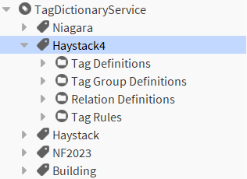
Using Haystack 4 for tagging
project-haystack.org/doc
Niagara 4.13 =>
https://project-haystack.org/doc/lib-phIoT/vav

Slide 10
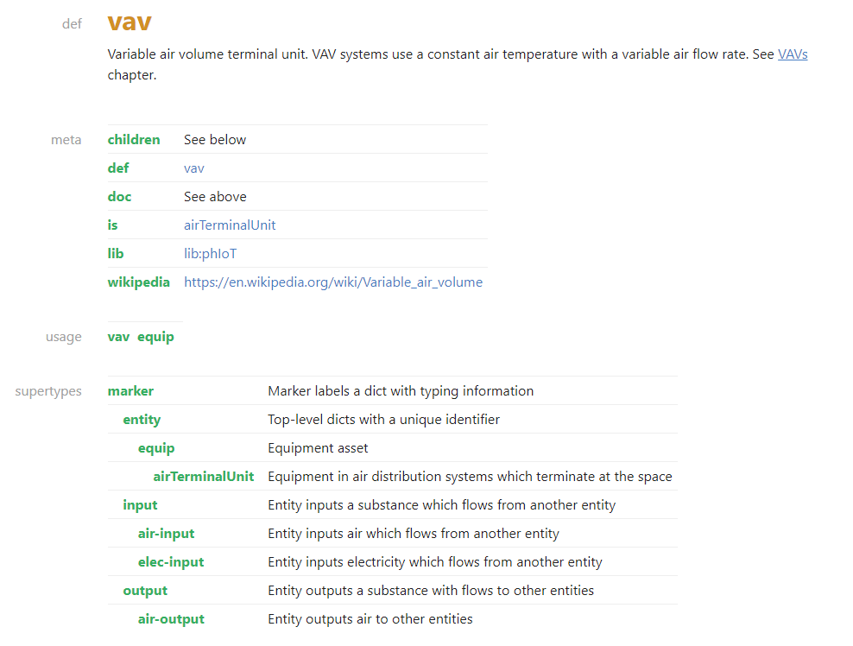
project-haystack.org/doc

Slide 11
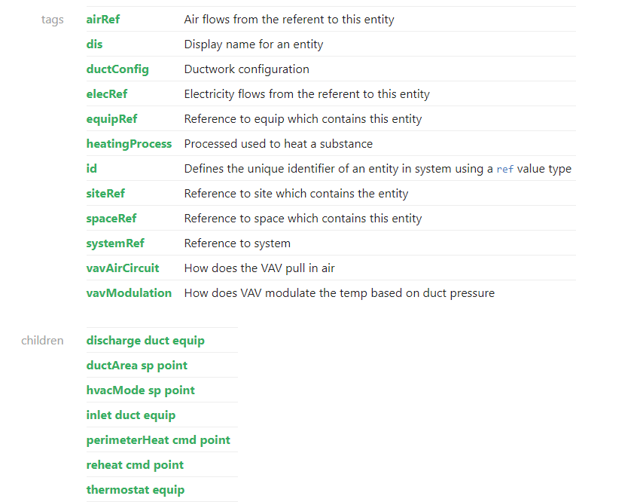
project-haystack.org/doc

Slide 12
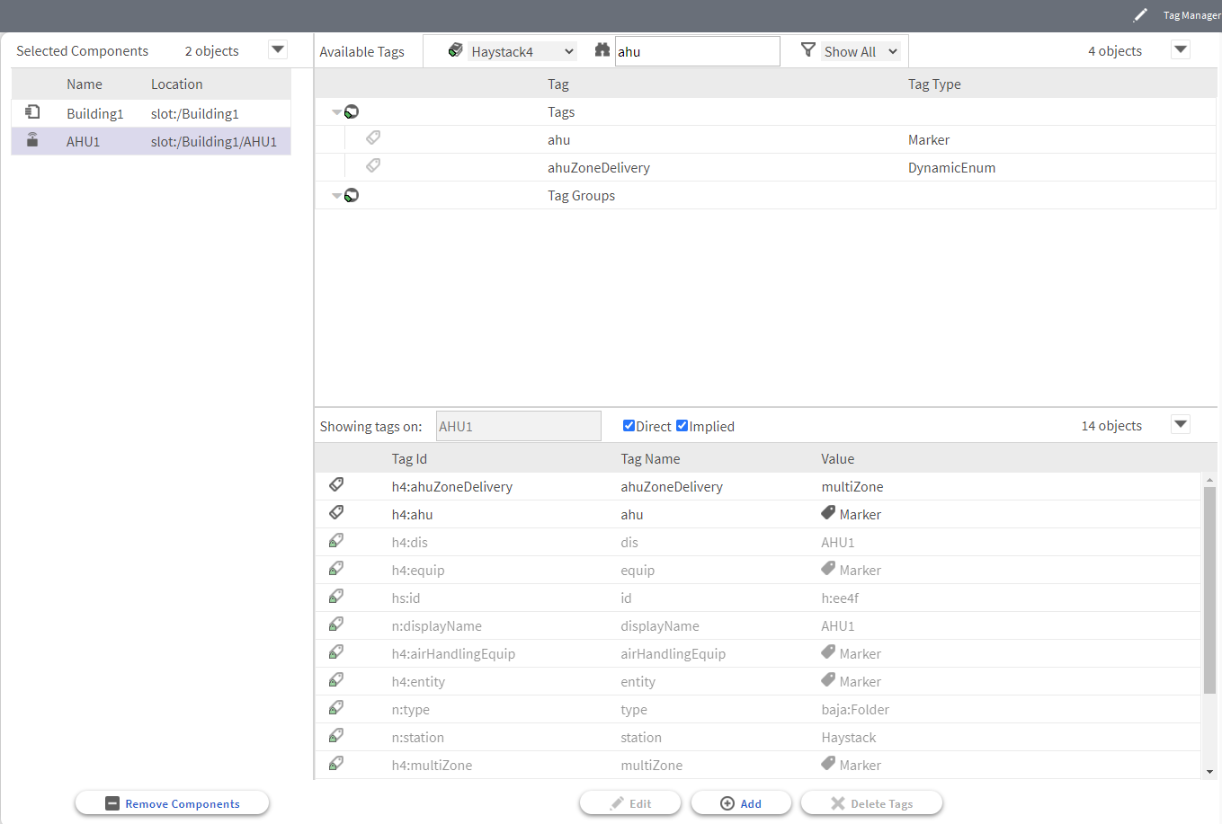
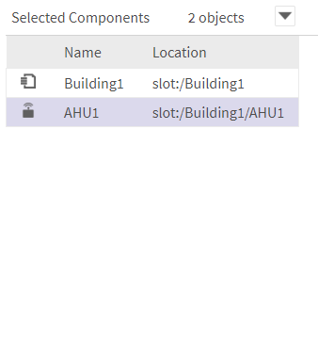
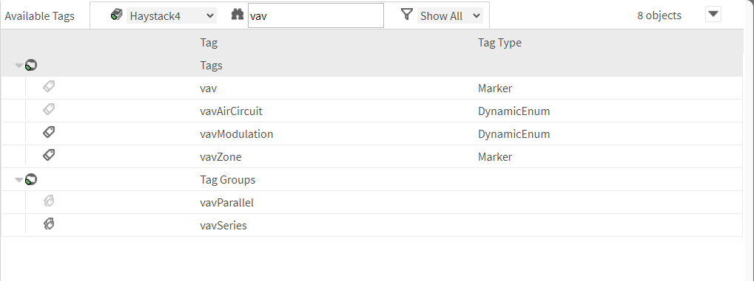
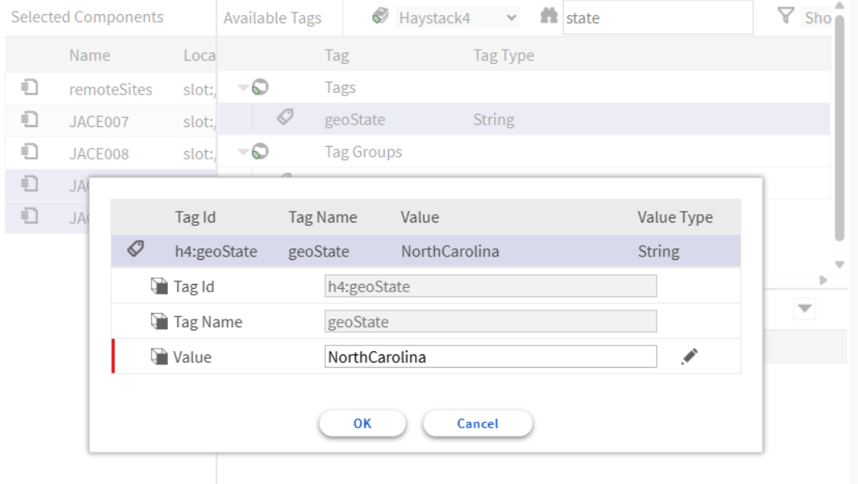
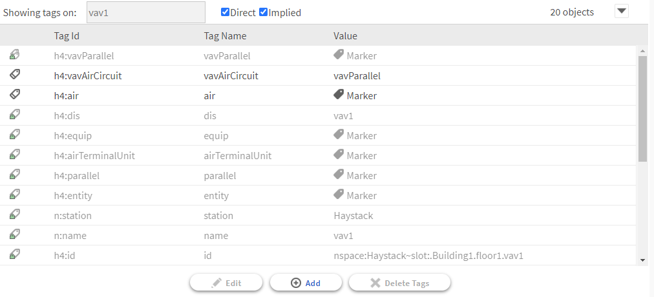

Shopping for tags
Use the HTML Tag Manager as the Store Front
h4:vavAirCircuit
h4:ahuZoneDelivery
h4:site

Slide 13

Building
h4:site
Value
h4:geoAddr
3951 Westerre Pkwy
h4:geoCity
Richmond
h4:geoState
VA
h4:geoPostalCode
23233
Floor / Office / Space
h4:hvacZoneSpace
h4:space
h4:hvacZonePoints
h4:hvac
h4:airQualityZonePoints

Slide 14
AHU
h4:ahu
h4:airHandlingEquip
h4:air
h4:gas
h4:ahuZoneDelivery
h4:multiZone
h4:chilledBeamZone
h4:equip
h4:directZone
h4:multiZone
h4:vavZone
h4:id nspace:Haystack~slot:.Building1.AHU1
airHandlingEquip HVAC equipment that conditions and delivers air via one or more fans
Fan Meter
h4:acElecMeter
h4:equip
h4:submeter
h4:elec
h4:ac
h4:meter
h4:phenomenon

Slide 15
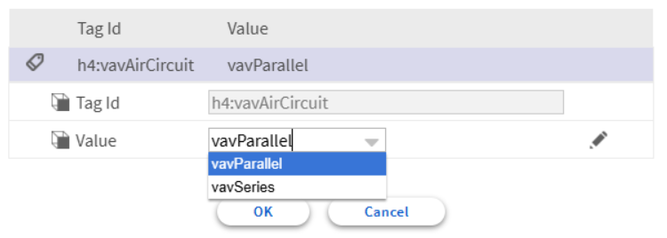
VAV
h4:vavAirCircuit
h4:airTerminalUnit
h4:air
h4:gas
h4:vav
h4:equip
h4:vavParallel
h4:parallel
h4:id nspace:Haystack~slot:.Building1.floor1.vav1
airTerminalUnit Equipment in air distribution systems which terminate at the space

Slide 16
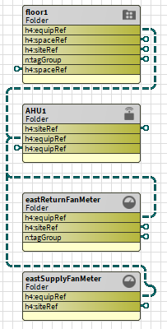
Using Relations and References

Slide 17



Building
Key
AHU1
Relation Mark
East Fan Meter 1
East Fan Meter 2
h4:spaceRef
Relate To
h4:space
Tag
Floor 1
h4:space
VAV 1
VAV 2
Office 1
VAV 3
VAV 4
h4:spaceRef
Office 2
VAV 5
VAV 6
Office 3
VAV 7
VAV 8

Slide 18
Building
Key
AHU1
Relation Mark
East Fan Meter 1
East Fan Meter 2
h4:spaceRef
Relate To
h4:space
Tag
Floor 1
h4:space
VAV 1
VAV 2
Office 1
h4:space
h4:spaceRef
VAV 3
VAV 4
Office 2
h4:space
h4:spaceRef
VAV 5
VAV 6
Office 3
h4:space
h4:spaceRef
VAV 7
VAV 8

Slide 19
Building
Key
AHU1
Relation Mark
h4:equip
East Fan Meter 1
East Fan Meter 2
h4:equipRef
Relate To
h4:equip
Tag
Floor 1
VAV 1
VAV 2
Office 1
VAV 3
VAV 4
h4:equipRef
Office 2
VAV 5
VAV 6
Office 3
VAV 7
VAV 8

Slide 20
Building
Key
h4:site
AHU1
Relation Mark
East Fan Meter 1
East Fan Meter 2
h4:siteRef
Relate To
h4:site
Tag
Floor 1
VAV 1
VAV 2
Office 1
h4:siteRef
VAV 3
VAV 4
Office 2
VAV 5
VAV 6
Office 3
VAV 7
VAV 8

Slide 21
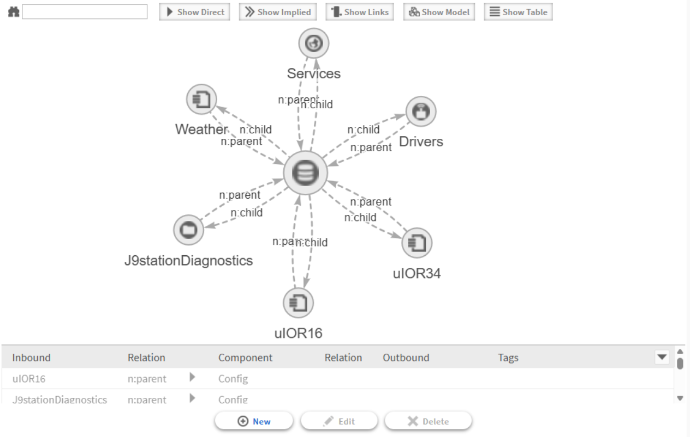
New to Niagara 4.15

Slide 22
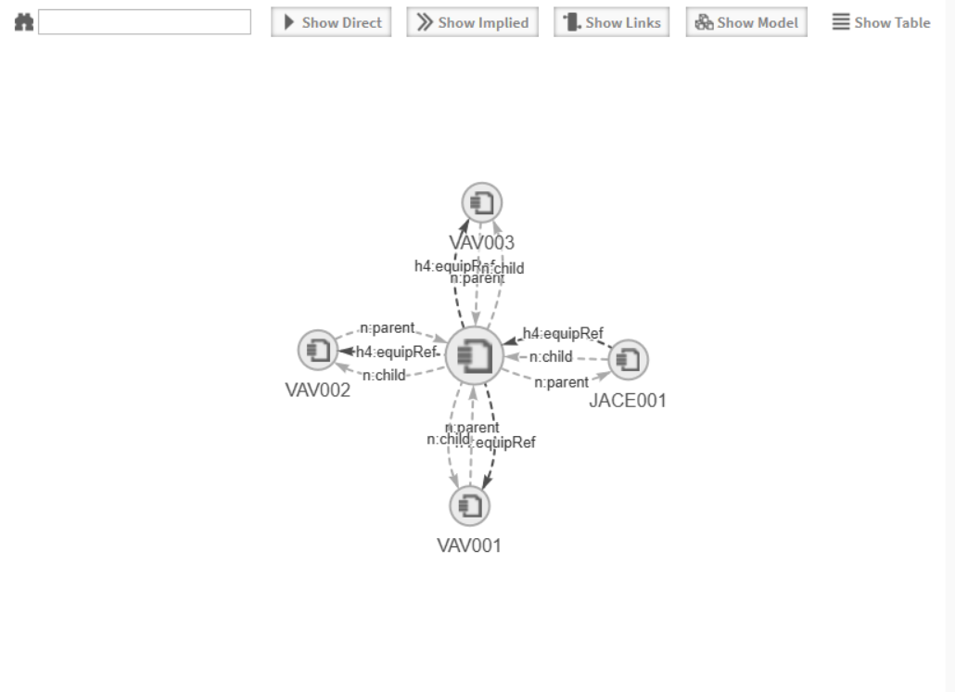
New to Niagara 4.15

Slide 23
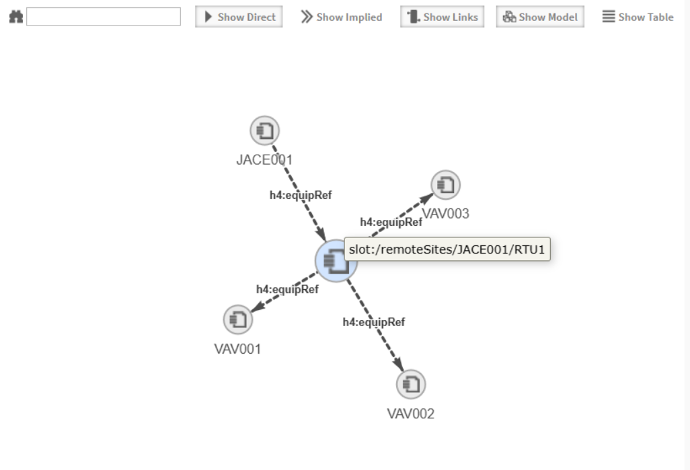
New to Niagara 4.15

Slide 24
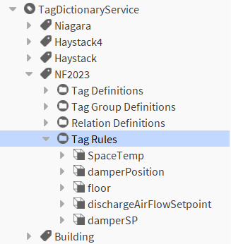
Using Tag Rules

Slide 25
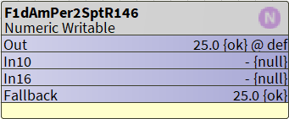
SpaceTemp
SpcTmp
SpaceTmp
SpaceTemperature
Space Temperature
spaceTemperature
spacetemperature
itIsAtemp

Slide 26

If the Name contains the letters roomtemp, all in a row, somewhere in the name itself
Regex Ignore Case
(?i)
Wild Card open/close
.*
.*
tag name
n:name
operator
like
characters
roomtemp
Filter
n:name
like
‘
(?i)
.*
roomtemp
.*
‘
n:name like '(?i).*roomtemp.*'
local:|module://docJdk/doc/jdk-se/java/util/regex/Pattern.bajadoc
http://xenon.stanford.edu/~xusch/regexp/

Slide 27
If the Name contains the letters damper, AND spt OR cmd in any group of letters somewhere in the name itself
Regex Ignore Case
(?i)
Wild Card open/close
.*
.*
tag name
n:name
operator
like
and
or
characters
damper
spt
cmd
n:name
like
‘
(?i)
.*
damper
.*
‘
and
Filter
n:name
like
‘
(?i)
.*
spt
.*
‘
or
n:name
like
‘
(?i)
.*
cmd
.*
‘
(n:name like '(?i).*damper.*') and ((n:name like '(?i).*spt.*') or (n:name like '(?i).*cmd.*'))

Slide 28
If the Name contains the letters damper and NOT spt or cmd in groups of letters somewhere in the name itself
Regex Ignore Case
(?i)
Wild Card open/close
.*
.*
tag name
n:name
operator
like
and
or
not
characters
damper
spt
cmd
n:name
like
‘
(?i)
.*
damper
.*
‘
and
not
Filter
n:name
like
‘
(?i)
.*
spt
.*
‘
or
n:name
like
‘
(?i)
.*
cmd
.*
‘
(n:name like '(?i).*damper.*') and not((n:name like '(?i).*spt.*') or (n:name like '(?i).*cmd.*'))

Slide 29
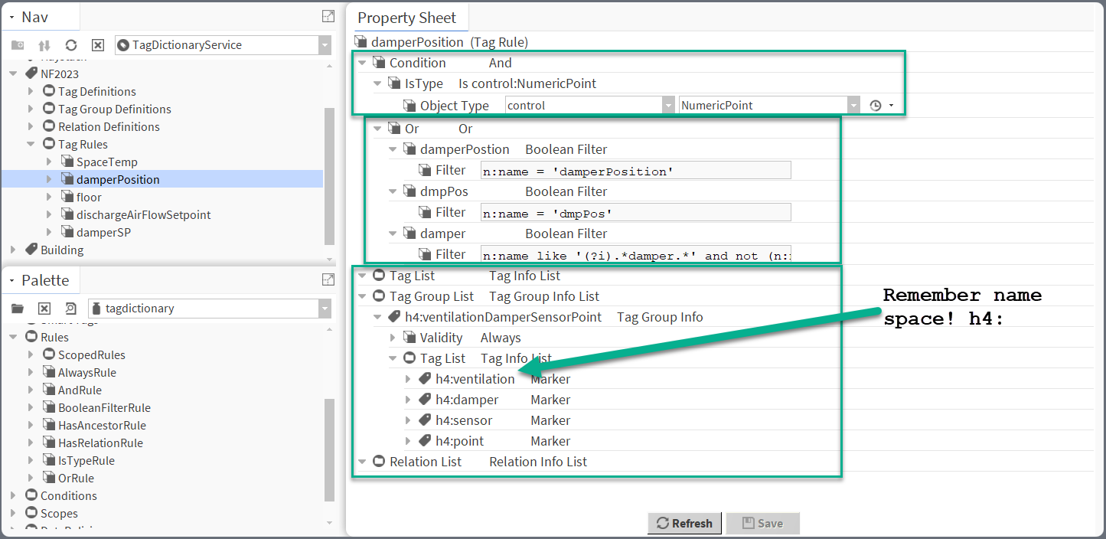

Slide 30
Niagara Hierarchy

Slide 31
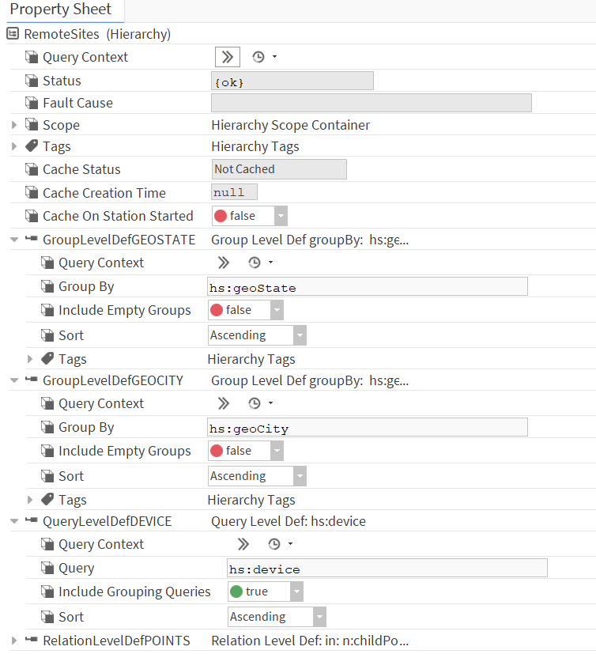
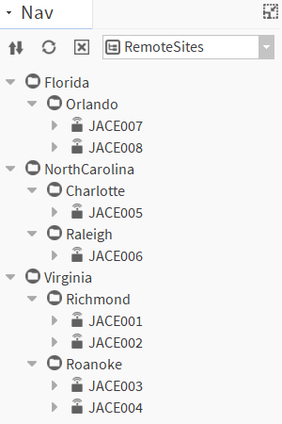
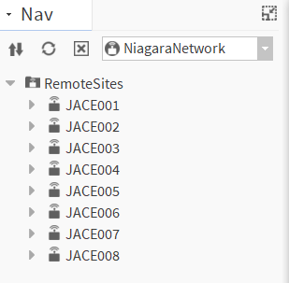

hs:geoState
hs:geoCity

Slide 32
Analytics

Slide 33
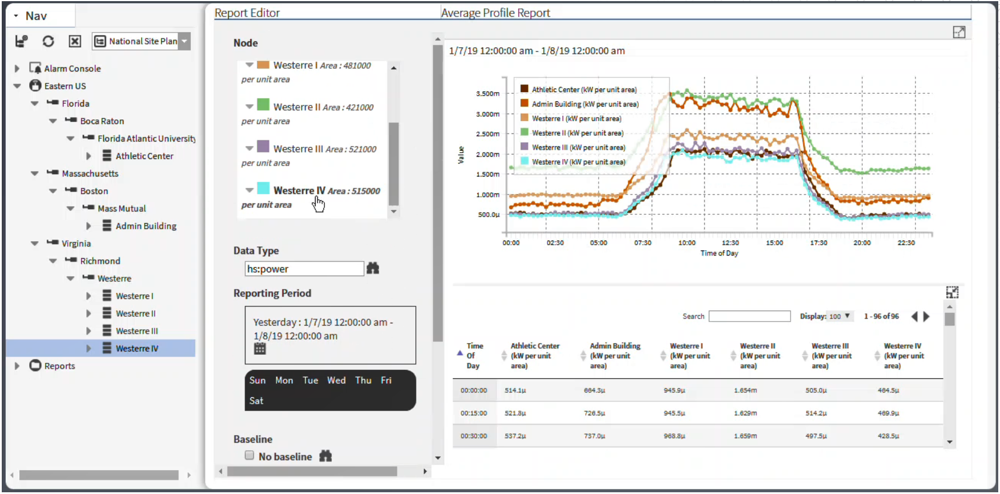

Slide 34
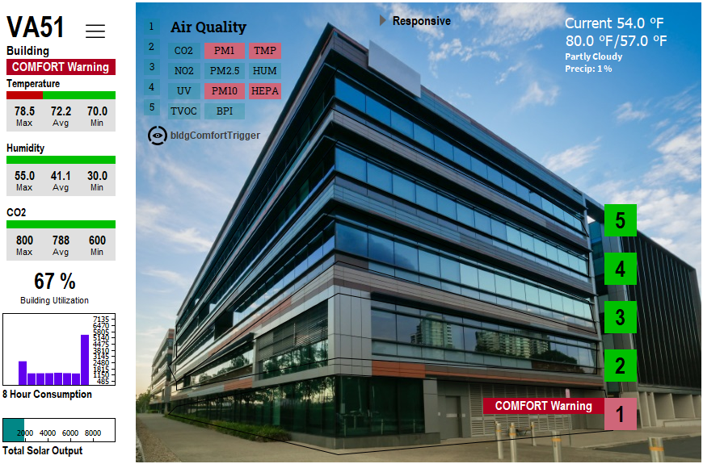
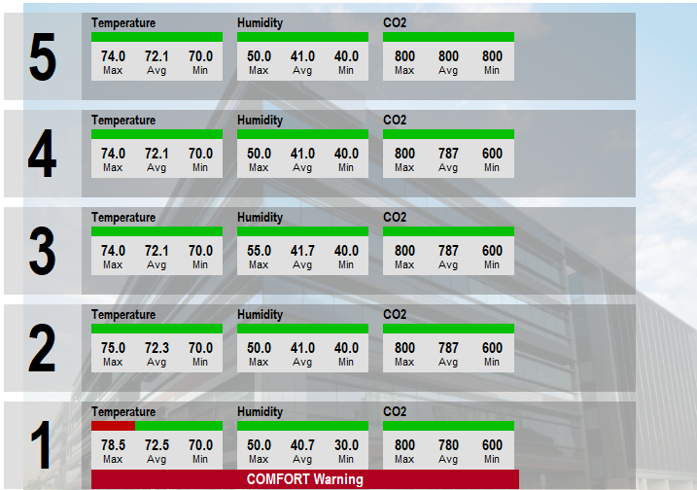
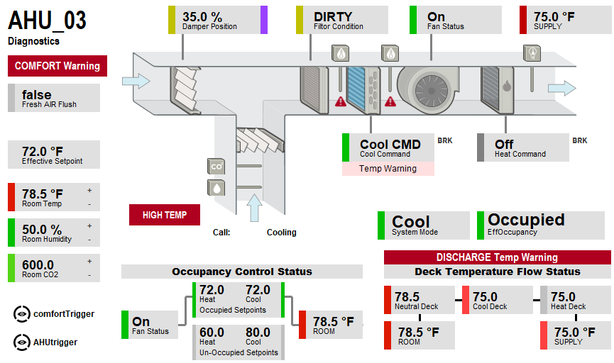
h4:temp
h4:humidity
h4:co2
75 Sensors
15 Sensors Per Floor
1 Sensor

Slide 35
Niagara Cloud

Slide 36
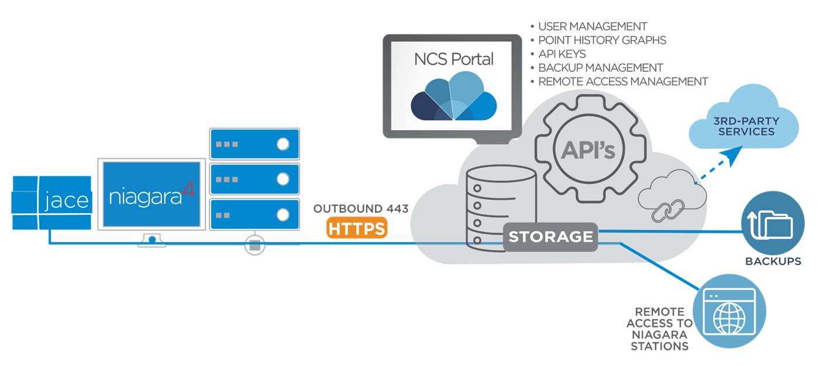
CloudID

Slide 37
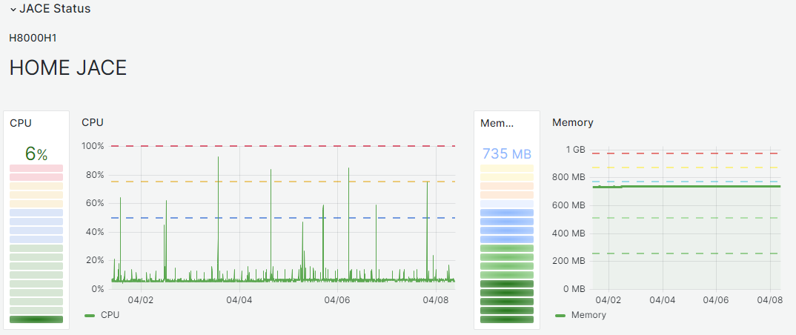
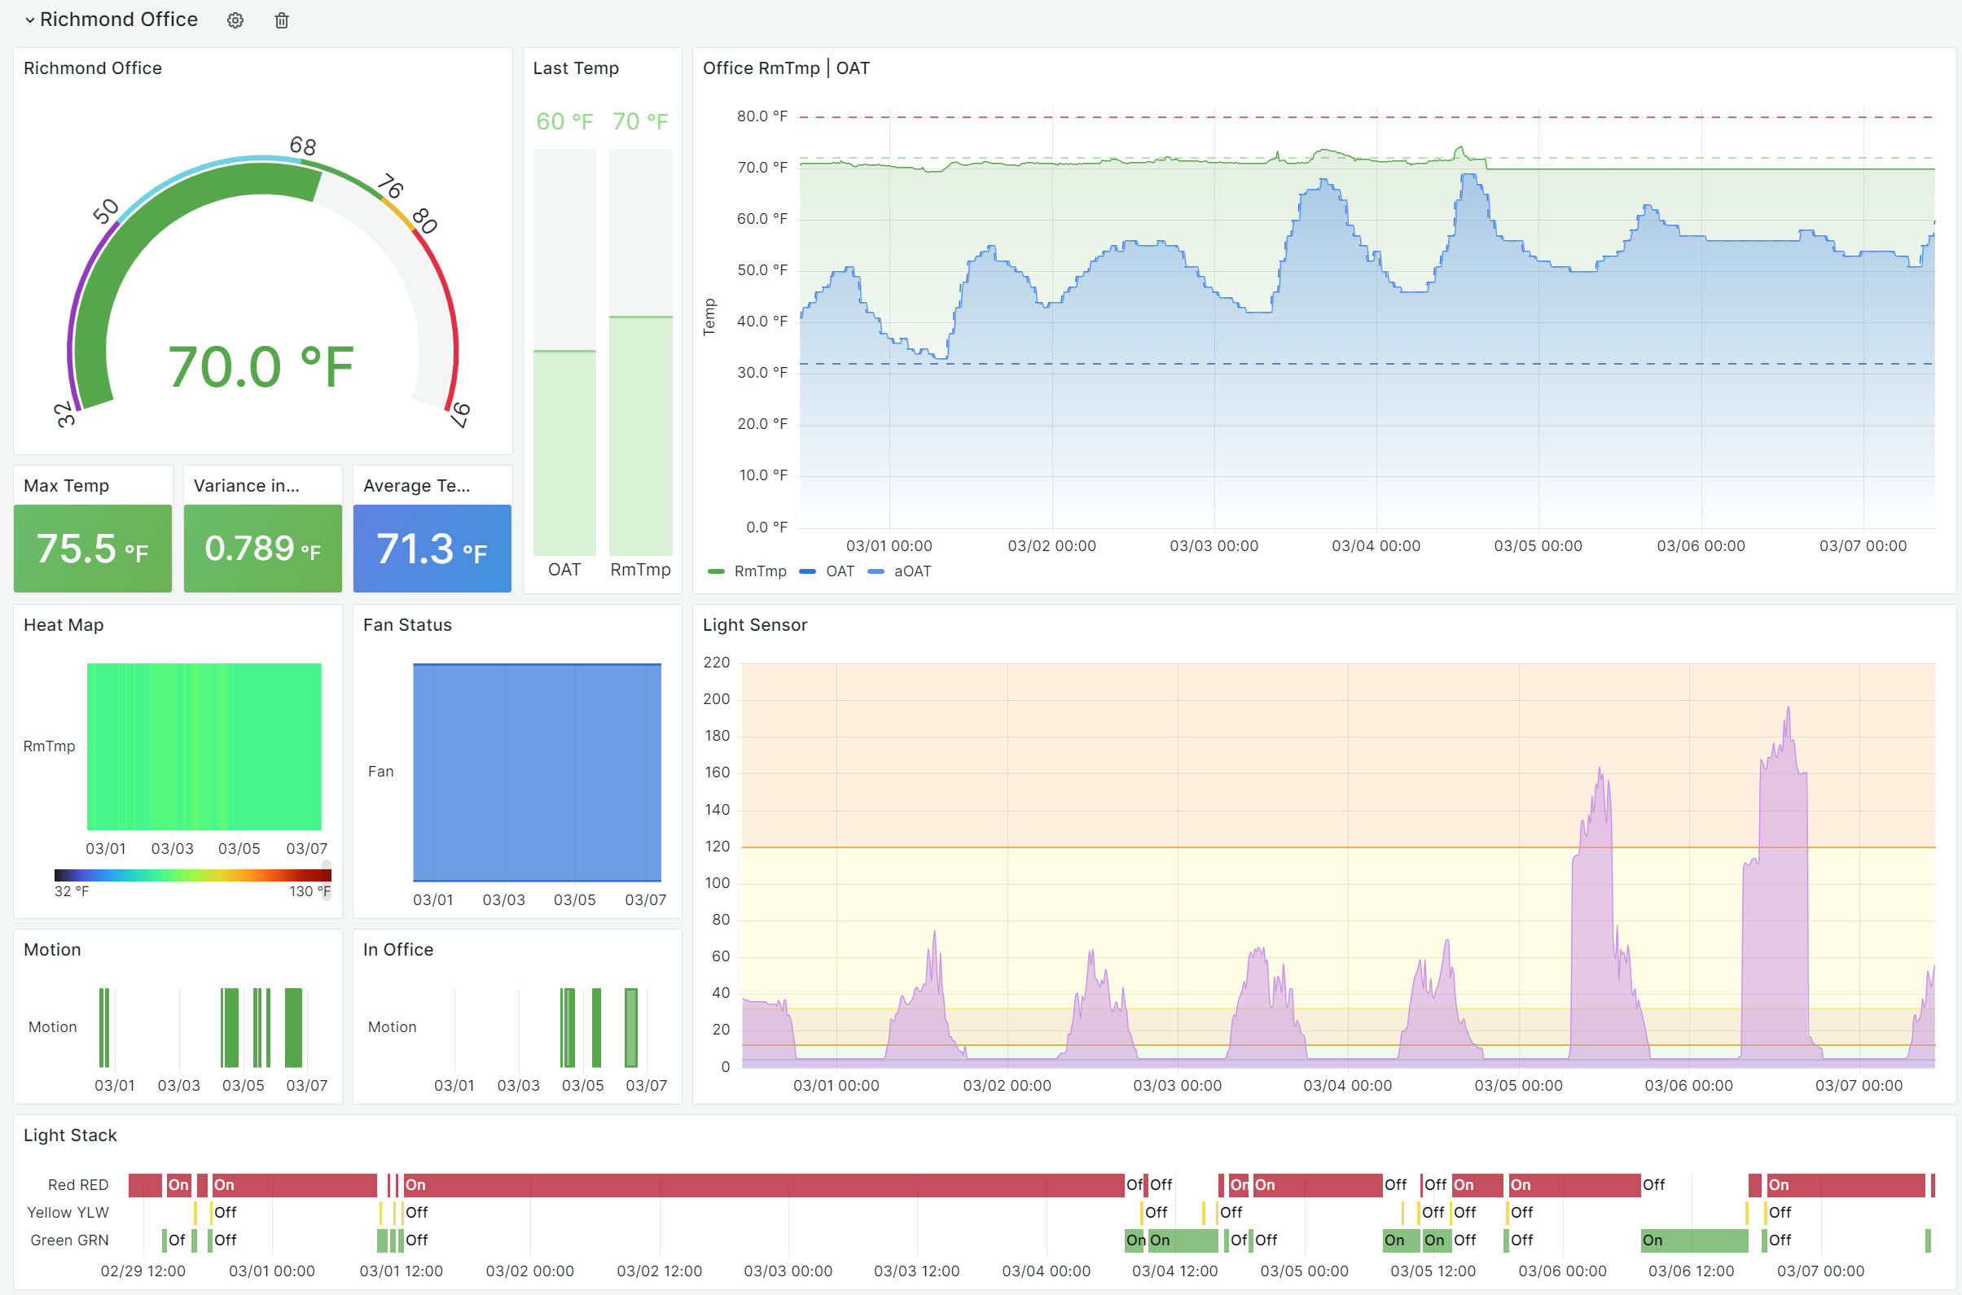

Slide 38
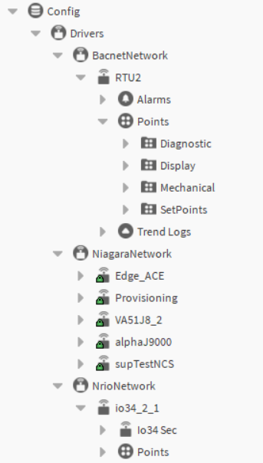
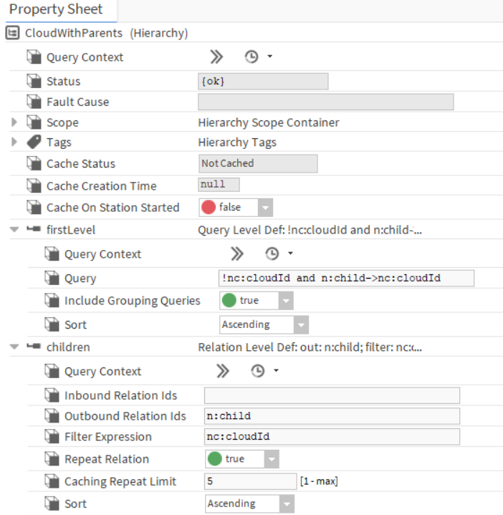

Slide 39
Future Proof your data
Easy Searching
Easy Hierarchy
Analytics
  On Premise
  In Cloud
Prepare for Cloud
  Where the customer owns the data model

