Slide 1
AI-Powered FDD: Turning Building Data into Actionable Insights
Business Track
Shilpa Basappa, Senior Director of Product Engineering, 75F

Slide 2
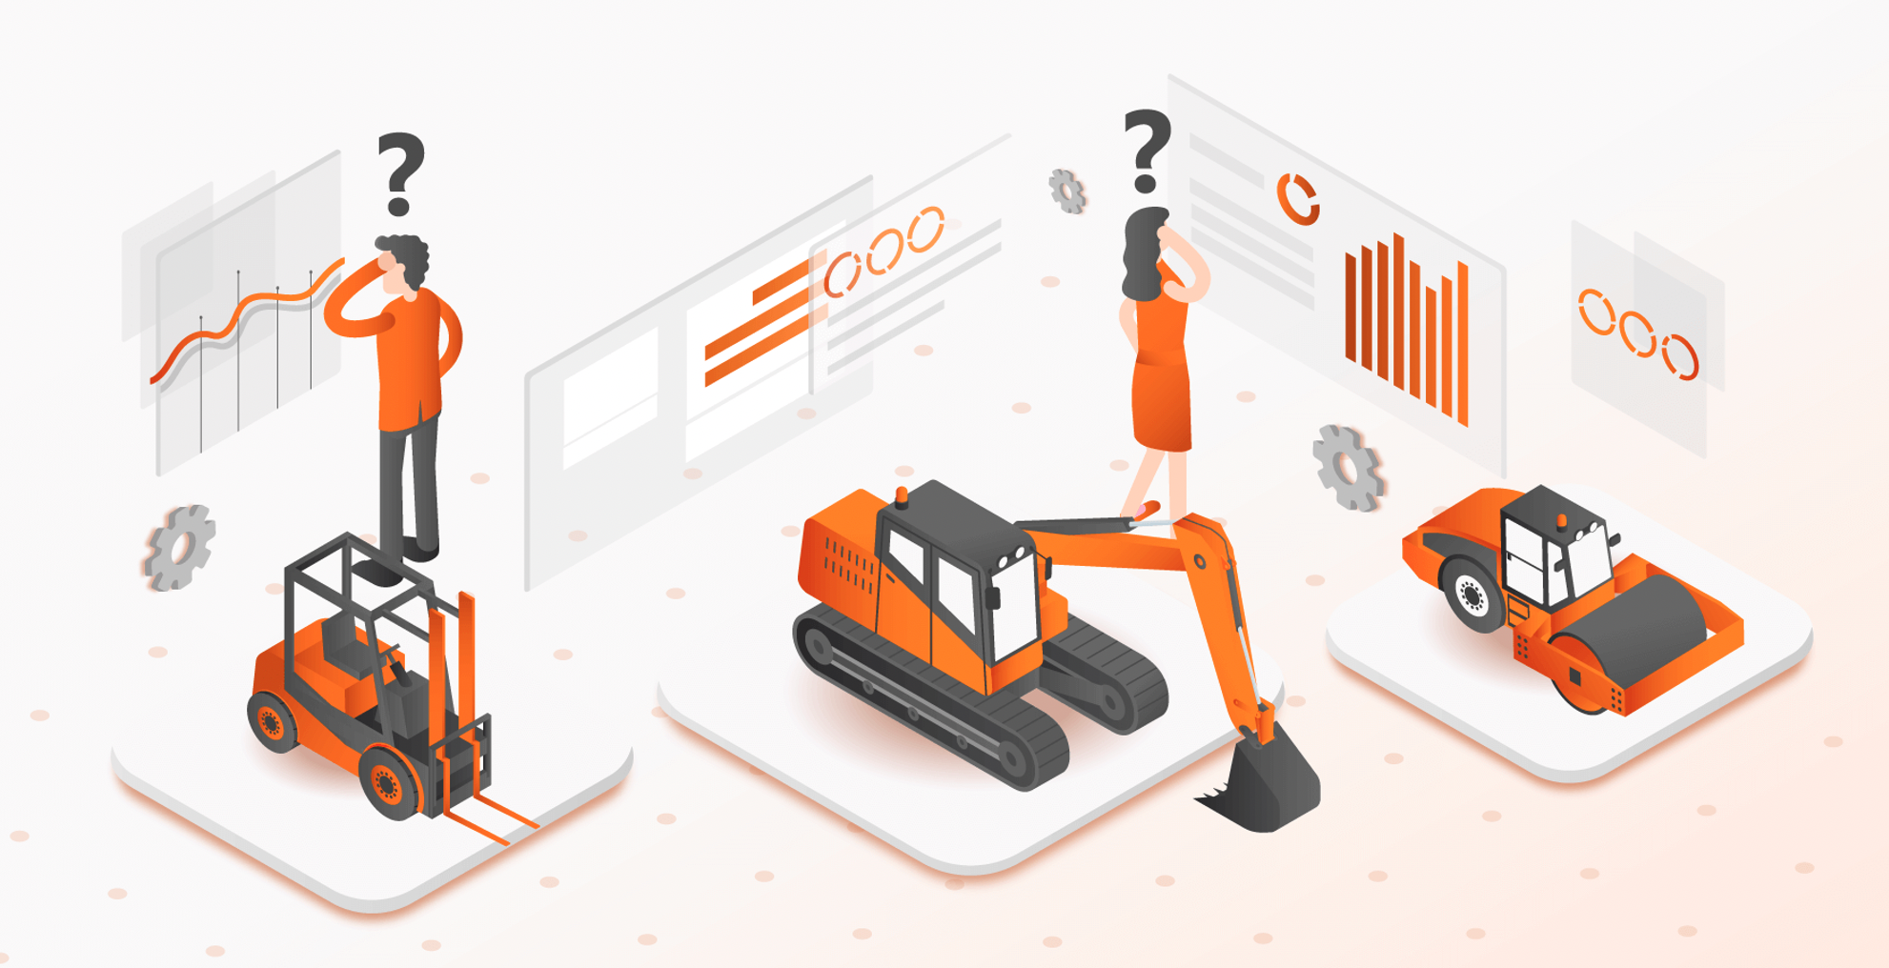
2
What do These Buildings Have in Common?
www.75F.io
2025
Notes:
what do these buildings have in common
rolling out deployments
worlds largest BMS deployment
Big box retails store

Slide 3
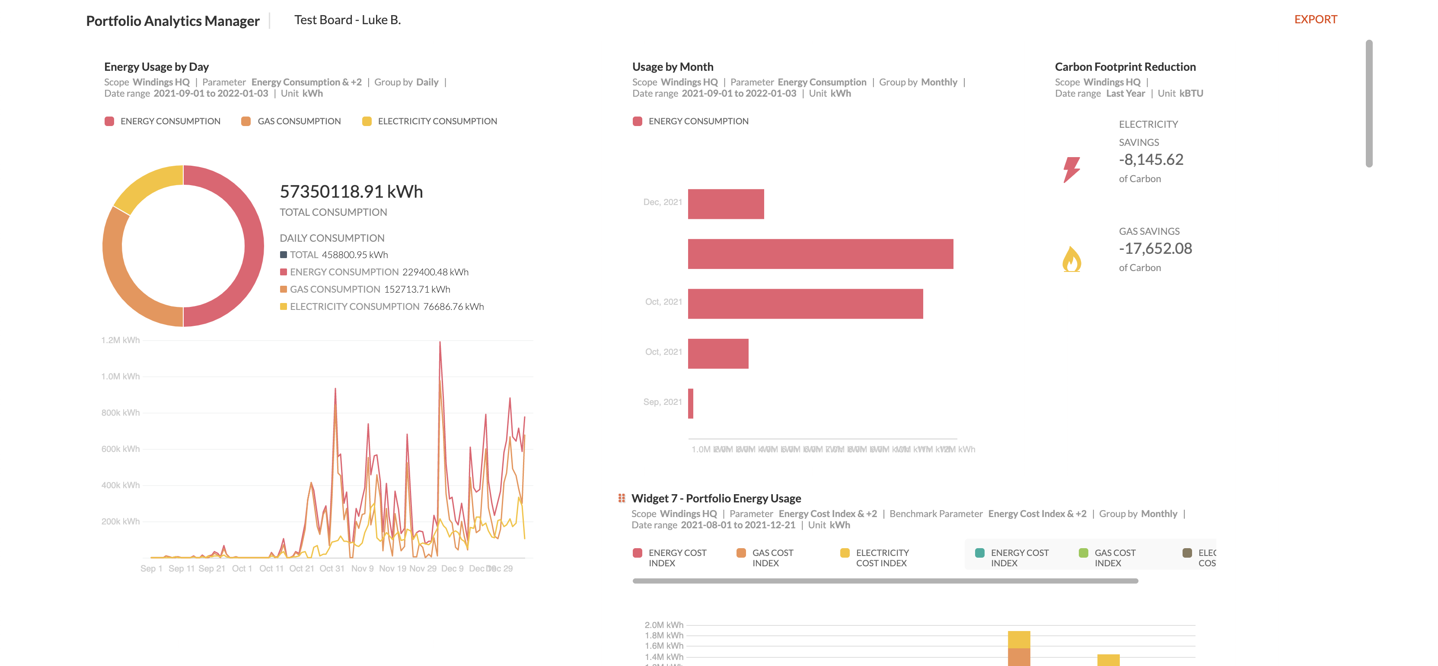
3
What do People Want From Their Data?
Insights:
www.75F.io
Reporting
Metrics
Analytics
2025
Notes:
Then you need some system that can pro normalize across a large amount of your portfolio
Haystack has done a phenomenal job of helping define the, the helping define the tagging and the ontology that makes this happen

Slide 4
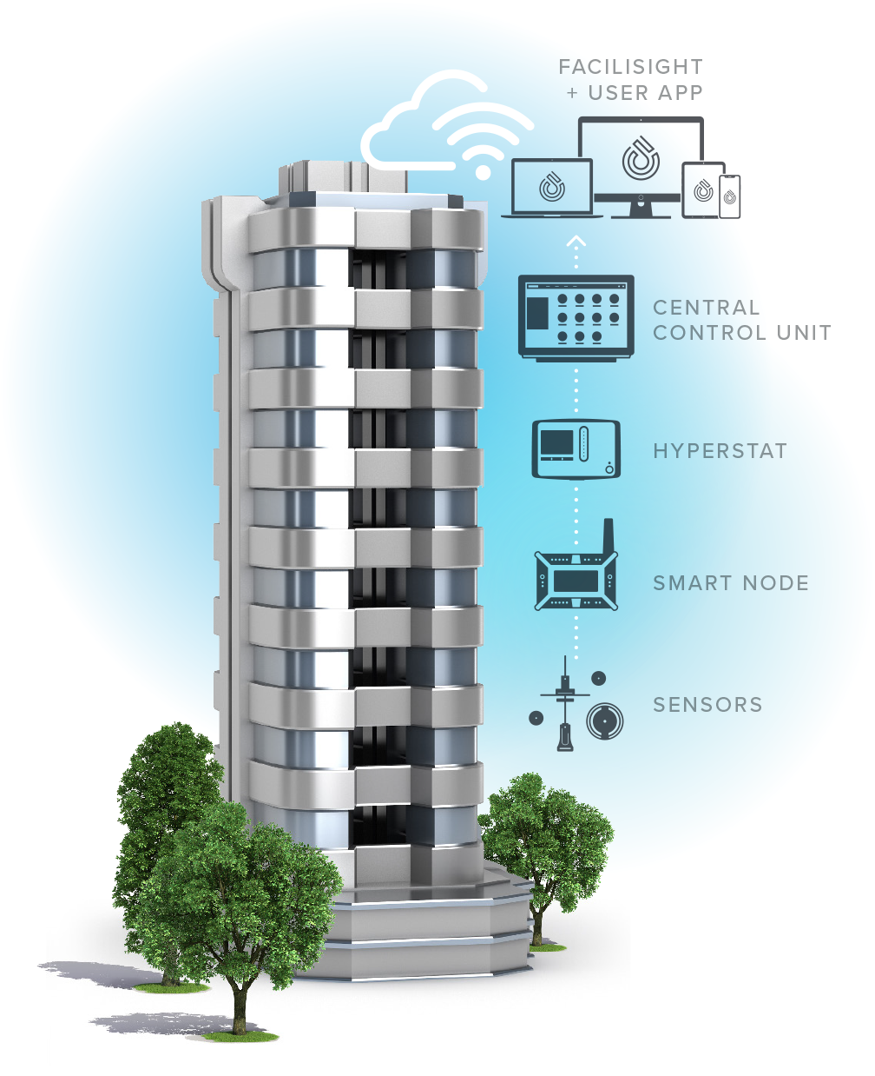
4
Data in the System
Haystack
Tagged Data
www.75F.io
2025
Notes:
The CCU sends minute by minute data in regards to the temperatures in different parts of the building to servers in the cloud. Every night, these servers run proprietary algorithms to crunch the historical data and create a thermal model of the building. They then predict thermal loads in each part of the building for the next day based on the forecast weather.
The optimal control strategy is then sent back to the CCU who then proactively commands the smart dampers to the required positions and turns on the HVAC equipment during the day.

Slide 5
5
As we keep evolving building models…
No Unified Repository
No Keeping Track
No Universal Experts
www.75F.io
Custom models live in multiple places, unknown to others.
Until now, there’s been no easy way to keep track of evolving models.
Not every organization has Project Haystack experts on hand.
2025
Notes:
We keep evolving our models, these buildings, there is no. Then you can get into the other trouble issues, right? There is no unified repository of all of the equipment. And as these equipment, our ontology keeps evolving, there's no way of keeping track of how the model has evolved, right? What we sought to do was both create what we want to do is.

Slide 6
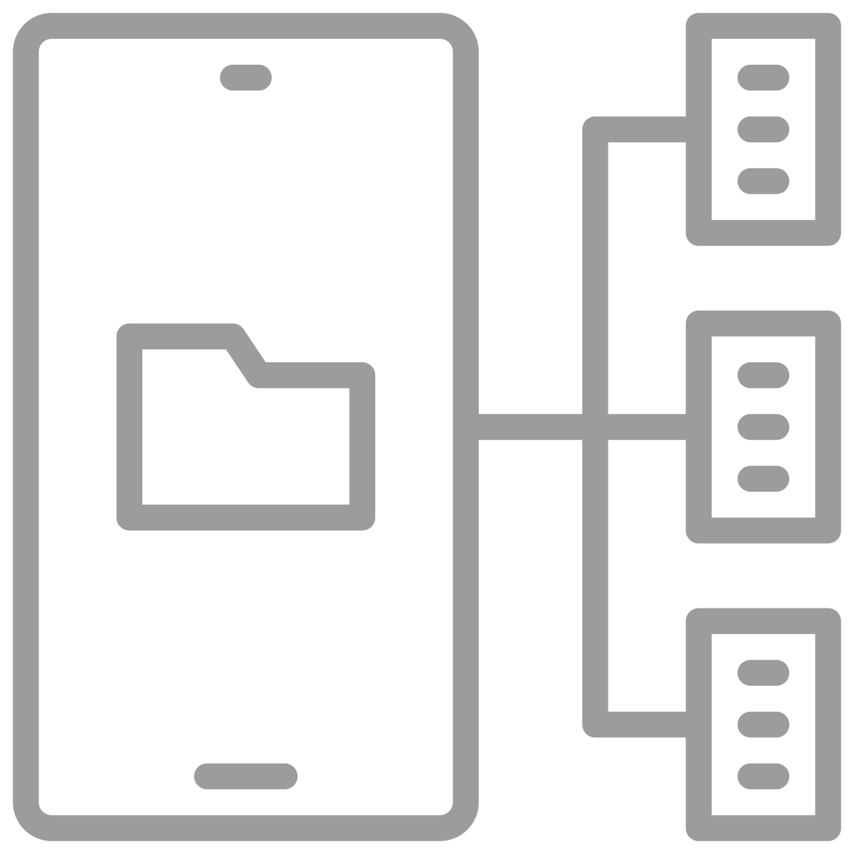
6
Metadata is part of a larger landscape
Leveraging & managing data for strategic advantage
Business Intelligence
Data Architecture
Coordinating & integrating disparate data sources
Data Integration
Metadata Management
“Bottom-Up” management & inventory of data sources
Unstructured Data
Semi-Structured Data
Content Management
Big Data
www.75F.io
2023
Notes:
https://www.youtube.com/watch?v=jyva44uHoR4
Speak about Data Diversity

Slide 7
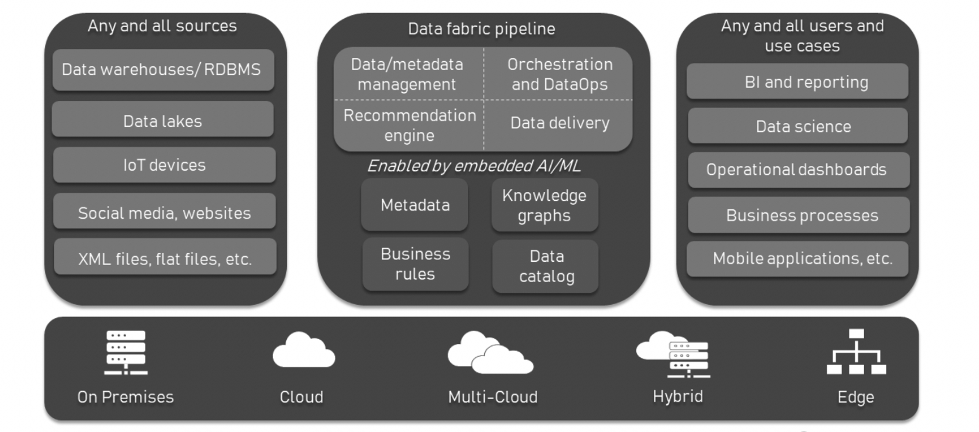
7
Data Fabric
www.75F.io
2025
Notes:
Metadata and ML
Machine learning models ingest large amounts of building data and learn thermal/performance trends to make intelligent decisions
In order to leverage reusable, generalizable machine learning models, this training data must be structured and consistent across our data sources
When supporting heterogeneous sites with various configurations and arbitrary topologies, it may not be scalable/feasible to customize ML models per site
Therefore, having the ability to either 1) enforce or 2) validate the compliance of these datasets with respect to a specification/template is critical
A data fabric is an architecture design presented as an integration and orchestration layer built on top of multiple, disjointed data sources like relational databases, data warehouses, data lakes, data marts, IoT, legacy systems, etc., to provide a unified view of all enterprise data.
In layman’s terms, a data fabric says that you don’t need to centralize data, but put things in order where this data resides. So, instead of replacing or rebuilding the existing infrastructure, you add a new, ML-powered abstraction layer on top of the underlying data sources, enabling various users to access and manage the information they need without duplication.
Data fabric vs data mesh vs data virtualization vs data lake
Here we’ll shed some light on the concepts of data mesh and data virtualization that, at first glance, may be mistaken for a data fabric and vice versa.
Data fabric vs data mesh
All in all data mesh is more about organizational and cultural principles for creating a distributed domain-focused architecture that treats data as a product. A data fabric, on the other hand, is more about technology that can help build an integration layer with access to all company data.
Besides, the data fabric approach leaves the organization with a centralized team that is responsible for all the data, while data mesh implies distributed ownership of the data — each team has its own data products and they are responsible for its distribution to other teams. You can learn more about the data mesh in our dedicated article.
Data fabric vs data virtualization
Here things get a bit more complex since data virtualization is one of the fundamental parts of the data fabric architecture. So, these concepts are neither competitors nor interchangeable terms.
The idea behind data virtualization is that data isn’t physically moved from various on-premises and cloud sources using the standard ETL (extract, transform, load) processes. Instead, there’s a virtual (logical) layer that connects to all the sources and creates a single representation of data no matter its location and initial format. As a result, end users can consume the information aggregated from numerous systems in the form of reports, dashboards, and other convenient views.
A data fabric uses a data virtualization approach but takes it to a whole new level by adding to it ML-enabled data catalogs, knowledge graphs, and recommendation systems.
Data fabric vs data lake
In the data fabric vs data lake dilemma, the distinction is simple. Data lakes are central repositories that can ingest and store massive amounts of both structured and unstructured data, typically for future analysis, big data processing, and machine learning. A data fabric, conversely, doesn’t store data. It is a metadata integration layer that can be built on top of a data lake or an architectural ensemble that includes it.
The issue with data lakes is it may be difficult to find a certain piece of information there. The more data is placed there, the greater the chance that a data lake will become a data swamp.
A data fabric allows for dealing with the technological complexities engaged in data movement, transformation, and integration, creating a unified view of all data across the enterprise. It also helps deploy and scale new apps and services while maintaining security concerns.

Slide 8
8
That’s Why we Created Hayloft.
Create
Standardize
Recycle
www.75F.io
Author definitions with peer review from Hayloft moderators.
Donate your definitions to the Hayloft repository to document the model.
Use definitions already made by your peers to expedite integrations.
2025
Notes:
Hayloft makes available the work of Haystack, to build on the fine work that Haystack has done and create higher level models so that you don’t have to be a Haystack expert to leverage.
All you have to do is be a standard system integrator and you can leverage these pre-created models that are always kept up to date.

Slide 9
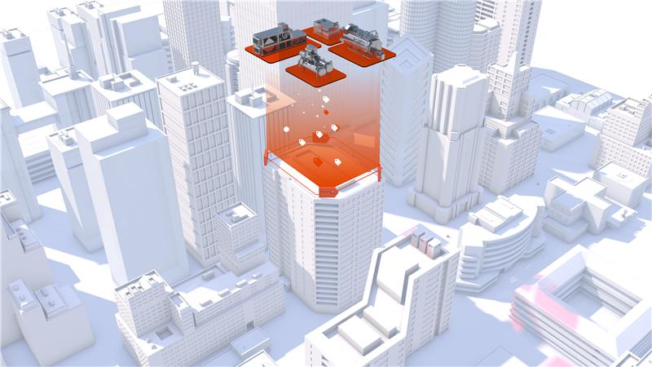
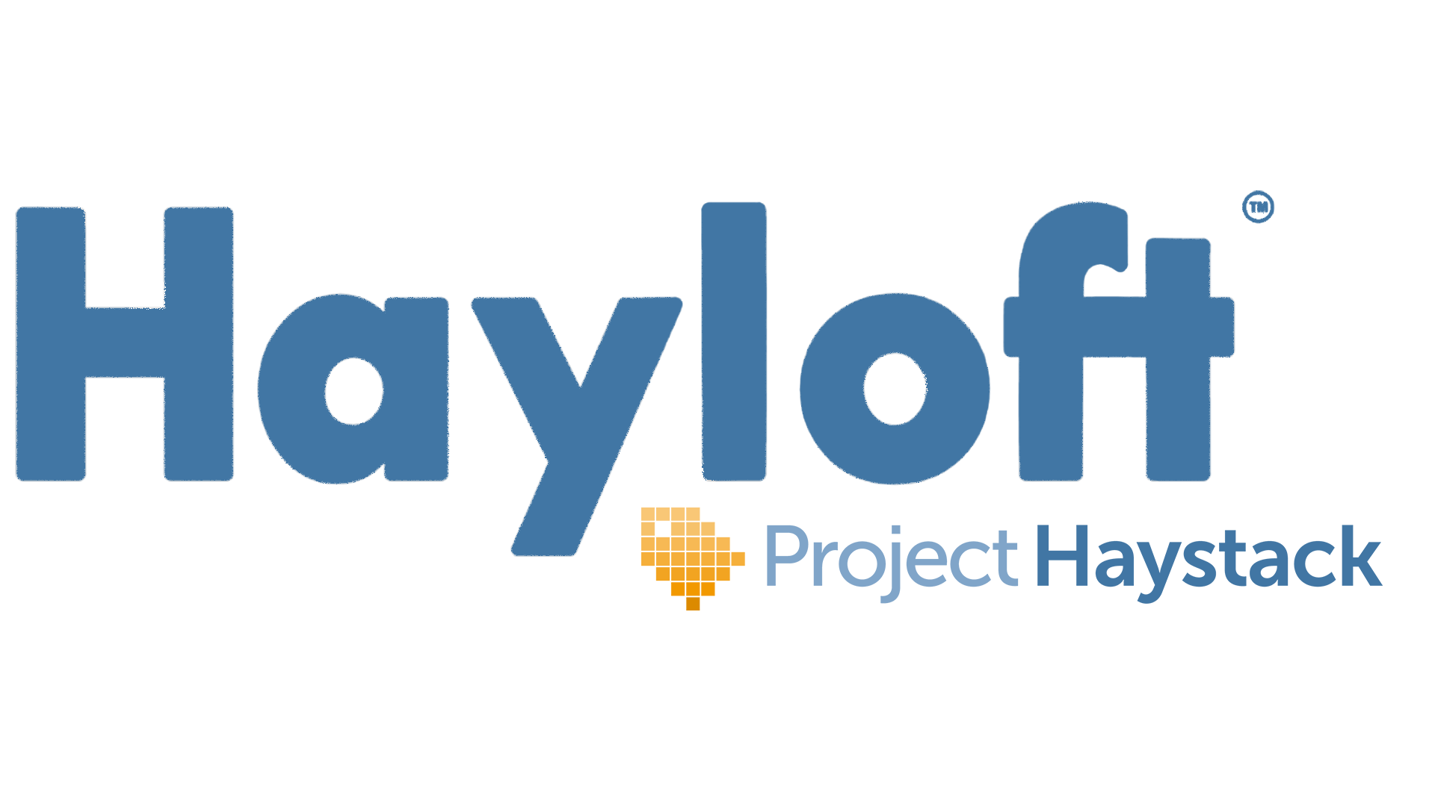
www.75F.io
www.hayloft.info | app.hayloft.info
2025

Slide 10
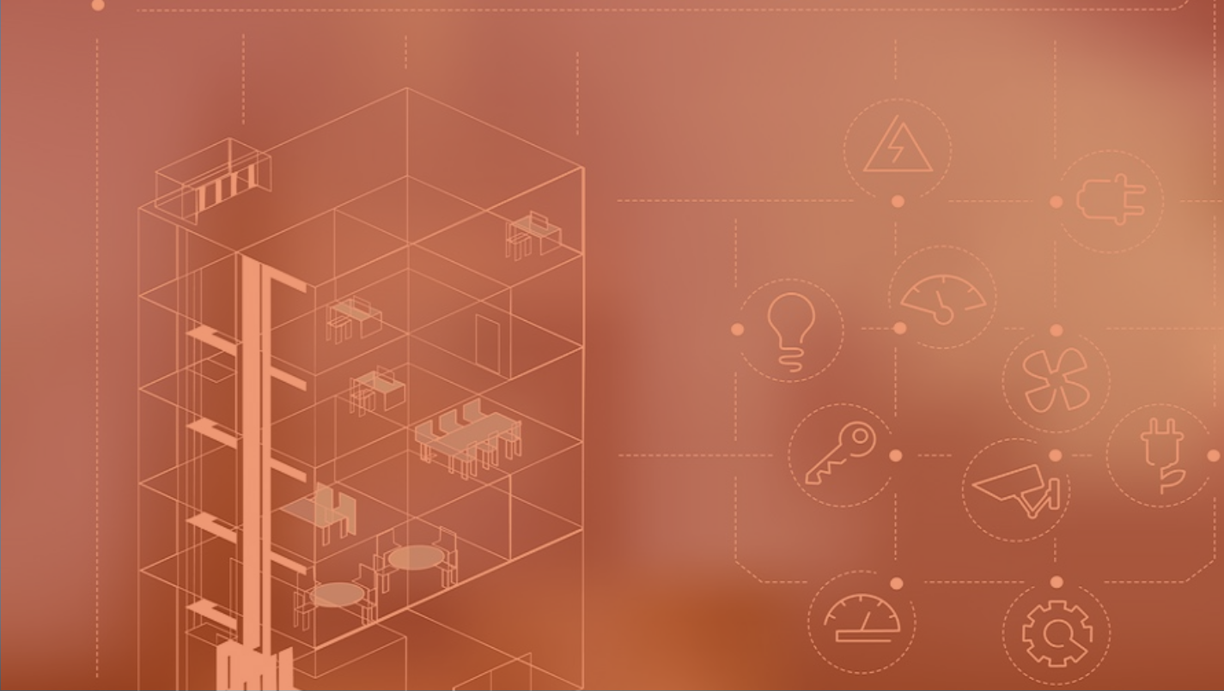
10
Who can use Site Manager and Hayloft?
SI/ MSIs
OEMs
Controls Contractors
Energy Analytics Companies
Developers
Optimization Overlays
www.75F.io
2025

Slide 11
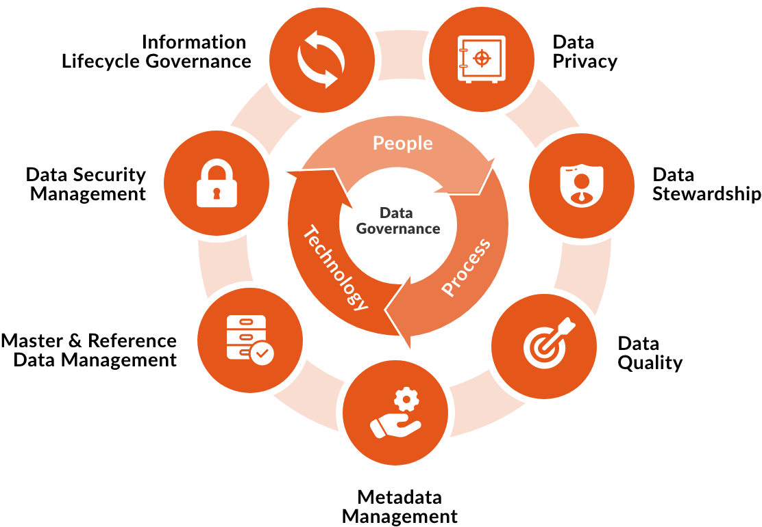
11
Normalized Data Utilization
Data Version
Management
Data Sharing
Data Consistency, Quality and Integrity
Data Stewardship
Integration
Management
Data Orchestration
www.75F.io
Metadata Management
2025
Notes:
https://www.computer.org/publications/tech-news/trends/the-importance-of-data-lifecycle-management
Best practices for data management
Data management is the process by which businesses allocate resources to identify the methods that will guarantee only the correct data is being captured, stored, used, and managed across the enterprise.
These are some of the best practices for data lifecycle management.
Shared data management
Under this model, business and IT stakeholders agree on a standard data model. This ensures that the correct data is captured at the right time across the company, which helps to improve performance and add to revenue.
Develop a centralized repository for data lifecycle management
This will enable businesses to develop a centralized data management information repository, which contains all the required data and processes, and allows data to be imported easily.
Data stewardship
This requires the role of data stewards in the business to control the data and oversee the ongoing processes. This will ensure that the correct data is collected, managed, analyzed, and used in the right way and ensure that the information is never misused.
Data training
For IT professionals to become more data-aware, they must embrace the right culture and ways of working. IT professionals need to consider their data as a critical asset and enable this to work to their benefit. This will help improve their ability to analyze data and determine which areas of their systems require the most attention.
Data aggregation
This allows the business to gain a more holistic view of the business’s data and, therefore, make more informed decisions.
Data standardization
This allows IT professionals to ensure that they’re using the correct data types for the proper purposes. Data standardization helps drive efficiency and agility within the business and help them make more informed decisions.
Robust data governance
This ensures that all data is secured and organized. It will also help to ensure that systems and processes are in place to help protect this data and help them to comply with regulations, such as GDPR.

Slide 12
12
AI-Based Fault Detection & Diagnostics
WHY
Reduce downtime and maintenance costs
Improve energy efficiency and occupant comfort
Enable facility managers to make smarter data-driven decisions about their buildings
WHAT
Continuous monitoring
Aggregate time-series + alerts + audit logs
Scheduled evaluation and incident generation every N minutes for every building
Extensible knowledge-base
Reliable, deterministic rule-based diagnostics
Automated RCA and impact analysis
Provide root-cause analysis of signals detected across multiple levels
Fault localization
Retroactive analytics
Has this issue occurred before?
AI chat integration
Enables facility managers to interact via a unified natural language interface
www.75F.io
2025

Slide 13
13
Temperature Modes in HyperStat & HyperStat Split
Why?
With the existing temperature mode which is the Dual Temperature Variable Deadband, the users need to adjust both the desired setpoints (cooling & Heating). This is sometimes very confusing for the end user.
What?
For users who want a fixed temperature difference, Dual Temperature Fixed Deadband makes it very effortless to set the Cooling and Heating desired temperatures seamlessly.
www.75F.io
2025

Slide 14
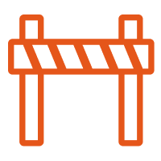
14
Easy Street – The Challenges Contractors Face
Operational Inefficiency
Time-consuming subcontractor coordination and delays from manual punch lists and incomplete documentation.
Workforce Limitation
Increased labor and operational costs due to heavy reliance on specialized commissioning skills.
Technological Barriers
Complex programming, network configurations, and reliance on multiple external tools complicate installations and checkout.
www.75F.io
2025

Slide 15
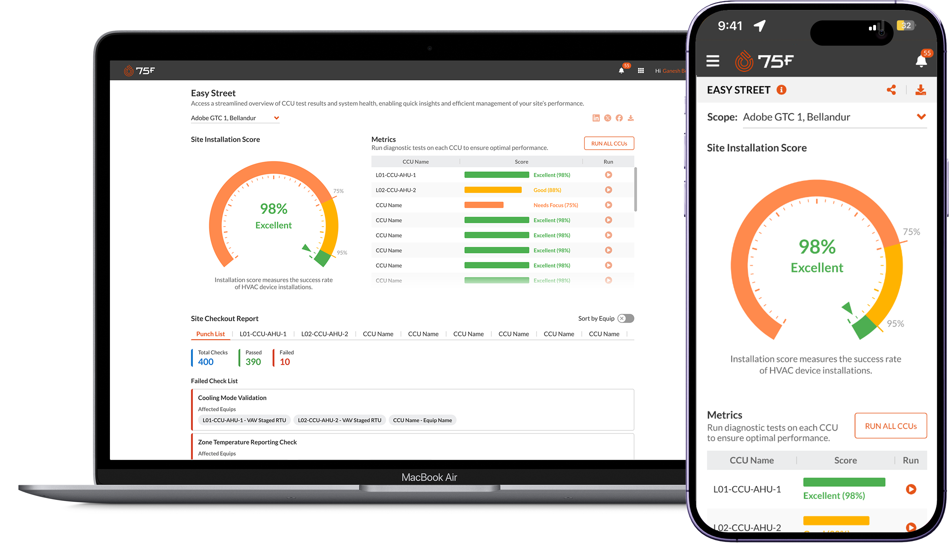
15
Introducing Easy Street
Faster and Simplified Installations:
Out-of-the-box seamless setup to check logic points and installation verification.
AI-powered Punchlist & Reports:
Detailed summary and actionable checks
Metrics:
Runs installation test and provide installation success rate
Social Media Engagement:
Recognition for Contractors, Achievement Badge & Community Building
www.75F.io
2025

Slide 16
16
Easy Street – The Business Impact
Efficiency Gains:
Reduced manual effort for site installation checks
Faster and more accurate testing
Comprehensive tracking and reporting
Historical Report Access
User Benefits:
Improved installation success rates
Enhanced operational efficiency
Recognition through badge sharing
www.75F.io
2025

Slide 17
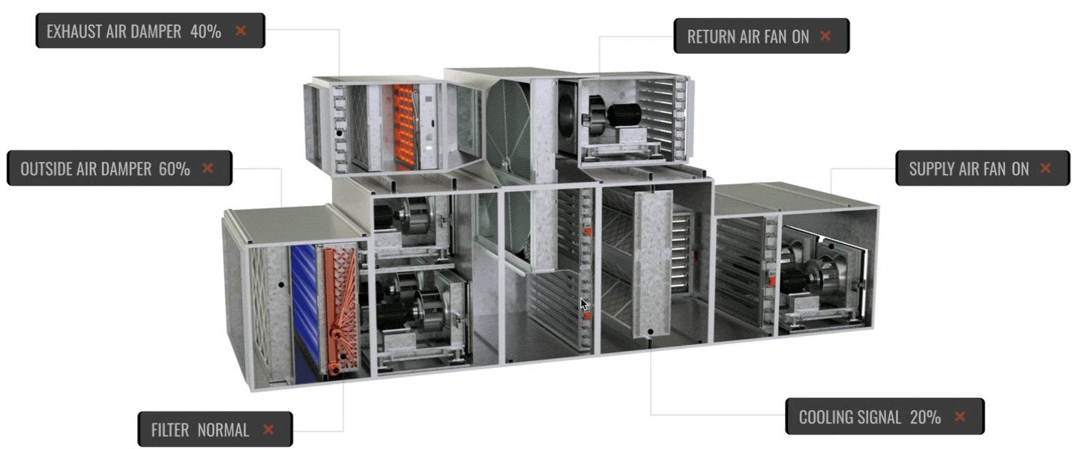
17
Common Framework – Equip Graphics
Custom Equip Graphics offers intuitive visual representations for all types of System and Zone profiles, making complex data easier to understand. With interactive controls, users can directly adjust point parameters in real-time.
The common framework ensures unmatched flexibility, allowing seamless customization to meet site-specific configuration needs, creating a more dynamic and user-centric experience
www.75F.io
2025

Slide 18
18
Common Framework – Equip Graphics
Common Framework Capability
1
Equip Graphics
2
Supports 75F Native + External Equip
Bulk Push to Multiple System or Zones
3
www.75F.io
Animation Support
4
2025
Notes:
Equip Graphics will provide user out of the box predefined 3d graphics for 75F System profiles which will allow users to visualize digital twin of the physical equipment located on-site along with key point parameters for monitoring
Now here out of the box is the word, what does that mean for our support user or partners or system integrator that they don’t have to spend time to build graphics from scratch
As soon as the user configures the System Profile on CCU, graphics pertaining to the selected profile will be available on the portals

Slide 19
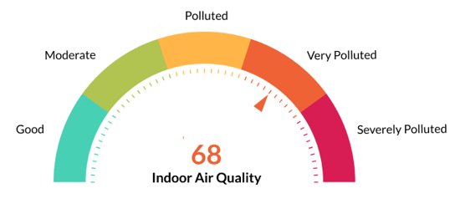
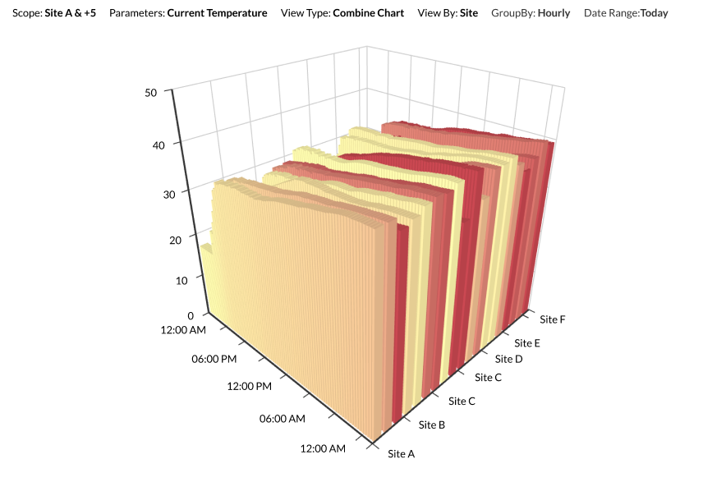
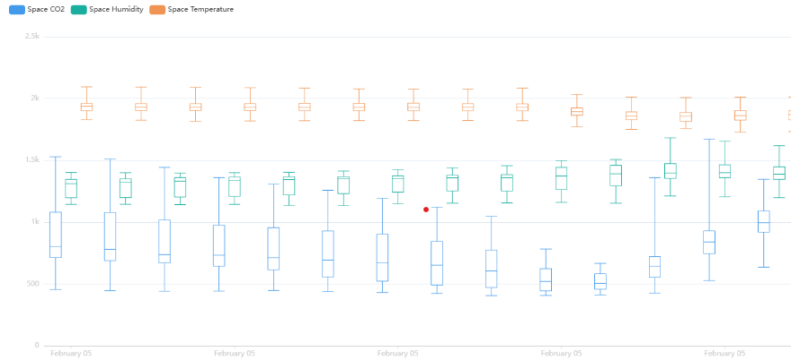
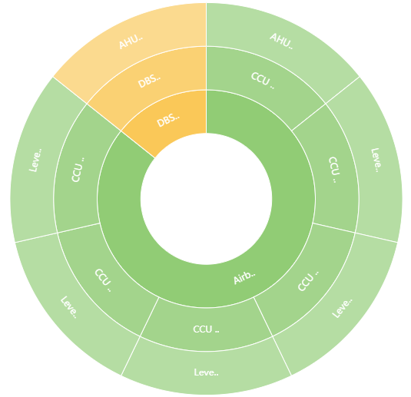
19
Dashboards – Enhancements
Latest dashboard update introduces support for advanced chart types such as
Gauge
Sunburst
Boxplot
Terrain
These new options allow for more versatile data visualization, facilitating use cases like visualizing comfort and energy metrics, displaying hierarchical data with radial layouts, analysing data distribution, and rendering detailed 3D terrain views.
www.75F.io
2025

