Slide 1
A Scalable Approach for Enhancing Demand Flexibility with Open Building Controls
Haystack in Practice
Lazlo Paul
Lawrence Berkeley National Laboratory
Notes:
Hi Everybody, Im Lazlo Paul from LBNL, here to talk about a scalable approach to enhance demand flexibility with Open Building Controls

Slide 2
Demand Flexibility and Energy Efficiency Opportunities
Energy Efficiency
Buildings can waste ~30% of energy due to faulty or poorly optimized controls
MCx/FDD can save 9%, improved control sequences can save more
Demand Flexibility
Buildings can reduce their peak load by 20%
Reduces electricity bills, supports the grid, provides additional opportunity for compensation
Notes:
People are probably already familiar with the opportunities for improving how buildings are controlled.
Building controls routinely can fall out of tune and waste a significant amount of energy. This may be due to faults in the controls like held setpoint overrides, poorly chose setpoints, or incorrect control parameters. It could also include missed opportunities for more efficient control sequences.
In observational studies we’ve found that commissioning and FDD can save 9% of that energy, improving the control sequences can save more.
There are other potential opportunities for controls beyond energy efficiency, including demand flexibility. With dynamic electricity rates, like we’re anticipating in California or demand flexibility programs, buildings can reduce their bills or be otherwise compensated by supporting the grid

Slide 3
Deployment of Controls
Today’s control design, implementation, and commissioning process is manual, labor-intensive, ambiguous and error-prone. It was not designed for high-performance HVAC systems.
Designer
Producing sequence specs is tedious & error-prone.
No tools to judge whether sequence works.
Controls Contractor
Interpreting verbose sequences is tedious & error-prone.
Tight schedule & budget.
Cx agent & operator
Verification is slow & limited.
Poorly documented.
Notes:
If well tuned control sequences are so valuable, then why doesn’t every building have them?
Today’s process of designing, implementing, and commissioning controls isn’t easy. Both for new buildings and retrocommissioning projects.
Controls are designed with limited tooling to determine if these controls will actually be effective on the buildings they’re implemented in.
And these controls may not even be implemented as designed. These control specifications can often leave a lot to interpretation, and the process of programming the controls can be tedious and error prone, especially due to tight timelines and budgets for controls contractors. Ultimately the control sequences produced may not perform as expected.
So the performance of these controls needs to be verified. This requires time to test and monitor the controls, and it requires extensive knowledge of the possible mistakes that could have been made when implementing the controls. If controls get more comprehensive or complicated, this process becomes significantly harder

Slide 4
EMIS Can Simplify the Deployment of Controls
Notes:
because of these challenges, we’ve been exploring other methods to improve controls.
Primarily, we’ve been exploring methods using energy management information systems, which have a lot of capabilities and can address these challenges cost effectively.
For existing buildings, traditional methods of fixing controls faults require many steps.
The first step is detecting the issue, and figuring out what it is. Hopefully in this step, you can determine if its an issue that can be addressed by improving controls.
Then people have to diagnose the fault and submit it to a work order system, which will get somebody else out to reprogram the building automation system.
Finally you have to monitor and find if the fault actually was addressed.
For many types of controls faults, this process could be automated. The fault can be detected by a person or software, and the mechanism for correcting the fault and improving the controls can be applied.
This requires integration of the building automation system and the EMIS. The integration is made wildly easier by using haystack. The ability to represent all of the buildings data points and capabilities is especially important because the EMIS is working bidirectionally, writing back to the building not just using collected data.

Slide 5
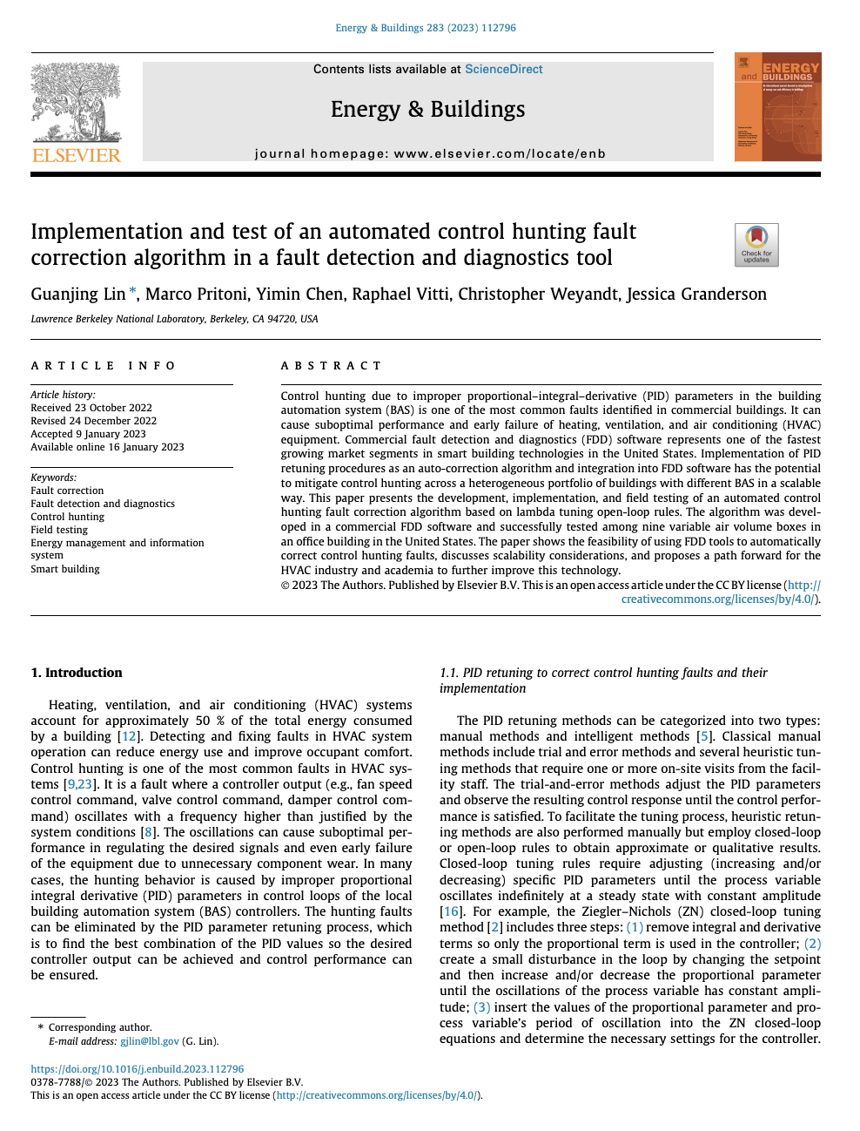
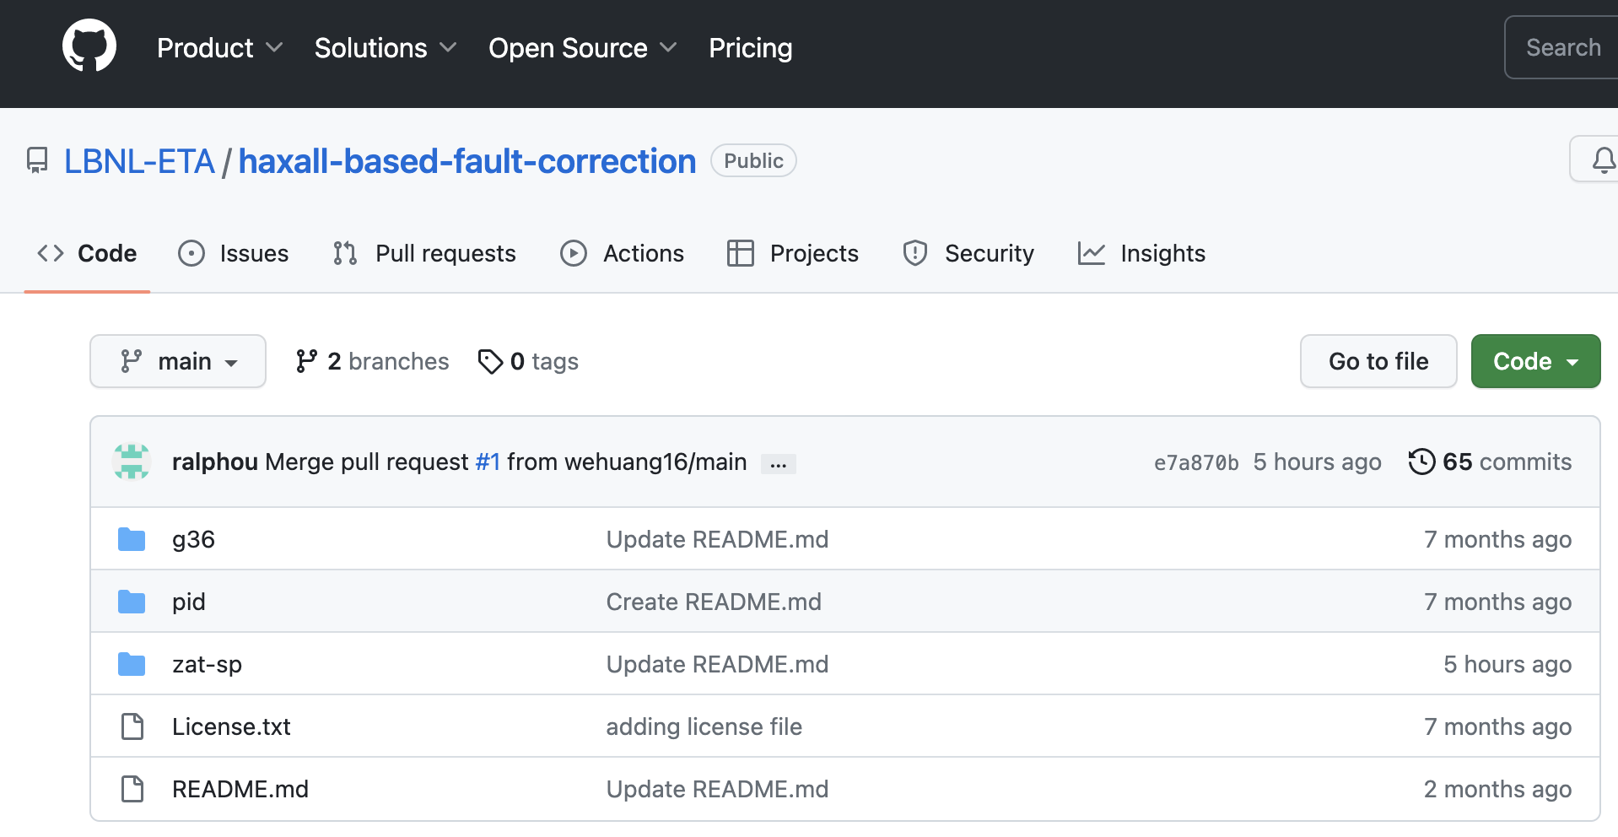
So Far - Open Specifications and Partners
DOE and Lab develop open specification and reference code (for SkySpark users)
Lab transfers to partners to instantiate in products, who refine as needed, keep their IP
Partners share field test data, lab documents efficacy
Notes:
So far how we’ve explored this is through open specifications developed by the lab, and partnership with leaders in the industry.
In addition to developing open specifications, we’ve developed reference Axon code, that can used by folks building on skyspark.
The lab develops and may pilot these specifications, then we transfer the specifications to partners who can freely build upon them, keeping their IP.
Partners share the results of their field tests, and we do some measurement and verification and document how effective the sequences are.

Slide 6
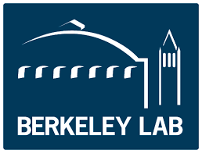
So Far - Open Specifications and Partners
Inaugural partners ‘go first’, generate field results
DOE and Lab develop open specification and reference code (for SkySpark users)
Lab transfers to partners to instantiate in products, who refine as needed, keep their IP
Partners share field test data, lab documents efficacy
Notes:
We have some partners that go first, implementing sequences, collecting data and lessons learned

Slide 7
So Far - Open Specifications and Partners
Inaugural partners ‘go first’, generate field results
With field results, open specs and open code, additional partners may join
DOE and Lab develop open specification and reference code (for SkySpark users)
Lab transfers to partners to instantiate in products, who refine as needed, keep their IP
Partners share field test data, lab documents efficacy
+ Others in progress
Notes:
With the field results we publish case studies, and make the open specifications and code available to additional partners that may also implement the open specs or become pilot partners for new sequences we develop.

Slide 8
EMIS-based strategies maximize the value of existing automation systems
Correct setpoints: zone temp., economizer high-limit lockout, equip. schedules, override release
Automate active tests: PID loop tuning, functional testing
Implement best-practice supervisory control: AHU reset w rogue zone suppression, demand flex.
Notes:
We’ve developed a range of sequence specifications already that are focused on improving the operation of existing automation systems.
We have some simple fault correction sequences that make one time changes to correct setpoints or control system parameters,we have automated active testing procedures to improve PID loops, and some continuous supervisory control sequences. So far including some air side guideline 36 trim and respond sequences and demand flexibility, load shifting sequences.

Slide 9
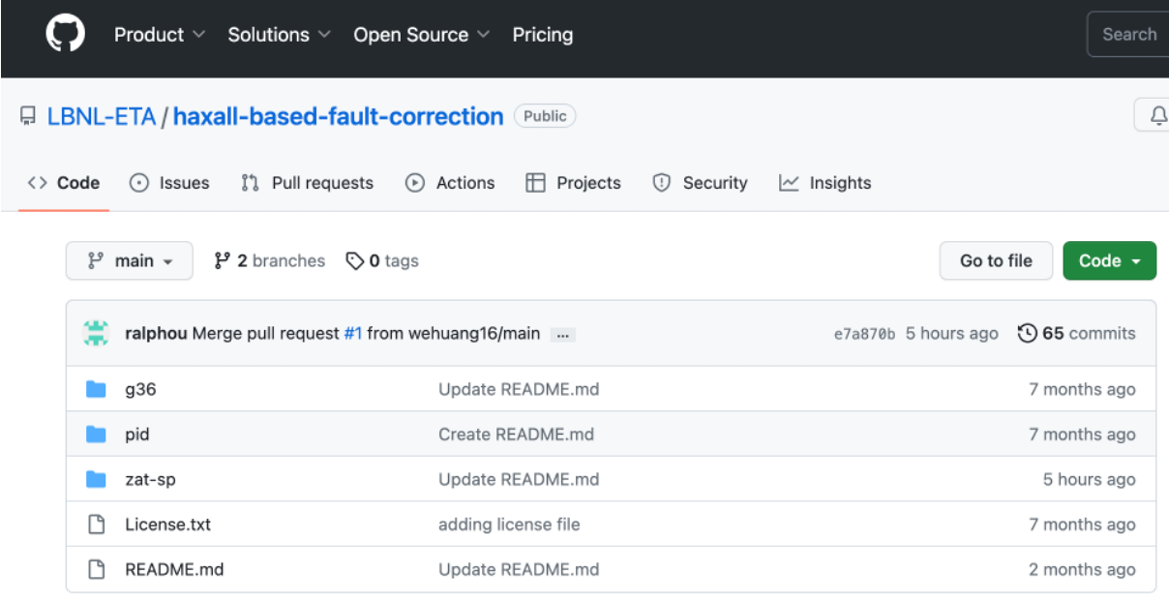
We are also populating a repo of open-source Haxall/Axon code
Currently available:
Rogue zone ID
Guideline 36 SAT and SP reset with rogue zone suppression
Zone temperature setpoint correction
PID loop tuning
Incorrect schedule detection and correction
Next up:
Demand response
And other strategies
https://github.com/LBNL-ETA/haxall-based-fault-correction
Notes:
Currently, we’re in the process of populating a github repo with the sequences we’ve specified that can be used with skyspark and haxall. We have more coming in the pipeline

Slide 10
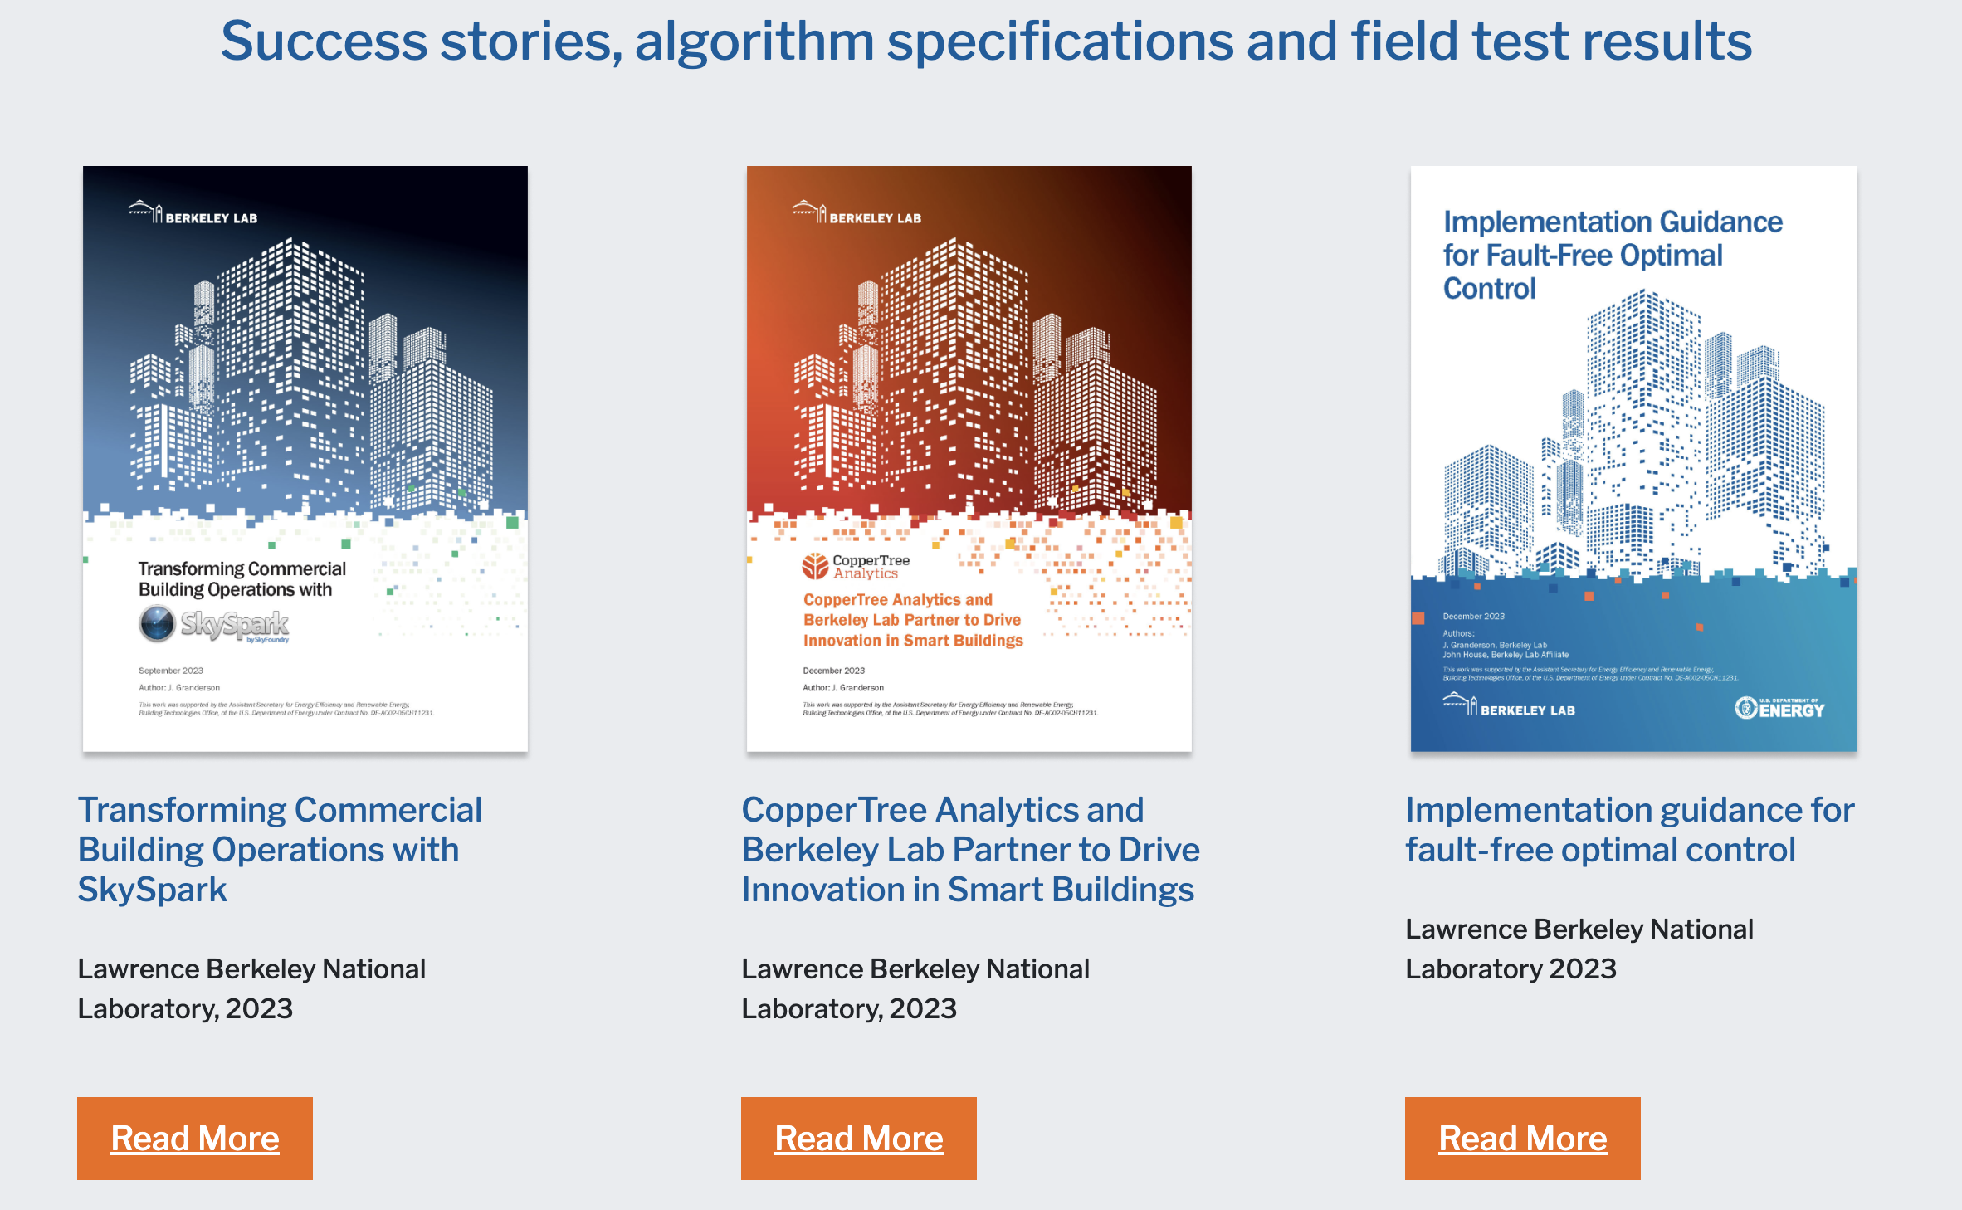
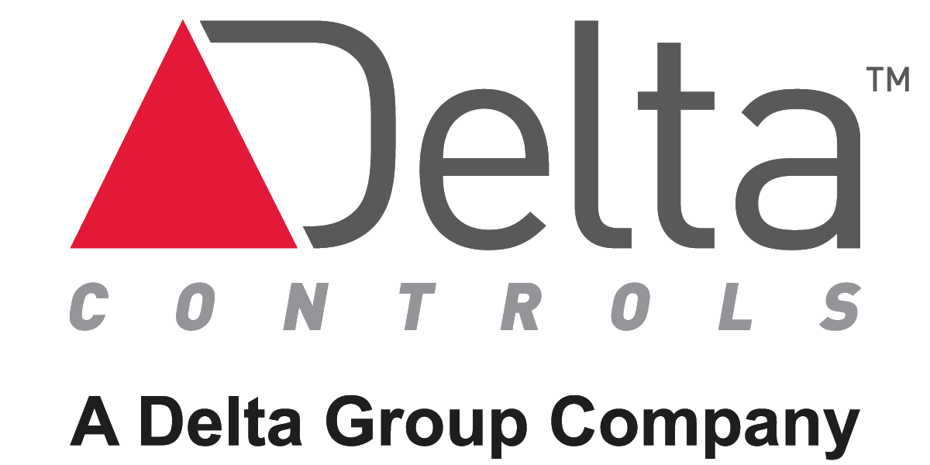
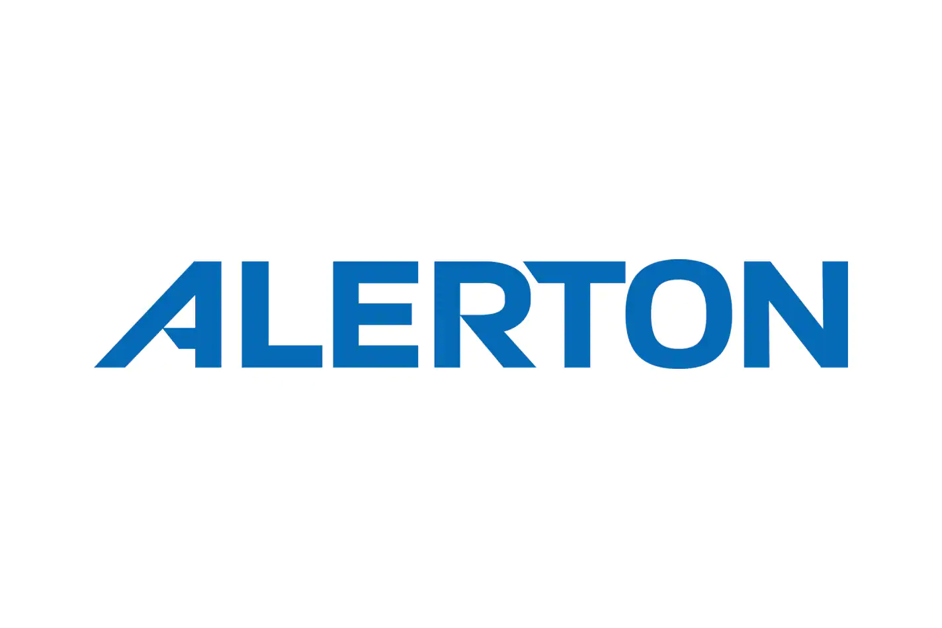
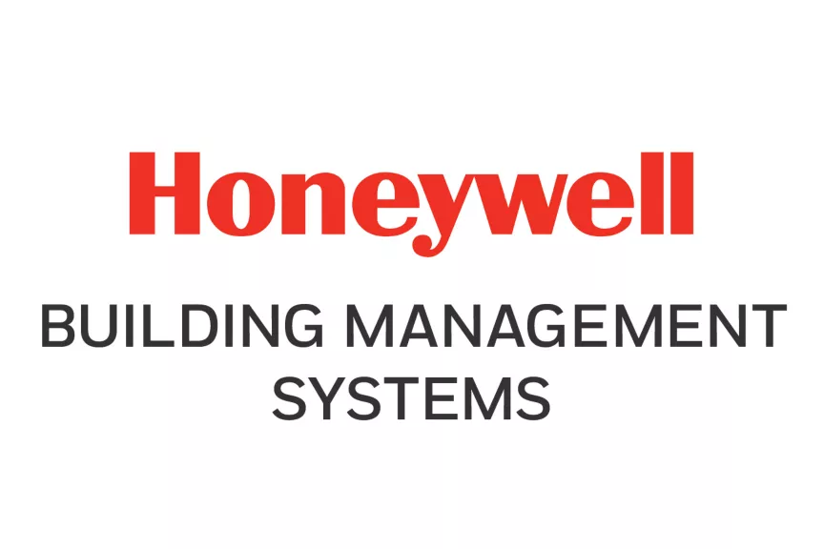
Demonstrations so far, Resources for owners and providers
Diverse set of building automation systems
Success stories, field test publications, owner-facing implementation guide, open specifications, reference code is available
If you are interested in learning more and exploring these enhanced capabilities, contact us: JGranderson@lbl.gov
Website: https://transformingbuildingcontrols.lbl.gov
49
Buildings
Notes:
So far we’ve demonstrated these sequences on 49 buildings and many of the major building automation systems. We’ve published quite a few success stories and lessons learned from field implementation. If you’re interested in learning more and maybe using or contributing to any of these open specifications, please reach out.

Slide 11
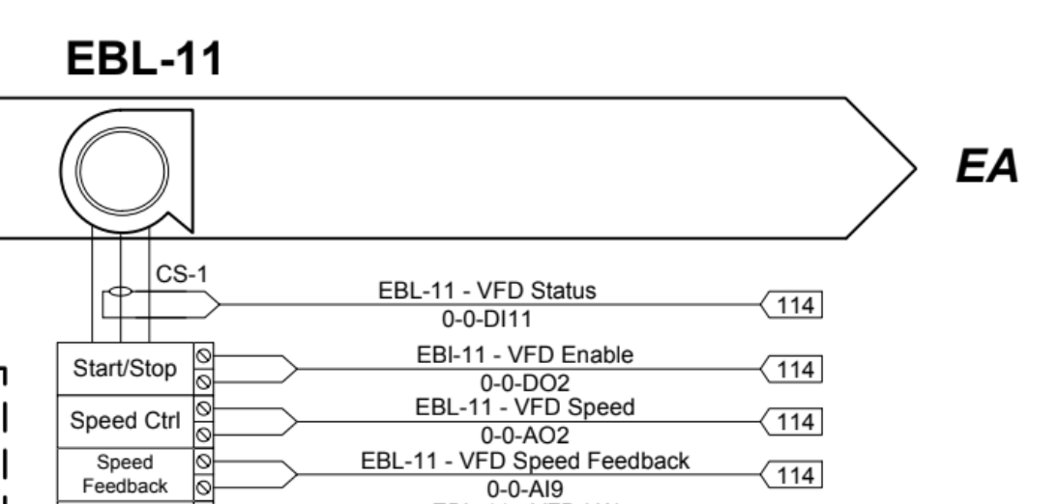
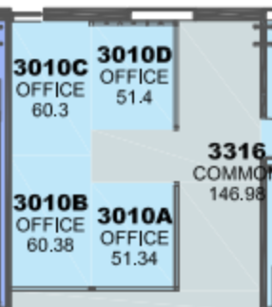
Opportunities Provided by Semantic Models
Major barrier for implementation - data access
?
As-Built/Mechanical Diagrams
?
Semantic Models
?
Floor Plans
BAS Graphics Point Names
Notes:
In our previous work implementing fault correction and supervisory controls sequences, one barrier has always been obvious. The major barrier to implementation is data access. BACnet networks can be a mess, BAS point names are definitely a mess, and the necessary information for implementing software and control sequences can be out of date and spread between a bunch of different resources. This makes implementation take too long.
Semantic models digitize the data necessary for implementing software, and bring this data together into a single easily accessible resource. Haystack can provide detail and context that can help connect the control sequences to the data in the buildings. With new capabilities provided by Xeto, there’s increasing opportunity for automation in the deployment of controls and for us to develop more comprehensive higher performance control sequences. These capabilities allow us to automate much of the deployment of these sequences and achieve deeper cost savings.

Slide 12
Improving Controls Deployment
We have demonstrated deployment using open specifications
-> Can we skip manual steps in coding and implementation?
We have implemented FDD, ACx, trim and respond, then validated in the field
-> Can we provide more and validate in simulation pre-deployment?
We have deployed through multiple different EMIS platforms using specifications
-> Can we deploy BAS and EMIS using same approach?
Notes:
So, to summarize
In our previous work, we’ve demonstrated deployment using open specifications. However, most of our partners still need to interpret and implement these sequences, which can kind of bottlenecks how much we can do.
Can we skip manual interpretation and implementation, and provide sequences that our partners can pull from a library and directly use?
We’ve implemented some fault detection, automated commissioning, and trim and respond sequences. We’ve done pilot testing and validation in field tests.
Can we develop a more comprehensive library of sequences that we fully validate in simulation prior to deployment? Will this enable us to produce better control sequences and handle the complexity of their development more easily?
We’ve been really focused on using EMIS platforms to implement these capabilities. However, we want to expand opportunities to adoption. Can we create a pathways to implementation that will work for both EMIS and BAS for our upcoming work on energy efficient and demand flexible sequences.

Slide 13
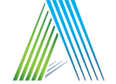
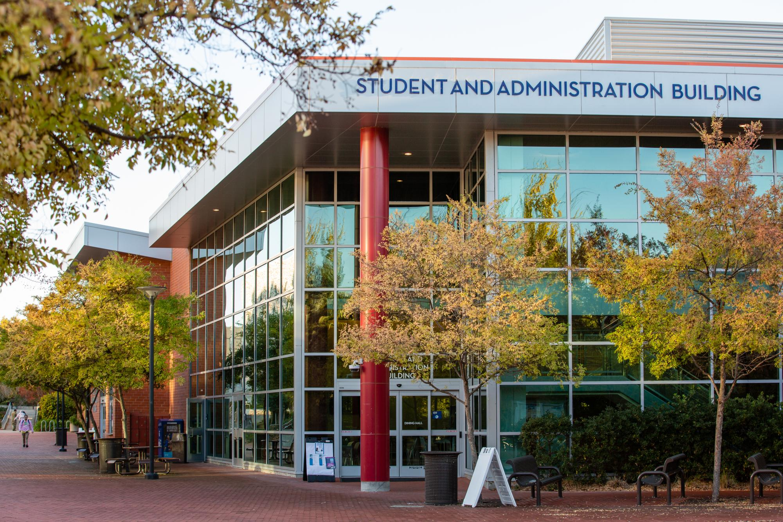
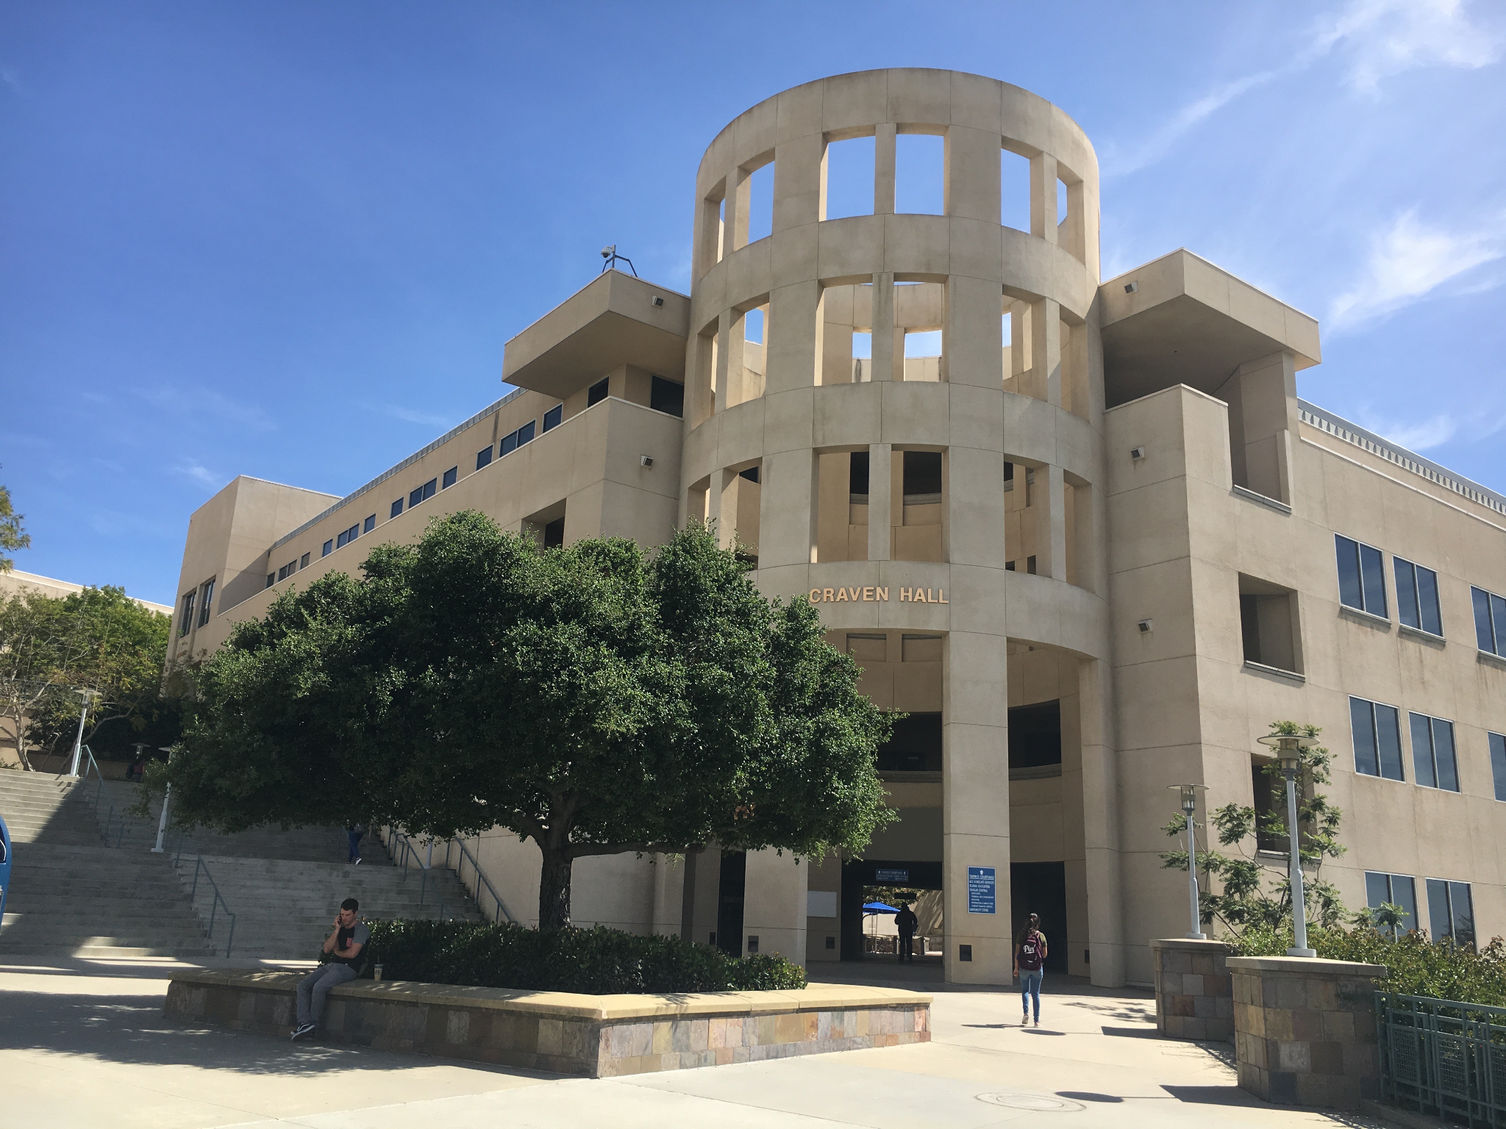
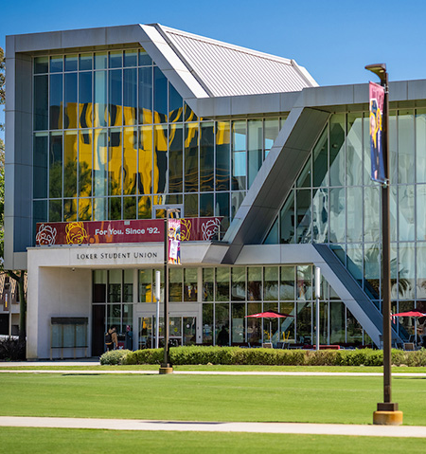
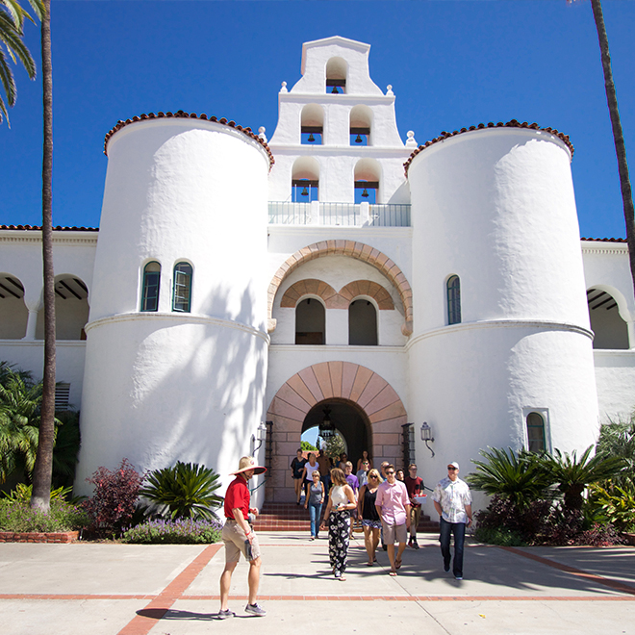
Our Approach in OBC-Flex
Collaboration with ASHRAE for inclusion in guideline 36
Best-in-class DF Specifications and Library using 223P and 231P
Integration with Vendors’ Platforms
Field Deployment and Testing
in 4-9 Real Buildings
Community Engagement
Technology/Knowledge Transfer Activities
BAS Pathway
EMIS Pathway
Carrier/ALC/Taylor
Tridium/Altura
Skyfoundry/Altura
Facil.ai
Noda
Contra Costa Community College District
California State University,
San Marcos
California State University, Dominguez Hill
San Diego State University
1-3 buildings
1-3 buildings
1 building
1 building 1 central plant
Notes:
This brings us to our new project, OBC-Flex.
In this project we will be defining a library of best in class demand flexibility specifications, that will join a library of guideline 36 sequences. These are implemented using Control Description Language, or CDL, which is codified in the upcoming ASHRAE standard 231P. These sequences will be created with integrated semantic models to enable automation in their configuration and deployment.
These sequences will be ingested by vendor platforms and deployed in several university campuses in California, totalling between 4 and 9 buildings. We will explore deployment through both BAS and EMIS, with help of many vendor partners including Altura, Tridium, SkyFoundry, ALC, Taylor, WebControl, Facil.Ai, and Noda.
We also have planned activities for community engagement to scale further across california campuses and beyond.
We also plan to include the newly developed demand flexibility sequences ashrae guidelines, potentially in Guideline 36.

Slide 14
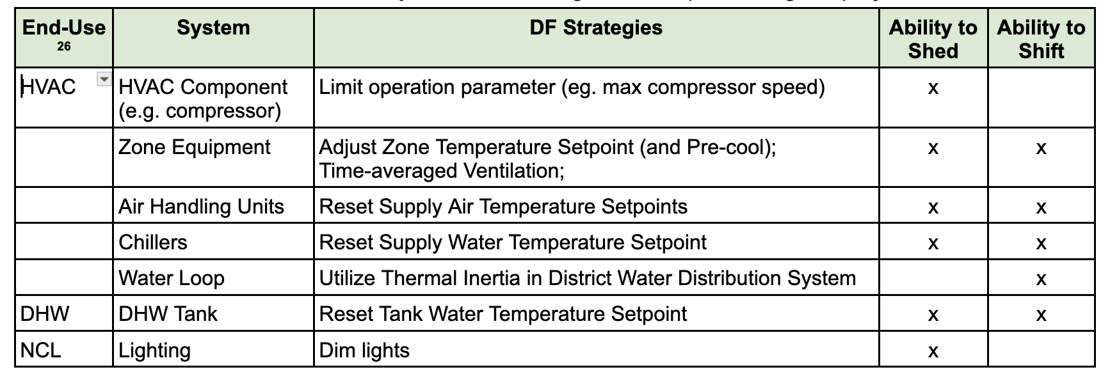
Preliminary Demand Flexibility Sequences
Using semantic models to scale across systems, equipt configurations, etc.
Notes:
This is the preliminary list of demand flexibility sequences we plan to implement, which includes compressor limiting, zone temperature adjustment, time-averaged ventilation, setpoint resets, and also dimming of lighting. This set of sequences will be developed to scale across different building systems, system configurations, and softwares. Several of the buildings already have haystack, so these sequences will be designed with that in mind.

Slide 15
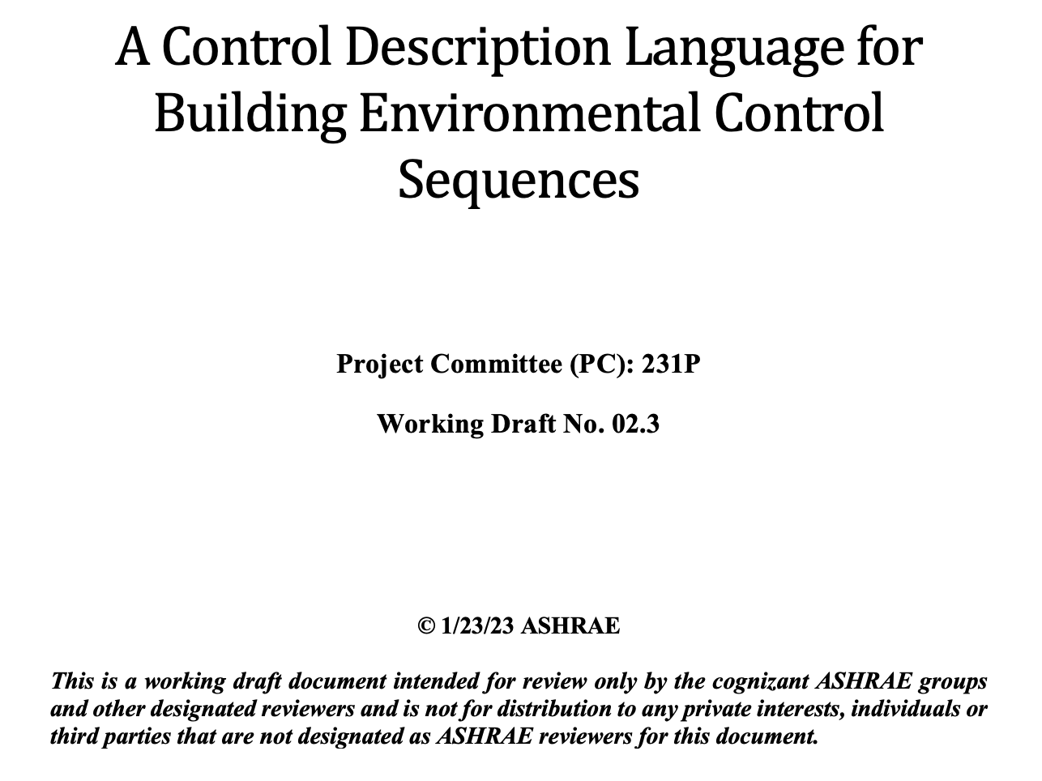
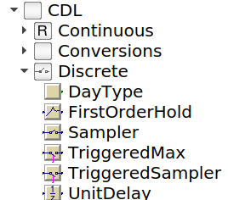
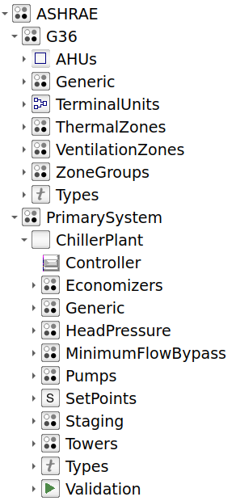
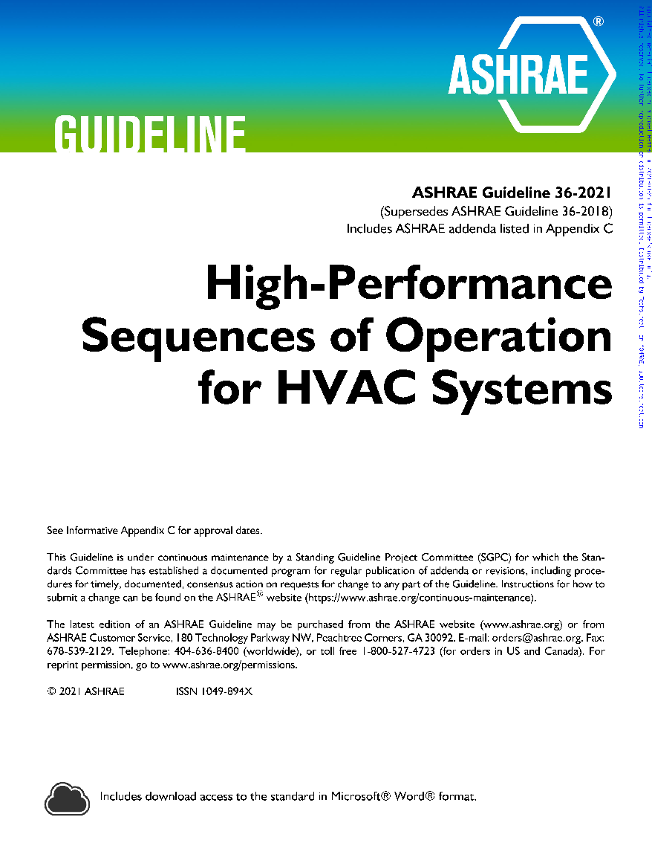
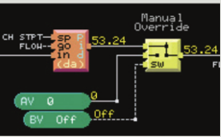
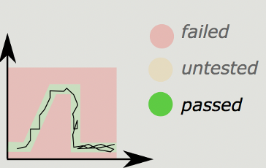
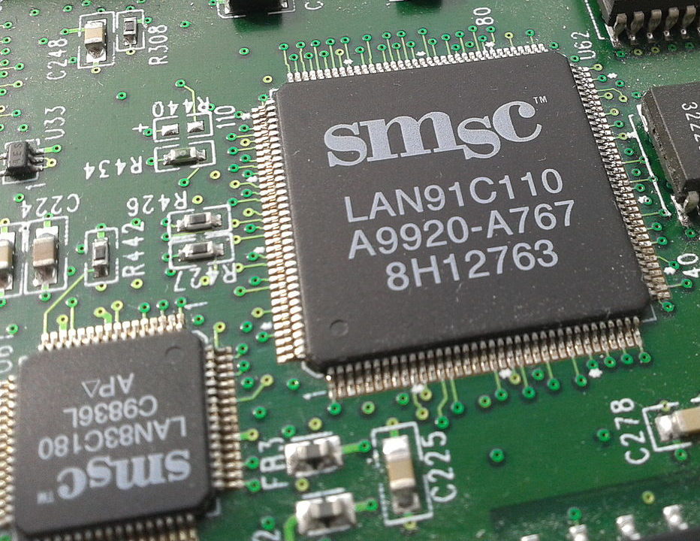
OBC - Simulation to Implementation
Standard digital control logic representation
Best in Class Sequences
Sequence selection and editing
CDL implementations of sequences
Performance evaluation
Implementation
Sequence specs and descriptions
+/-
Code Generation
Commissioning
Notes:
This is a lot to put in one slide, but it describes the process for developing and implementing the control sequences using the framework of Open Building Controls.
We will develop specifications and an executable library of sequences using CDL. CDL is an open block-based language for controls with tooling to help translate these controls into the native control languages of different vendors. This integration allows CDL to show up in a platform as native controls that can be further edited and inspected through the platforms like anything else. We already have defined the guideline 36 control sequences in a library like this to demonstrate the approach.
We also have downstream tools to evaluate the sequences in simulation and to the select the appropriate sequences based on your equipment configuration.
These sequences are implemented by each of the vendors integrating this library. Additionally, since the sequences in the library are executable code, the sequence implemented can be tested directly against the sequence in the library. This can make commissioning more complete and faster.

Slide 16
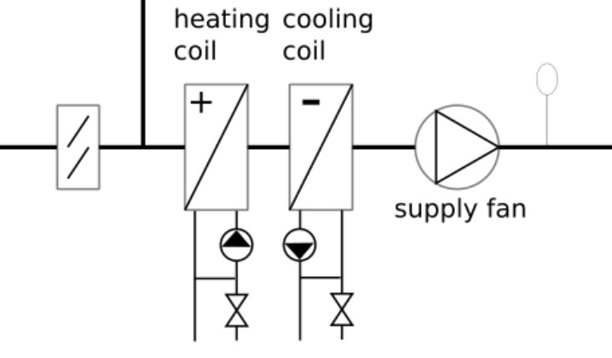
Vendor Integrations
Significant cost reduction from approach via EMIS and loading sequences from library
EMIS Platforms
Best-in-class DF Specifications
BAS and SkyFoundry Skyspark
Library of Sequences with CDL and Semantic Models (tested in simulation)
Notes:
In this project we’ll be exploring multiple pathways for integration of these sequences with vendors. We have some EMIS platforms that will be using the demand flexibility specifications to create their implementations, which will be done by Noda and Facil.ai.
SkyFoundry, Tridium, and ALC are all developing capabilities to translate CDL into their own native controls programming languages. This lets them directly integrate the library of sequences defined using CDL and semantic models.

Slide 17
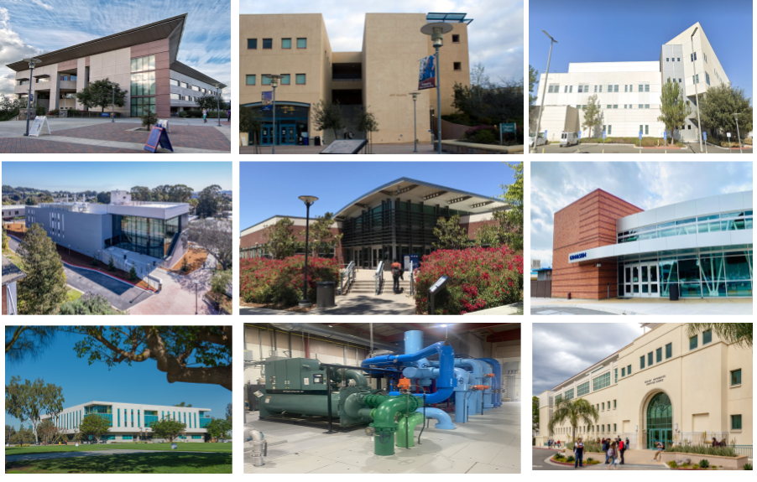
Field Deployment and Testing
In CA, significant opportunities from both EE and DR
# | Scenario | Description | Cost Savings
0 | Baseline | No DF participation | $0
1 | ELRP-1 | 10% shed during ELRP events (for 60h during the year) | $1,700
2 | PLR-1 + ELRP-1 | 10% reduction in peak load during on-peak hours + ELRP-1 | $10,500
3 | ELRP-2 | 20% shed during ELRP events | $3,400
4 | PLR-2 + ELRP-2 | 20% reduction in peak load during on-peak hours + ELRP-2 | $20,600
5 | EE | 20% reduction in energy through energy efficiency | $53,000
Opportunities for DF are growing (CPP, RTP, CBP, etc.)
Notes:
Each of the partners will implement both demand flexibility and energy efficiency focused sequences across the california campuses. We’ve evaluated some of the savings opportunities from these sequences considering a few of the DF programs they currently have available. The savings is pretty significant, especially from energy efficiency. Opportunities for demand flexibility are growing a lot in Calfornia, including through dynamic electricity rates like critical peak pricing, real time pricing, and capacity bidding programs. Other states may have other programs

Slide 18
Community Engagement and Tech Transfer
Engagement with campus energy managers via UC Davis Annual Global Energy Manager Workshop:
Started in 2019 with an in-person workshop (70 participants). Moved online in 2020 (200-300) attendees
﻿﻿2024 registered attendees:
﻿﻿From Australia, Canada, China, India, Japan, Mexico, 12 US states
﻿﻿40+ colleges or universities represented
20+ industry and government partners
Partnerships with Taylor Engineers, TRC for direct engagement with ASHRAE committees to codify and scale future CDL library amendments reflective of best-in-class sequences
Notes:
We also plan to scale these sequences beyond these pilot buildings. We’ll be engaging with all the California campuses and more attendees through a global energy management workshop.
We also plan to include the demand flexibility specifications we define in Guideline 36 or another guideline, with the help of our partners Taylor engineers and TRC.

Slide 19
This technology is core to the future of buildings
Potential EE and DF from buildings is untapped
Controls, sequences, and installations are bespoke and costly
We have more tools/infrastructure than ever to improve EE and DF through digitization
Interoperable + well tested sequences, data models, and workflows are key
Notes:
There’s a lot of opportunity for improved energy efficiency and demand flexibility in buildings.
But it’s not easy to get to using traditional methods for controls deployment.
Right now, we have more tools and digital infrastructure than ever before to potentially address this.
Through this project we will develop open, interoperable and well tested sequences that anybody can use and adopt. They will be based on open data models including haystack to streamline their configuration and improve their accessibility. They will be deployed by several vendors and open to all.

Slide 20
If you use Haystack, these technologies are easy to adopt
Sequences/libraries are designed around scalability, portability, and use with semantic models
Haystack makes it easier to integrate and deploy a library of sequences
Enable discoverability of points and of controls
Enriching/building upon sequences in library
Notes:
If you use haystack, these technologies are going to be easy to adopt and use.
The sequences are designed around scalability and portability, based on the use of semantic models. This means that there is compatibility between the library and vendor platforms that use haystack for deployment, that will make it easy ot integrate the library.
Haystack also is key to improving the process of deploying controls from the library. having haystack in your platform will make it easier to discover all the points necessary for controls, or automatically query them. It will also make it easy to find which controls within the library are applicable to your specific building and system, and then configure the controls.
We also think that if you already have haystack its going to be easier to build upon the sequences in the library in an extensible way. This should allow vendors to offer more capabilities and to make the controls their own, or to contribute new sequences to the library.

Slide 21
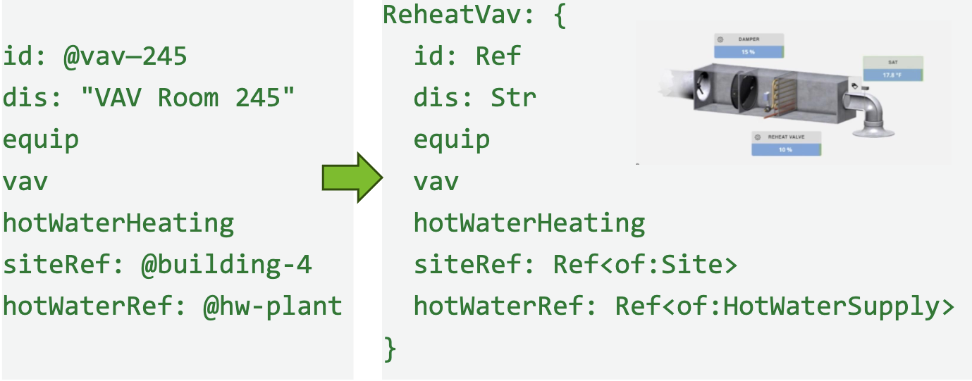
(coming soon) … Made Possible by Xeto
Validation of building models against controls spec
Automating point binding for configuration
Standardizing haystack deployments across orgs
Haystack RDF-SHACL for alignment/exchange of SM
Notes:
The automation in this controls deployment process will all be made possible by Xeto in a few very important ways.
To make sure that the haystack models of the buildings we plan to deploy these controls to are correct and complete, we need validation. This is crucial to scaling these controls across many buildings. We also think this validation will make it easier to use the library by knowing which controls can be run.
Xeto also enables us to better automate point querying and point binding to configure these controls by letting us be more specific about the equipment and points we wish to query.
In this project we plan to control buildings that are maintained by multiple organizations. Use of validation and templates should hopefully help us align these models within the project. Xeto can hopefully enable further standardization of haystack models across organizations for further scaling.
Xeto also enables alignment and exchange of semantic models using RDF and SHACL which creates interoperability with other semantic modeling schema like brick, REC, and 223P.

Slide 22
Interested in learning more?
More buildings and early users
More technology/service partners
Specification or CDL Implementation
Additional operational strategies
Demand flex/demand mgt
Automated Cx, functional testing
FDD and correction
Feedback on ASHRAE Standards 223P and 231P
Notes:
So, for our existing sequences and everything we’re developing, we have opportunities to deploy to more buildings and for more early users. If you’re interested in bringing these capabilities to your buildings, we are excited to share them with you.
If you are a technology provider interested in providing best-in-class fault correction and control sequences, we’re interested in providing our open specifications and code to more partners for deployment.
If you would like to develop capabilities to translate sequences from CDL, or if you just want to learn more about the vision of open building controls, please reach out.
We also want to add more operational sequences to the library. This includes automated commissioning, demand flexibility, and fault correction strategies. The bigger the library the better.
Finally, both of the ashrae standards we intend use, 231P for the control description language and 223P for semantic modeling are going out for public review imminently. We want these standards to fit your use cases, so please provide feedback through the public review process or talk with us.

Slide 23
Thank You
Contact: LPaul@lbl.gov

