Slide 1
Haystack Data Modeling Boiler Controls
April Slotterback and Jakob Bell

Slide 2
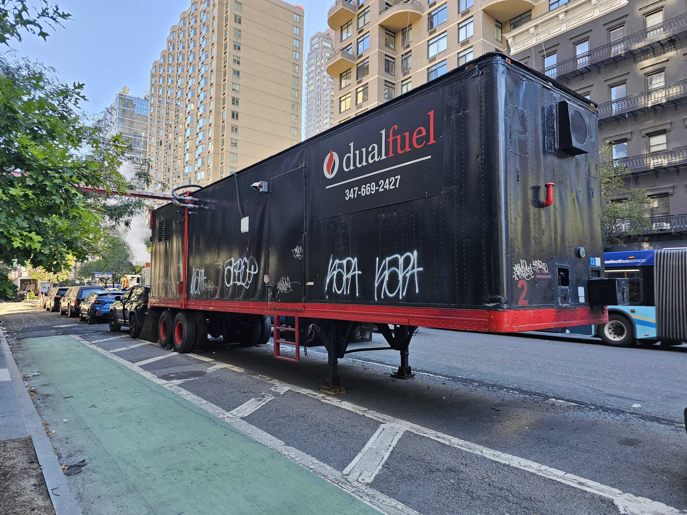
How do we tag every boiler in New York City?
Photo by J. Bohm

Slide 3
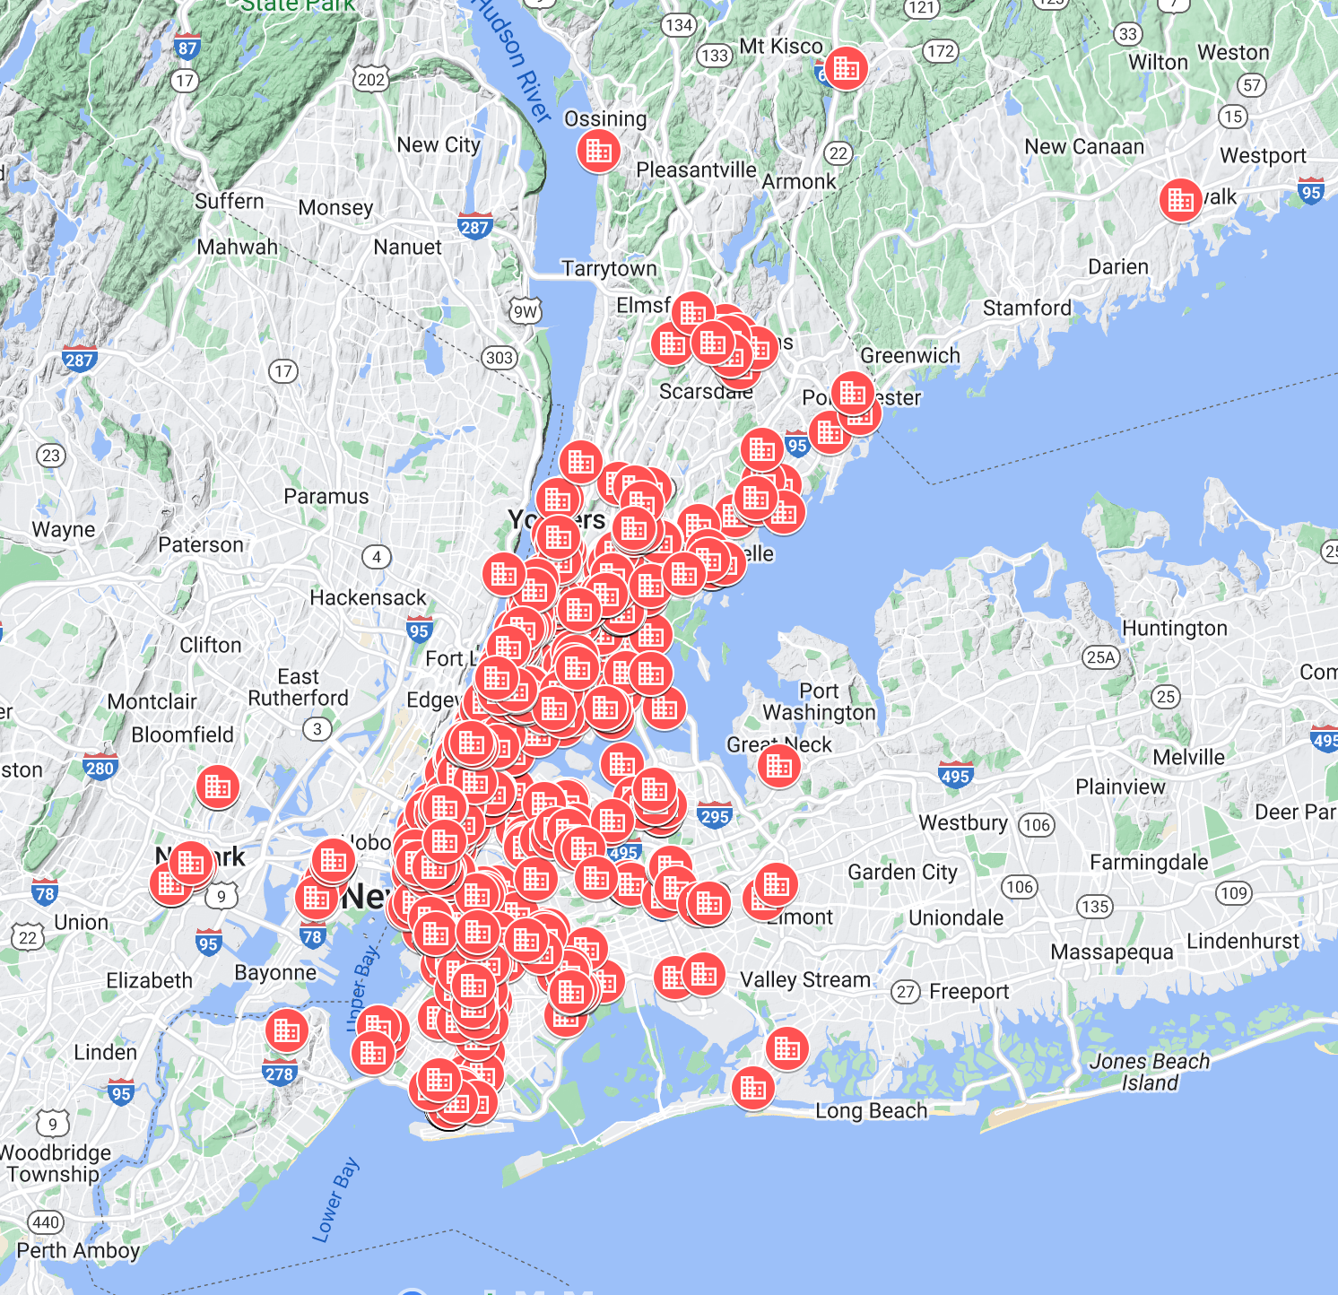
ABOUT US
Company founded 2012
Customer base: NYC metro area
Controls and monitoring for 350+ heating plants (25+ mm sqft)
Service 700+ heating plants
100+ active mechanical installation projects
100+ Employees

Slide 4
Integrated Energy Services
Maximize Comfort, Minimize Costs, Increase NOI
Service, Installation, & Compliance
24 Hour Emergency Service
Boilers, Burners, Water Heaters
Oil to Gas Conversions, CHP
Triennial, BO-9, Backflow Filings.
Real Time Energy Management
Monitor & Control - fault detection, reliability, efficiency
Preventative & Proactive Service
Demand Management & Load Shifting
Energy supply risk management

Slide 5
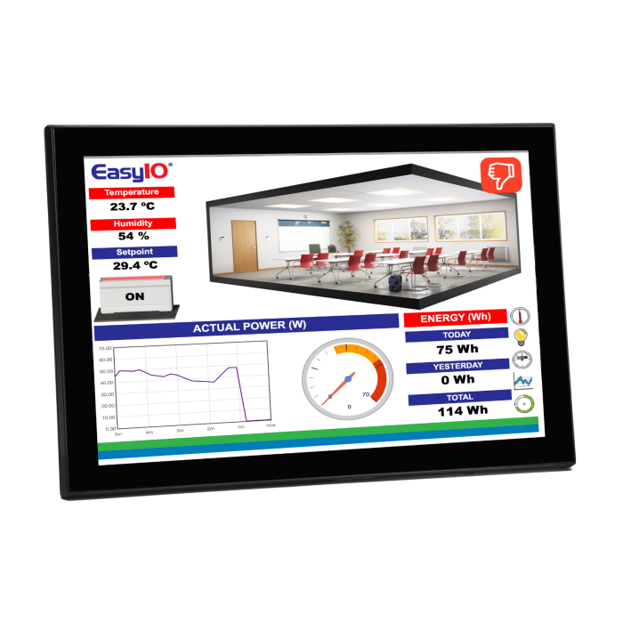
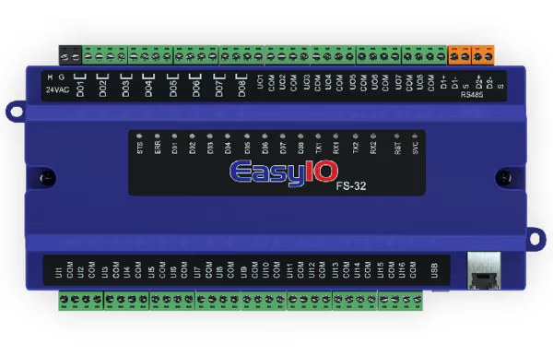
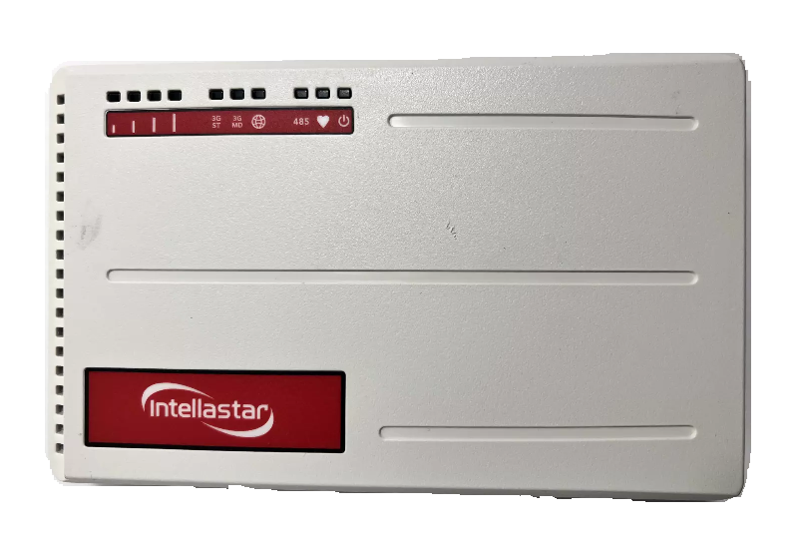
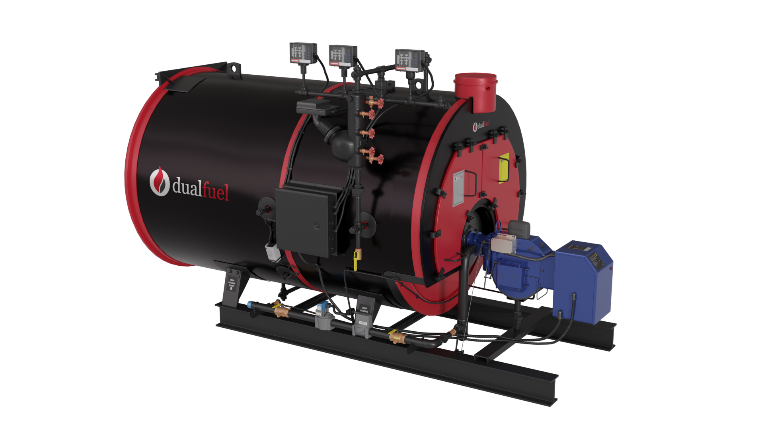
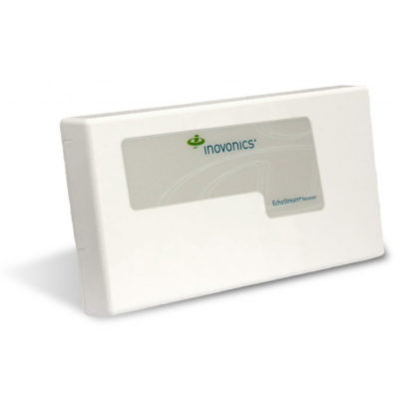
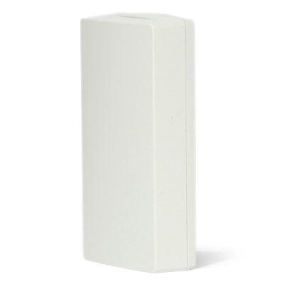
Axxon Architecture
CPT API
Haystack
Connector
Sedona Connector
Wiring, BACnet, Modbus, et al
Inovonics Connector

Slide 6
Boiler Tagging

Slide 7
Early Axxon Controls
The boiler is one equip
All points, whether sensors, setpoints, or commands, were under this boiler equip.
Write once, install everywhere.

Slide 8
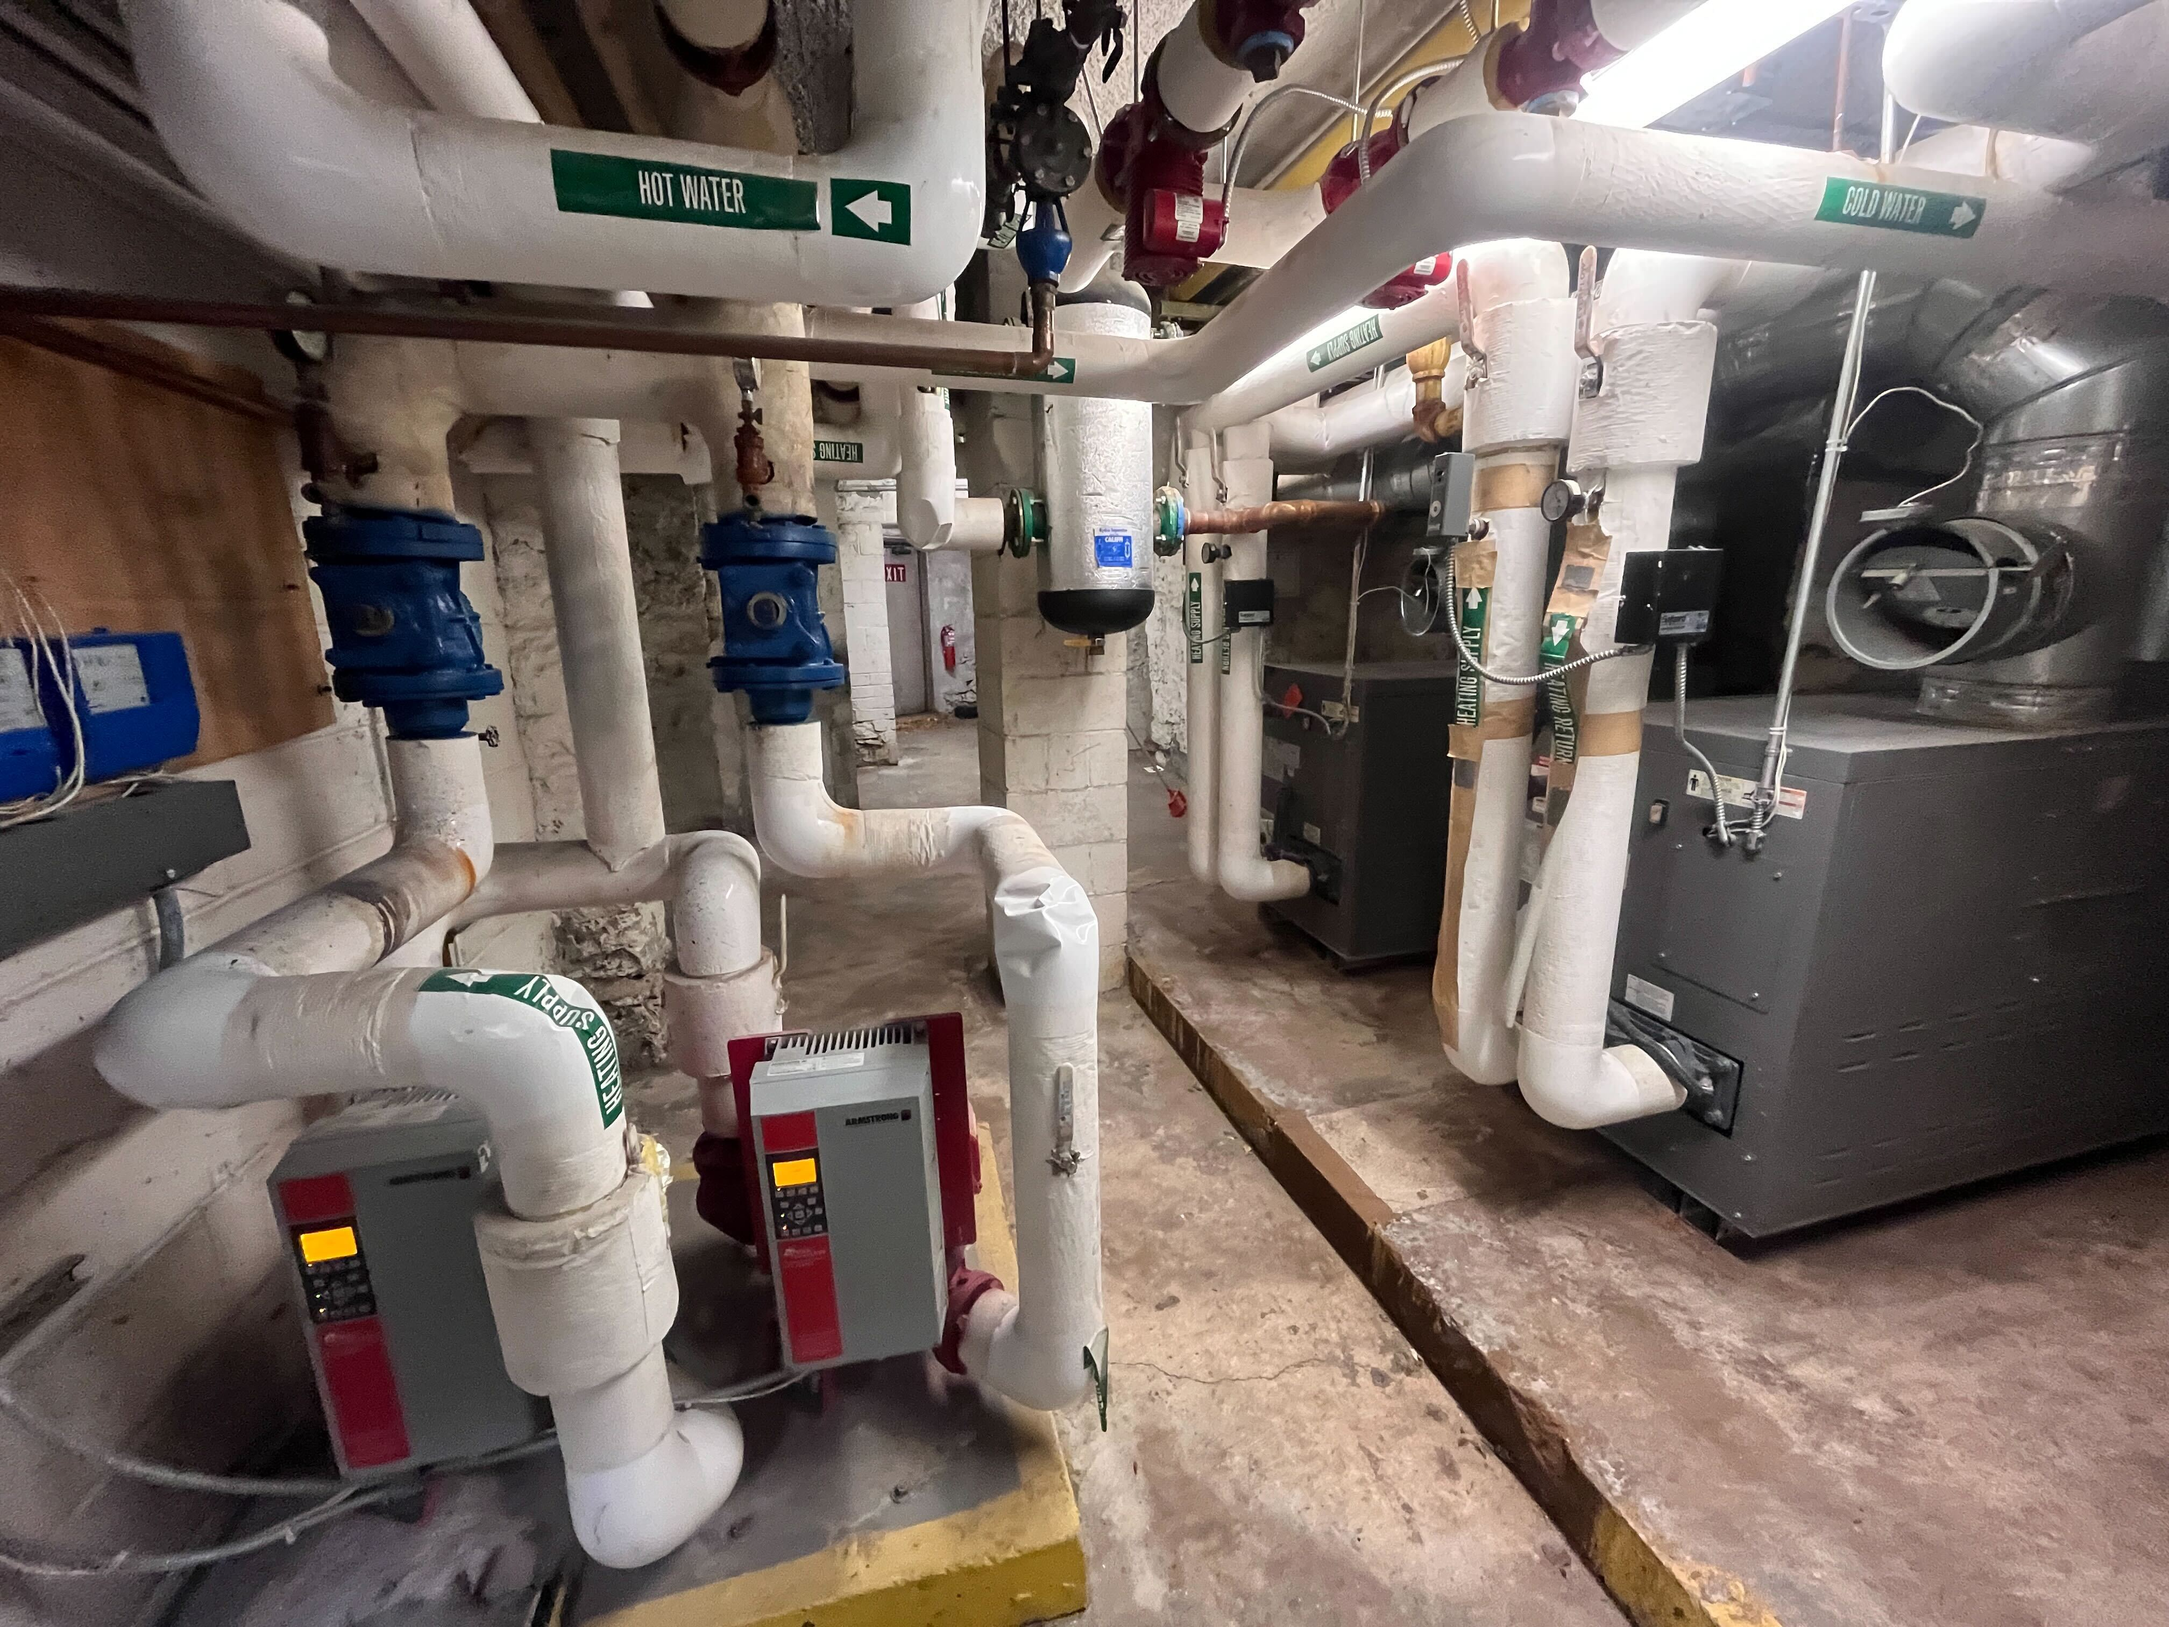
Oversimplification
“Boiler”
“Boiler 2”
Photo by N. Cruz

Slide 9
Increasing Technical Debt
Undocumented features/revisions
Lack of version control for configurations
Rapid expansion of system control offerings
Covid turnover -> loss of institutional memory
Result: Unreliable code that took very long to develop and maintain

Slide 10
Cleaning Up

Slide 11
Axxon Controls
CPT API
Haystack
Connector
Sedona Connector
Wiring, BACnet, Modbus, et al
Inovonics Connector

Slide 12
Wrangling the technical debt: controllers
Listening to customer complaints
Cataloging existing systems
Correcting known bugs in older systems
Result: More consistent controls

Slide 13
Axxon Data Model
CPT API
Haystack
Connector
Sedona Connector
Wiring, BACnet, Modbus, et al
Inovonics Connector

Slide 14
Building Better Data Models
hot water boiler number:1
hot water boiler number:2
flue duct
primaryLoop hot water pipe
secondaryLoop hot water pipe
pump number:1
pump number:2
Photo by N. Cruz

Slide 15
Axxon Control Panel
axxon controls panel
heating controls panel
outside air thermostat
indoor air thermostat
primaryLoop reset
secondaryLoop pump sequencer
boiler sequencer
….
domestic hot water controls panel
domestic hot water thermostat
(red tags above are custom tags)

Slide 16
Axxon Server
CPT API
Haystack
Connector
Sedona Connector
Wiring, BACnet, Modbus, et al
Inovonics Connector

Slide 17
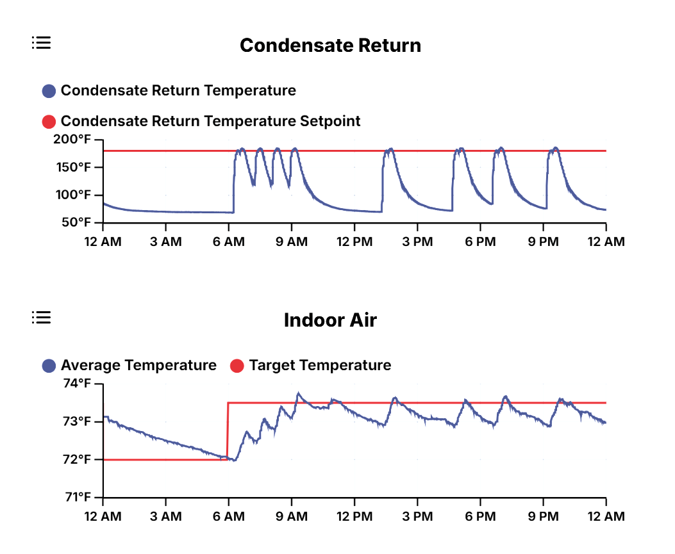
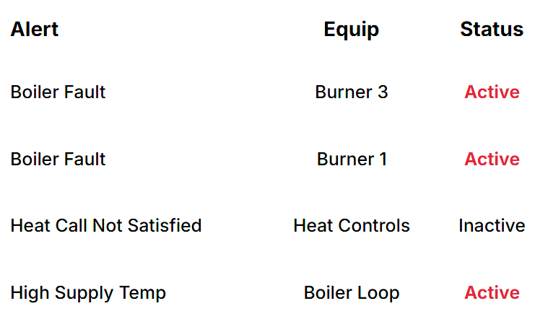
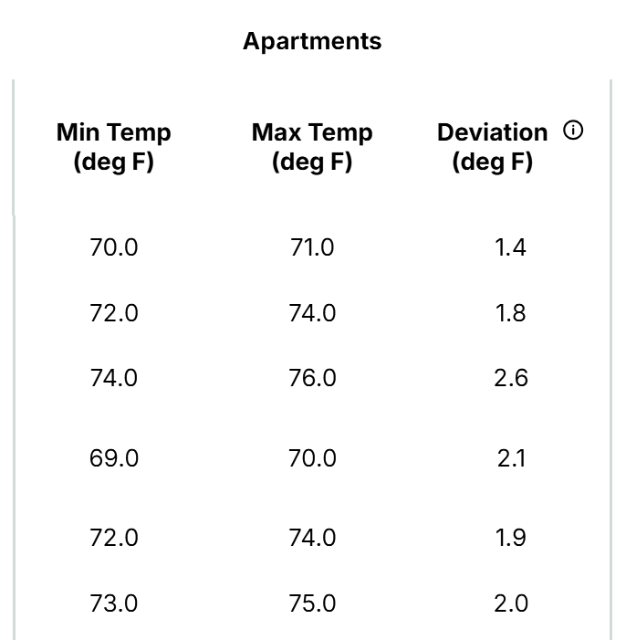
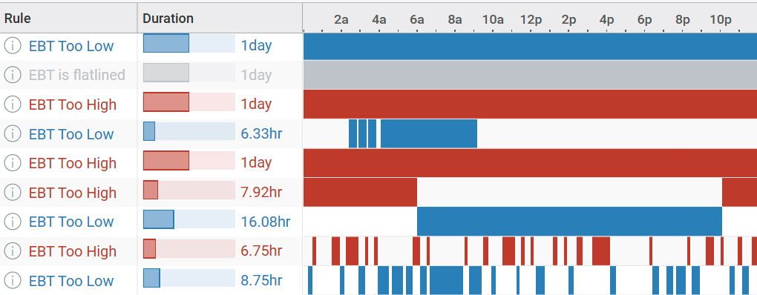
Cloud Responsibilities

Slide 18
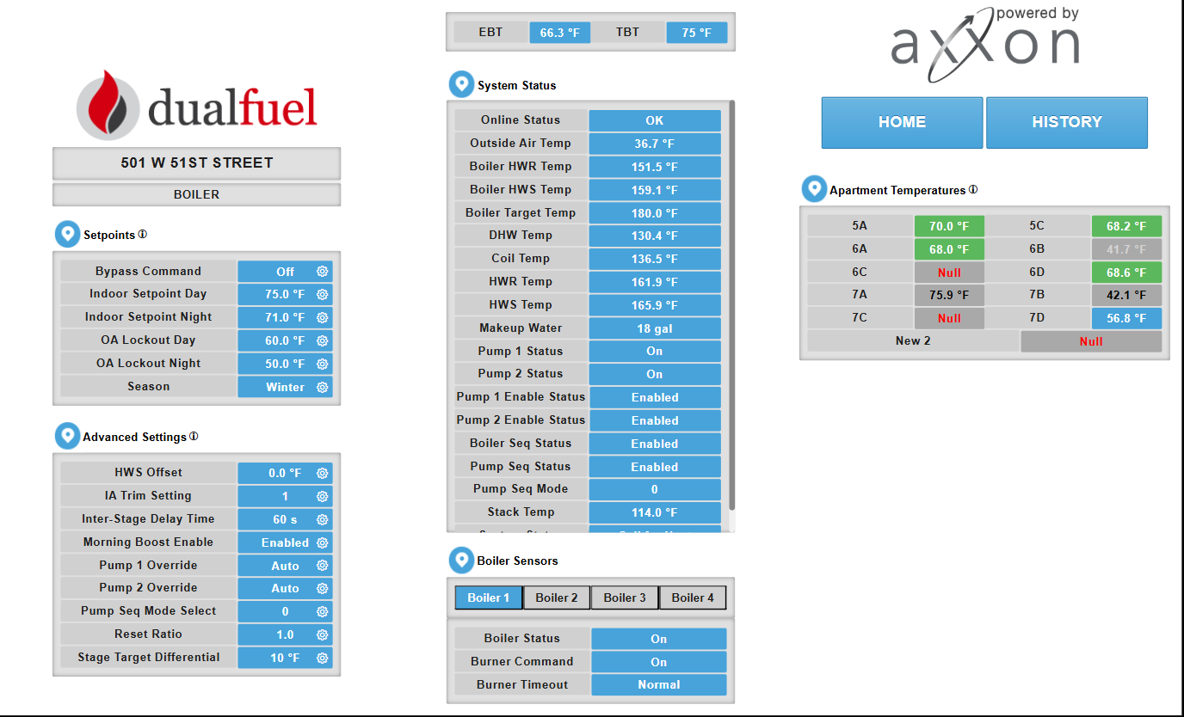
Custom Tags in Action
setpointsTable
systemStatusTable
advancedTable
boilerSpecific

Slide 19
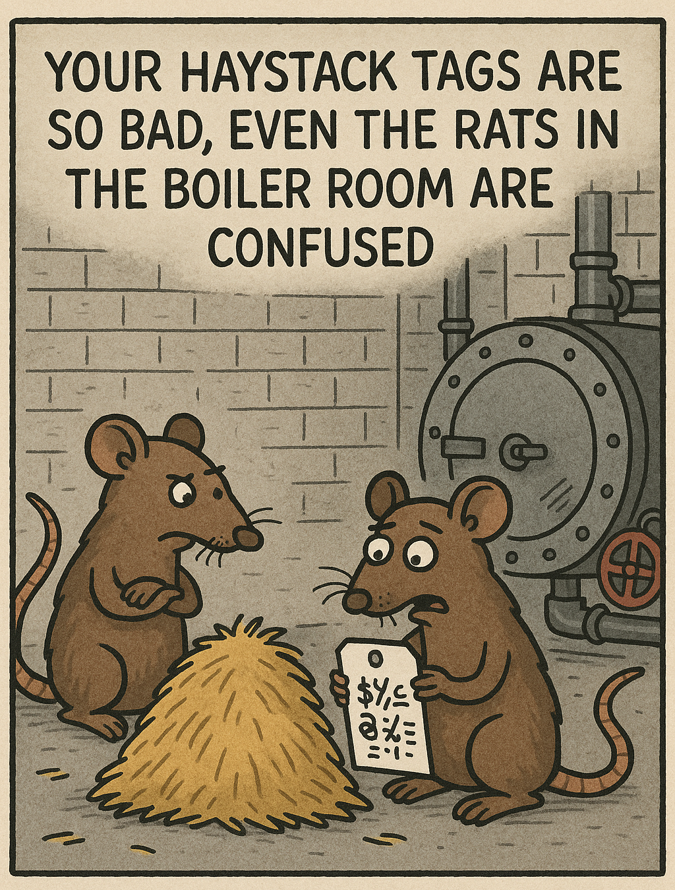
Custom Tags in Action
hwViewPoint
mobilePoint
portfolioViewPoint
heatViewPoint
heatCallComponent
chartGroup: Used to sort data and group charts by default

Slide 20
Challenges with Custom Tags
Hard to maintain
Difficult to create custom views without hacky workarounds
Poor documentation
Unnecessary learning curve for new employees

Slide 21
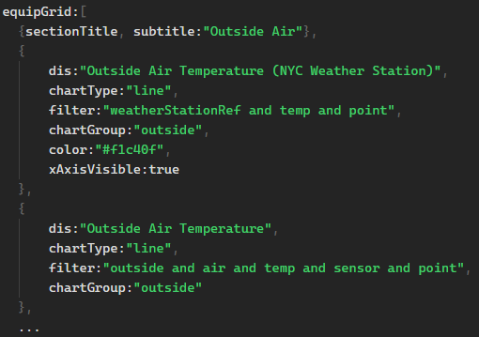
Shifting to Templates
New Approach: Replaced custom tags with templates
Templates allow implementers a structured format to define views and charts
Templates eliminate the need for custom tags
Template types include:
Frontend tile templates
Chart templates

Slide 22
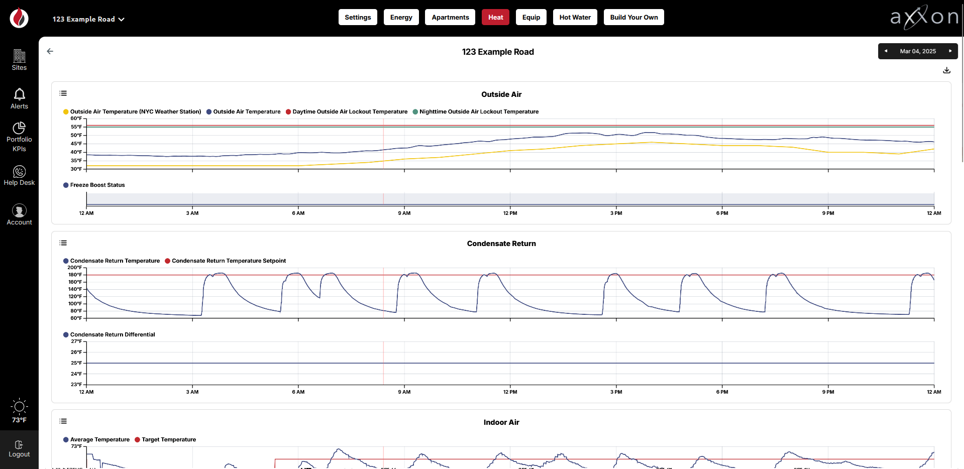
Chart Templates

Slide 23
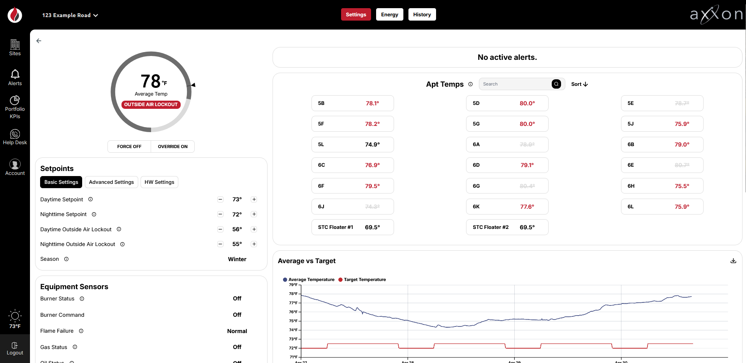
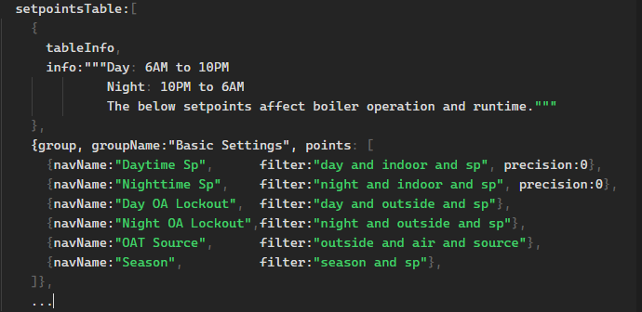
Frontend View Templates

Slide 24
Improved Maintainability
Improved Maintainability
Clear templates replace obscure tags
Better documentation and standardization
Enhanced Customization
Templates allow flexible, site-specific views and charts
Scalability
Easier to adapt to new requirements
Future-proof with Xeto Specs integration

Slide 25
Future Plans
Use Xeto specs as a commissioning tool:
Validate new and existing data models
Allow structural typing to determine templates
Example Xeto Spec Checking For Templates:

Slide 26
Conclusion
Don’t optimize too soon
Early assumptions caused us to have substantial technical dept
Use existing tagging structure as much as possible.
Custom tags should be used sparingly and be thoroughly documented.
Views, Rules, and charts should be built using standard tagging whenever possible.
Design with flexibility in mind
Consider adding new equips, zones, spaces, etc.
Don’t shove every point into a single equip.

Slide 27
Thank you

Slide 28
April Slotterback
Software Engineer
aslotterback@dualfuelcorp.com
Jakob Bell
Software Engineer jbell@dualfuelcorp.com
Dual Fuel Corp.
32 Cortlandt Street
Mount Vernon, NY 10550
347-669-2427
www.dualfuelcorp.com

