Slide 1
Haystack Labs Update: The 2-Pipe Problem
TECHNICAL TRACK
Mike Melillo
Solutions Architect – Albireo Energy

Slide 2
Outline
Problem Definition
Why is it a problem?
Suggested Solution
Other Examples / Use Cases
Walk Through Source Code
Q&A

Slide 3
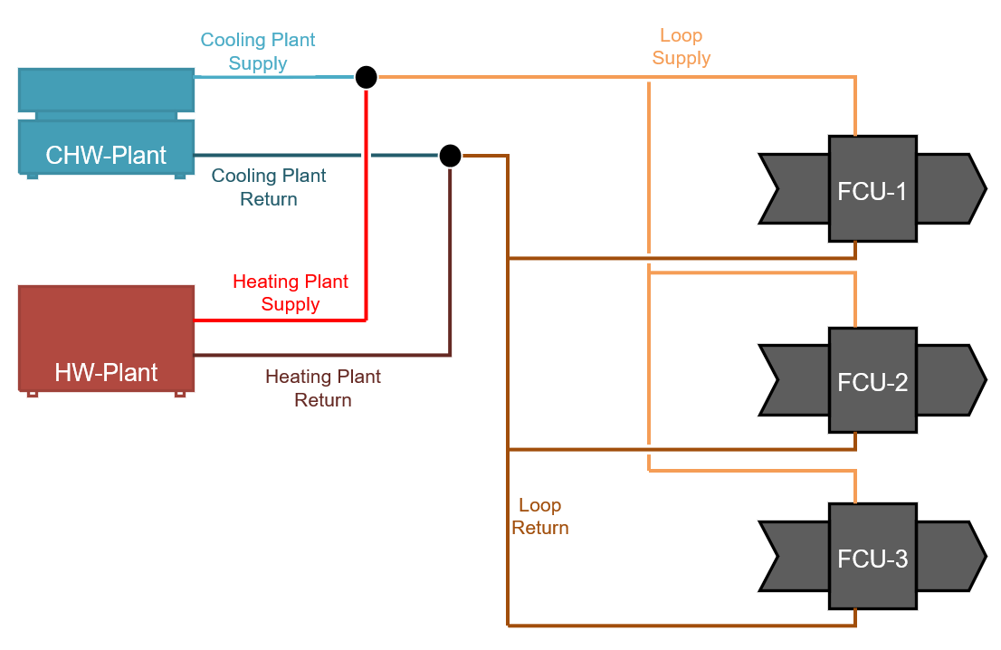
Problem Space – 2 Pipe Systems
Notes:
Describe system layout
Edge case that crosses meta data and historical data

Slide 4
Why do we care?
Never had clear guidance on how to model/tag
Leads to inconsistency between different implementations
Difficulty in pulling relevant data from the “activeRef” across time

Slide 5
Problem Space – What to do?
How to correctly model & tag?
Marker tags, heating + cooling, introduce dualTemp, etc.? How do avoid “and not” filtering?
What about references? hotWaterRef, chilledWaterRef, just waterRef?
How to tell the difference between each over time?

Slide 6
Suggested Solution – FCU Specific
waterRef as a list rather than separate hotWaterRef and chilledWaterRef tags
Child point of fcu-equip tagged as “waterSwitch” indicating that it is in charge of the currently active “waterRef” on its parent
Historized data on Child point maps its values to a history of the active water ref
Notes:
waterRef = fooRef
waterSwitch = fooSwitch

Slide 7
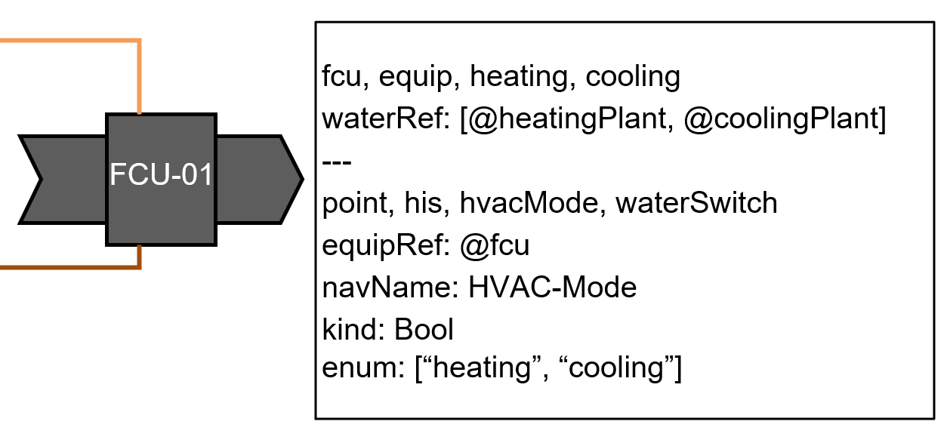
Suggested Solution – Sample Model

Slide 8
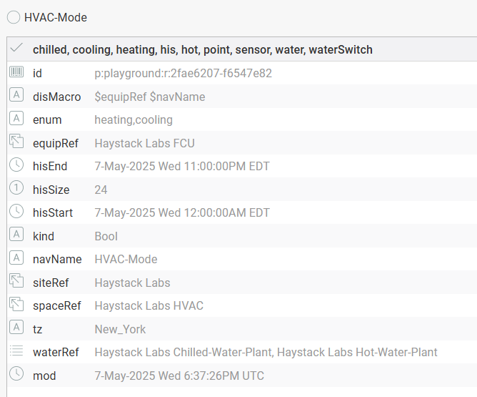
Example: 2-Pipe FCU

Slide 9
Step 1: Read out the Mode Data
Start with our HVAC Mode
True = Cooling / False = Heating

Slide 10
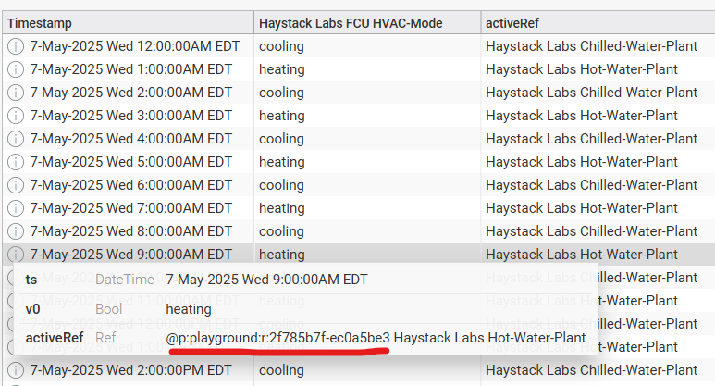
Step 2: Map HVAC-Mode to timeseries ref data

Slide 11
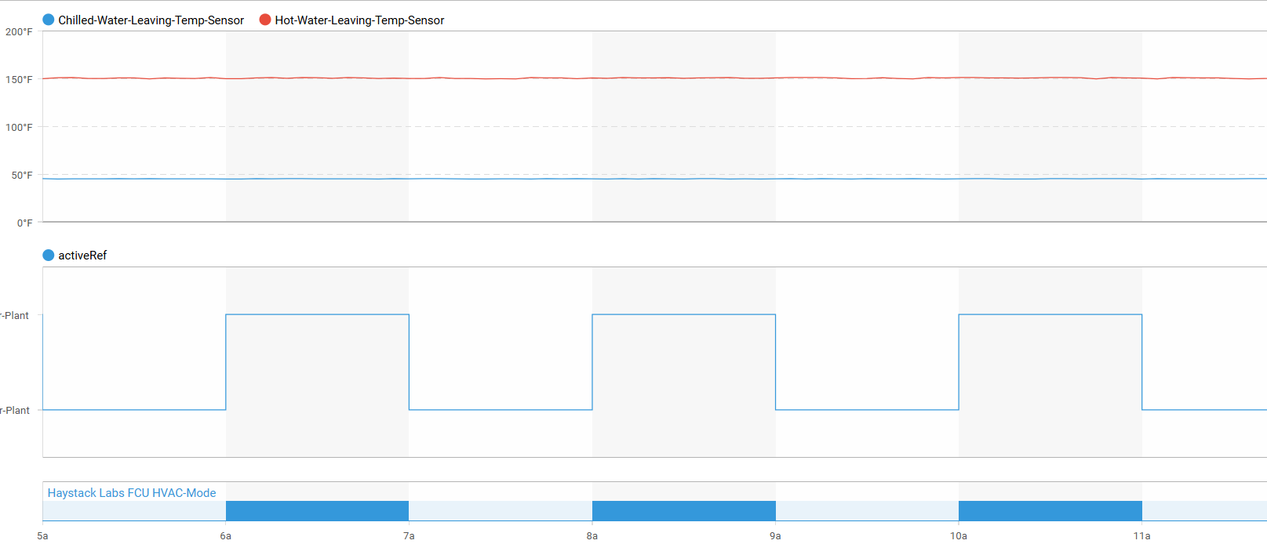
Step 3: Map refs to target data from the plant

Slide 12
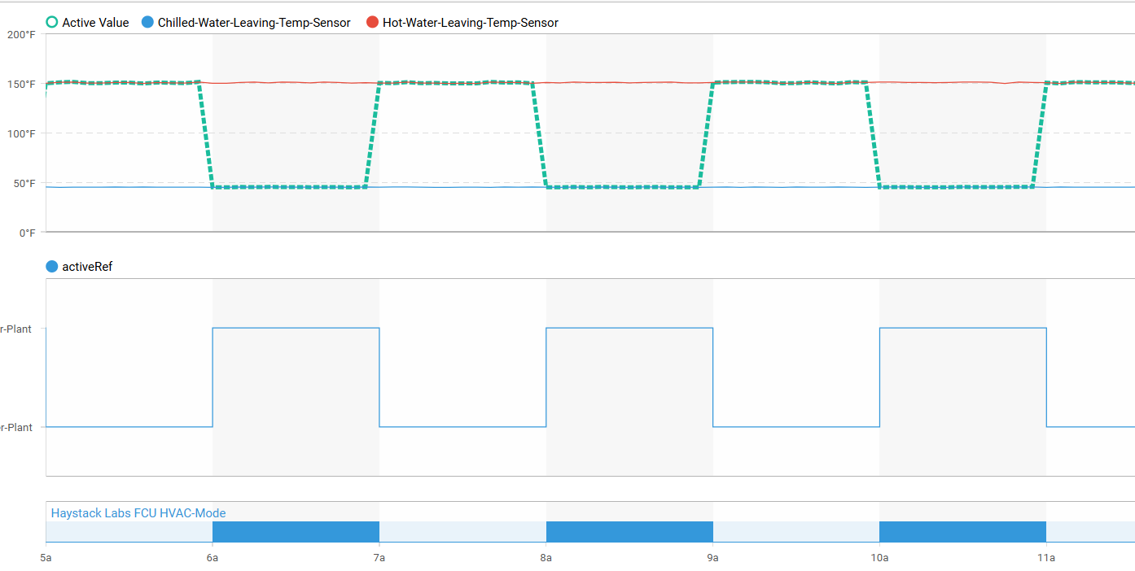
Step 3: Map refs to target data from the plant

Slide 13
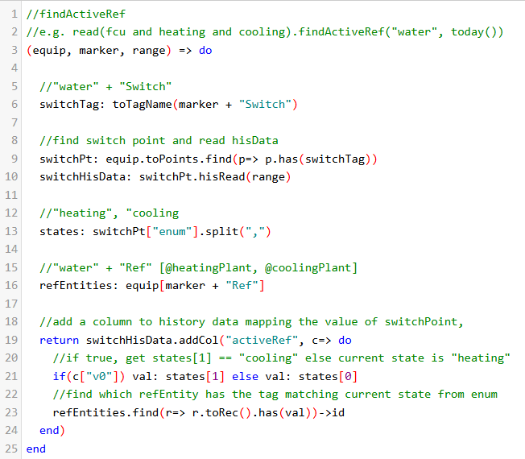
Sample Code 1: Find Active Ref
Notes:
Over commented
Line 13, grab states like “heating”
Line 23, ask “which water ref is tagged ‘heating’”
Could also use order of enums to accomplish this

Slide 14
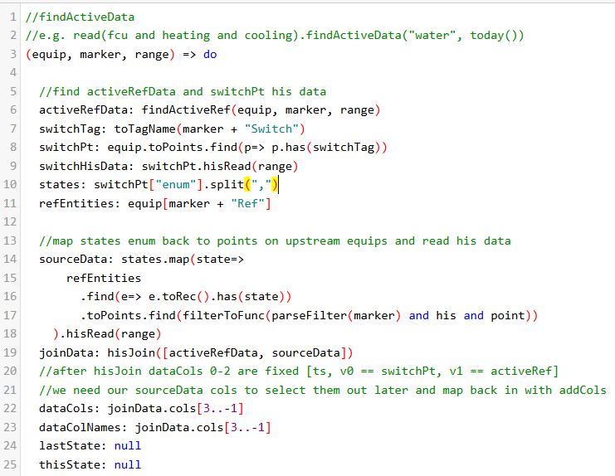
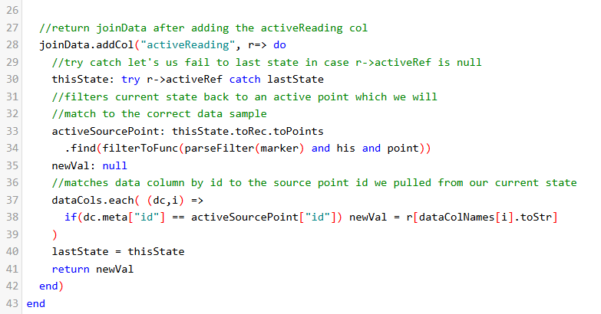
Sample Code: Map Ref Data to Sensor Data

Slide 15
Similar Applications
Electrical Systems: Automatic Transfer Switch selecting “elecRef” based upon switch position
Data Center Cooling: CRAC Units selecting Chilled Water Source based on Isolation Valve Position (A/B chilled water plant design)

Slide 16
Other Thoughts
Couples the data model & historical data
“fooSwitch” is kind of clunky
Hard coded enum order or tag-based selection?
https://github.com/mikeMelillo/haystackLabs-2PipeProblem

Slide 17
Q&A

