Slide 1
Data Modeling for Electrical Systems
Technical Track
Rick Jennings, PE, CEM

Slide 2
Agenda
Update on Xeto electrical point specs
Power quality monitoring applications
Community examples
Smart building & EV charging interface
Next steps & wrap up

Slide 3
Xeto Electrical Point Specs
Technical Track

Slide 4
Data Specifications for RFPs and Beyond
Example Specification for a Net Energy Meter
Benefits:
Precision
Streamlined
Consistency
Xeto Library | Spec Name | Description
ph.points | ElecAcTotalNetActiveEnergySensor | Sensor for total net of AC electric active energy
ph.points.elec | ElecAcTotalNetActivePowerSensor | Sensor for total net of average magnitude of AC electric active power
Xeto specs can be referenced in RFPs like this using data available from the specs themselves.
Xeto specs are intended to augment vendor documentation.

Slide 5
Example: Composing Elec Point Specs
Applies active for the required ElecAcPowerSubtype choice
ElecSensor
ElecDemandSensor
ElecAcDemandSensor
ElecAcActiveDemandSensor
ElecAcImportActiveDemandSensor
ElecAcTotalImportActiveDemandSensor
Applies import for the required ElecDirection choice
Applies total for elec location
Add tags to the left
ElecAc prefix
Sensor suffix

Slide 6
Xeto Libraries for Elec Point Specs
ph.points library
ph.points.elec library
AC demand & energy sensors
Total location only
AC power, voltage, current, & power factor sensors
Other locations for AC demand & energy
DC specs
Elec setpoint specs
Library placement of specs are subject to change.

Slide 7
Spec Count Across Elec Point Libraries
 | ph.points | ph.points.elec | Both Libraries
Abstract Spec Count | 29 | 46 | 75
Concrete Spec Count | 26 | 156 | 182
Total Spec Count | 55 | 202 | 257
Previously was 579
(~56% reduction)
These counts are subject to change.

Slide 8
Power Quality Monitoring Applications
Technical Track

Slide 9
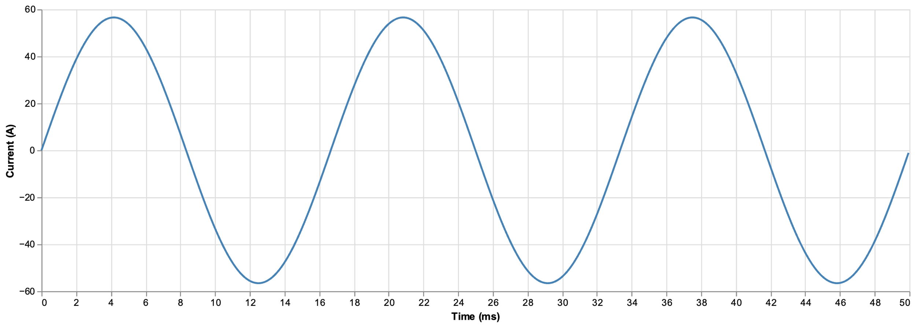
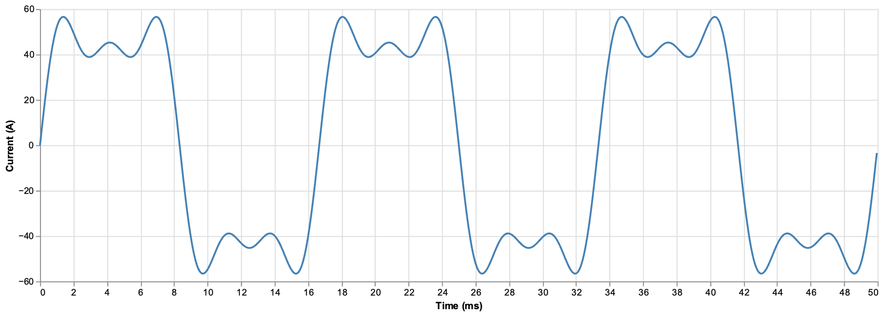
Motivation for Power Quality Analysis
Ideal
Harmonics can lead to energy waste, suboptimal equipment performance due to transistor misfiring, and premature equipment failure
Impact of Harmonics

Slide 10
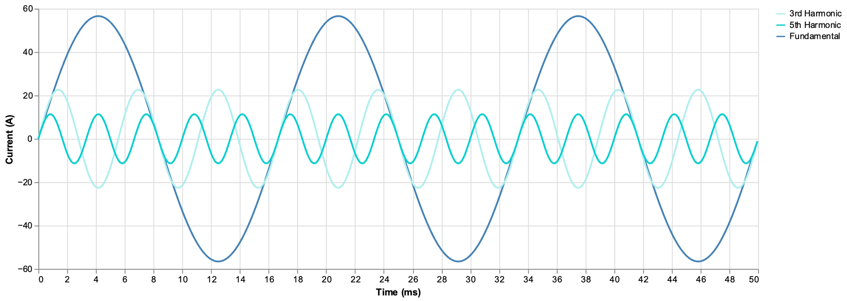
Decomposing Electrical Waveforms
Goal is to support semantics for data points offered by power quality meters (e.g., THD or IHD)

Slide 11
Waveform Capture
Loss of Power
Working towards supporting waveform capture for advanced use cases.

Slide 12
Modeling Power Quality Metrics
ElecAcWaveformStat: Choice
ElecAcThffWaveformStat: ElecAcWaveformStat { telephoneHarmonicFormFactor }
ElecAcIhdWaveformStat: ElecAcWaveformStat { individualHarmonicDistortion }
ElecAcThdWaveformStat: ElecAcWaveformStat { totalHarmonicDistortion }
ElecAcOddThdWaveformStat: ElecAcWaveformStat { oddTotalHarmonicDistortion }
ElecAcEvenThdWaveformStat: ElecAcWaveformStat { evenTotalHarmonicDistortion }
ElecAcKFactorWaveformStat: ElecAcWaveformStat { kFactor }
ElecAcCrestFactorWaveformStat: ElecAcWaveformStat { crestFactor }
ElecAcImbalanceWaveformStat: ElecAcWaveformStat { imbalance }
ElecAcLineStatCurrentSensor {
totalHarmonicDistortion
lineCurrent: "L1"
}
Example Usage
Plan to convert ElecAcWaveformStat to ElecAcWaveformMetric

Slide 13
Community Examples
Technical Track

Slide 14
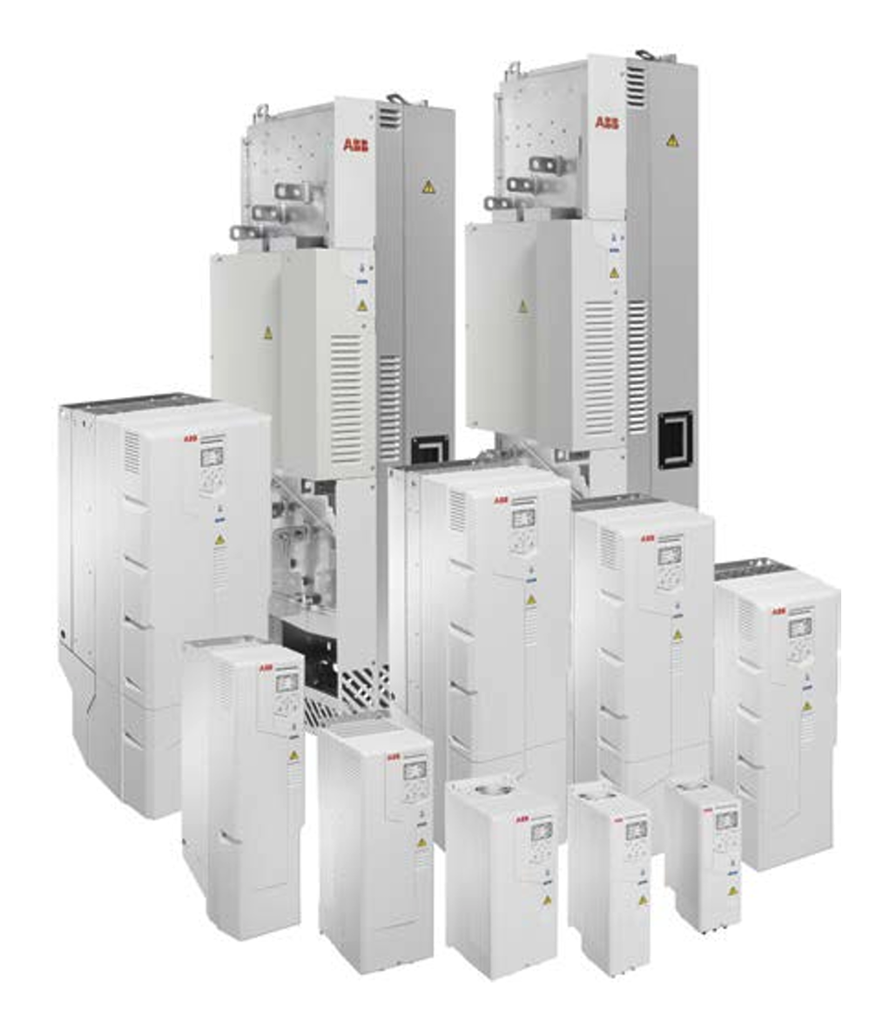
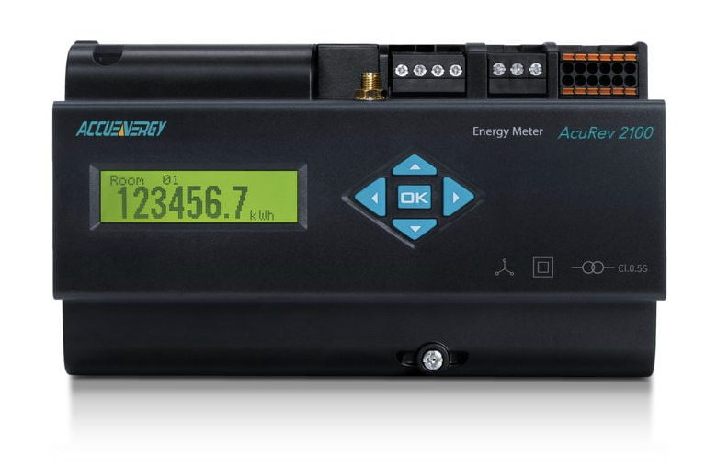
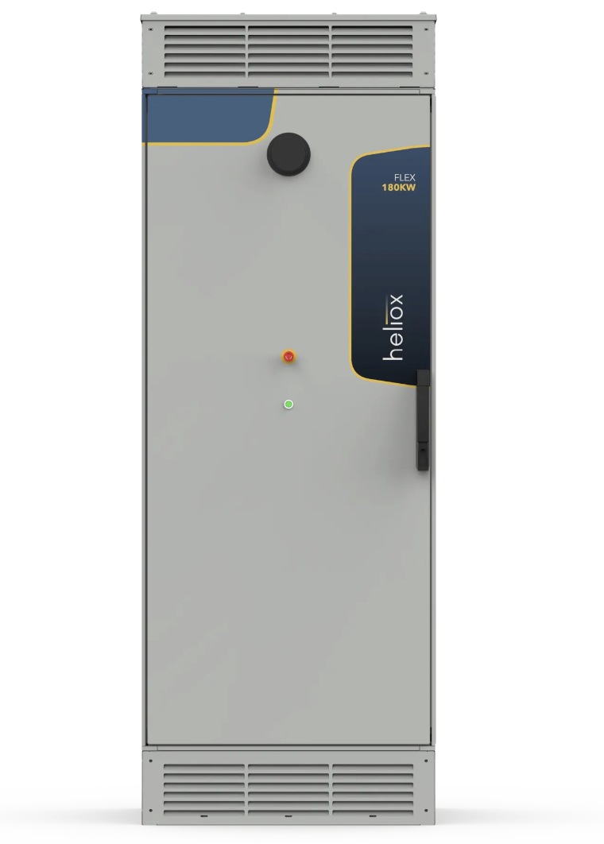
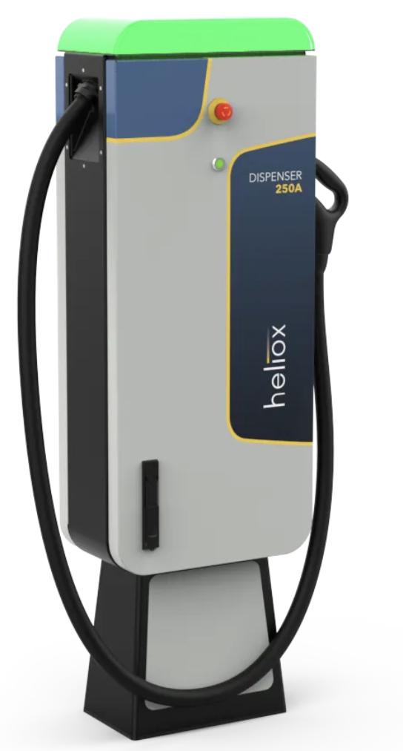
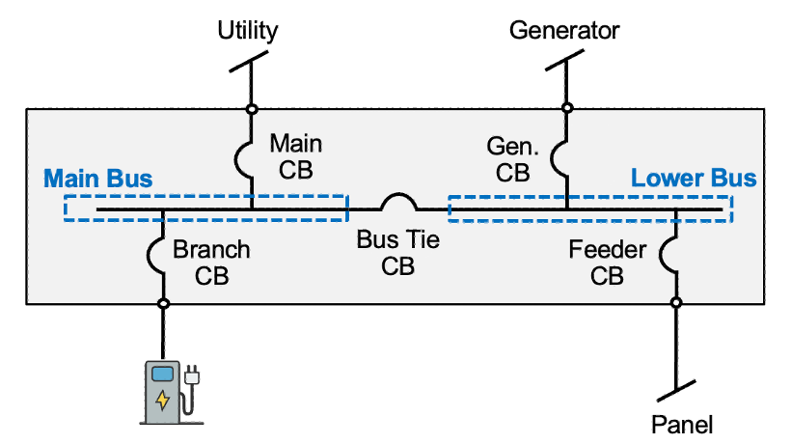
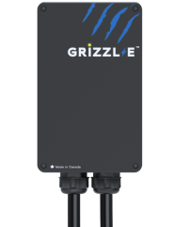
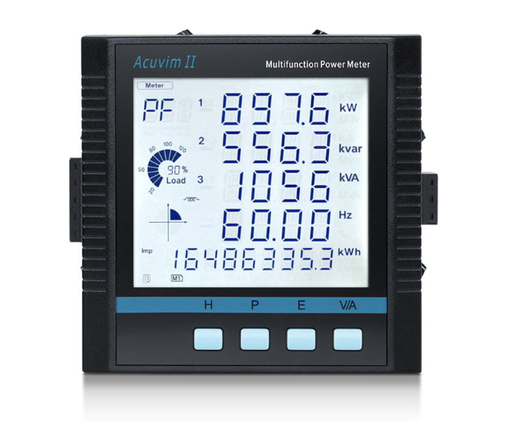
Community Product Examples
ABB ACH580 VFD
Multi-Circuit Submeter
Level 3 DC EVSE
Example Elec Panel
Level 2 AC EVSE
Advanced Power & Energy Meter

Slide 15
Example: Accuenergy’s Acuvim 2
Acuvim2ElecMeter : AcElecMeter <abstract> {
attrs: Query {
ManufacturerAttr { val: "Accuenergy" }
ModelSeriesAttr { val: "Acuvim II" }
DimensionLengthAttr { val: 96mm }
DimensionWidthAttr { val: 96mm }
DimensionHeightAttr { val: 64.3mm }
TempRatedMinOperatingAttr { val: -25°C }
TempRatedMaxOperatingAttr { val: 70°C }
}
points: {
ElecAcFreqSensor {
modbusAddr: ModbusAddr { addr: "16384", encoding: "f4" }
bacnetAddr: BacnetAddr { addr: "AI1" }
}
ElecAcPhaseVoltSensor {
phaseVolt: "L1-N"
modbusAddr: ModbusAddr { addr: "16386", encoding: "f4" }
bacnetAddr: BacnetAddr { addr: "AI2" }
}
...
}
}
Attributes
Points

Slide 16
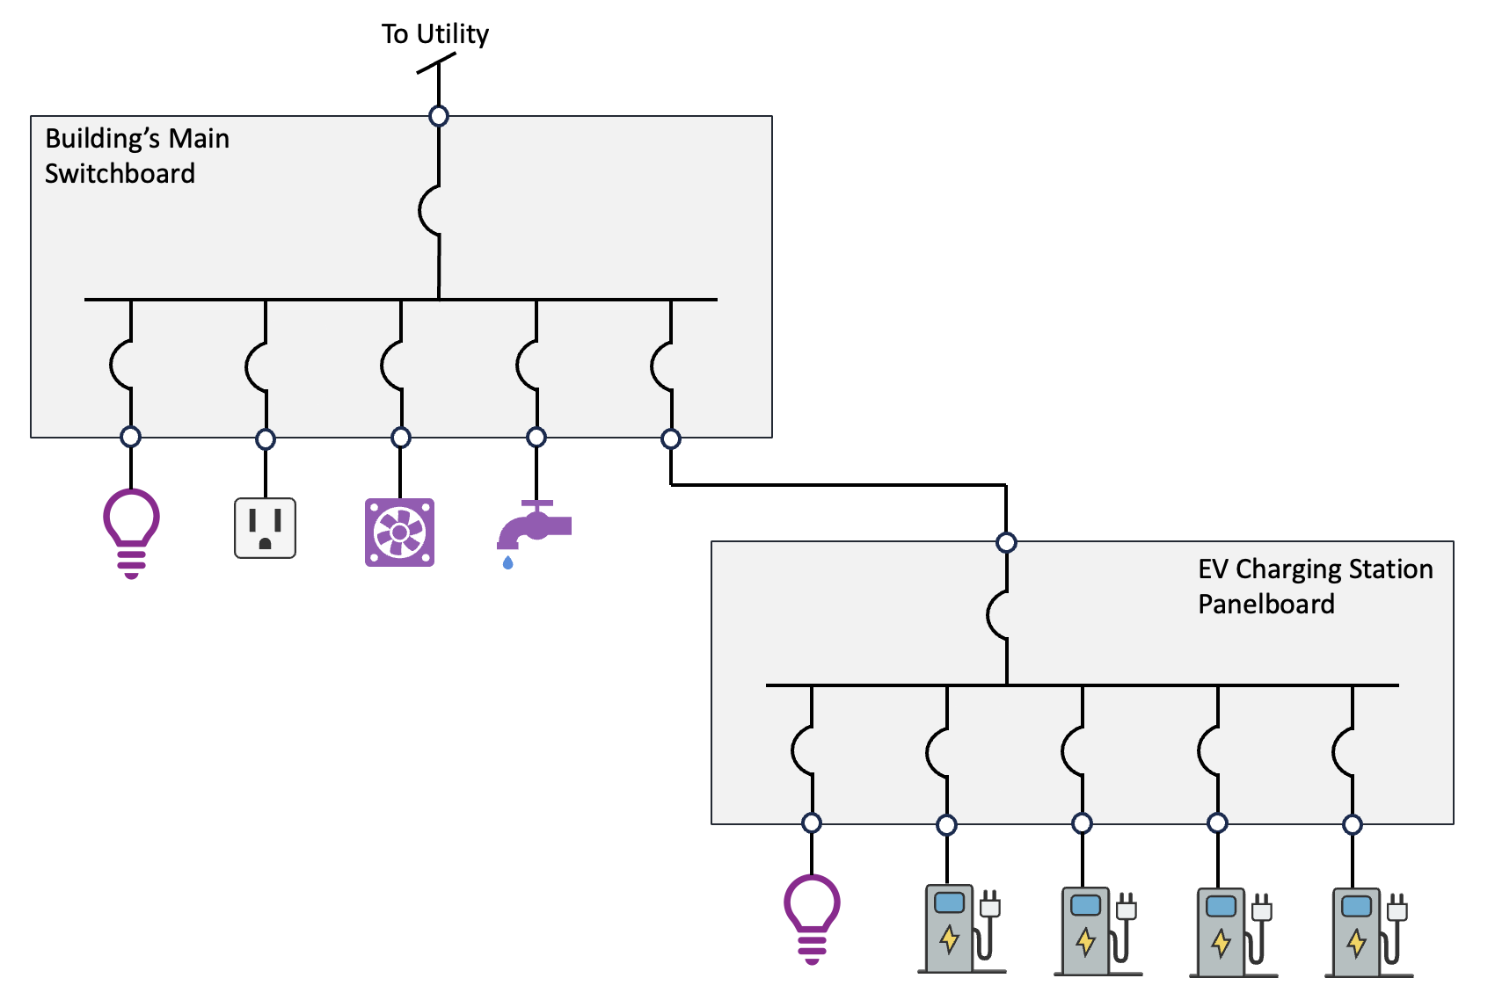
Modeling Single Line Diagrams using Xeto
Use cases
Capacity management
Service operations
Panel example actively being worked on in the Labs WG

Slide 17
Smart Building & EV Charging Interface
Technical Track

Slide 18
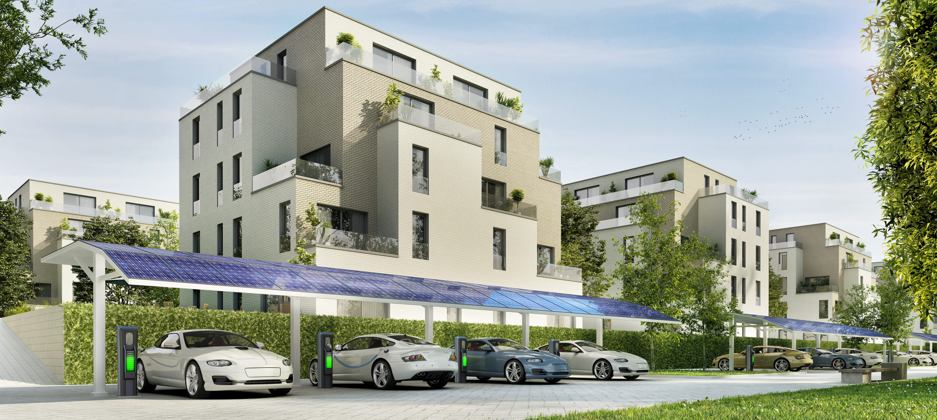
Most EV Charging occurs in the Built Environment
Completely new paradigm than refueling petrol vehicles
Opportunities to leverage unused electrical capacity in a building
“The electric-vehicle market in 2030 will require more than 55 million chargers in buildings, consuming at least 525 TWh per year.” (Source: McKinsey & Company)
Mostly Level 2 EV chargers in buildings
Synergies with:
Residential & Multifamily housing
Building & Fleet Electrification
Solar & Battery Energy Storage
Energy Efficiency

Slide 19
Smart Building & EV Charging Interface
To Utility
MSB
3-Phase, 480Y/277V
3P
Limits scope for the EV charging system integrator and allows for the smart building system integrator to indirectly control EVSE loads
To Building
Loads
3P
ElecAcLineImportCurrentMaxSp { lineCurrent: “L1” }
ElecAcLineImportCurrentMaxSp { lineCurrent: “L2” }
ElecAcLineImportCurrentMaxSp { lineCurrent: “L3” }
EV Panel
3-Phase, 208Y/120V
ElecAcTotalImportActiveDemandMaxSp

Slide 20
Next Steps & Wrap Up
Technical Track

Slide 21
Next Steps
Freeze APIs for ph.points & ph.points.elec ASAP
Lower-level dependency
Stay tuned for upcoming draft reviews
No set deadline yet
Ramp up elec attribute initiative
Iterate on the 6+ xeto-cc electrical product examples
“benchtesting” initiative

Slide 22
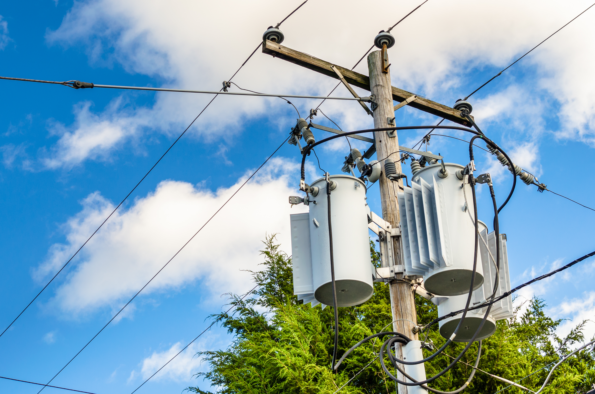
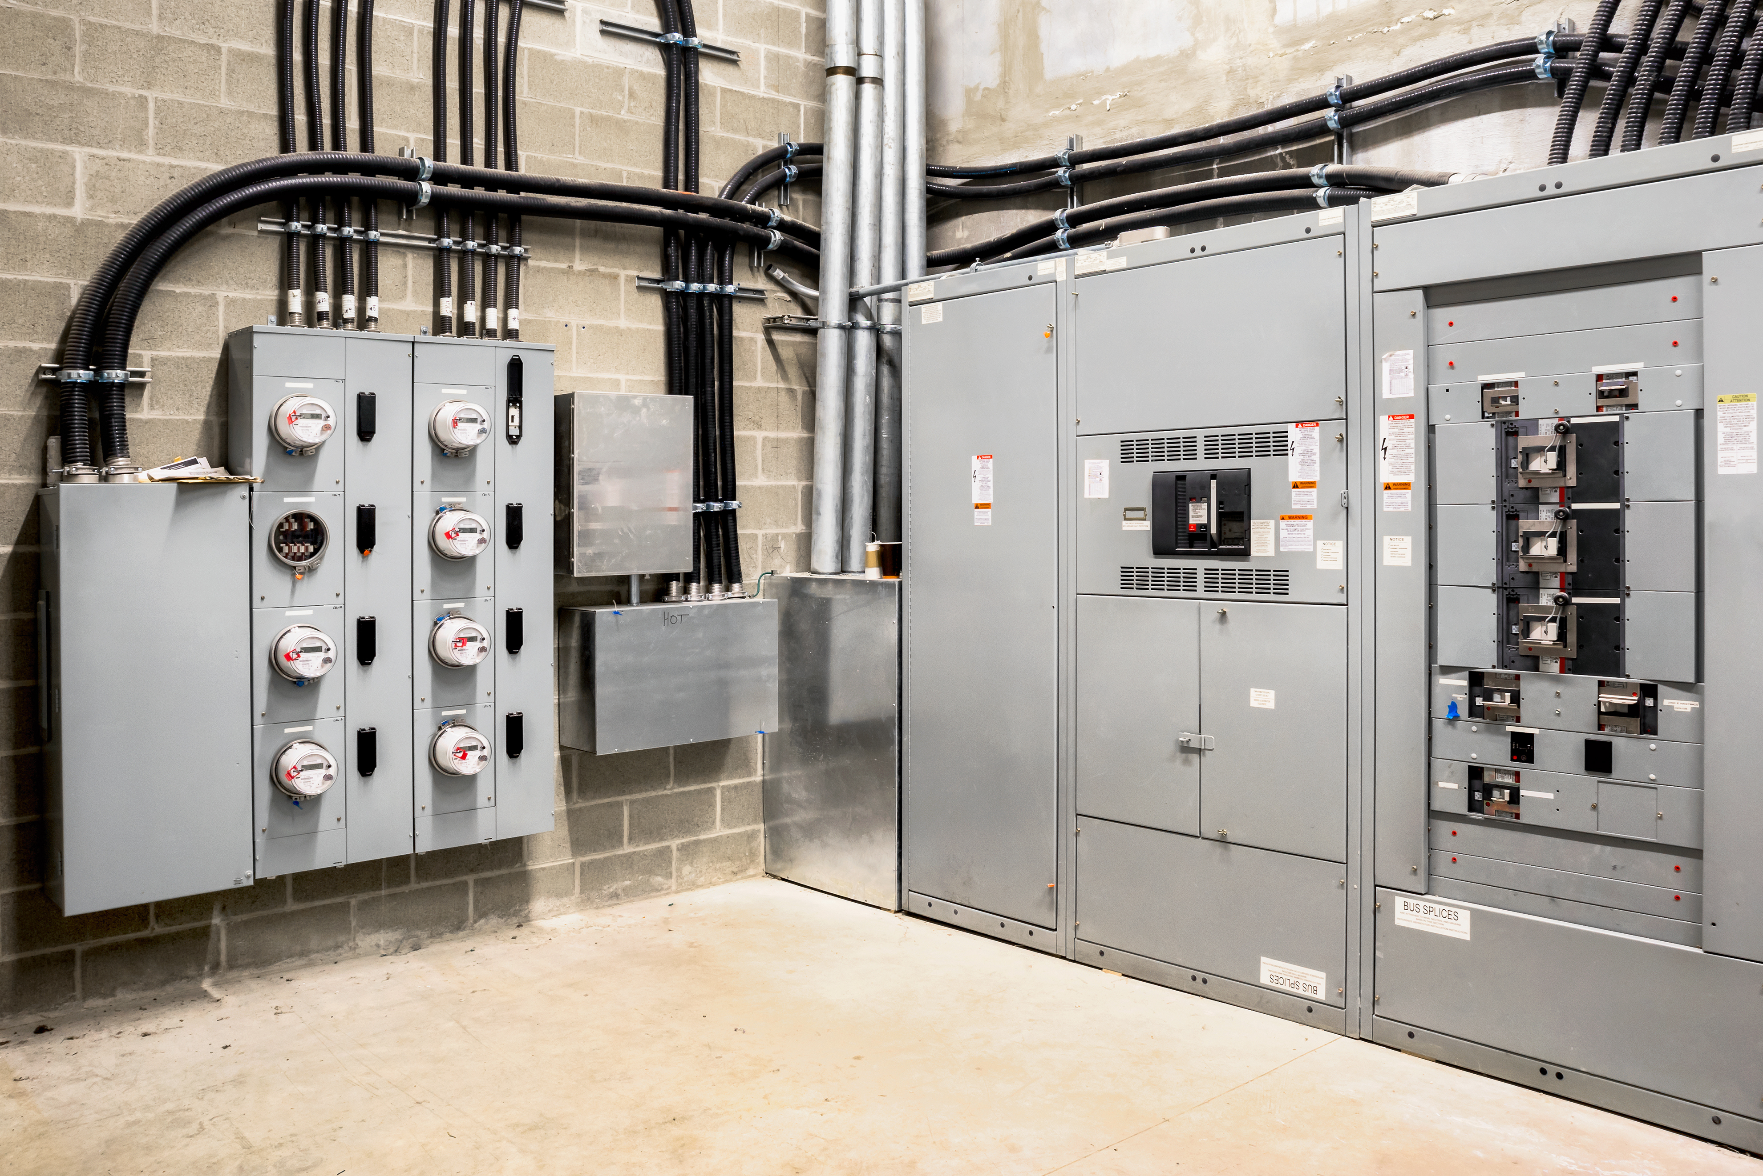
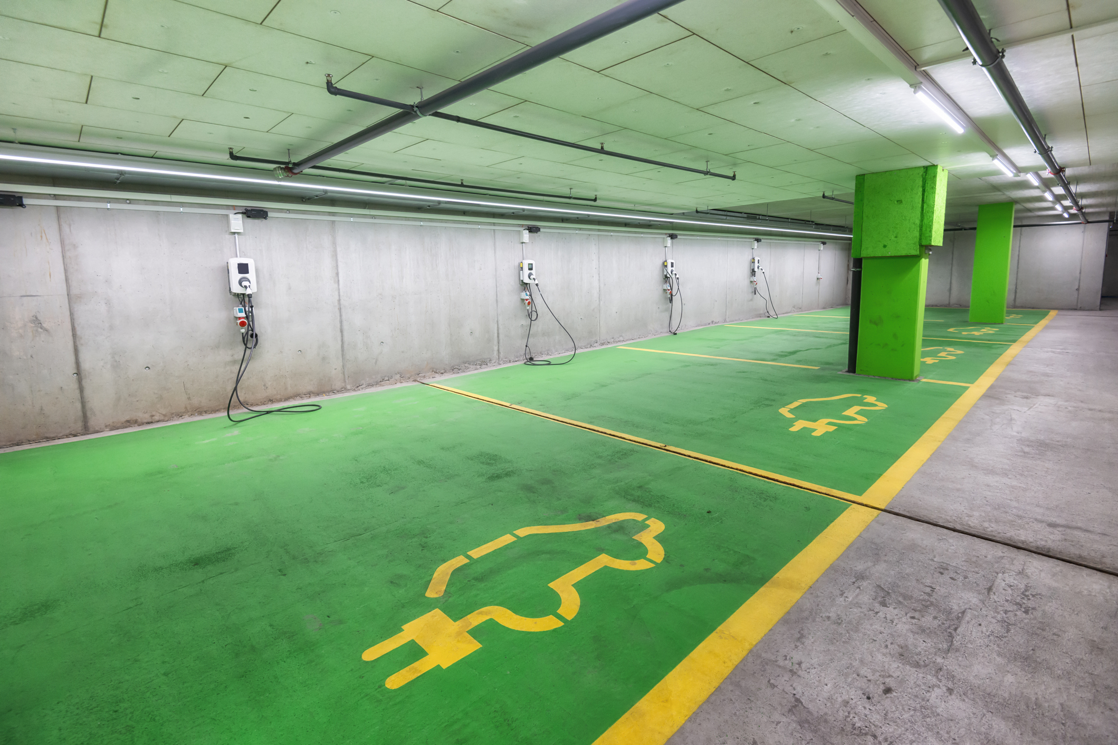
Wrap Up
Significant progress on Xeto electrical points
Better support for advanced power monitoring applications
Community examples for education and project assistance
Smart building & EV charging interface for happier end customers
Thanks to all contributors!

