Slide 1
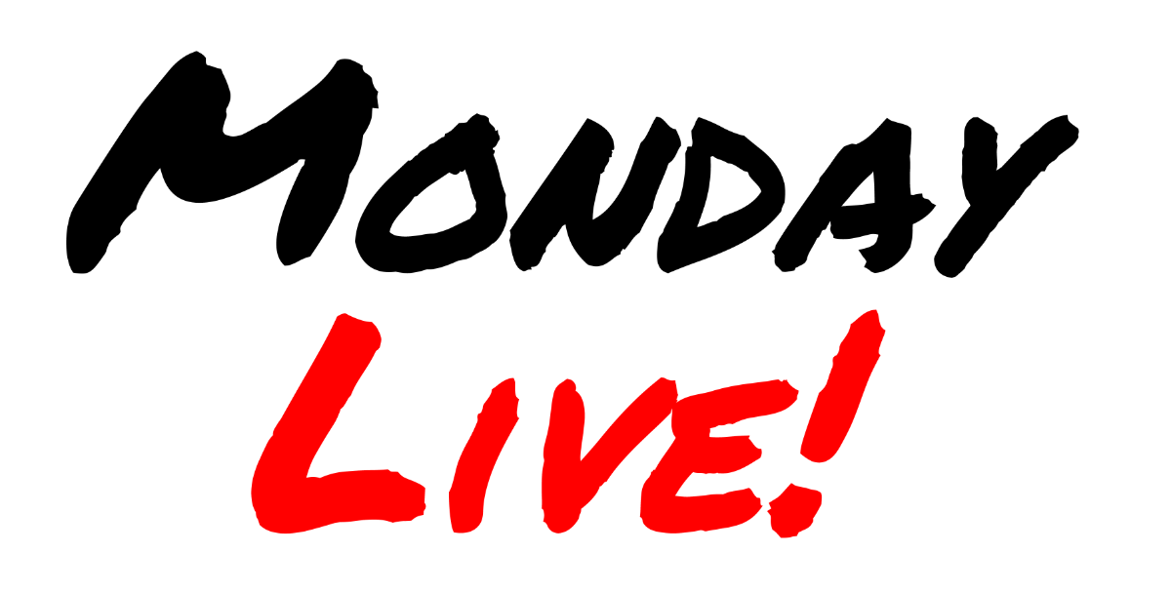
Cloud-Native/IBB Pitch at Haystack Connect 2023
Nashville, TN • June 7, 2023

Slide 2
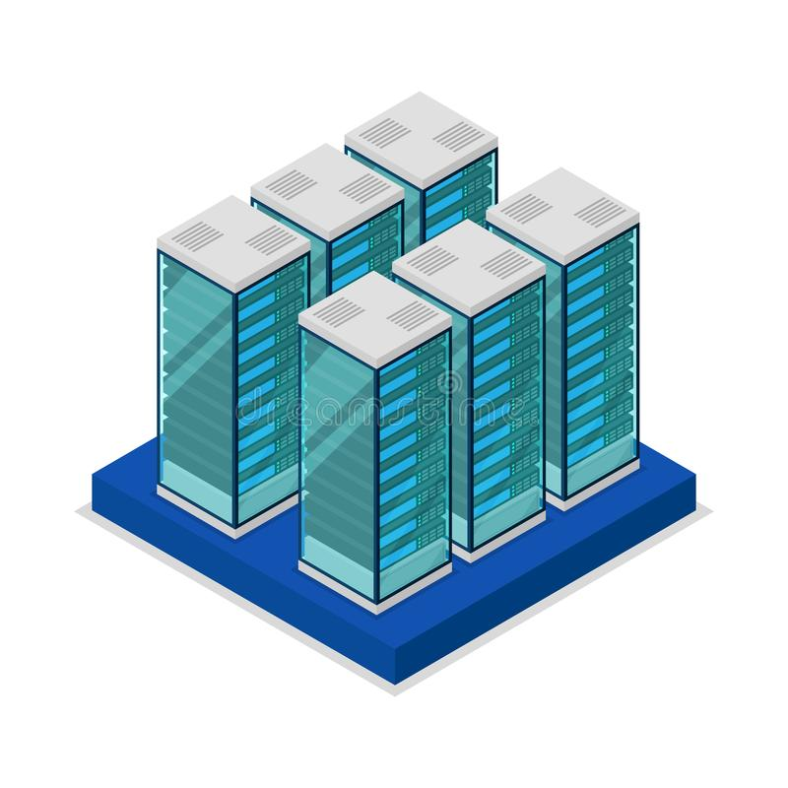
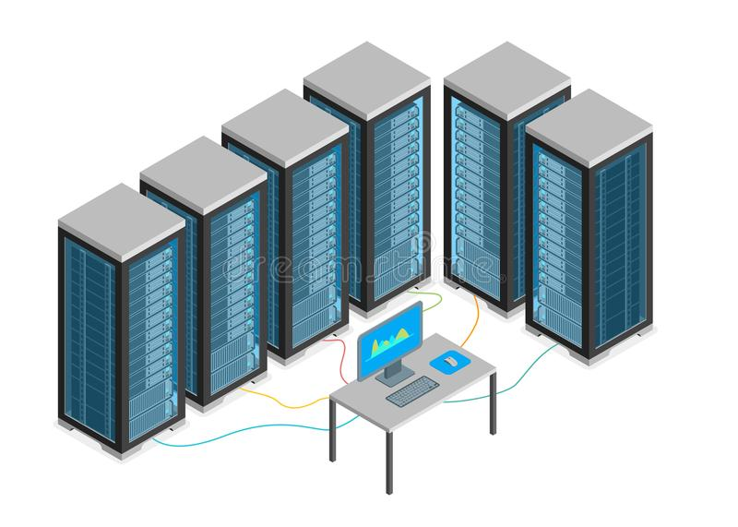
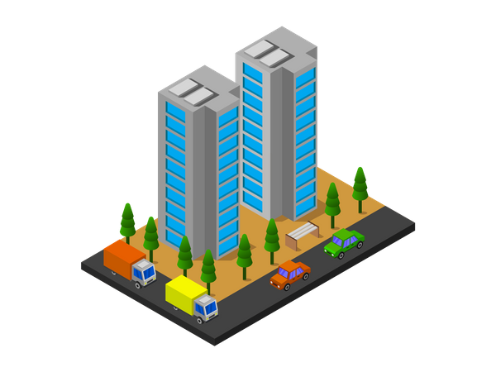
Cloud Computing and Buildings
“SaaS Era” Consume Services from the Cloud
“Dropox Era”
Put stuff in the cloud
Public
Public
Cloud-Native Cloud as a Computing Platform
Private
“Hybrid Era” Our Cloud Works with Other Clouds
On-Prem

Slide 3
Cloud-Native Computing
Public
Public
O
I-P-O-S
I Input
P Processing
O Output
S Storage
P
I
S
S
S
P
O
P
I
I
O
Private
On-Prem

Slide 4
Cloud-Native and Buildings
Public
Public
Orchestration To Manage the Complexity
IBB
Admin
Interoperability Building Box
Operating Environment
Private
On-Prem

Slide 5
Imagine a Box…
That is located on-premise
That exists physically (a device) or virtually
That provides a common and open platform to…
Host control "heads" for building systems
Manage secure communications with on-prem systems
Manage secure communication to the Internet cloud
Enable interoperation & message exchange between systems
Provide local data storage to improve performance and efficiency
Something that building owners can easily and safely specify
A product available from multiple vendors and configurations
Where vendors can safely install their application/service
That is securely & remotely managed responsibly with accountability
A standard way to gather and host on-prem applications/services

Slide 6
Box Bridging the Cloud to On-prem Systems
Administration
• Install & manage
• Updates & patches
• Access & policies
Containerized…
• Applications
• Services
• Data storage
• Etc..
Admin
A “mini” Datacenter
• Compute resources
• Network management
• Interface orchestrator
Operating Environment
IBB

Slide 7
Hosting Existing Systems
Legacy App
Legacy Devices

Slide 8
Connecting Legacy to Cloud Systems
IDL
Analytics
Gateway
Legacy Devices

Slide 9
Combining Legacy with Future Systems
UI
Analytics
Legacy App
Gateway
Future Apps
Legacy Devices
Future Devices

Slide 10
IBB on the Smarter Stack
Choice
Specifiable
Security
Manageability
Multi-Tenancy
Integrators
FM
Engineering
Web
Dashboards
UI & SPoG
Digital Twin
Analytics
Reports
AI/ML
Grid
Etc…
IBB
Middleware
Haystack
Gateways
Orchestration
Admin
Cloud IDL
Public Data
TSDB & Logs
Local IDL
Controls
Unitary
Automation
Meters
IoT
Operating Environment
HVAC
Lighting
Energy
Vert Transp
Etc…

Slide 11
Benefits of Cloud-Native/IBB
Building Owners Already Committed to the Cloud
Ideal for Zero Trust & Security Policy Management
Enables Extraction and Use of Haystack Data
Enables Dynamic Open Composition
Access to Cloud signals (utility, carbon, weather)
Flexibility and Choice
Serves Boiler Room to Boardroom

Slide 12
Adopting the IBB
Seeking Feedback on IBB Adoption from:
Building Owners
Hardware Vendors
Software Vendors
Integrators & Contractors
Consulting Engineers
Get Engaged with C4SB IBB Project
Help write/create specifications and prototypes
Test and validate Hardware and Applications
Read this AutomatedBuildings.com article on Cloud-Native
Contact Anto directly at anto@padi.io

Slide 13
Thank You!
Anto Budiardjo anto@padi.io

