Slide 1
Advancing Integrated Automation Design: Haystack Enabled Interoperability
Matthew Turk

Slide 2
Independent Data Layer: Haystack for Applications

Slide 3
System Interoperability: Haystack for Equipment

Slide 4
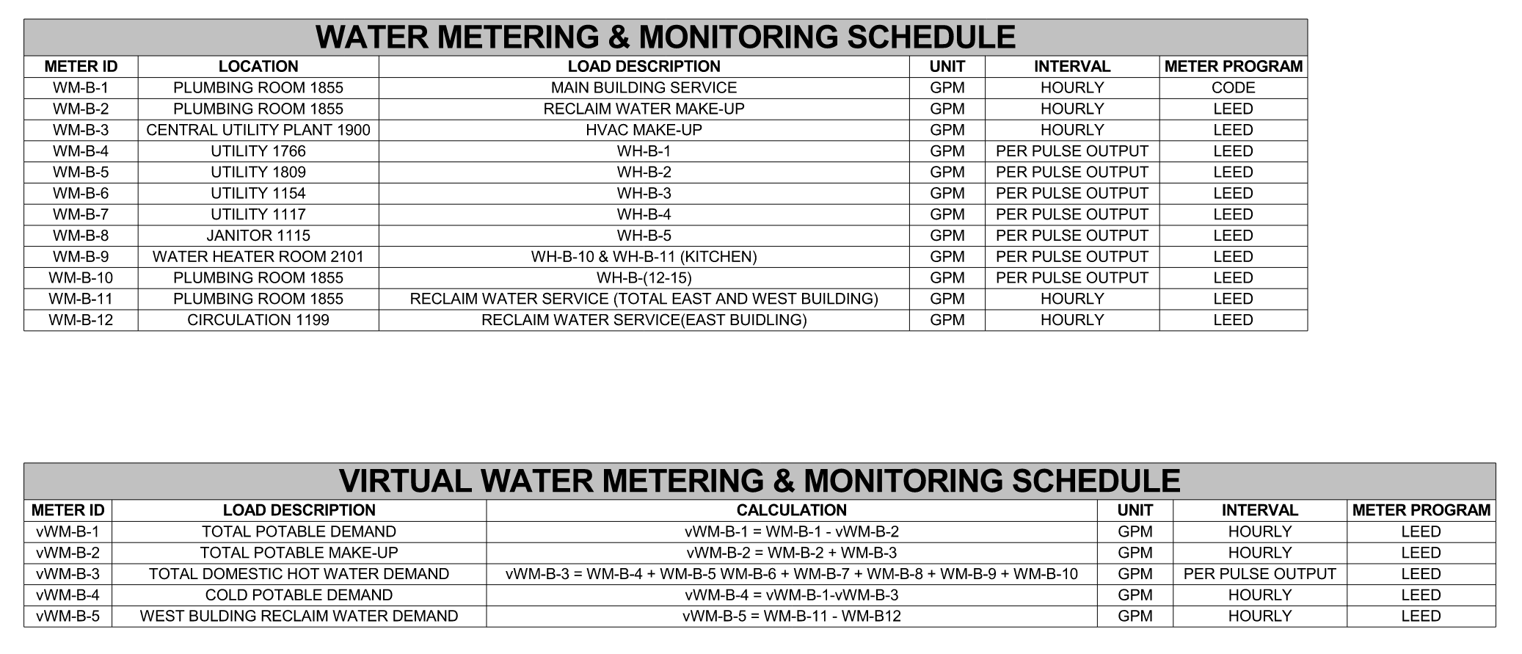
Metering & Monitoring: Haystack for Data Relationships

Slide 5
Specifying Haystack: Haystack for Today
Implement metadata tagging in XXX accordance with Project Haystack standards.
Verification of Implementation?
Metadata Tagging Commissioning?
Systems not covered by Haystack?
Workshops? – Project Specific Nomenclatures or other standards
Where to apply Haystack Tags?
Field Level Controls?
Independent Data Layer?
Software Applications?

Slide 6
Specifying Haystack: Haystack for Tomorrow
250000 Integrated Automation
251500 Integrated Automation Software
252000 Integrated Automation Cybersecurity
252100 Integrated Automation Procedures and Process for Owner’s Information Technology Engagement
253100 Integrated Automation Integration and Interoperability Requirements for Automatic Shading Systems
253200 Integrated Automation Integration and Interoperability Requirements for Conveying Equipment
253400 Integrated Automation Integration and Interoperability Requirements for Plumbing Systems
253500 Integrated Automation Integration and Interoperability Requirements for HVAC Systems and Equipment
253600 Integrated Automation Integration and Interoperability Requirements for Electrical Systems
253800 Integrated Automation Integration and Interoperability Requirements for Electronic Safety and Security Systems
253905 Integrated Automation Instrumentation & Equipment for Environmental Monitoring
253910 Integrated Automation Instrumentation & Equipment for Space and Occupant Utilization
25XXXX Integration Automation Metadata Tagging Implementation Requirements

Slide 7
Questions?
Matthew B. Turk
Associate | Intelligent Buildings
404 730 8549
mturk@newcomb-boyd.com
LinkedIn:
https://www.linkedin.com/in/matthew-turk-a86915140/

