Slide 1
Progress Update from the EV Charging Working Group (#982)
The Technical Track
Stephen Frank, PhD – NREL
(Coauthored by Rick Jennings, PE – SkyFoundry)

Slide 2
Agenda
Working Group objective
Existing EVSE equip model
Proposed EVSE equip taxonomy
evseCableType and EVSE-level tags
EVSE data points
Summary of active proposals
What’s next?

Slide 3
EVSE Working Group’s Objective
Define the equipment, points, relationships, and operational data related to Level 1-2 (AC*) and Level 3 (DC) Electric Vehicle Supply Equipment (EVSE)
*AC = Alternating Current, DC = Direct Current

Slide 4
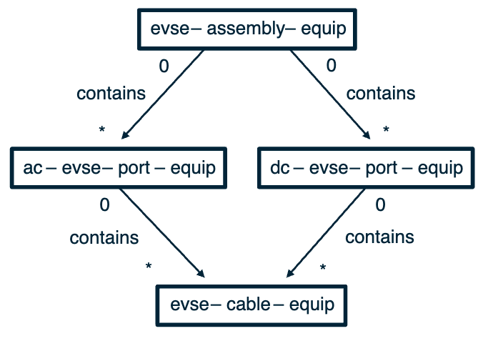
Existing Equip Model
Strengths:
Simple
Captures most AC Level 2 use cases
Limitations:
evse-assembly-equip can’t model 1 vs. multiple equipment enclosures
Difficult to capture nameplate data
Tricky to define electrical references
assembly vs. system confusion?
Limitations preclude advanced analytics and control use cases: we need a more flexible model!
Zero-to-many relationships

Slide 5
Goals for Updated Model / Taxonomy
Align with industry terminology and practice
Capture both simple and complex installations
Allow tracing of energy flows

Slide 6
Inspiration from NEVI*
*National Electric Vehicle Infrastructure (NEVI) Program
Note: An AC EVSE is not technically a “charger” because the AC/DC power conversion happens onboard the vehicle. (We want to be precise to avoid tagging conflicts!)
Some EVSE’s consist of multiple enclosures (equipment). In Haystack, we accommodate this by using evse as an adjective.
“Charger means a device with one or more charging ports and connectors for charging EVs. Also referred to as Electric Vehicle Supply Equipment (EVSE).”
“Charging port means the system within a charger that charges one EV. A charging port may have multiple connectors, but it can provide power to charge only one EV through one connector at a time.”
The evse-port conjunct (already in Haystack) follows this definition
Source: “National Electric Vehicle Infrastructure Standards and Requirements,” 23 CFR Part 680

Slide 7
Inspiration from NEVI*
*National Electric Vehicle Infrastructure (NEVI) Program
“Charging station means the area in the immediate vicinity of a group of chargers and includes the chargers, supporting equipment, parking areas adjacent to the chargers, and lanes for vehicle ingress and egress. A charging station could comprise only part of the property on which it is located.”
Haystack does not currently model a “charging station” in this sense. Future work is needed to decide how to handle it. (Is it a site? Is it a system?)
Source: “National Electric Vehicle Infrastructure Standards and Requirements,” 23 CFR Part 680

Slide 8
Inspiration from OCPP* 2.0.1
*Open Charge Point Protocol
Doesn’t quite match NEVI
evse-cable-equip
Delivery to one EV at a time matches the NEVI definition for “port”
Source: Open Charge Alliance, “Open Charge Point Protocol 2.0.1”

Slide 9
NEVI ↔ Haystack (Existing) ↔ OCPP
Charging Station
Charging Station
Only sort of…
Charger
evse-assembly-equip
Charging Port
evse-port-equip
EVSE
Connector
evse-cable-equip
Connector
We thought about using connector but it is far too generic. An EVSE connector generally has a single cable, so this works pretty well.

Slide 10
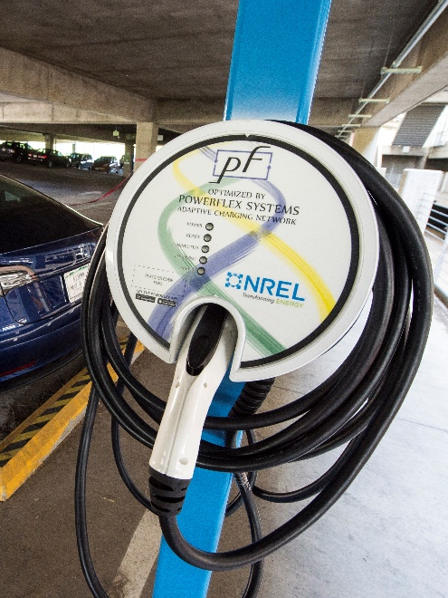
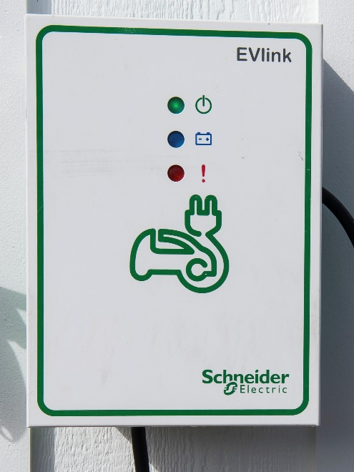
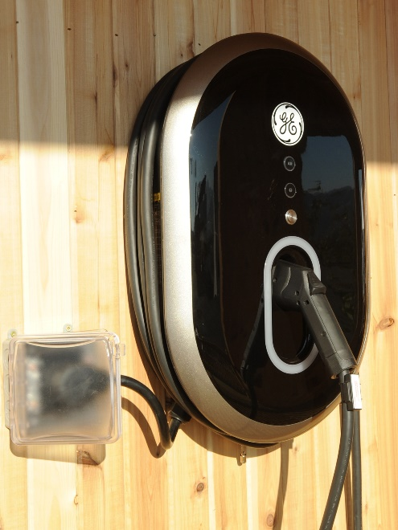
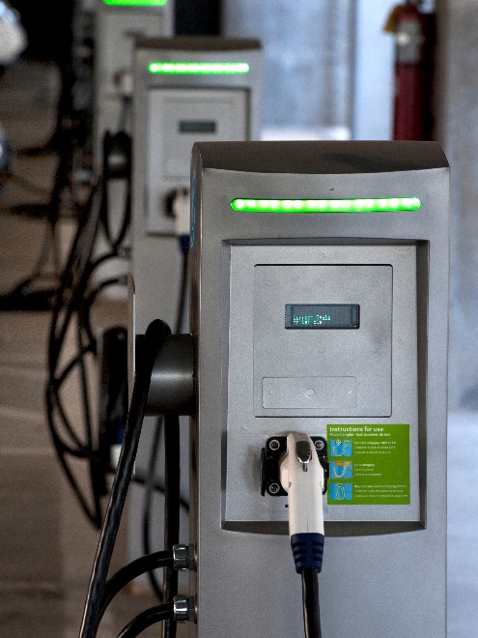
Introducing the EVSE dispenser
AC Dispenser
Definition: The physical EVSE enclosure and its contents to which an EVSE cable attaches. Dispenses electricity to an EV.
An evse-dispenser often contains one or more evse-port
In simple cases, dispenser directly replaces assembly
(1) Port
(1) Cable
(1) Connector
Photos: Dennis Schroeder / NREL (21660,48406, 56649), Thomas Kelsey / U.S. DOE Solar Decathlon (37699)

Slide 11
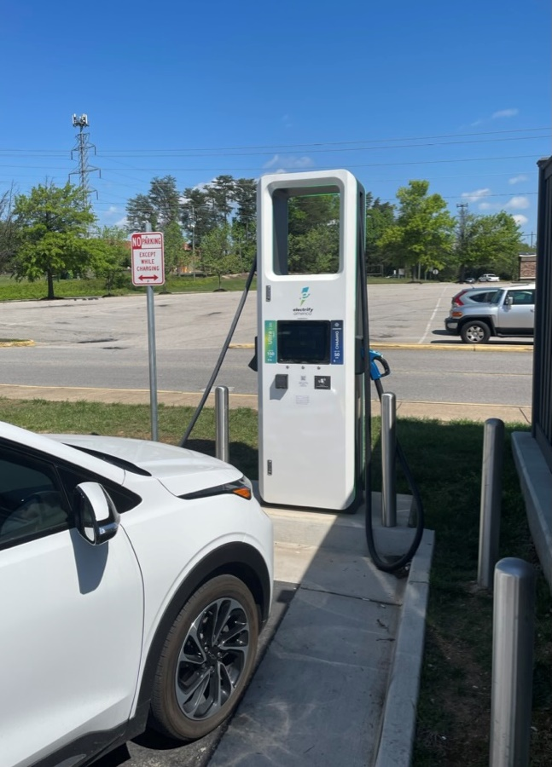
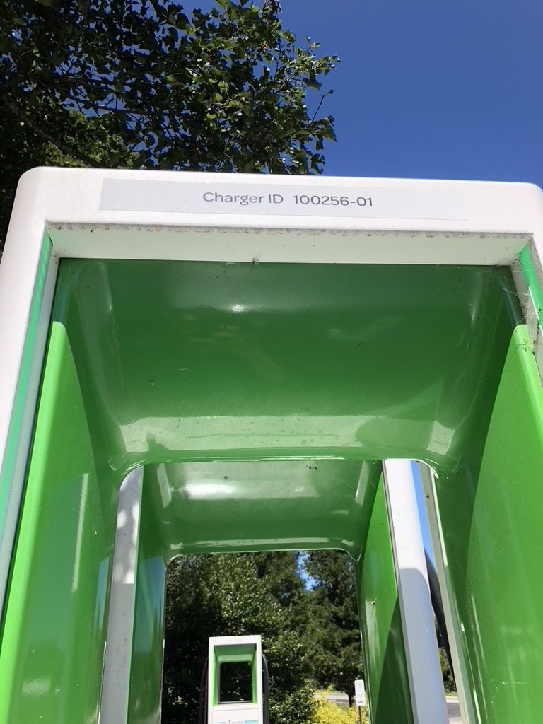
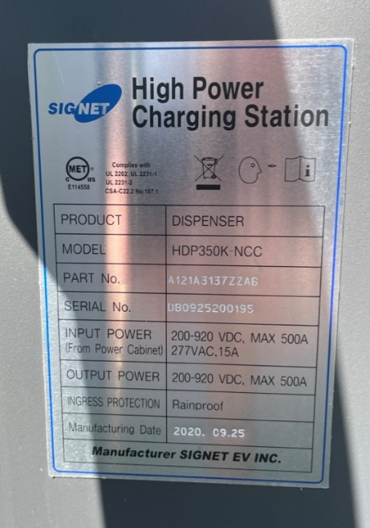
Level 3 (DC) EVSE Dispensers
Electrify America’s dispensers have “Charger ID XX” for EV drivers to use when they report issues
This Signet EVSE has a nameplate that labels it as a “dispenser”
Photos: Rick Jennings

Slide 12
Revisiting evse-port
An evse-port delivers electricity to a single EV at a time
An evse-port is typically comprised of a software-controlled electrical contactor or circuit breaker
An evse-port is typically (but not always) contained within an evse-dispenser
More than one evse-cable may be connected to a single evse-port, but only one may be energized at any given time

Slide 13
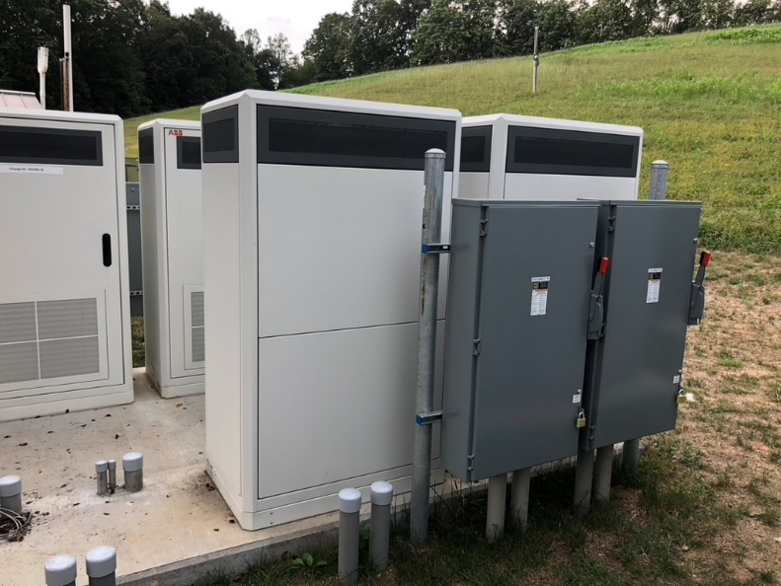
Introducing the evse-powerConverter
Power Converter: converts one electrical waveform to another using power electronic circuitry. Has clearly defined inputs and outputs. May convert:
AC → DC
AC → AC*
DC → DC
DC → AC
The evse-powerConverter may be either within the evse-dispenser or in a separate equipment enclosure.
*An AC/AC power converter performs the same task as a power transformer but using power electronics.
Photos: Rick Jennings

Slide 14
New EVSE Equipment Taxonomy: Option 1
evse-system
(Not yet formally proposed)
evse-powerConverter-equip
0
elecRef
This handles the case where power conversion is separate from the dispenser.
*
evse-dispenser-equip
0
equipRef
Any element can be omitted; hence the “zero” option for each relationship.
*
evse-port-equip
0
equipRef
*
evse-cable-equip

Slide 15
New EVSE Equipment Taxonomy: Option 2
This handles the case where power conversion is integral within the dispenser (but still modeled as a distinct equip.)
evse-dispenser-equip
1
equipRef
equipRef
*
*
evse-powerConverter-equip
evse-port-equip
0
equipRef
*
evse-cable-equip

Slide 16
New EVSE Equipment Taxonomy: Option 3
evse-dispenser-powerConverter-port-cable-equip
evse-dispenser-port-cable-equip
evse-dispenser-port-equip
evse-dispenser-equip
etc.
Different elements can also be collapsed into a single equip, or some elements may be omitted from the model in simple applications.
These options cover the majority of the use cases. We anticipate this taxonomy will also accommodate evse-port located in a separate equipment enclosure than the evse-dispenser.

Slide 17
NEVI ↔ Haystack (Proposed) ↔ OCPP
Charging Station
evse-powerConverter-equip
Charging Station
Charger
evse-dispenser-equip
Mapping depends on system configuration; future evse-system conjunct may be a better mapping?
Charging Port
evse-port-equip
EVSE
Connector
evse-cable-equip
Connector

Slide 18
evseCableType tag on evse-cable-equip
Enum that defines the cable type
Based on OCPP 2.0.1 ConnectorEnumType but limited to physical cables only
Values
ccs1
ccs2
chademo
nacs
saeJ1772
iecType2
saeJ3068
mcs
gbt
This is near-final; just need to review the list for completeness and consistency
Note: Since OCPP 2.0.1 was published Tesla open-sourced their connector and called it the “North American Charging Standard” (NACS)

Slide 19
Preview: Introducing EVSE Level Tags
Proposal to add marker tags:
evseLevel1 = 120 V_{AC} Charging
evseLevel2 = 208 V_{AC} or 240 V_{AC} Charging
evseLevel3 = DC Fast Charging
Still working on the correct labels for these markers.

Slide 20
Preview: Points on ac-evse-port-equip
 | evse, session, sensor, point | evse, status, sensor, point | total, import, ac, elec, active, power, sensor, point | total, import, ac, elec, active, energy, hisTotalized, sensor, point | import, ac, elec, current, magnitude, sensor, point
ts1 | - | “Available” | - | - | -
ts2 | - | “Preparing” | - | - | -
ts3 | "1234" | - | - | 0kWh | -
ts4 | - | “Charging” | - | - | -
ts5 | - | - | 9.44kW | 0.17kWh | 40.62A
...
tsX1 | - | - | 9.39kW | 29.37kWh | 40.41A
tsX2 | stop | - | 9.38kW | 29.41kWh | 40.38A
tsX3 | - | “Finishing” | - | - | -
tsX4 | - | “Available” | - | - | -
Stores the EV charging session ID
Ongoing work related to total and import tags

Slide 21
Preview: Points on dc-evse-port-equip
 | evse, session, sensor, point | evse, status, sensor, point | total, import, dc, elec, active, power, sensor, point | total, import, dc, elec, active, energy, hisTotalized, sensor, point | total, import, ac, elec, active, energy, hisTotalized, sensor, point | elec, vehicle, battery, level, sensor, point
ts1 | - | “Available” | - | - | - | -
ts2 | - | “Preparing” | - | - | - | -
ts3 | "1234" | - | - | 0kWh | 0kWh | -
ts4 | - | “Charging” | - | - | - | -
ts5 | - | - | 9.44kW | 0.17kWh | 0.17kWh | 40.2%
...
tsX1 | - | - | 9.39kW |  | 29.37kWh | 90.8%
tsX2 | stop | - | 9.38kW |  | 29.41kWh | 90.9%
tsX3 | - | “Finishing” | - |  | - | -
tsX4 | - | “Available” | - |  | - | -
Stores the EV charging session ID
Ongoing work related to total and import tags

Slide 22
Preview: evse, status, sensor, point
An enum based on OCPP 2.0.1 ConnectorStatusEnumType
Possible values
available
occupied
reserved
unavailable
fault / faulted
For OCPP 1.6J: Map “Preparing”, “Charging”, “SuspendedEVSE”, “SuspendedEV”, “Finishing” to “occupied”

Slide 23
Preview: elec-vehicle
Electric vehicle location and state of charge data can be important when developing EV charging strategies
Work in progress – defining this new taxonomy
Very simple and limited scope for now
Points
Location tracking: kind: “Coord”, point
elec, vehicle, battery, level, sensor, point

Slide 24
Ready to Propose - Equip
Remove
evse-assembly
Add
evse-dispenser
evse-powerConverter
Modify
evse-cable
Proposal to limit the scope of the evse-cable definition to physical EVSE cables

Slide 25
Work in Progress - Tags
Add enum
evseCableType
Add marker tags
evseLevel1
evseLevel2
evseLevel3
Proposal to limit scope of evseCableType to types of physical EVSE cables

Slide 26
Work in Progress – Points
Add points on evse-port-equip
evse, session, sensor, point
evse, status, sensor, point
Add points on ac-evse-port-equip
total, import, ac, elec, active, power, sensor, point
total, import, ac, elec, active, energy, hisTotalized, sensor, point
import, ac, elec, current, magnitude, sensor, point
Add points on dc-evse-port-equip
total, import, dc, elec, active, power, sensor, point
total, import, dc, elec, active, energy, hisTotalized, sensor, point
Work involves defining enum values to: evse, status, sensor, point
Ongoing work related to total and import tags

Slide 27
Future Work - Equips
evse-system
evse-chiller
elec-vehicle
Sockets, pantographs, & wireless charging
Related electrical distribution equipment (separate WG?)

Slide 28
Future Work – Points
Add points on elec-vehicle
Location tracking: kind: “Coord”, point
elec, vehicle, battery, level, sensor, point
Points that model generic and vendor-specific errors codes
The #1 industry challenge right now is equipment reliability!
Therefore, we need a clean and efficient way to capture and express error codes within Haystack
Other EVSE points: setpoints, OCPP configuration settings, etc.
Introducing these points depends on a vehicle proposal

Slide 29
How To Get Involved
Join the working group
Review WG proposals
Beta test proposed tags and relationships
Share examples of real-world systems and data

Slide 30
Q&A and Contact Info
Stephen.Frank@nrel.gov
rick@skyfoundry.com

Slide 31
Funding Statement & Disclaimer
This work was authored in part by the National Renewable Energy Laboratory, operated by Alliance for Sustainable Energy, LLC, for the U.S. Department of Energy (DOE) under Contract No. DE-AC36-08GO28308. Funding was provided by the U.S. Department of Energy. The views expressed in the article do not necessarily represent the views of the DOE or the U.S. Government. The U.S. Government retains and the publisher, by accepting this presentation for publication, acknowledges that the U.S. Government retains a nonexclusive, paid-up, irrevocable, worldwide license to publish or reproduce the published form of this work, or allow others to do so, for U.S. Government purposes.

Slide 32
References
“National Electric Vehicle Infrastructure Standards and Requirements,” 23 CFR Part 680. Federal Register, Vol. 88, No. 39. pp. 12724–12757. Accessed: May 23, 2023. [Online]. Available: https://www.federalregister.gov/documents/2023/02/28/2023-03500/national-electric-vehicle-infrastructure-standards-and-requirements
Open Charge Alliance, “Open Charge Point Protocol 2.0.1.” Mar. 31, 2020. Accessed: May 23, 2023. [Online]. Available: https://www.openchargealliance.org/

