Slide 1
Integrating BMS into cloud analytic platform using Haxall
Haxall As An Integration Solution
Christopher Malavisi
Airmaster

Slide 2
Agenda
Introduction
Challenges of integrating BMS into cloud analytic platform
What is Haxall?
Solving the challenges with Haystack & Haxall
Framework to expand capabilities

Slide 3
Introduction

Slide 4
Agenda
Introduction
Challenges of integrating BMS into cloud analytic platform
What is Haxall?
Solving the challenges with Haystack & Haxall
Framework to expand capabilities

Slide 5
Challenges of integrating BMS into cloud analytic platform
Different platforms, vendors, protocols, sites integrating into a single system
Lots of different systems
Doing different things

Slide 6
Challenges of integrating BMS into cloud analytic platform
Platform expects data to be granular
Platform has a specified interval requirement for time-series data
Platform offers the option of specifying time-series data as COV, platform must know what data is COV
Existing BMS systems not designed to service analytics:
May not be historizing required data
Existing historization intervals can be too infrequent or irregular
If existing historization is COV this may not be easy to identify

Slide 7
Challenges of integrating BMS into cloud analytic platform
Data often has issues and requires transformation
Scaling issues
Unit problems
Inverted
Multistate enumeration

Slide 8
Challenges of integrating BMS into cloud analytic platform
Platform may have to traverse network to reach systems
Firewalls
Intermittent network issues

Slide 9
Agenda
Introduction
Challenges of integrating BMS into cloud analytic platform
What is Haxall?
Solving the challenges with Haystack & Haxall
Framework to expand capabilities

Slide 10
What is Haxall?
“Haxall is an open-source software framework for the Internet of Things.”

Slide 11
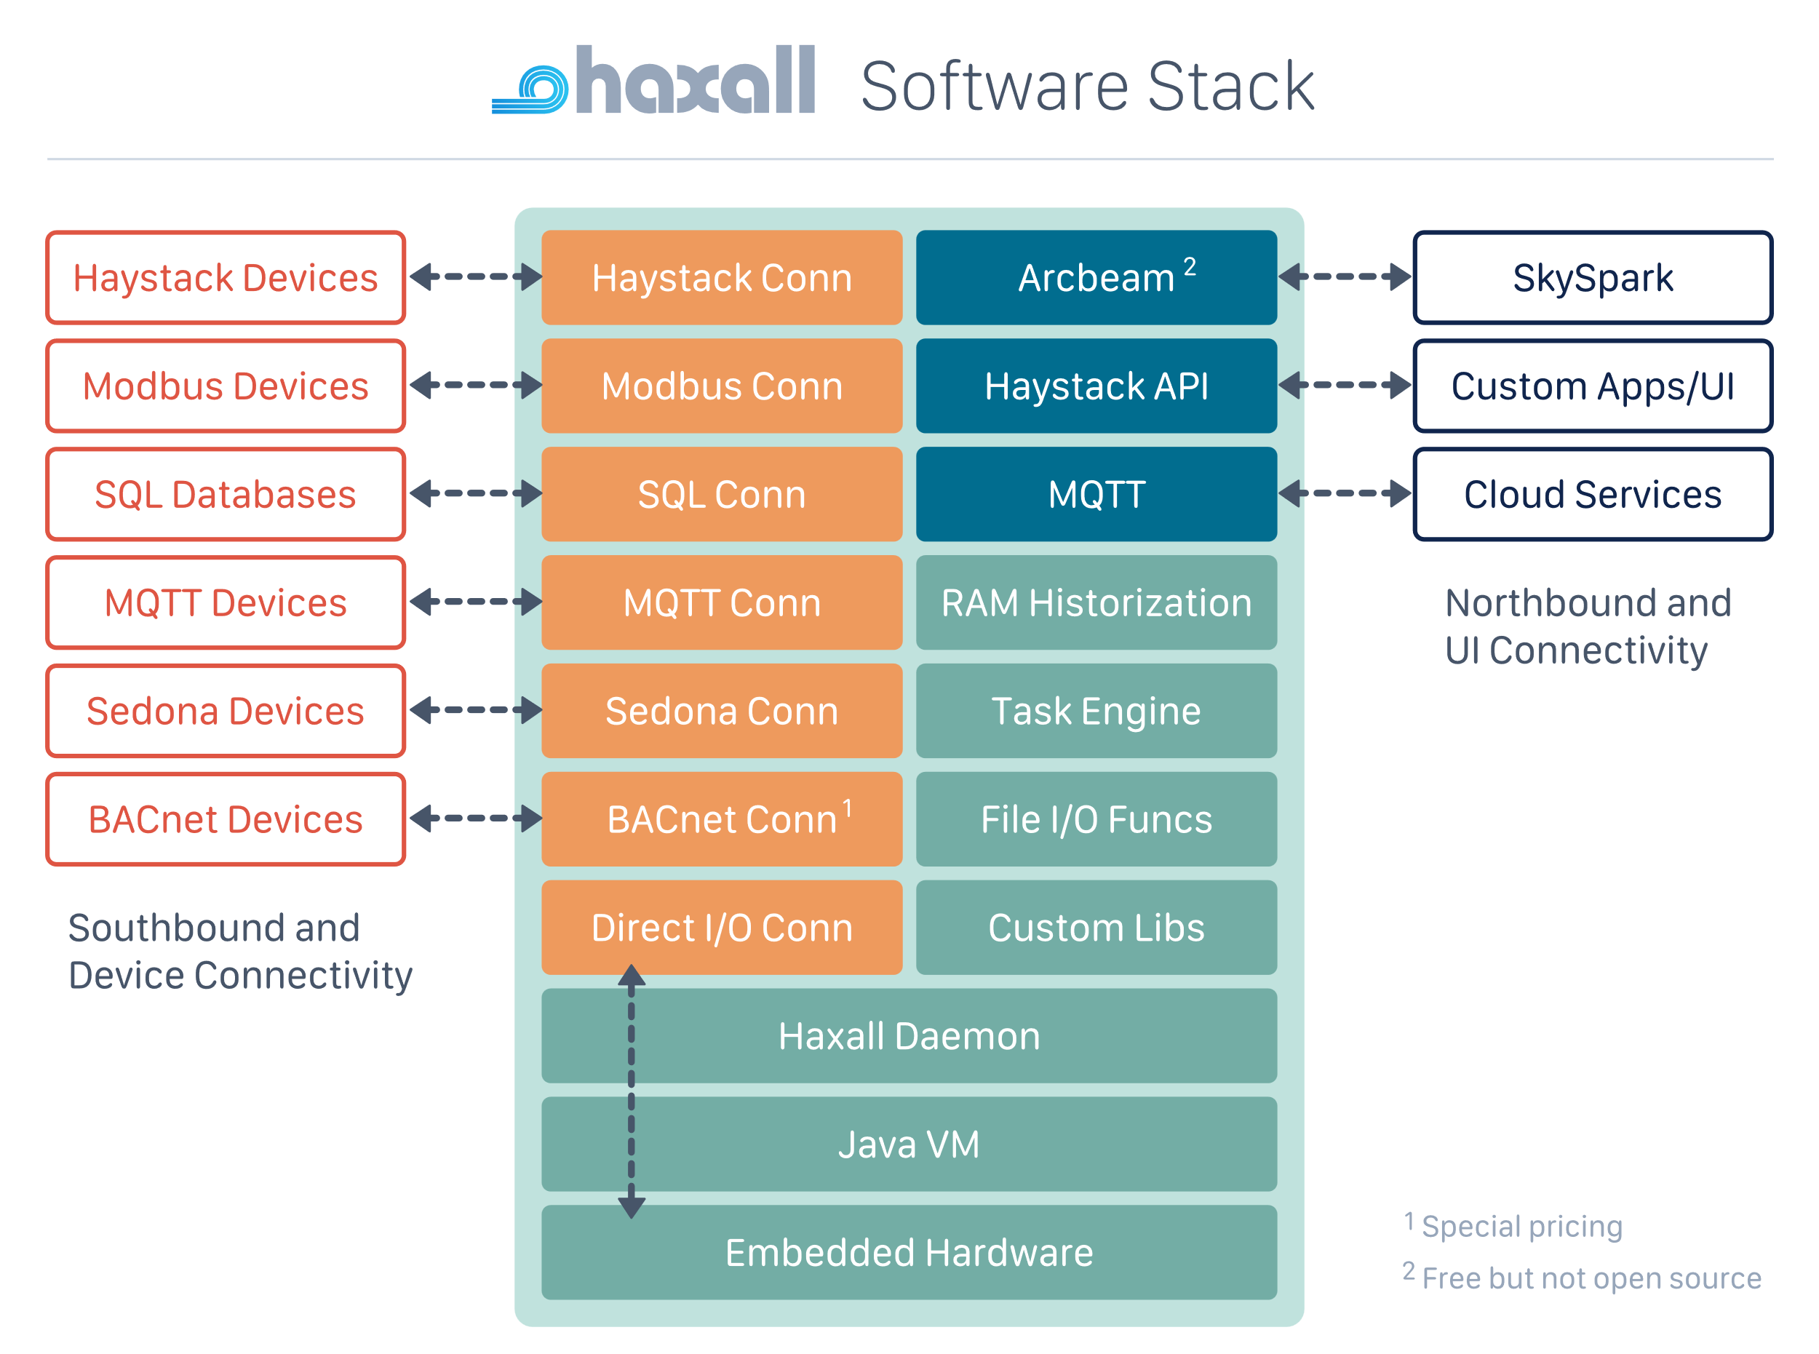
What is Haxall?

Slide 12
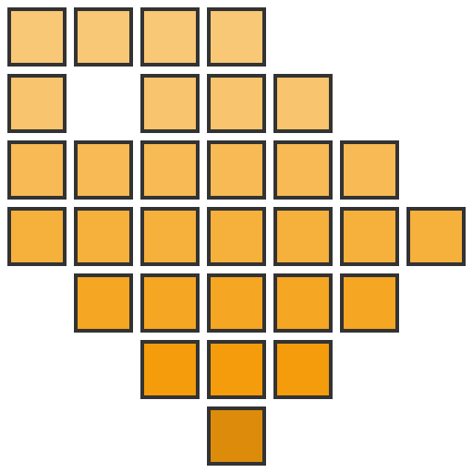
What is Haxall?
Haystack
Haxall is built from the ground up around the Haystack data model - it bundles a rich set of APIs to model, encode, and query data using the Haystack 4 ontology.

Slide 13
What is Haxall?
Connectors
The connector framework standardizes the integration of IoT protocols into the Haxall ecosystem. A suite of ready to use connectors is provided including Haystack, MQTT, Modbus, SQL, oBIX, Sedona, Nest, and Ecobee. Or use the framework APIs to write your own custom connectors.

Slide 14
What is Haxall?
Axon
Haxall includes a functional scripting engine named Axon. Create scripts to onboard, configure, query, and transform your IoT data using a library of hundreds of functions. The Axon function library has been leveraged for over a decade to streamline working with Haystack data.

Slide 15
Agenda
Introduction
Challenges of integrating BMS into cloud analytic platform
What is Haxall?
Solving the challenges with Haystack & Haxall
Framework to expand capabilities

Slide 16
Challenges of integrating BMS into cloud analytic platform
Onboard data
Import different protocols and data formats using the connector framework
Axon to assist with import

Slide 17
Challenges of integrating BMS into cloud analytic platform
Structure data
Haystack to structure
Axon to assist

Slide 18
Challenges of integrating BMS into cloud analytic platform
Historize Data
Use Haxall historian to historize
Configurable with Haystack tags
COV or interval
Axon to assist

Slide 19
Challenges of integrating BMS into cloud analytic platform
Resolve Data Issues
Convert live values before historization
Pre-built functions
Adjust scaling
Change units

Slide 20
Challenges of integrating BMS into cloud analytic platform
Network Traversal
Connection to cloud platform initiated by Haxall node.
Isolated from other nodes.
Communication to cloud platform over secure ArcBeam tunnel
Utilize connector framework to deliver northbound

Slide 21
Challenges of integrating BMS into cloud analytic platform
Open
Mostly open-source
No licensing costs except some connectors

Slide 22
Agenda
Introduction
Challenges of integrating BMS into cloud analytic platform
What is Haxall?
Solving the challenges with Haystack & Haxall
Framework to expand capabilities

Slide 23
Framework to expand capabilities
Can do these things
Can read from historian and pipe data in & out of Python environment utilizing existing framework
Easily containerized
Package code with pods
Utilize existing tools to assist in deployment and modelling

