Slide 1
Haystack Labs WG Update: Portfolio & Attributes
Track 2 – Session 2
Annie Dehghani
Buildings IOT

Slide 2
Overview
2 New Concepts Introduced to Haystack:
Portfolio
Attributes

Slide 3
Portfolios
Higher Level organization and grouping for sites

Slide 4
portfolio, portfolioRef
def: ^portfolio
is: ^entity
doc: "A collection of sites“
def: ^portfolioRef
is: ^ref
of: ^portfolio
tagOn: [^site, portfolio]
containedBy: ^portfolio
portfolio
portfolio
portfolio
site
site
portfolioRef

Slide 5
campus
def: ^campus
is: ^site
doc: "A collection of contiguous sites. “
campus
site
site
site
siteRef

Slide 6
building
def: ^building
is: ^site
doc: "A closed structure with walls and a roof."
usage: building site

Slide 7
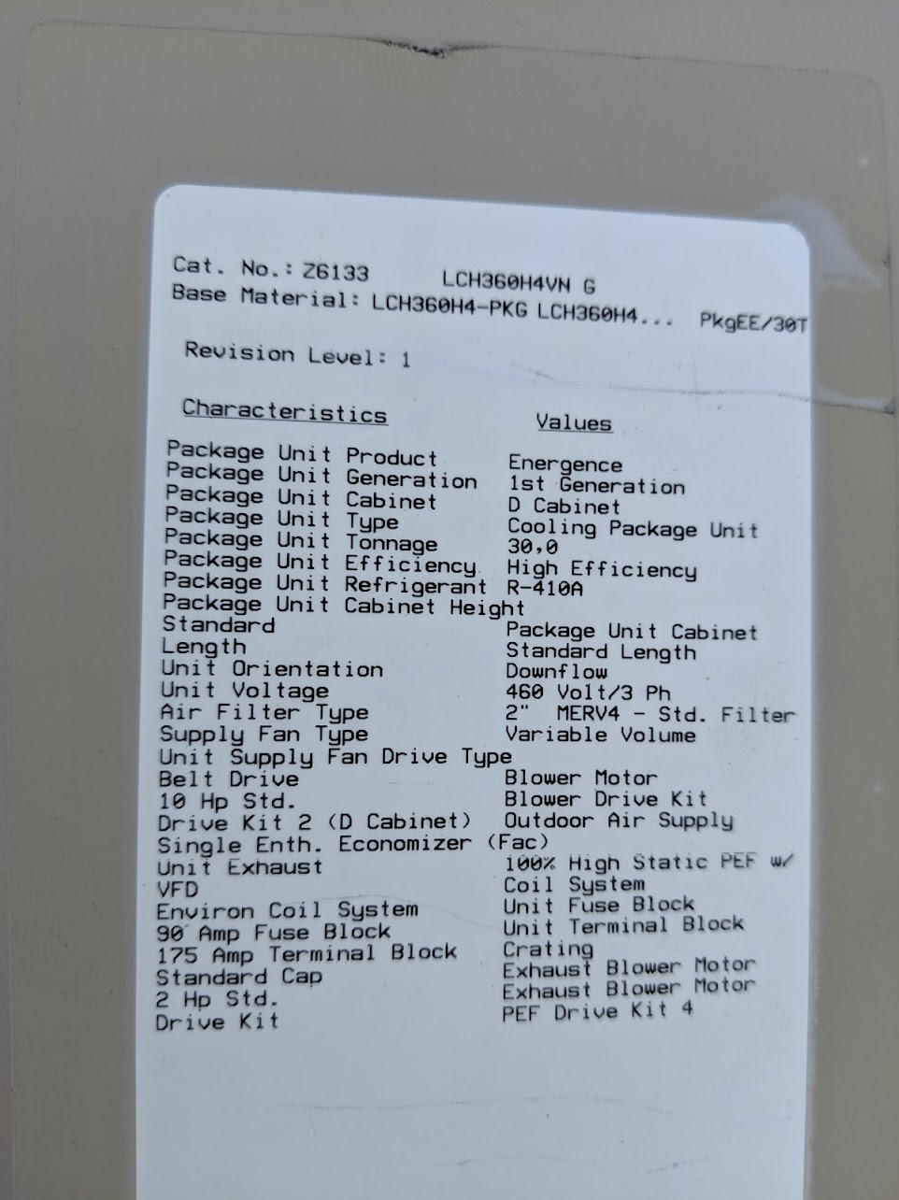
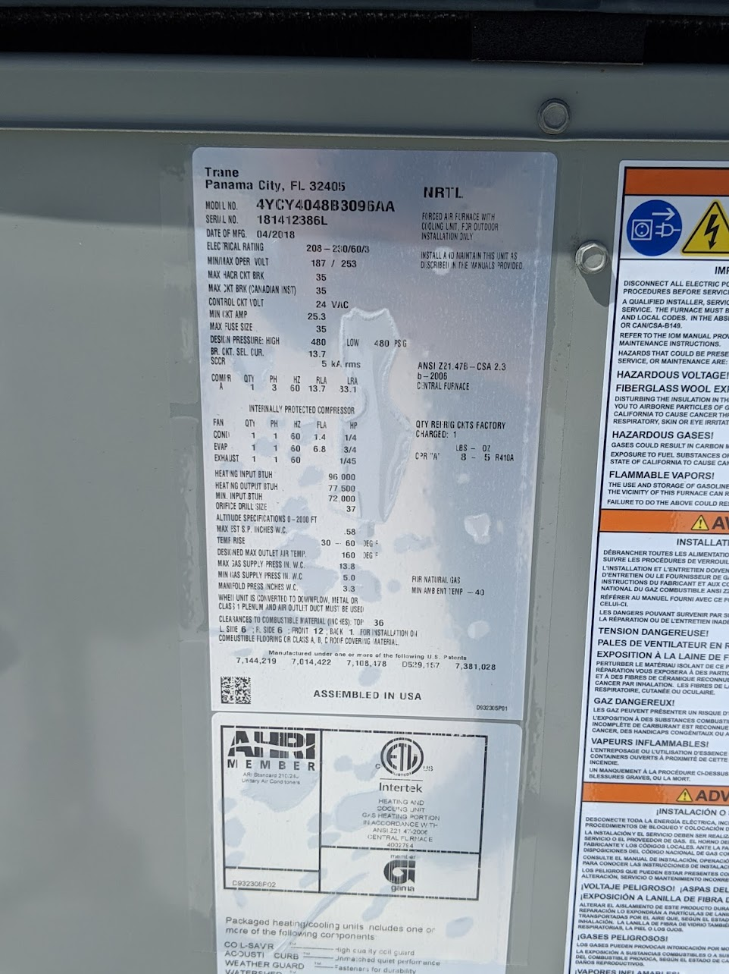
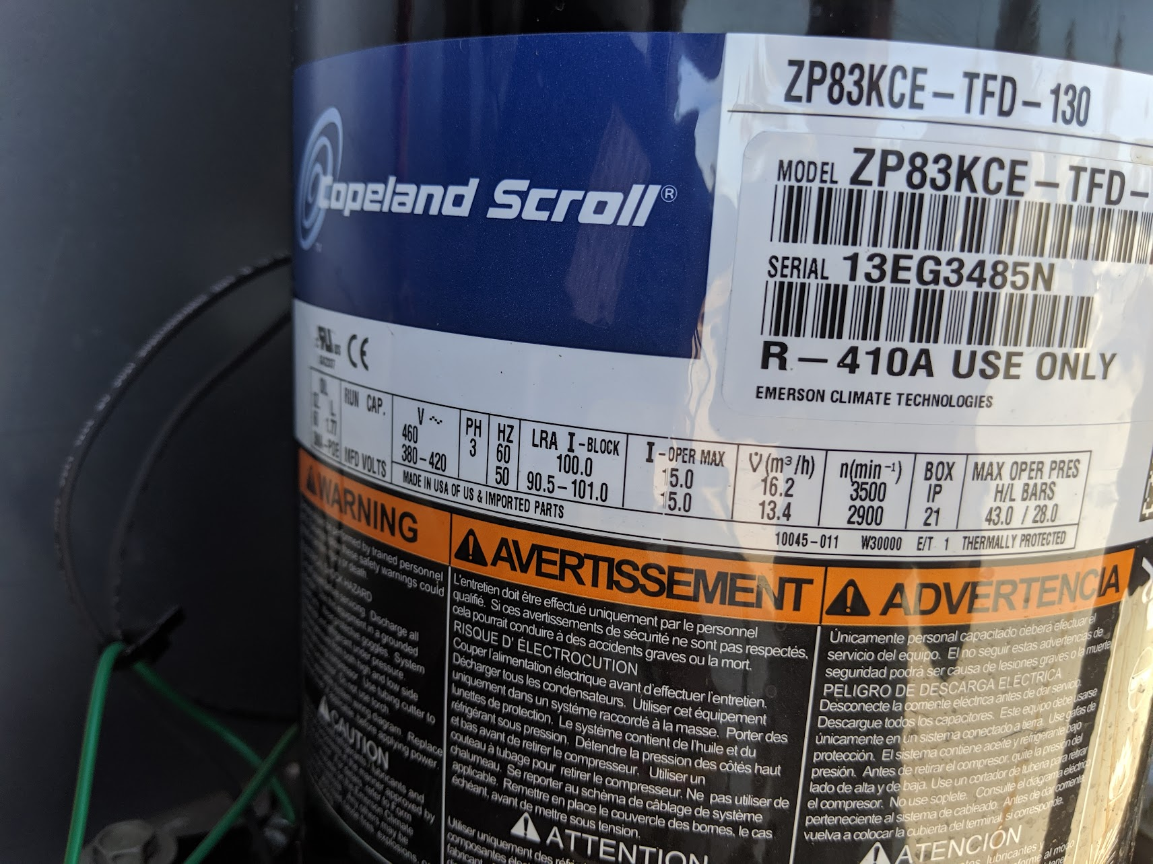
Attributes
Static (not time-series) meta data about an entity, typically an equip
Examples include: equipment schedules and name plate data, BIM data

Slide 8
Typical Attributes
Identifying Information
Make
Model
Serial number
Equipment size
Capacity
Airflow
Power
Voltage
Spatial Attributes
Gross Floor Area
Design Occupancy

Slide 9
Modelling Considerations
Attributes have a scalar value
Attributes are messy just like points
Model as a "bag" of marker tags on an equip ?
Camel case is fraught: heatEnergyMaxRatedOutput or is it maxHeatEnergyRatedOutput?
Model each attribute as a Dict with the val tag?
Soo many attribute records
{heat energy max output rated val:425kBTU id: @heatEnergyAttr1}
{heat energy max input rated val:525kBTU @heatEnergyAttr2}

Slide 10
Question at Hand
How to associate attribute Dicts with a given entity (equip most common use case)
There could be lots of them (potentially many more than points) – do we want each one to be a first class entity with its own id?
Most name plate attributes are shared between equipment models
Avoid needlessly bringing back a huge list of attributes every time an entity is queried

Slide 11
Attributes Model
id:@ahu
attrsRef: @ahu-attrs
id: @ahu-attrs
attrs: [
{modelNum val:"48A3T025DNV62AHP"}
{serialNum val:"0517U4481"}
{heat energy max output rated val:425kBTU},
{heat energy max input rated val:525kBTU},
]
equip
attrs
attrsRef

Slide 12
List of Attributes Refs
id:@ahu-1
attrsRef:[@ahu-1-attrs, @fan-attrs , @coil-attrs ]
id:@ahu-1-attrs
attrs: [
{serialNum val:"0517U4481"}
]
id:@fan-attrs
attrs: [
{fan rated power energy max output rated val:5hp},
{fan design static pressure val:1.5”w.g. },
]
id:@coil-attrs
attrs: [
{coil design flow rate val:10gpm},
{coil design water pressure delta val:10ft H20},
]
equip
attrs
attrs
attrs
attrsRef

Slide 13
Attributes Nested Directly on Equip
id:@ahu
attrsRef: @ahu
attrs: [
{modelNum val:"48A3T025DNV62AHP"}
{serialNum val:"0517U4481"}
{heat energy max output rated val:425kBTU},
{heat energy max input rated val:525kBTU},
]
equip
attrs
attrsRef

Slide 14
Questions?

Slide 15
Querying
Current filter syntax is not going to handle looking up a specific attribute Dict
Do we need to? We could just leave it up to implementations to implement an attrs() function
We also could potentially handle via Xeto query slots which work more like GraphQL

Slide 16
Xeto
We could solve attributes more elegantly using native Xeto
IMO better to solve modeling strictly with existing Haystack data structures
Leverage Xeto for templates and validation
Attribute template/validation very similar to point templates

