Slide 1


Open-Source Tool for Haystack Model Validation and Harmonization with RDF-based Schemas
Gabe Fierro
Assistant Professor
Colorado School of Mines
Joint Appointment at NREL
Avijit Saha
Senior Research Engineer
NREL

Slide 2


Motivation
We all agree on the need for standardization and validation…
… but how do we provide this in a world with Haystack, Brick, 223P, and other metadata models?
RDF:
ASHRAE 223
Brick
RealEstateCore
SPARQL
SHACL
Haystack:
Tags
Xeto
Proto
Specs

Slide 3
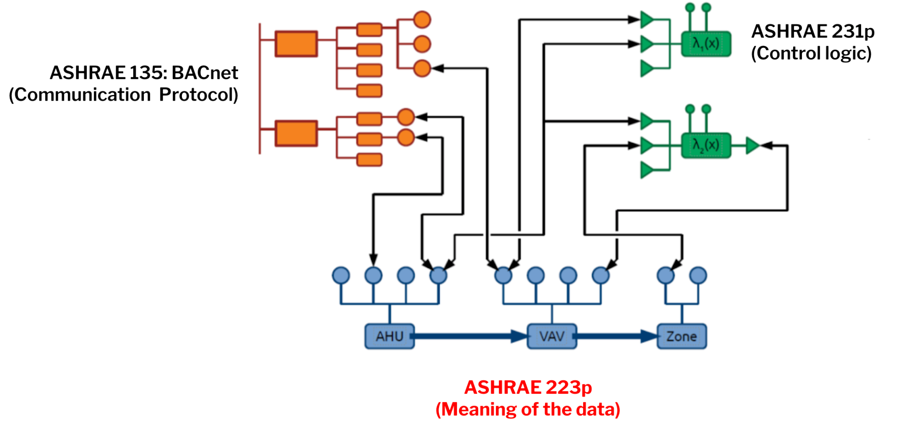
A Vision of Harmonization
Building Semantic Standard (ASHRAE 223) works in conjunction with other ASHRAE standards to provide a standard process of control delivery and validation.
RDF-based models integrate multiple perspectives on same building
How does Project Haystack fit into this picture?

Slide 4
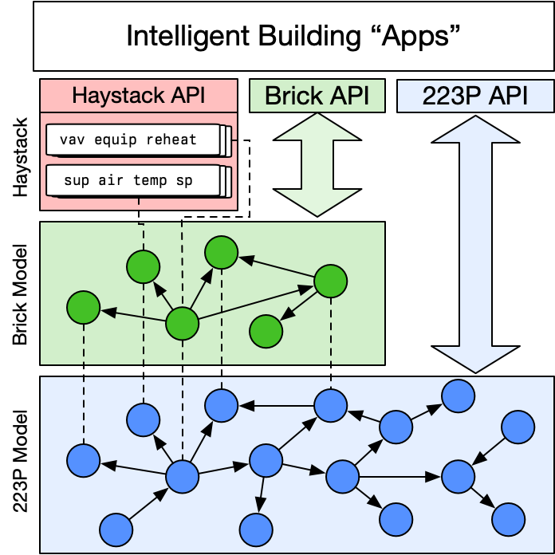
A Vision of Harmonization
Goal: Interoperability among metadata solutions, not necessarily make them same/similar
  Embrace why they are different
ASHRAE 223P Standard:
  Extremely detailed and precise, and therefore…
  Verbose to express/query building systems
Haystack/Brick:
  Lean on common understandings and shared vocabularies
  Less precise, but easier to query and use
Proposed approach:
  Haystack and Brick used by field implementers, software developers (as always) – preserve existing tech investments
  Map into 223P standard for validation and exchange

Slide 5
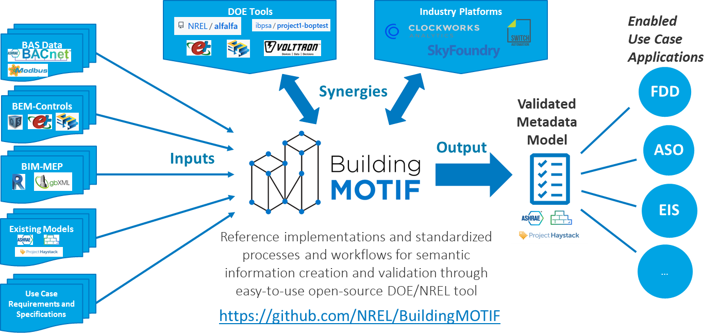
DOE/NREL Open-Source Tool: BuildingMOTIF
MOTIF = Metadata OnTology Interoperability Framework

Slide 6
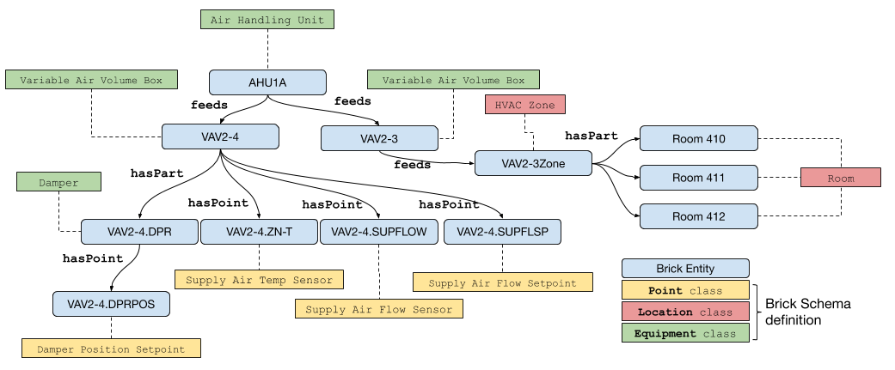
Primer on RDF Graphs
The Resource Description Framework (RDF) is a framework for expressing information about resources. An RDF statement expresses a relationship between two resources: a subject and an object through a predicate which is the relationship. These relationships together form a graph which is called an RDF graph.
<Subject> <Predicate> <Object>
AHU-1A feeds VAV2-4
Brick Example:

Slide 7
BuildingMOTIF Abstracts Away RDF
BuildingMOTIF provides programmatic abstractions that hide RDF implementation details
  Graph generation → templates
  Graph validation → shapes
RDF as a standard exchange of concepts, rules, metadata and entities
Informs Haystack/Brick harmonization process:
  More details on this later in the talk!

Slide 8
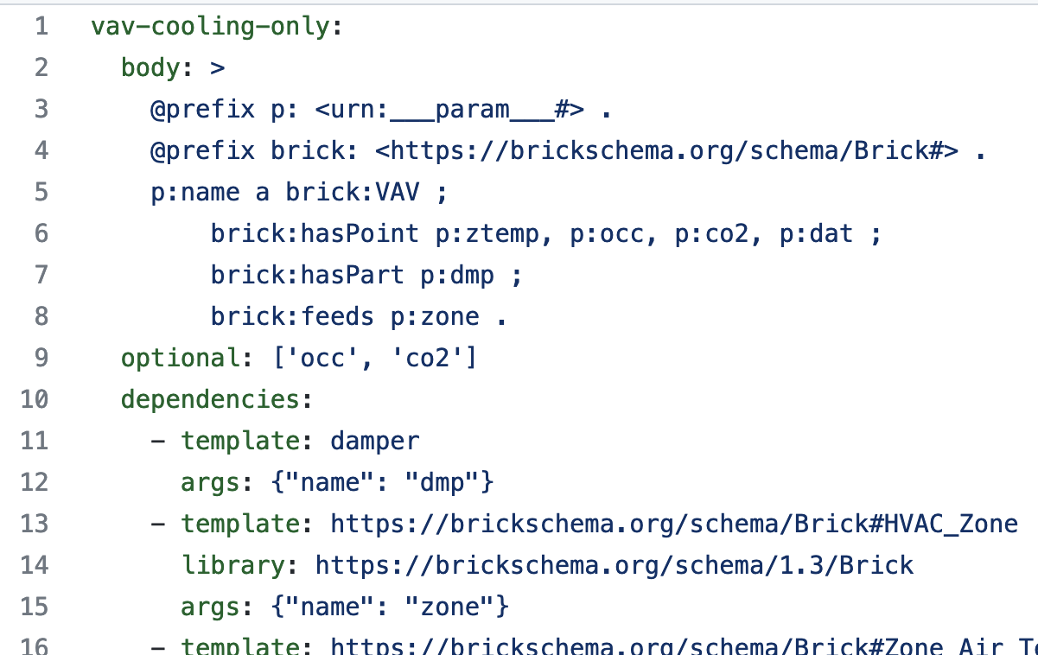
Graph-Based Templates in BuildingMOTIF
Template: parameterized specification for generating common subgraphs
User- or tool-provided bindings from CSV, XSV, BACnet scan...
Parameter | Binding
name | urn:bldg/vav-123
ztemp | urn:bldg/vav-123:temp
zone | urn:bldg/B1F2Z34
bldg:vav-123
brick:VAV
bldg:vav-123:temp
brick:Temp_Sensor
Consistent semantic model for a component, device, system, etc
bldg:B1F2Z34
brick:HVAC_Zone
Notes:
Imports from csv, etc.
Matching process

Slide 9


Primer on SHACL Shapes
SHACL is a language for validating RDF graphs against a set of conditions. These conditions are provided as shapes and other constructs expressed in the form of an RDF graph.
Rules:
G36 VAV must have:
  discharge-air-flow-sensor
  damper-cmd-shape
“One motivation for SHACL is Application Integration, where different software components, potentially maintained by different organizations, need to function together smoothly.”
I have defined:
G36 VAV:
discharge-air-flow-sensor
I have defined:
G36 VAV:
discharge-air-flow-sensor
damper-cmd-shape
I have defined:
G36 AHU:
damper-cmd-shape
https://www.w3.org/TR/shacl-ucr/#scope-and-motivation

Slide 10
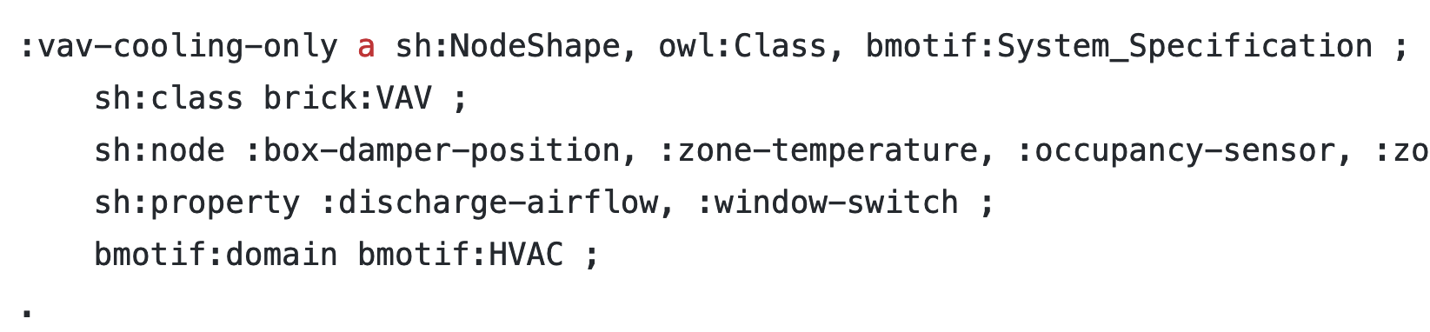
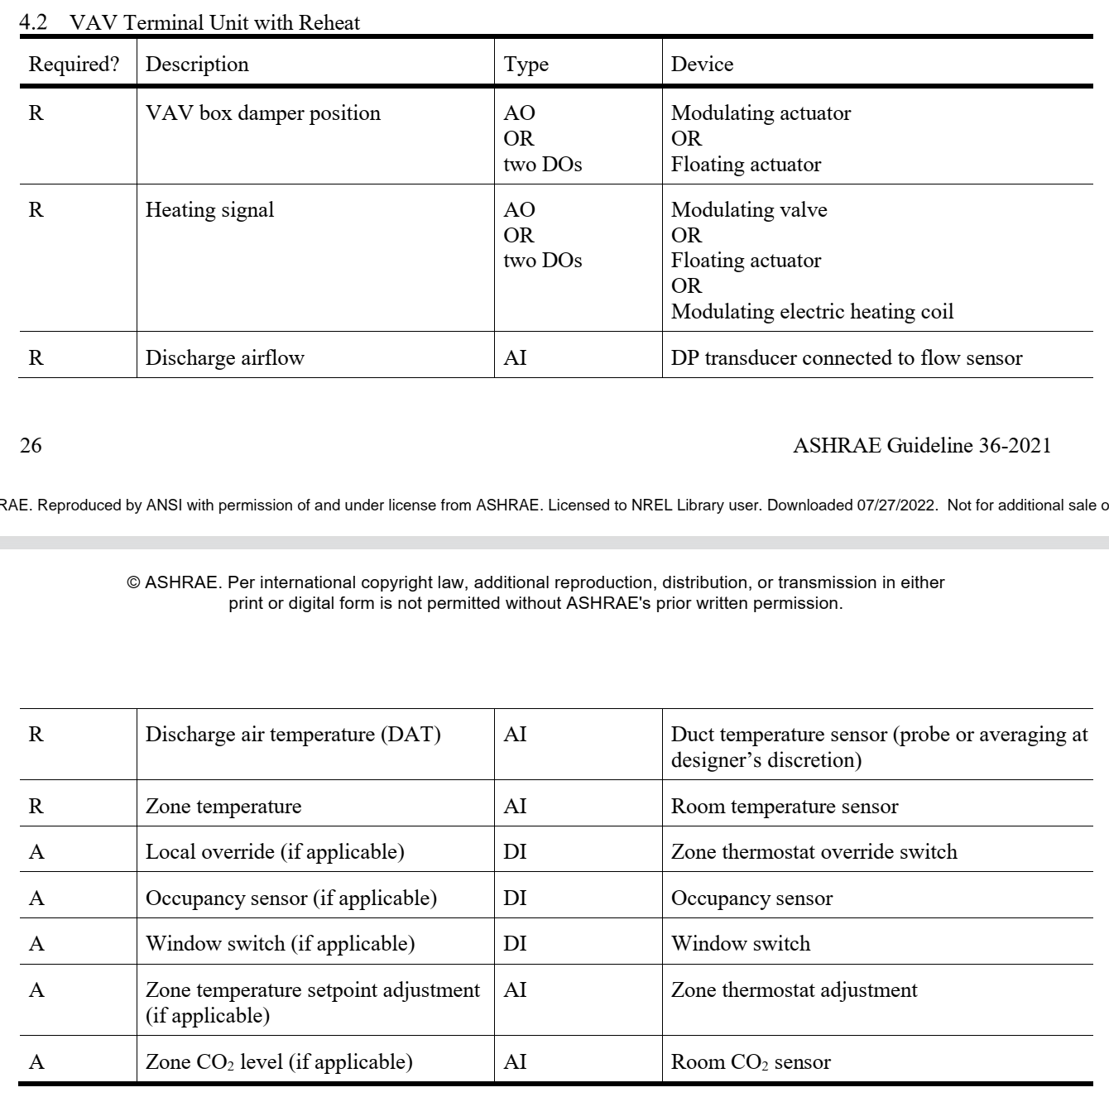
Shapes in BuildingMOTIF
Shape: sets of constraints, conditions that validate part of a metadata model
Target | Condition
brick:VAV | hasPoint 1 brick:Zone Temp Sensor
brick:VAV | hasPart 1 brick:Damper
brick:Damper | hasPoint 1 brick:Damper Pos Cmd
- Built using SHACL W3C standard
- Composable, expressive, declarative language
- Computational validation of metadata models
- Ontology agnostic
Represent point lists, system configurations, etc...
Notes:
Imports from csv, etc.
Matching process

Slide 11
Applying BuildingMOTIF to RDF/Haystack
There is plenty more to say on BuildingMOTIF!
  Check out repository + documentation if you are curious
  https://github.com/NREL/BuildingMOTIF
Let’s look at how BuildingMOTIF enables interoperability between the RDF world (Brick, 223P, etc) and Haystack

Slide 12
Approach: Xeto – RDF/SHACL Harmonization
Two goals
Haystack → RDF:
  Produce Brick and 223P descriptions of Haystack entities
  Validate Haystack models against 223P standard
RDF → Haystack:
  Use Xeto type system to add Haystack tags to Brick, 223P entities
  Produce valid Haystack models from valid Brick, 223P models
Along the way:
  Resolve differences between Brick/Haystack types

Slide 13
Behind the Scenes, Briefly
Some technical details:
Express Xeto type system using RDF SHACL:
  SHACL: constraint language for RDF
  Validates graphs against constraints
  Can also infer/add new information via rules
SHACL does three things for us in this context
  Add Brick (or 223P) types based on existence/structure of Haystack tags
  Add Haystack tags based on Brick/223P type
  Ensure that properties, tags, relationships, etc are consistent with the stated types

Slide 14
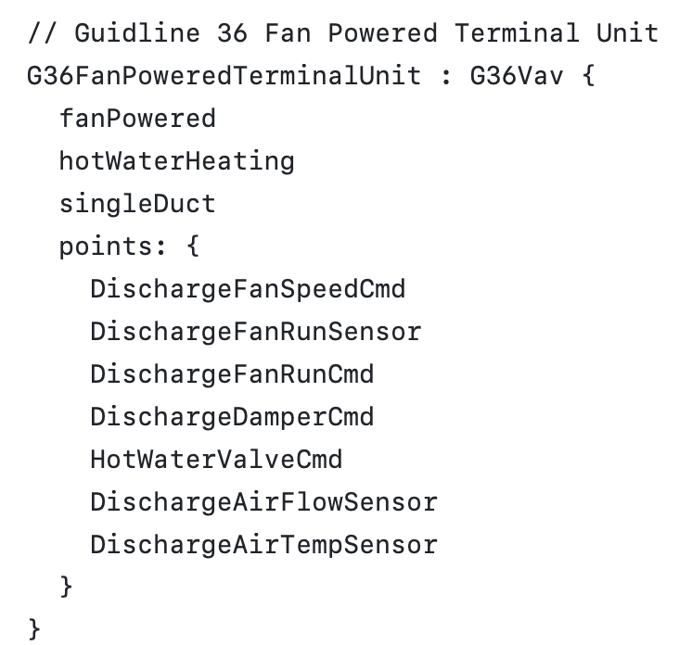
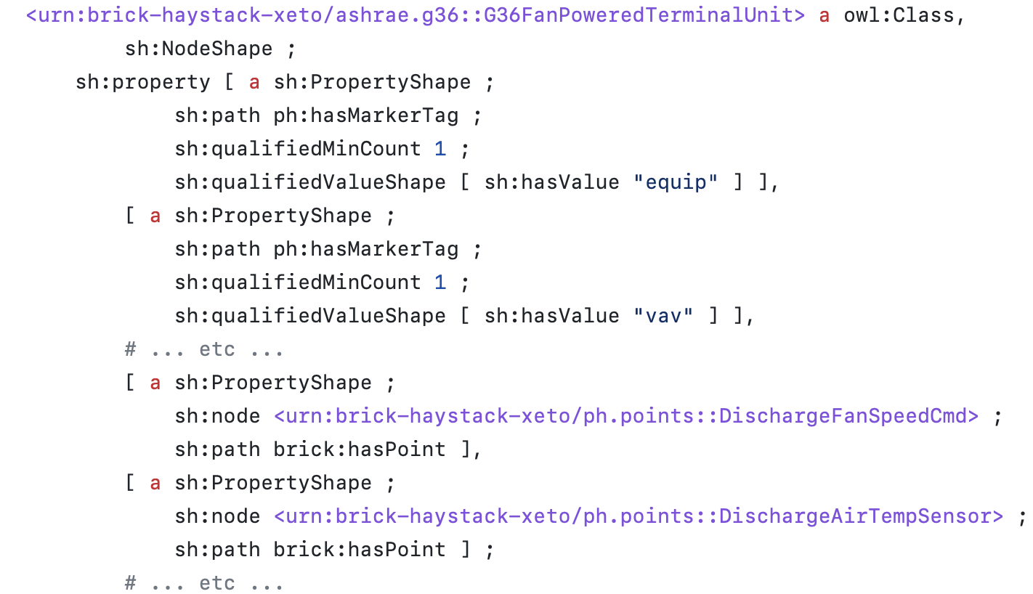
Behind the Scenes: Haystack → RDF
Developed a SHACL-based “ontology” for Haystack:
  Representing Haystack data model in RDF (no semantics!)
  Allows BuildingMOTIF and SHACL to interact with Haystack
Xeto → SHACL translator:
  Express Xeto type definitions as SHACL constraints
Translating ASHRAE Guideline 36
Xeto types to Brick/RDF

Slide 15
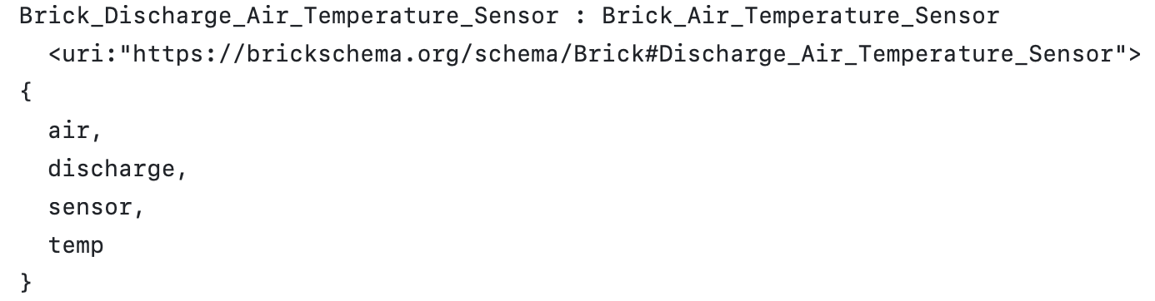
Behind the Scenes: Haystack → RDF
Xeto → SHACL translator:
  Express Xeto type definitions as SHACL constraints
Also allows definition of Brick types using Xeto
  Haystack constructs → Brick constructs
  Built on community-constructed “mapping file”
  Leverage Xeto type system to infer additional equivalences
  Import this Xeto library to ensure compatibility with Brick (and thus RDF)
Additional tags inherited from the parent type
Fully qualified Brick “type” embedded in Xeto metadata

Slide 16
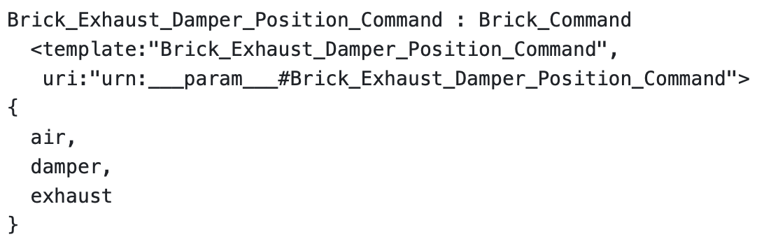
Behind the Scenes: Haystack → RDF
Challenge: how to handle “flat” Haystack entities
  Haystack (sometimes flat): exhaust damper position cmd point
  Brick (equip, points separate): Exhaust Damper hasPoint Damper Position Command
Solution: use BuildingMOTIF templates to generate RDF graphs
  URI “minting” and Axon lookups to generate reasonable names
  id assigned to the ‘point’ parameter in the template
BuildingMOTIF template to generate Brick subgraph

Slide 17
Two POC: Haystack → RDF and RDF → Haystack
Scenario 1:
  Have: Existing RDF model (223P and/or Brick)
  Want: Valid Haystack model
Scenario 2:
  Have: Valid Haystack model
  Want: Brick and/or 223P model
Not showing running code due to time constraints
  Online “demo-quality” code at
  https://github.com/gtfierro/Brick-Haystack-harmonization

Slide 18
VAV w/ Reheat: 223P
Directionality, substance, properties propagated through process flows
Equipment composition, explicit sensor observation relationships
Close-to-finished 223P with some details removed

Slide 19
VAV w/ Reheat: 223P → Brick
Brick model captures composition, flow, relationship to BMS points
  Simplification of the 223P model with more specific names
Brick model is programmatically generated from the 223P model
  Uses SHACL to infer types, add necessary relationships
Level of abstraction for Brick / Haystack is basically the same
  Just need to express the Brick types as Haystack types --- easy thanks to Xeto!

Slide 20
VAV w/ Reheat: 223P → Brick → Haystack
Application of SHACL rules adds Haystack tags to Brick entities
  Rules constructed automatically from Xeto type definitions
  Adds ref tags and (soon!) value tags
Haystack import formats (e.g. JSON) generated from the augmented RDF model

Slide 21
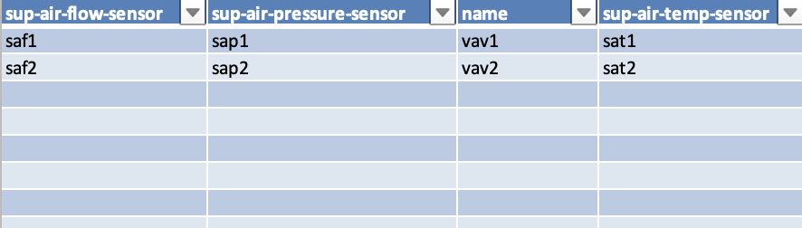
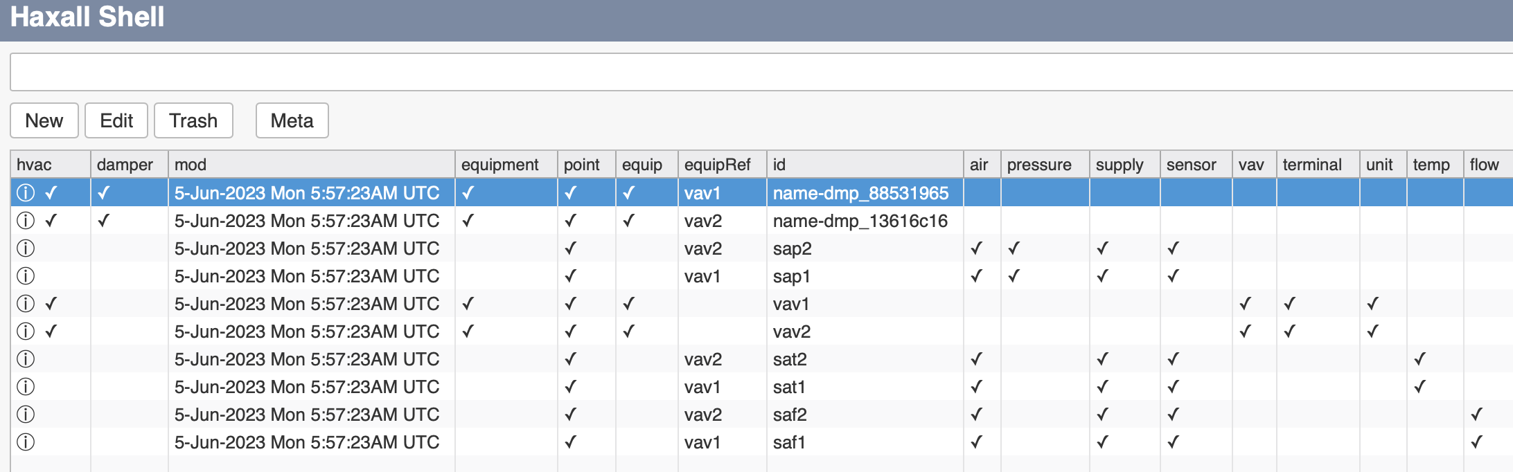
End-to-end: BuildingMOTIF-enabled RDF to Haystack
RDF Models
Evaluate template
Spreadsheet input
(or BACnet scan, BMS dump, etc…)
Xeto-enabled
SHACL inference
Haystack model

Slide 22
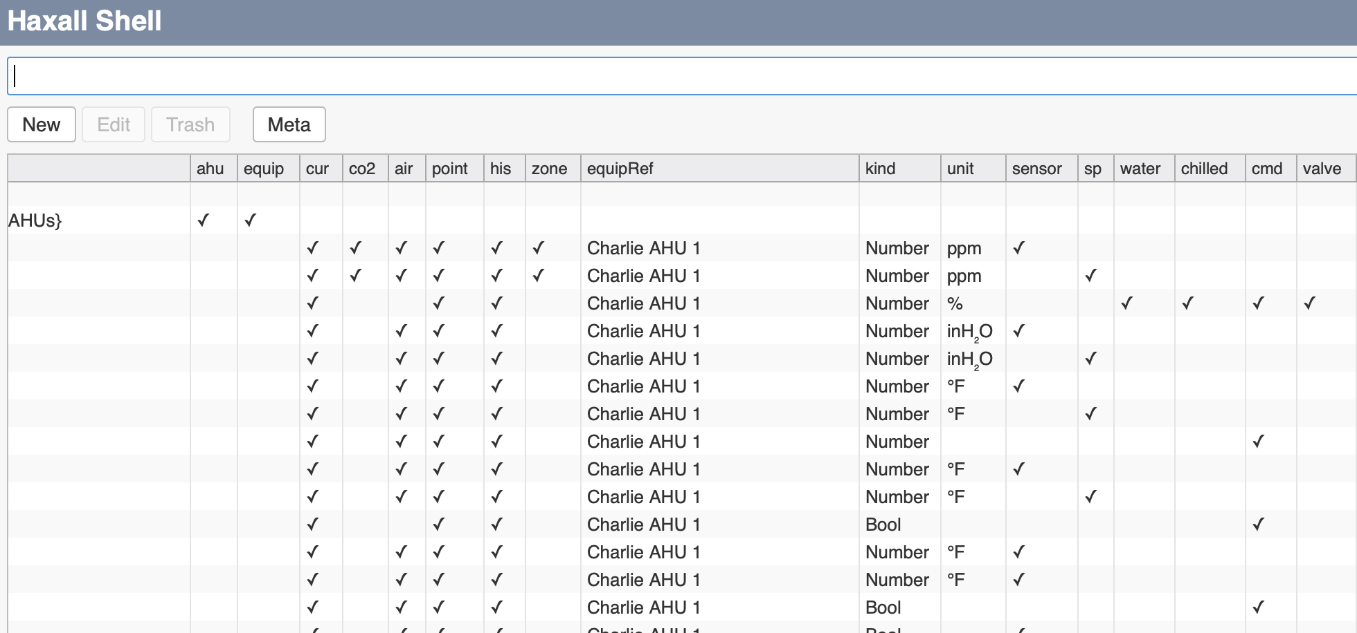
End-to-end: BuildingMOTIF-enabled Haystack to RDF
Haystack RDF
model
Xeto-enabled
SHACL inference
SHACL inference
223P model
Brick model

Slide 23
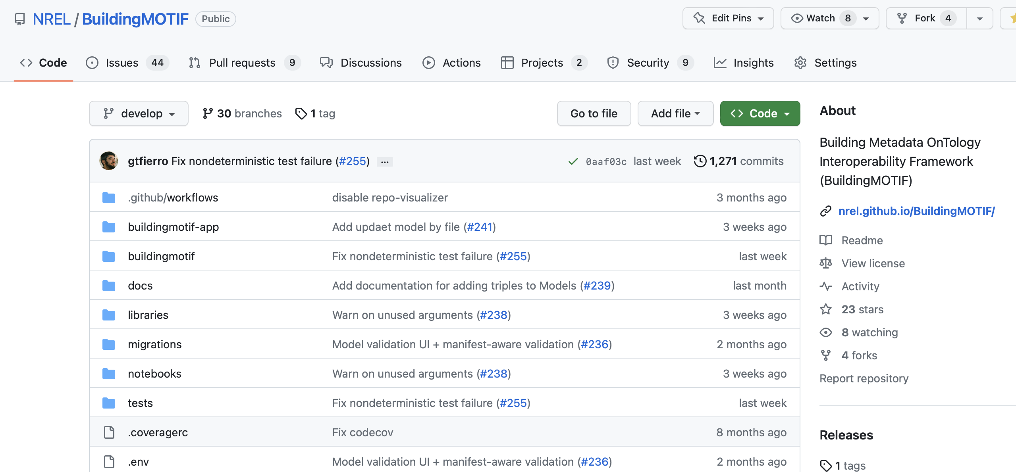
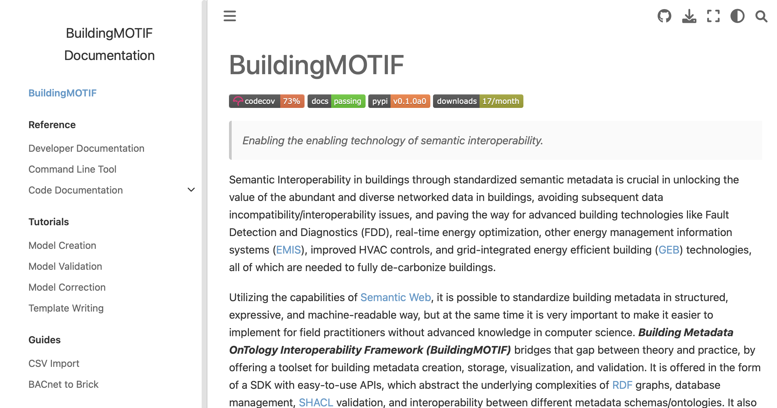
Thank You!
Please check out BuildingMOTIF!
https://github.com/NREL/BuildingMOTIF
Still in “alpha” but tutorials, Jupyter Notebooks, MVP web interface already available
Support for Brick, 223P, RealEstateCore and Haystack underway
Raise issues, leave comments, send emails
gtfierro@mines.edu
Avijit.Saha@nrel.gov

