Slide 1
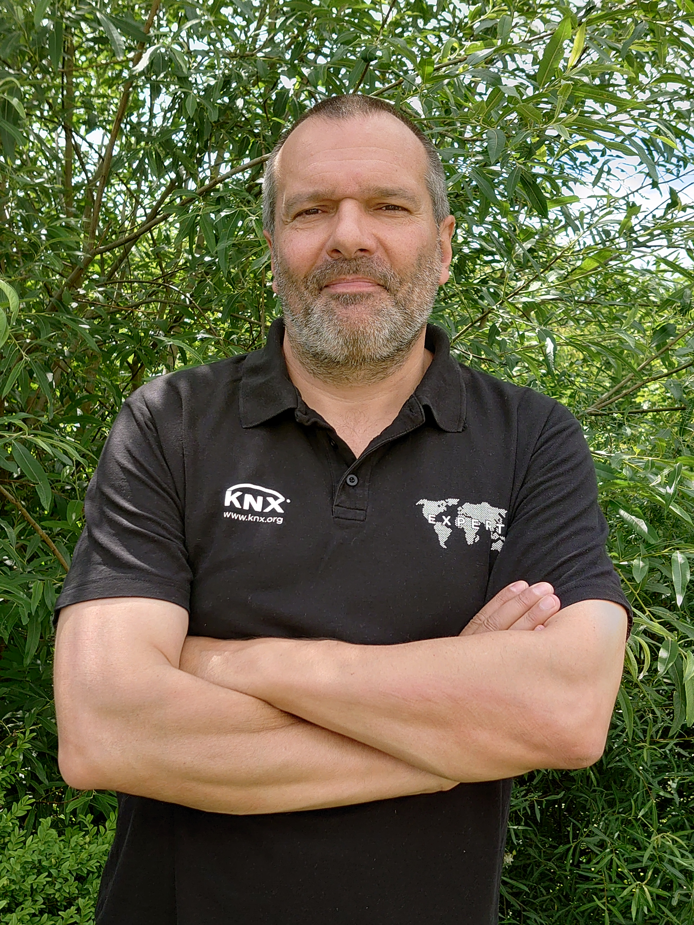
How KNX is Using Haystack to Describe Building Semantics
Haystack in Practice
André Hänel
Systems & Tools, KNX Association

Slide 2
Agenda
KNX briefly
Why semantics (also) in KNX?
How KNX is using semantics (main workflows)?
How KNX is using Haystack for the semantics?
A (data) walkthrough
A (usage) example
Summary

Slide 3





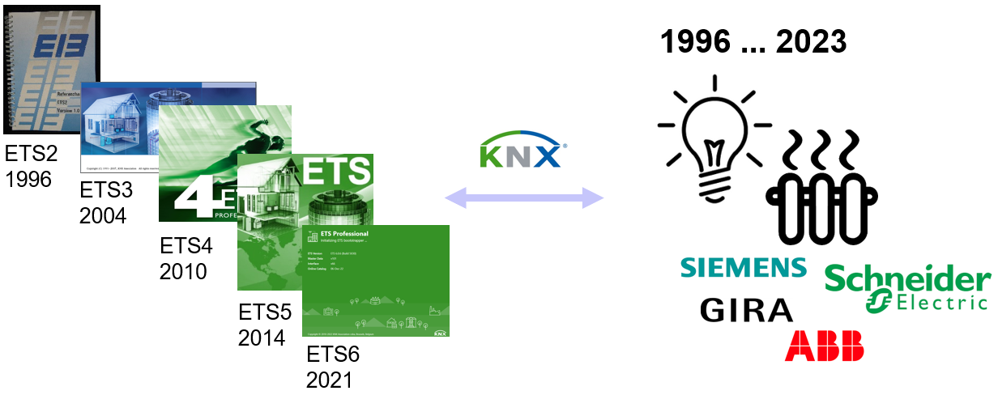

KNX briefly
What is KNX?
An ecosystem system for building automation, > 100k installers and > 500 product manufacturers worldwide,
> 8k certified (backward compatible) products, thanks to third party certification.
One commissioning tool for all, with tool project compatibility (the tool can open projects from 1996…).
https://www.knx.org/knx-en/for-professionals/What-is-KNX/A-brief-introduction

Slide 4




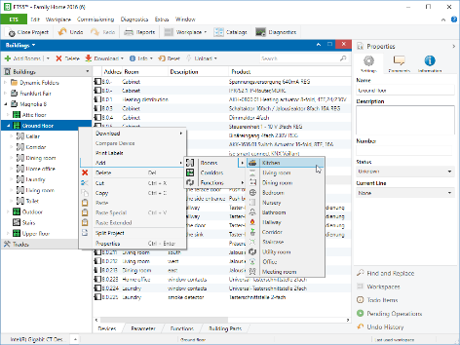
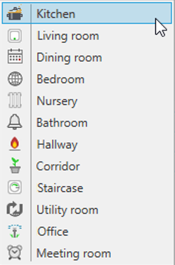




Why Semantics
Why do we need semantics as part of a KNX installation?
    Applications (outside KNX) need to understand the data content → direct M2M communication
    ‘Dictionaries’ in the IoT environment define common terms for this (for specific domains such as lighting, HVAC)
Installer assigns location
Hey … , turn on the radio in the Kitchen.
uses
Dictionary
Kitchen
Bath
…
uses
controls

Slide 5
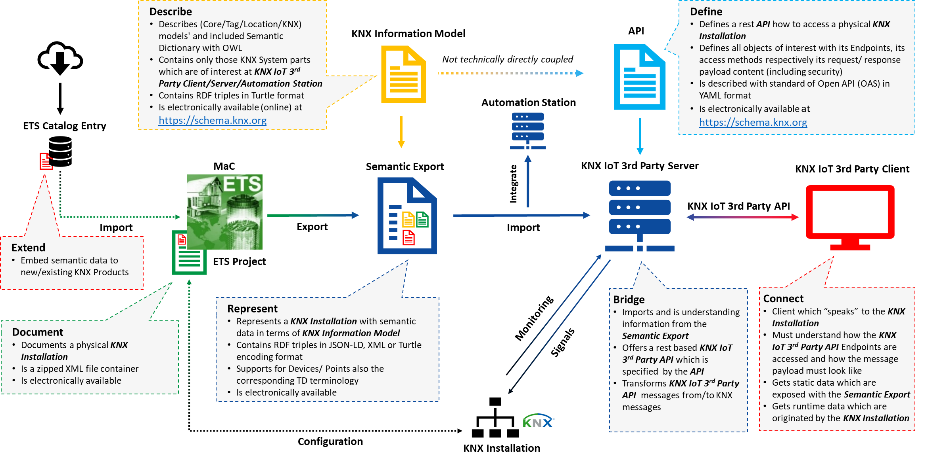


Semantics in KNX
Big Picture, looks complicated, but we will study it in detail!
Semantics
Example

Slide 6
Semantics in KNX
Big Picture, main workflows.

Slide 7
Semantics in KNX
Source of KNX semantics.
Model and dictionary content (concepts, tags, types,…) used for the semantic export.

Slide 8
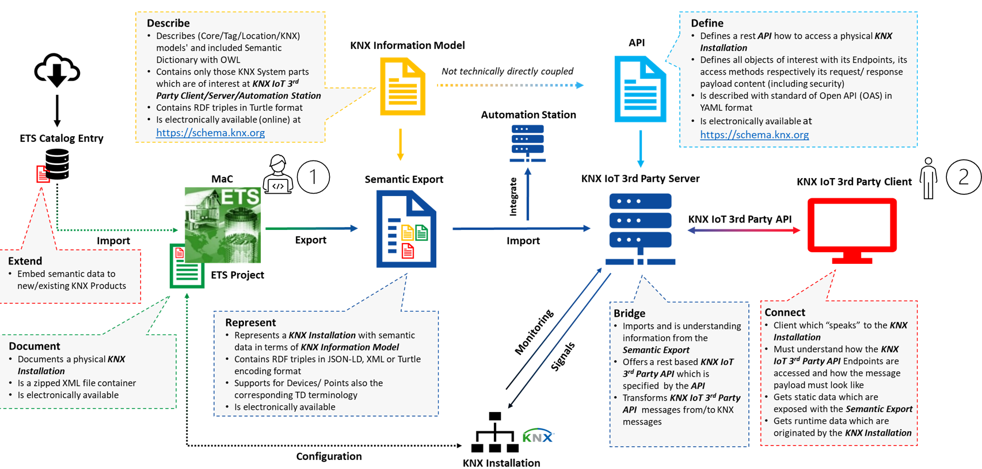

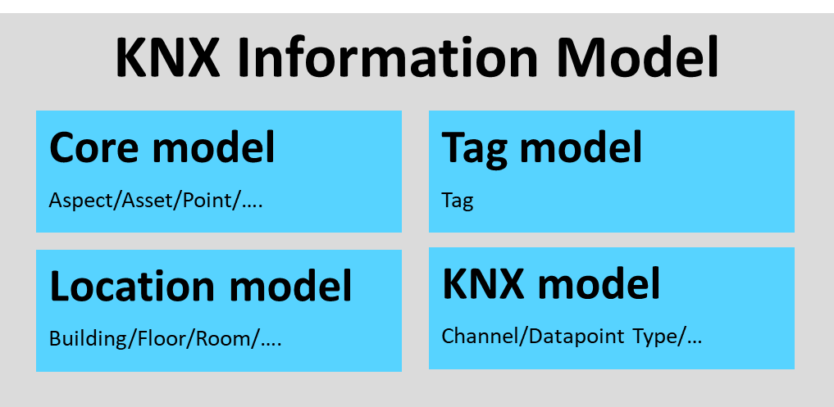

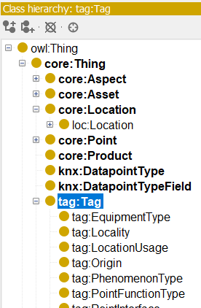
Haystack semantics in KNX
Used models for the KNX semantics.
Core model
The common concepts of the building control domain for an installation.
→ A datapoint (I/O interface) of a device.
Location model
A spatial location structure for an installation (reuse of IFC).
→ A location structure representing a building with rooms, floors, and others.
Tag model
A set of entities used as indications for information classification. Each entity has a standardized
semantical meaning that is independent of an installation (reuse of QUDT, SOSA/SSN, TD Thing).
From we are using tags for equipment/phenomenon types, localities and quantity kinds.
A device with datapoints, each assigned with specific entities, such as actuator, output or temperature.
KNX model
The KNX System specific entities for an installation.
→ A device with datapoints, whereas each datapoint is assigned with a (KNX) datapoint type with as specific
applicative meaning, such as a boolean increase/decrease, up/down or a common on/off.
RDF View Excerpt

Slide 9

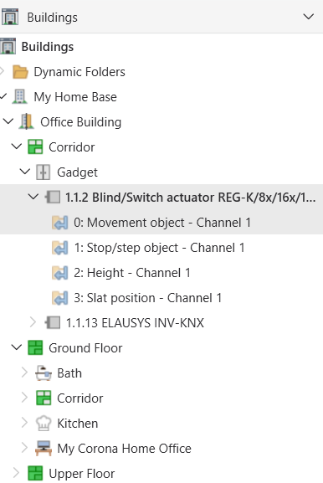
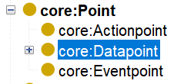
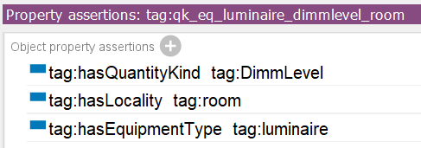
Data Walkthrough
A data walkthrough with an example installation.
Installation
…
"@graph": [{ // JSON-LD graph part (as array), possible is also TURTLE, RDF/XML
"@id": "uuid-dev1",
"@type": ["td:Thing", "core:Device"], // from Core model
"dct:title": “Blind/Switch actuator REG-K/8x/16x/10 manual mode",
"td:hasPropertyAffordance": {"@id": "uuid-dev1-app1-datapoint1"}, // from TD Thing
"loc:isEquipmentOf": {"@id": "uuid-office445"},
…
},
{
"@id": "uuid-dev1-app1-datapoint1",
"@type": ["td:PropertyAffordance", "knx:dpa.320.51"],
"dct:title": “Movement object – Channel 1",
"knx:adjustsEquipmentQualityKind": {"@id": "tag: qk_eq_luminaire_dimmlevel_room "},
"knx:datapointType" : "knx:upDown", // from KNX model
"tag:hasPointInterface": "tag:if.i",
"tag:operatesForTrade": ["tag:lighting"],
…
}
Model
Datapoint
Datapoint
defines
Semantic Export Data

Slide 10
Usage Example
Source of (rest based) access.
‘Rest’ API Model (Swagger) + Client/Server

Slide 11

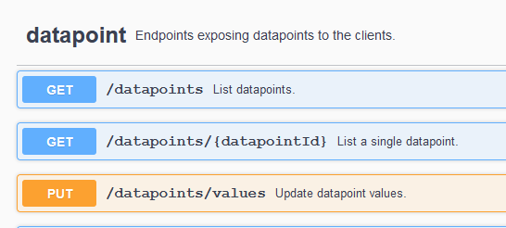
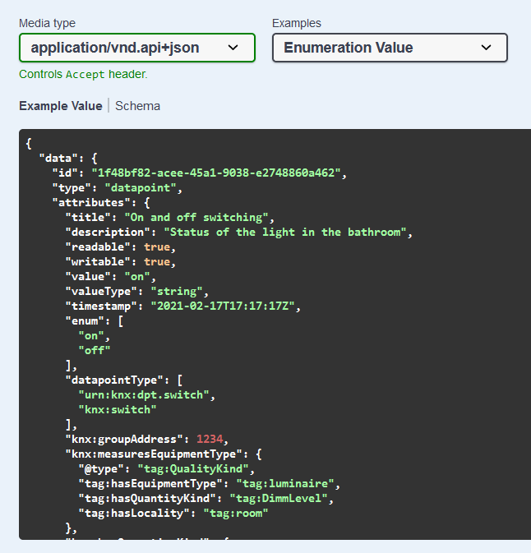
Usage Example
Accessing KNX installations by the 3rd Party API.
Installation
API Endpoints
Datapoint
Model
…
"@graph": [{ // JSON-LD graph part (a
"@id": "uuid-dev1",
"@type": ["td:Thing", "core:Device"], // from Core model
"dct:title": “Blind/Switch actuator REG-K/8x/16x/10 manual mode",
"td:hasPropertyAffordance": {"@id": "uuid-dev1-app1-datapoint1"}, // from TD Thing
"loc:isEquipmentOf": {"@id": "uuid-office445"},
…
},
{
"@id": "uuid-dev1-app1-datapoint1",
"@type": ["td:PropertyAffordance", "knx:dpa.320.51"],
"dct:title": “Movement object – Channel 1",
"knx:adjustsEquipmentQualityKind": {"@id": "tag: qk_eq_luminaire_dimmlevel_room "},
"knx:datapointType" : "knx:upDown", // from KNX model
"tag:hasPointInterface": "tag:if.i",
"tag:operatesForTrade": ["tag:lighting"],
…
}
Datapoint
Datapoint
Semantic Export Data

Slide 12
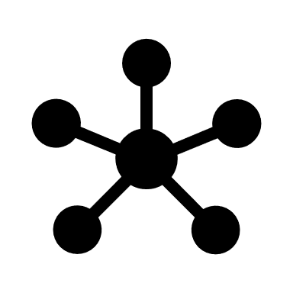

Summary
KNX semantics is reusing existing concepts and tags from other systems such as from Haystack. This basically allows a (semi automatic) mapping between different ecosystems.
To ‘place’ a wish, improved collaboration at technical level between the different technologies would be desirable.
  Example
  Linked Data already foresees (OWL) methods to be able to directly import other ontologies/concepts, however sometimes corresponding ontologies are missing or import of available electronic files results in errors at runtime (obliging offline compilation with required data).
…

Slide 13
Thanks
Andre Hänel
System & Tools Department
+32 2 775 8590
andre.haenel@knx.org
For general questions:
info@knx.org – www.knx.org

