Slide 1
Transforming building operations with new fault-free optimal controls technology
June 6, 2023
Notes:
Hi and thanks. Glad for the time to share with you today a preview of new technology for self-correcting controls.

Slide 2
Our buildings are generating more data than ever before
Project Haystack has made it easier for applications to use that wealth of data
Notes:
[]

Slide 3
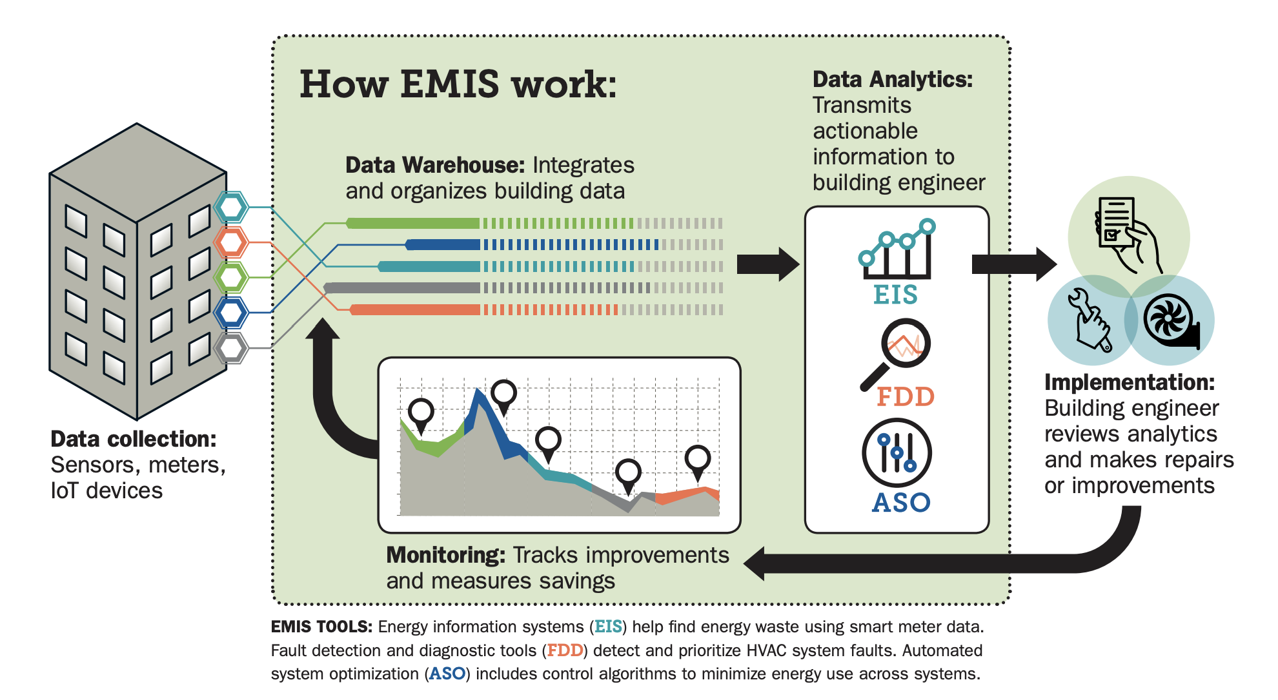
EMIS technologies enable continuous operational efficiency - analytics and control applications
Notes:
My work focuses on building analytics and control applications, particularly as implemented in EMIS technologies. These are the smart building software tools that span meter visualization and analysis, equipment level fault detection and diagnostics, and automated HVAC system optimization. This class of technologies is seeing rapid uptake in the commercial buildings sector among portfolio owners and campuses that understand the that continuous operational efficiency is an essential complement to asset level efficiency and capital retrofits.

Slide 4
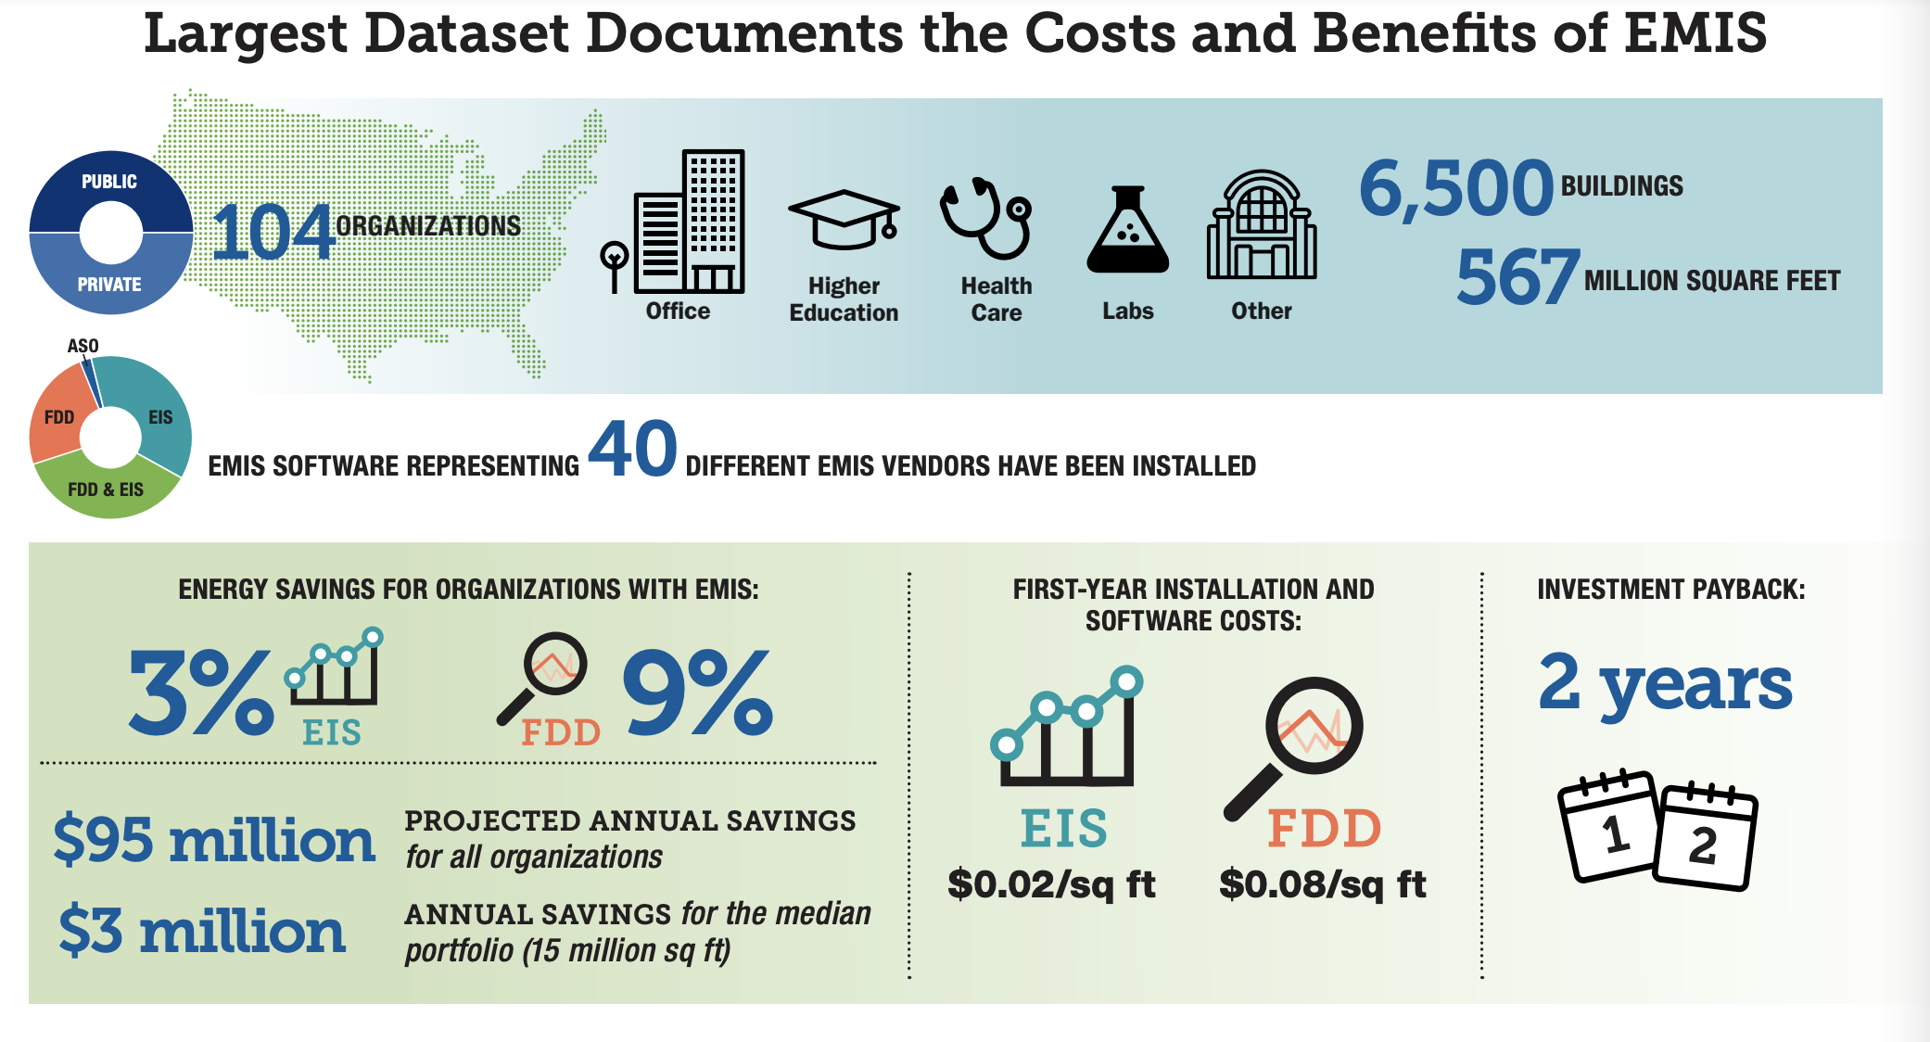
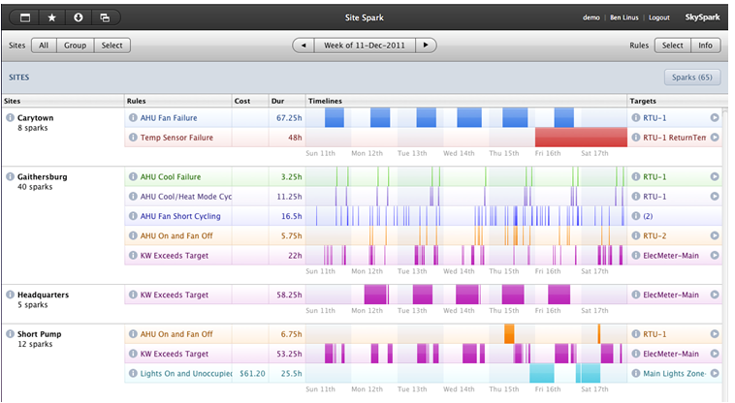
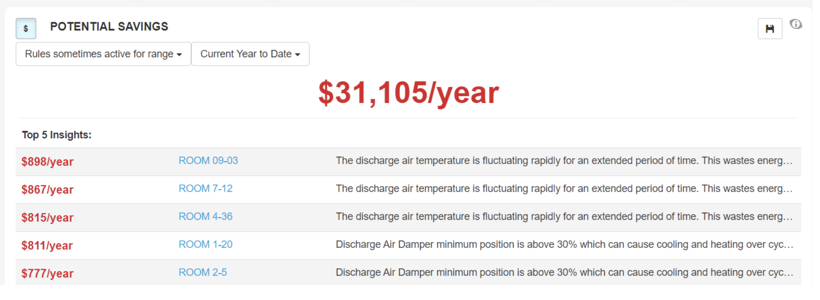
FDD analyze control and equipment faults to great benefit
Right: SkyFoundry SkySpark
Left: CopperTree Kaizen
Notes:
Enhancing FDD technology is where we will focus our attention today. These technologies are typically integrating data from meters and sometimes IOT devices, as well as the operational trends from the BAS. And they are continuously running to identify control problems like scheduling, problems meeting setpoint, lockouts, or equipment failures like stuck dampers or leaking valves. These faults are surfaced for facility staff attention through UI screens. top plot is from SkyFoundry sky spark), and may be prioritized and quantified as in the image below from CopperTree’s Kaizen. My team conducting the largest every study on the costs and benefits of EMIS, across [] ..

Slide 5
FDD software IDs problems, people fix them
Notes:
So FDD users are saving impressively. The software automates the ID of problems, but getting them fixed is a pretty manual, multi-step process [] -- the result being that faults can linger for months before they get resolved, and staff can get bogged down in mundane work.

Slide 6
The US DOE has invested in accelerating the adoption and enhancement of EMIS
Notes:
The US DOE has invested heavily over the years in []. And today I’m excited to share with you new work with near term promise to transform how buildings are operated. We have partnered with the smart buildings industry to enhance FDD technology to not just find faults but ALSO correct them, and optimize the controls.

Slide 7
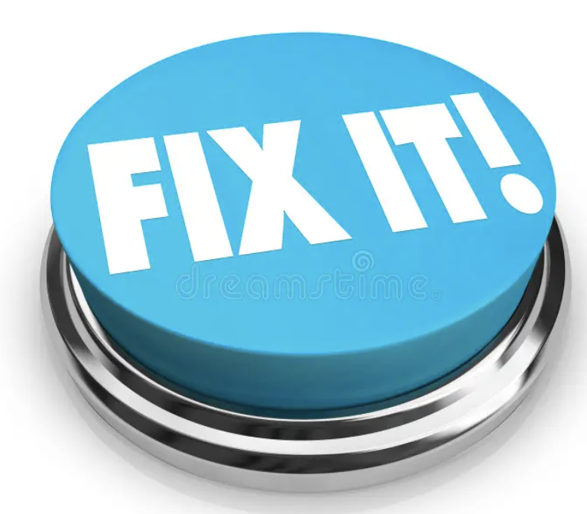
From automated fault detection, to automated fault correction
Notes:
So now we short circuit that BAU process, and give users a fix it button, removing the need to get someone to reprogram the BAS. Now, once a problem is identified, a recommended fix is presented, upon user- authorization, the corrective action is implemented by the FDD software. Controls problems can be resolved in hours, operations are kept in tune, and staff can free their time for the really hard problems.

Slide 8
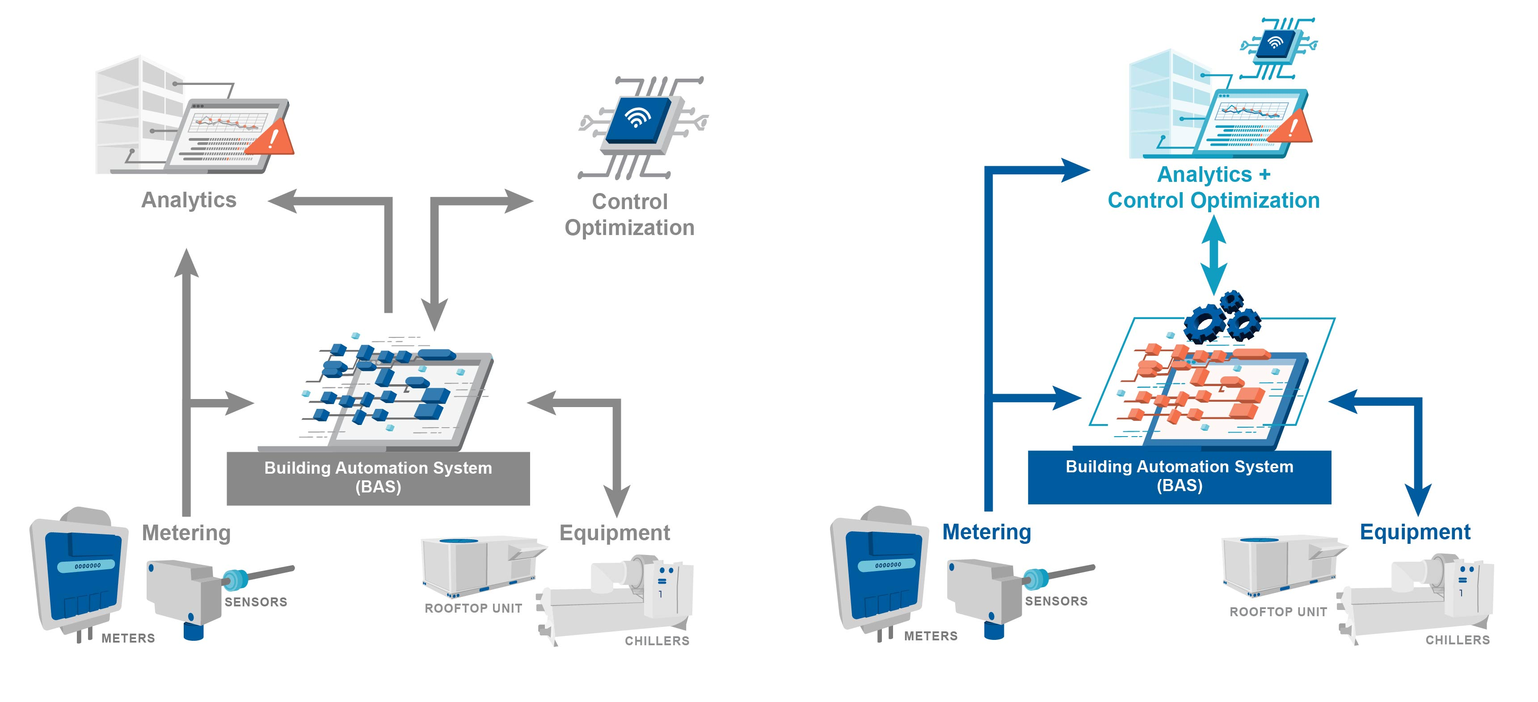
We opened BAS ‘write’, added corrective logic to the FDD
Historically, FDD products have offered analytics capabilities, ‘reading’ data from the BAS and other sensors and meters
By adding BAS ‘write’ capability and additional corrective logic, FDD products can now fix the problems they detect
Notes:
We did this by opening write capabilities to the FDD software, and by adding corrective logic to the software to complement the pre-existing logiv for fault detection and diagnosis. So on the left, we depict what has been the typical architecture, where FDD software is limited to reading data in, and on the right, the two—way architecture that enables problem correction and optimization.

Slide 9
We have developed solutions for the most common impactful controls problems
Solutions span “one time” fault correction, limited active testing, continuous supervisory control
Notes:
[]. And these solutions span “one time” correction, like economizer high limit lockouts, schedules, overrides, sensor bias, and temperature setpoints. They also include PID loop tuning, which involves a limited period of active testing, and finally, G36 AHU reset strategies that get into continuous supervisory control.

Slide 10
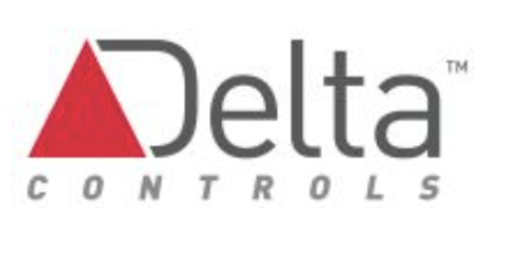
Solutions have been field tested at multiple sites, across 5 BAS
Notes:
[]

Slide 11
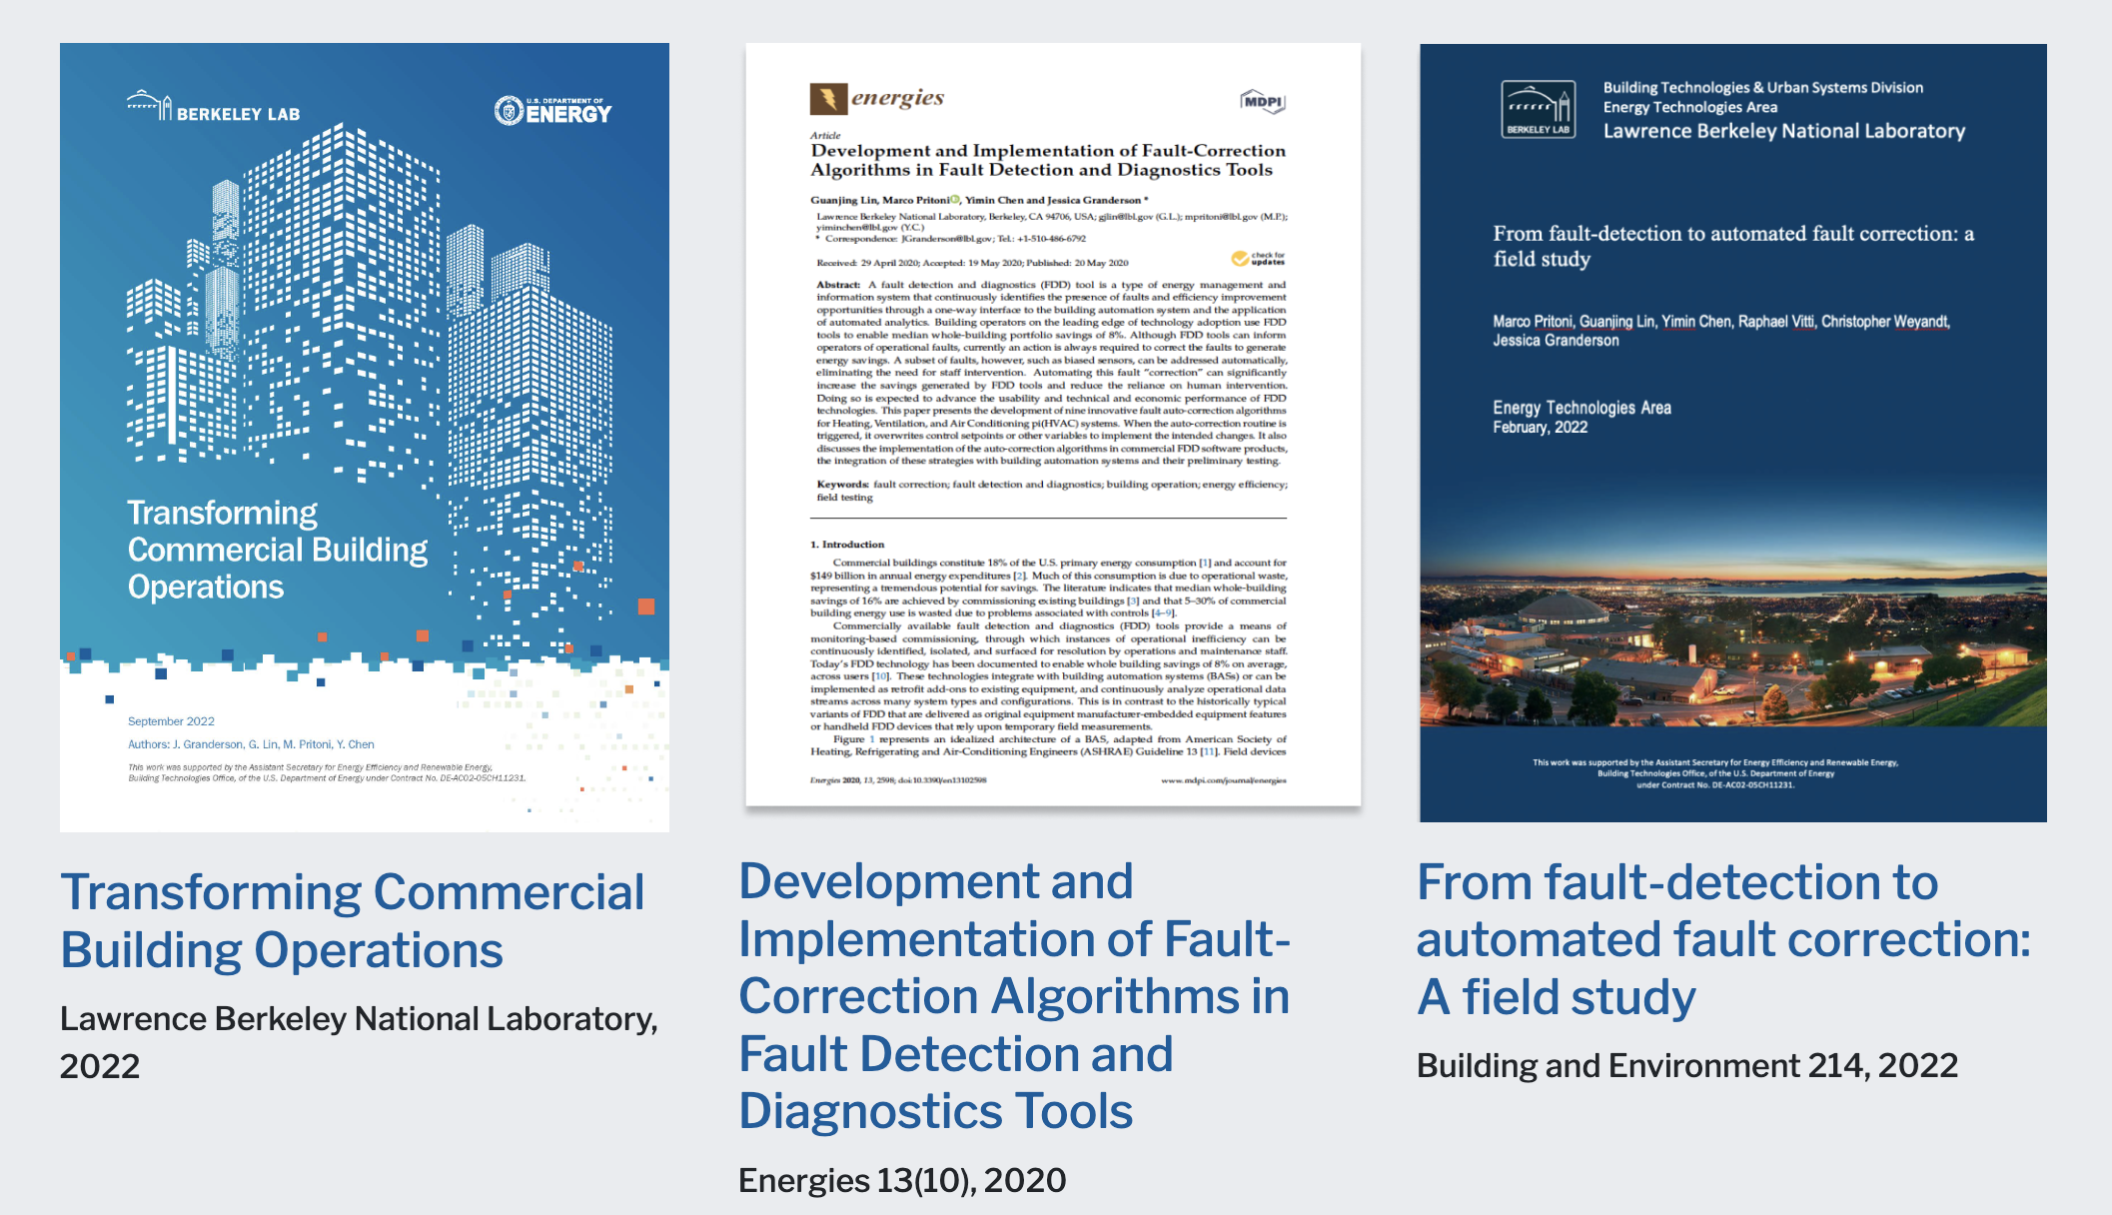
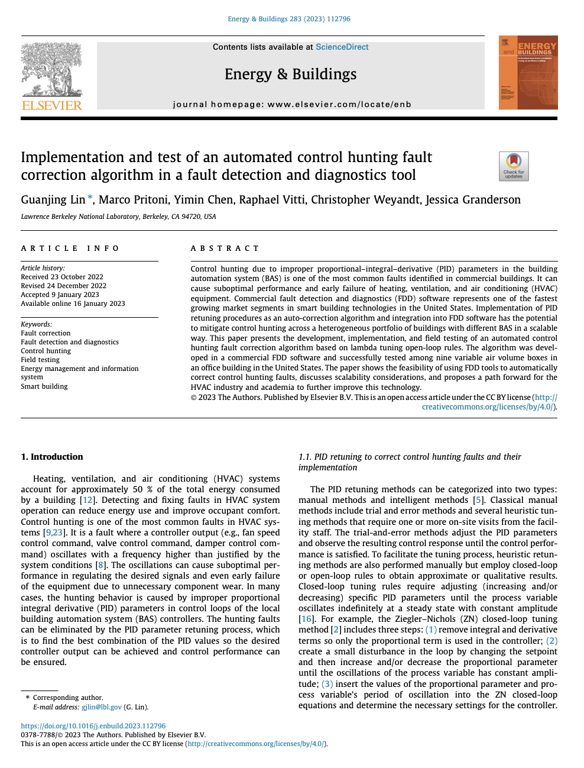
Specification and field results for these solutions are openly available
Implementation and test of an automated control hunting fault correction algorithm
Energy and Buildings 283, 2023
transformingbuildingcontrols.lbl.gov
Notes:
And the [] – I encourage folks to visit our website.

Slide 12
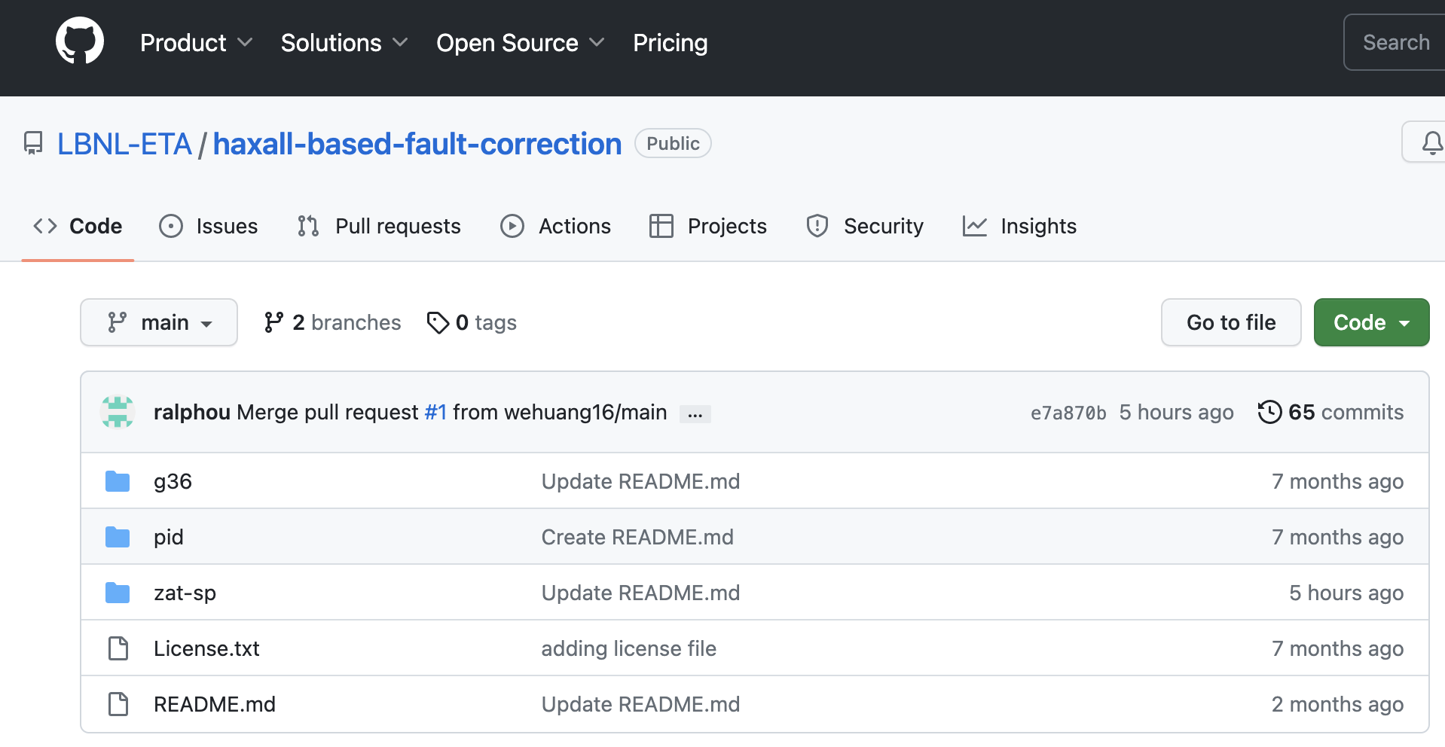
We are also populating a repo of open-source Haxall/Axon code
Currently available:
Rogue zone ID
Guideline 36 SAT and SP reset with rogue zone suppression
Zone temperature setpoint correction
PID loop tuning
Coming soon:
Incorrect schedule detection and correction
Next up:
Demand response
And other strategies
https://github.com/LBNL-ETA/haxall-based-fault-correction
Notes:
What I think we be especially of interest is that in addition to the specifications and filed results, we []

Slide 13
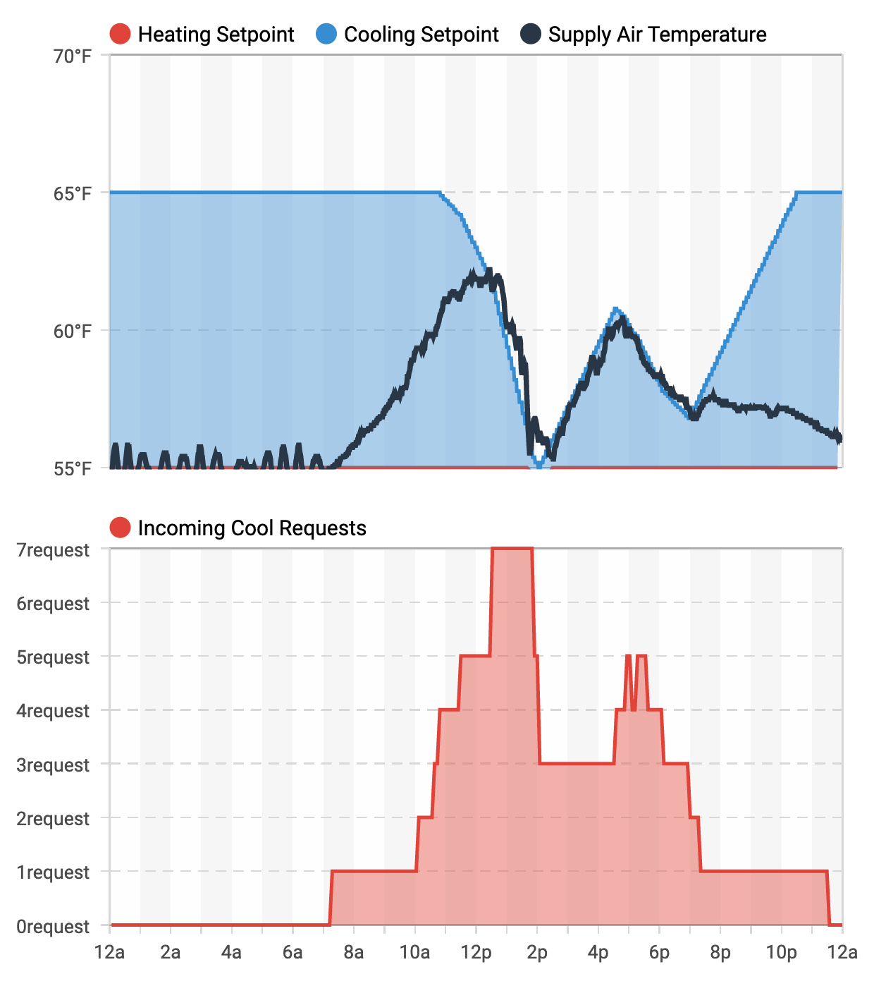
Supply air temperature
and pressure resets
Optimizes air handling unit (AHU) supply air temperature and pressure setpoints based on zone-level equipment operating conditions
Implements ASHRAE Guideline 36 standardized Trim and Respond calculations with minimal modification to existing BAS logic
Notes:
Here are a few results from the field for those solutions in the repo, starting with the G36 supply air and static pressure resets. In the plots you can see that as the cooling requests increase (red), the cooling setpoint (blue) is ratcheted down, and the supply air temperature (dark blue) follows. This was all done with minimal modification at the BAS level.

Slide 14
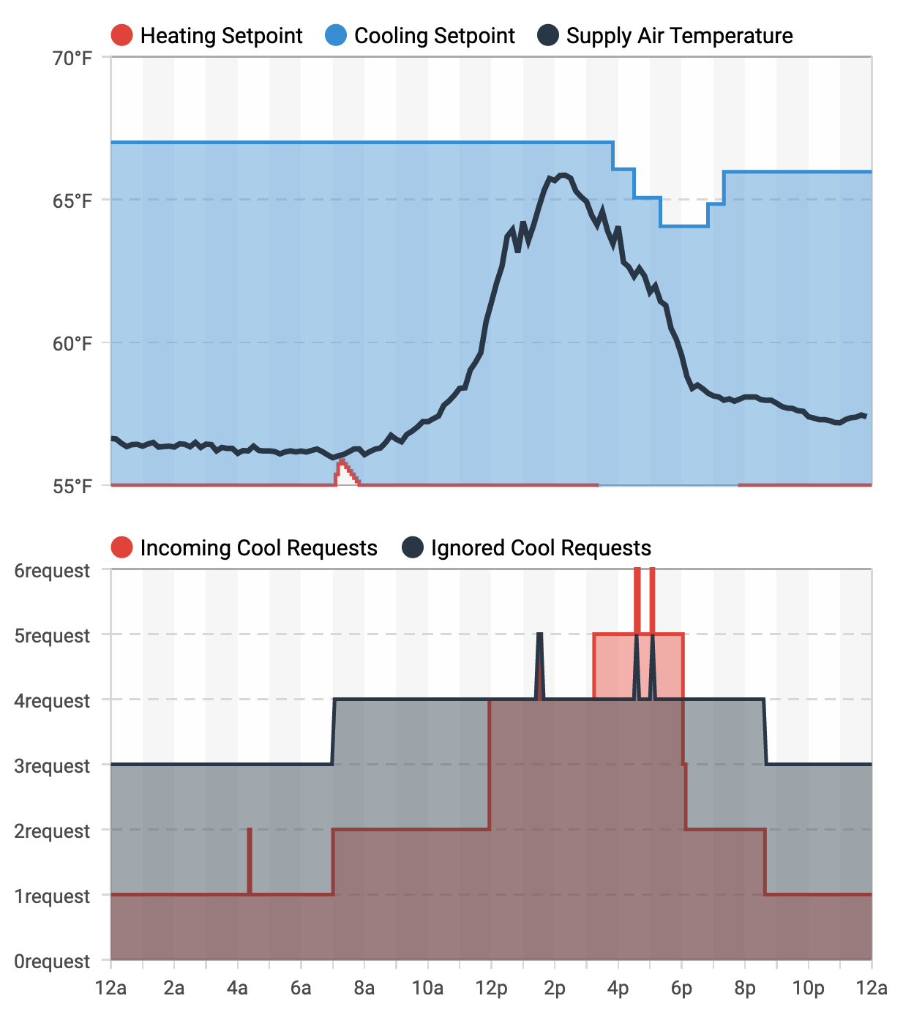
Identify and ignore
rogue zone requests
Instructs the BAS to ignore requests (i.e. for colder supply air) from zones that are unsatisfied due to local equipment issues
Faults causing disqualification:
Leaky reheat valve
Airflow setpoint not met
Cooling setpoint too low
Notes:
We have added rogue zone identification and suppression into the reference code base as well. There are of course different ways to do this, but in our reference code we define a zone as rogue if it has a leaky reheat valve, the airflow setpoint is not being met, or the cooling setpoint is excessively low. The calls from these zones, say for colder supply air, are ignored – the result being significant energy savings. Field results are shown on the right. You can see that it’s not until well into the day that they cooling setpoint is lowered due to valid requests from zones.

Slide 15
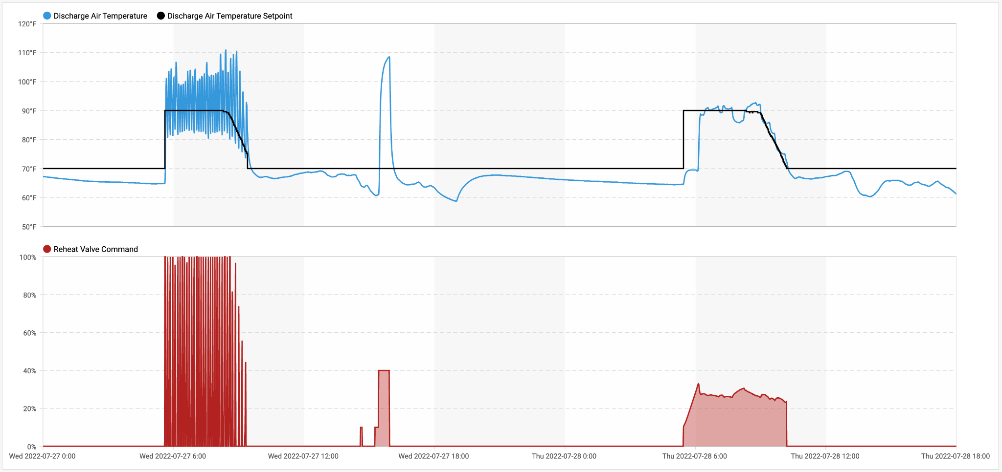
Automated loop tuning with active testing
New tuning pushed
to BAS after second successful test
Controller Hunting
Active Test
Controller Stable
Notes:
Here are results from automated loop tuning. On the left you see a reheat valve that is hunting (red), and the oscillating discharge air temp, we drove the controller into a period of active testing, pushed new parameters from the FDD to the BAS, and on the right you see the corrected stable behavior. I will acknowledge that we’ve only so far solved this for one type of tuning method – zeigler/Nichols.

Slide 16
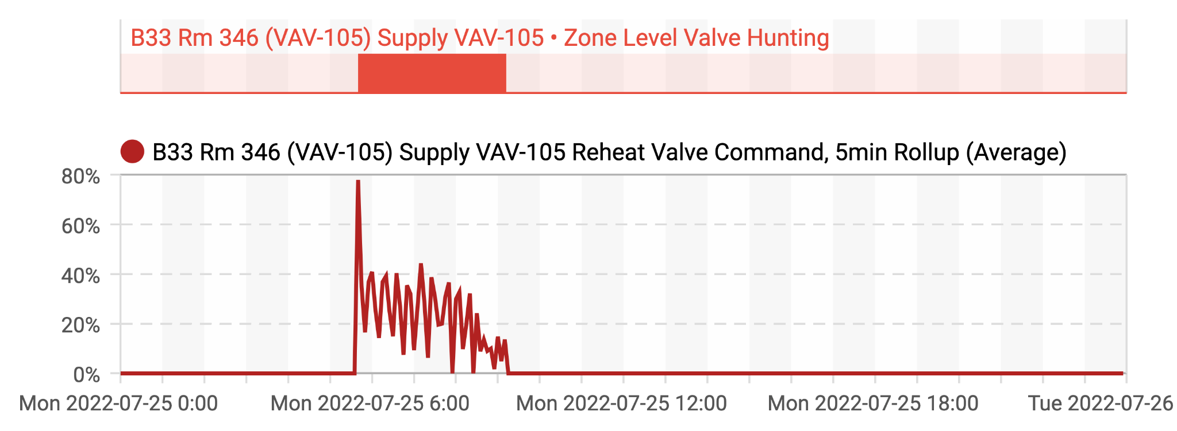
Process for active testing and tuning with FDD
1. Identify control hunting with FDD
2. Perturb system and measure response
3. Calculate improved tuning parameters
4. Push updated tuning parameters to BAS
Notes:
So, the FDD logic IDs the hunting. The additional corrective logic perturbs the system, measures the response, calculates improved tuning parameters, and then pushes them back to the BAS.

Slide 17
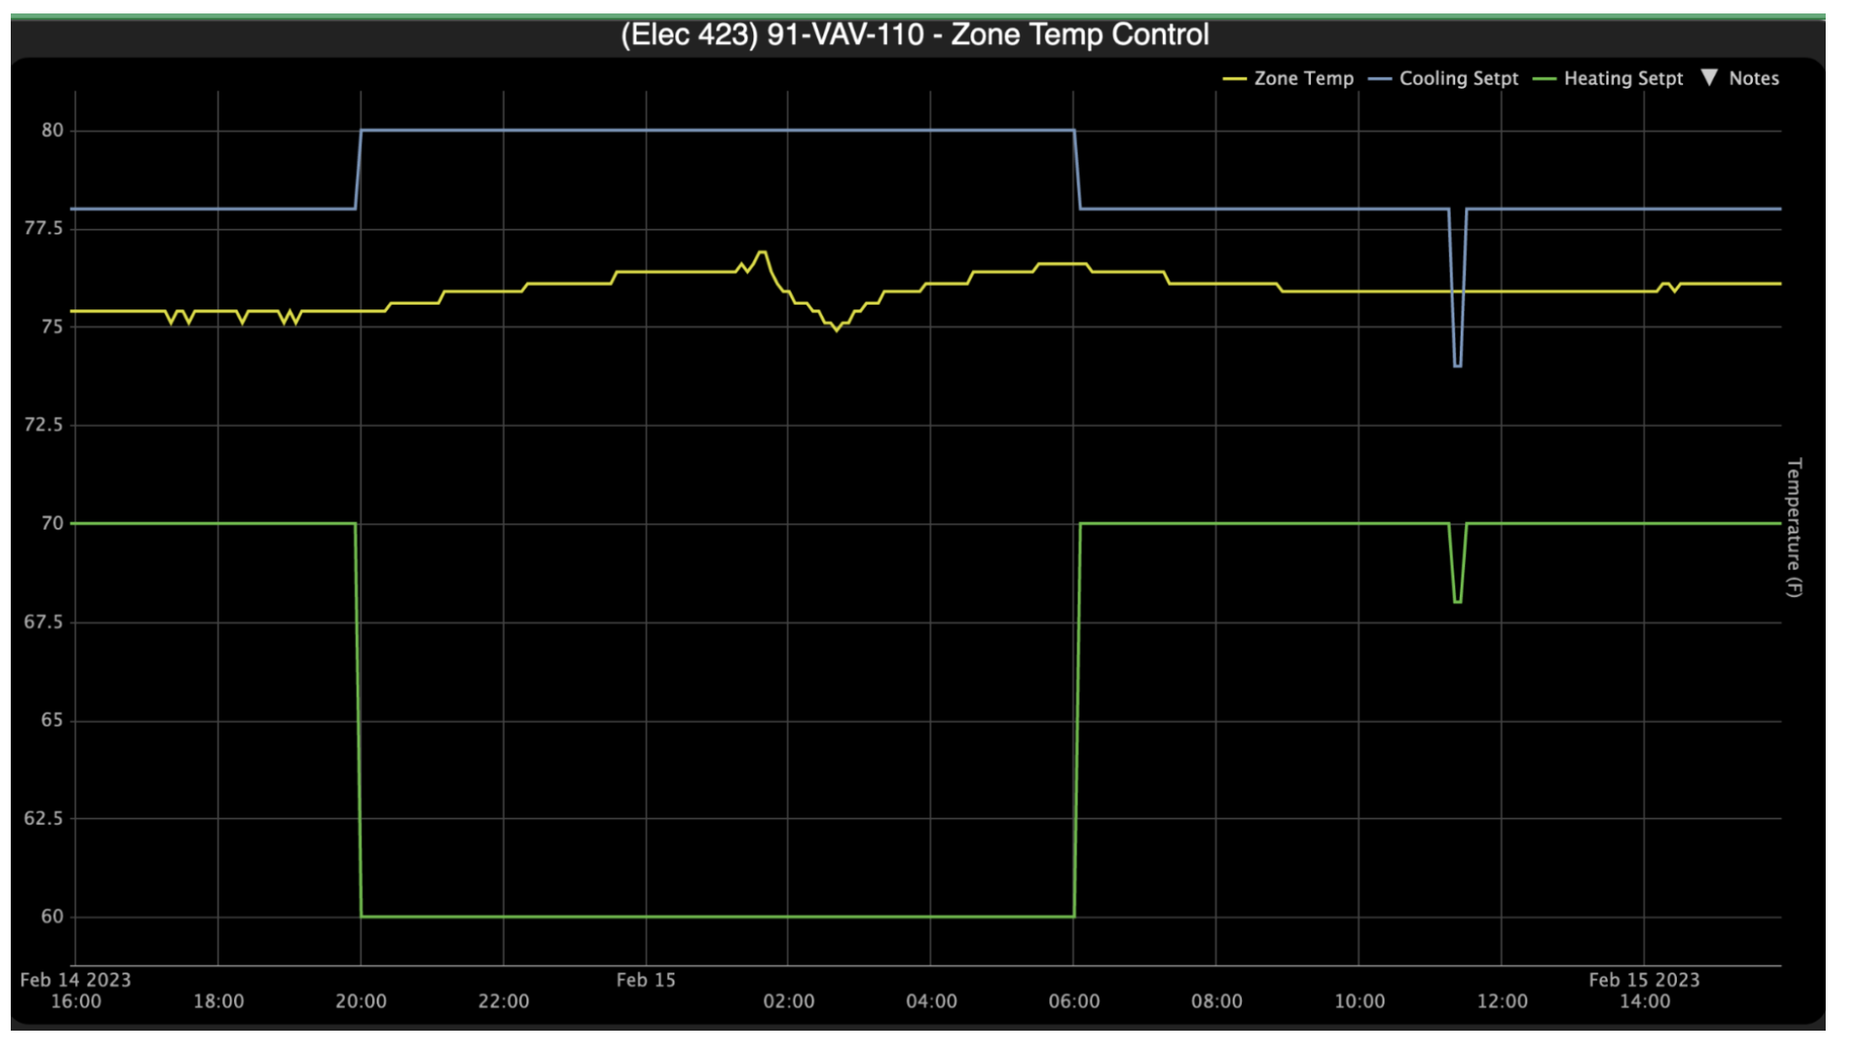
Zone temperature setpoint correction
Define operational intent in reference setpoints
Compare actual setpoints to ‘reference’
Enable operator to ‘push’ automated corrections when divergence is detected
Notes:
To implement zone temperature setpoint correction we []. In this test there the occupied heating and cooling setpoints as well as the unoccupied heating setpoint were detected to be different from operational spec, and with the grayed out button we could push the intended reference temperatures back, and you we can observe in the BAS trends that the write back worked.

Slide 18
Ongoing work and call to action
More buildings and early users
More technology/service partners
Additional operational strategies
Demand flex/demand mgt
Automated Cx, functional testing
Notes:
We keep at it. We are expanding to more buildings and early users of these solutiions, broadending the fold of technology and service provider partners, and adding demand flexibility and automated Cx – functional testing to the set of solutions.

Slide 19
JGranderson@lbl.gov
https://transformingbuildingcontrols.lbl.gov
Notes:
Open call to action to partner []

Slide 20
This technology is core to the future of buildings
Historic investments in retrofits and electrification
Retiring workforce, next gen. expects networked intelligent systems
Industry mobilization around speed and climate urgency
Increasing asks of our buildings – health, grid, DERs, IEA
Persistent performance, enduring value
Automation and modern tools for building O&M
Mechanism to scale across systems, data models, equipt configurations
Growing footprint of software-based infrastructure to rapidly deploy
Notes:
BIL and IRA are driving generational investment in retrofit and elctrificn. And we know that EMIS are critical to ensure that the value of those assets persist – as operated.

Slide 21
This technology is core to the future of buildings
Historic investments in retrofits and electrification
Retiring workforce, next gen. expects networked intelligent systems
Industry mobilization around speed and climate urgency
Increasing asks of our buildings – health, grid, DERs, IEA
Persistent performance, enduring value
Automation and modern tools for building O&M
Mechanism to scale across systems, data models, equipt configurations
Growing footprint of software-based infrastructure to rapidly deploy
Notes:
We have a retiring ops workforce and a next gen that was born on and expects networked intelligent systems. EMIS provide that workforce with supportive automation and modern tools

Slide 22
This technology is core to the future of buildings
Historic investments in retrofits and electrification
Retiring workforce, next gen. expects networked intelligent systems
Industry mobilization around speed and climate urgency
Increasing asks of our buildings – health, grid, DERs, GHGs
Persistent performance, enduring value
Automation and modern tools for building O&M
Mechanism to scale across systems, data models, equipt configurations
Growing footprint of software-based infrastructure to rapidly deploy
Notes:
Our industry is mobilizing around speed climate urgency, while at the same time asking more and more of our buildings. That they flexibly integrate with a renewable grid, minimize emissions, and integrate across a growing number of distributed energy resources while providing a health and comfortable indoor environment.

Slide 23
This technology is core to the future of buildings
Historic investments in retrofits and electrification
Retiring workforce, next gen. expects networked intelligent systems
Industry mobilization around speed and climate urgency
Increasing asks of our buildings – health, grid, DERs, GHG
Persistent performance, enduring value
Automation and modern tools for building O&M
Mechanism to scale across systems, data models, equipt configurations
Growing footprint of software-based infrastructure to rapidly deploy
Notes:
To that end, EMIS have taken done a lot of the legwork. They are doing the hard work of integrating across diverse systems, data models, and equpiment configurations. And they are increasingly being adopted in the commercial sectors – so we have a software based infrastructure to tap into to continue ”pushing” control and analytics updates to our stock.

Slide 24
THANK YOU

