Slide 1
Adoption Of Tagging And How Owners and Operators Can Drive Its Application
The Current State Of What We Are Seeing
Aaron Brondum
VP, Customer Success

Slide 2
Integrating existing systems can be challenging even in 2023. We are still seeing BACnet systems installed with generic controller names and points labeled as AO:1 or BO:1.
In this session, you’ll learn about the current state of what we at Prescriptive Data are seeing around the adoption of tagging and how owners and operators can help to drive its application.

Slide 3
Agenda
About Me
Pre Project Haystack Landscape
Overview & Why Tagging Is Important To PD
Types Of Buildings PD Integrates
What We Are Seeing In The Market
Customers Thoughts And Best Practices
What PD Is Doing To Overcome Challenges

Slide 4
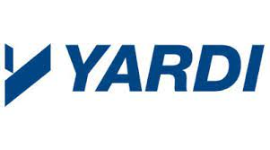
Company | Company Type | Customer Types | My Roles
 | CRE Building Operations, Integration & Optimization Software | Commercial Class A, Government, Multifamily Hospitality & Higher Ed | VP Customer Success
Yardi | CRE Property & Investment Management Software | Commercial & Multifamily | Operations Manager (Yardi Energy)
MSS | Regional Mechanical, Controls & Fire Alarm Contractor | Health Care, Higher Ed, K-12, Comercial, Retail, Government & Hospitality | Branch Manager, Account Executive & Project Manager
/ | Large Controls Contractor | Comercial, Government, Health Care, Higher Ed, & K-12 | Software Engineer & Application Engineer
YAMAS
Controls

Slide 5
2. Pre Project Haystack Landscape

Slide 6
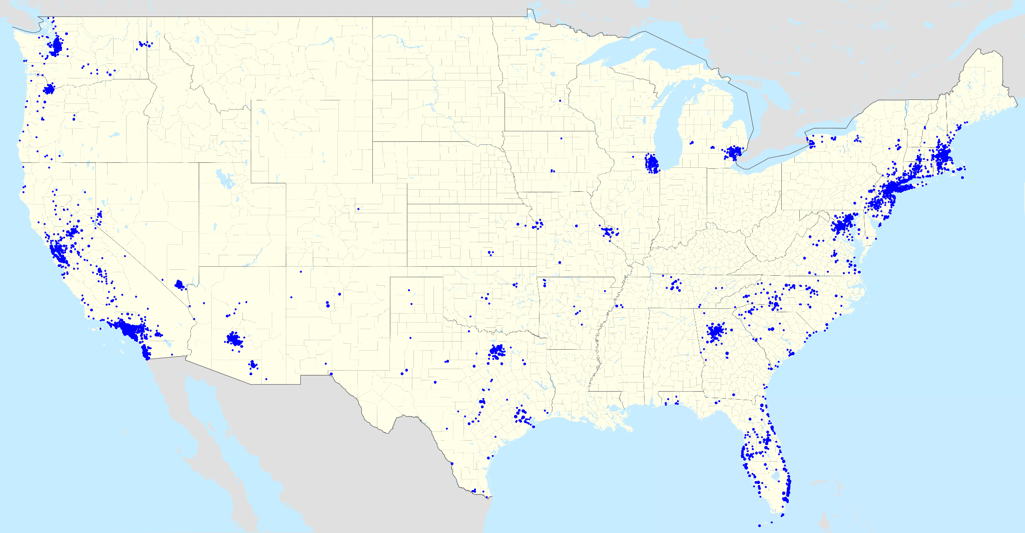
2010 Bank Branch Roll Out
Project Goals
Energy reduction
Compete within 36 months
Reduce truck rolls
Network Operations Center (NOC)
Track & measure HVAC Equipment performance
Centralized database of historical data
Feed in-house developed applications
Feed third party applications
Branch Scope of Work
3,600 Locations
DDC controls
Lighting controls
Utility metering
Occupancy counting

Slide 7
2010 Bank Branch Roll Out
Challenges
Haystack didn’t exist in 2010
Tagging wasn’t really a thing
Never done anything of this scale before
Database selection
Team to operate & maintain database
Standard naming convention for all and any scenarios
New applications connected to the Database
Hardware limitations
Outcomes
Energy reduction goals met
Truck rolls have been reduced
NOC created & still running today
Database now has 13 years of historical performance data available. Data is being used to make purchasing decisions for new HVAC equipment

Slide 8
2010 Bank Branch Roll Out
Lessons Learned Around Data
Project Haystack or an Industry standard would have saved us all a lot of time and energy.
Creating & maintaining standard naming conventions was critical to the success of what we had at the time.
Having a reliable database that can be used by third parties particularly by those not from the traditional controls industry can create new insights and better tools for managing a large portfolio of real estate.

Slide 9
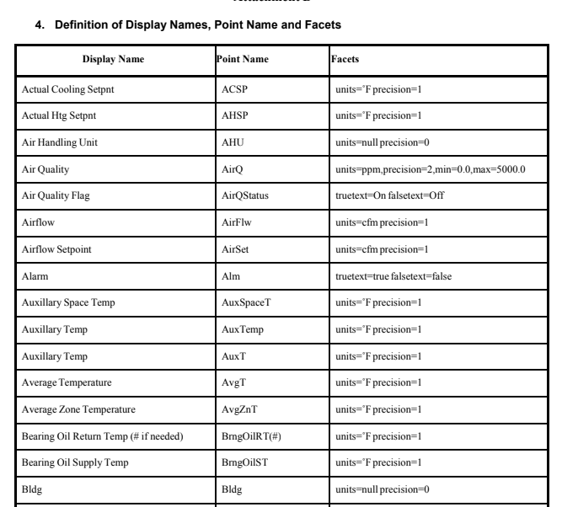
Pre Project Haystack - Naming Conventions
Owners & Operators had to drive adoption of standards
Controls contractors had to drive adoption on their own
No industry standards to follow

Slide 10
3. Types Of Buildings PD Integrates

Slide 11
What’s Driving Real Estate Sustainability & ESG?
What Is Nantum OS?
We help the world’s top institutions use artificial intelligence and machine learning to reduce their real estate carbon footprint to zero.
Corporate Net-Zero Goals
Enterprise commitment to net-zero carbon emissions goals has been pervasive across the corporate ecosystem
Consumers & Investors
Consumers are demanding climate action from corporations, investors are rewarding sustainability & ESG commitments
Carbon & ESG Regulation
Regulatory mandates from the SEC around ESG reporting as well as federal, state, and local carbon emission fines have already entered commercial markets
Corporations are starting their Carbon Zero journey with real estate because it’s the fastest way to see early carbon emission reduction results.
Energy Price Volatility
Global volatility in energy markets and rising cost of electric power, water, natural gas, combined with the high cost of procuring renewable energy have caused energy risk

Slide 12
Types of Buildings PD Integrates
Large Portfolio Owners
Mostly Commercial Class “A”
50/50 Owner Managed vs Third Party Managed
50/50 Owner Occupied vs Tenant Occupied
Owners that prioritize the following:
Sustainability
ESG
Optimization
Portfolio Management
AI/ML
Cyber Security
Data Lake

Slide 13
4. Overview & Why Tagging Is Important To PD

Slide 14
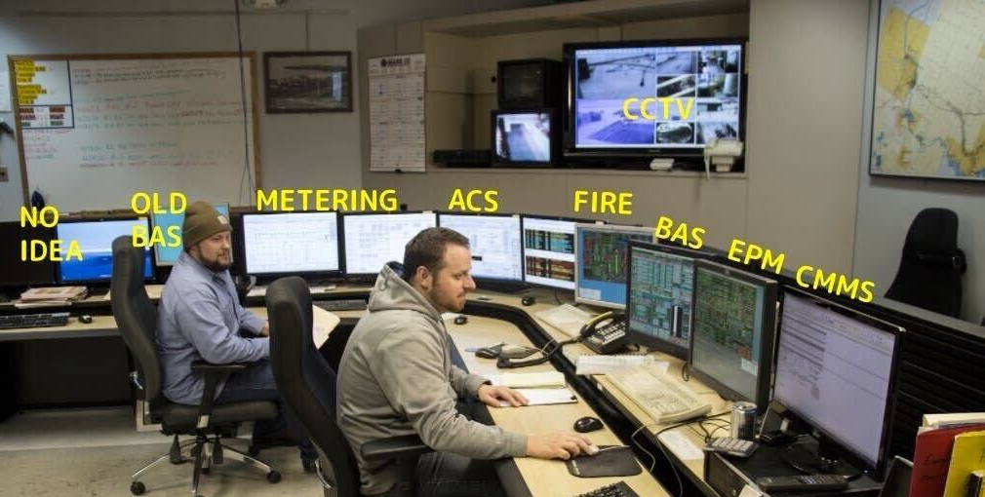

Slide 15
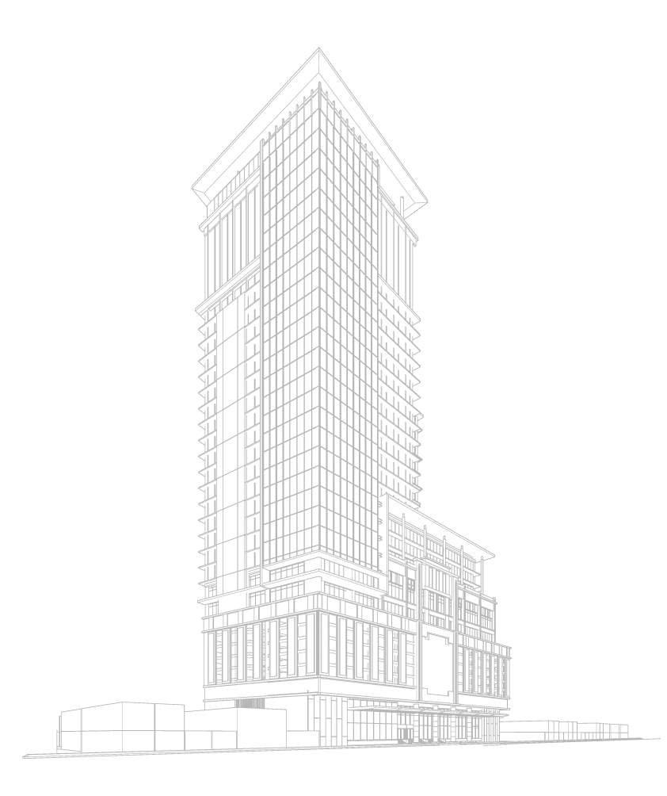
Data Integration
External Cloud Services / Apps
IoT Device Cloud
✅
✅
People Counters
NANTUM OS
BMS
Direct Secure connection
Air Quality
✅
Building OT Network
Electricity
Gas
Water
Gateway
Lots of data from lots of different sources are brought into Nantum OS. When semantic tagging is available, it is increasing customer time to value and reducing customer onboarding time.
Steam
✅
✅
✅ Supports Tagging

Slide 16
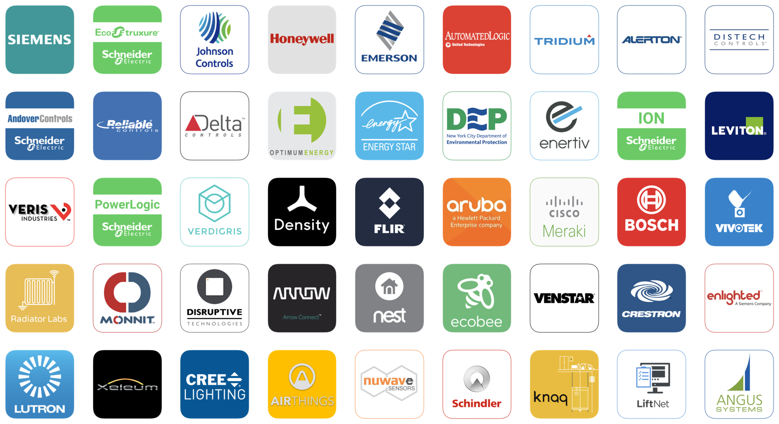
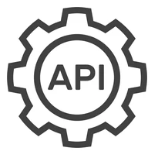
3rd Party Applications
NANTUM OS
Nantum OS has an open API that both sends and receives data from third party applications. All semantic tagging is made available.

Slide 17
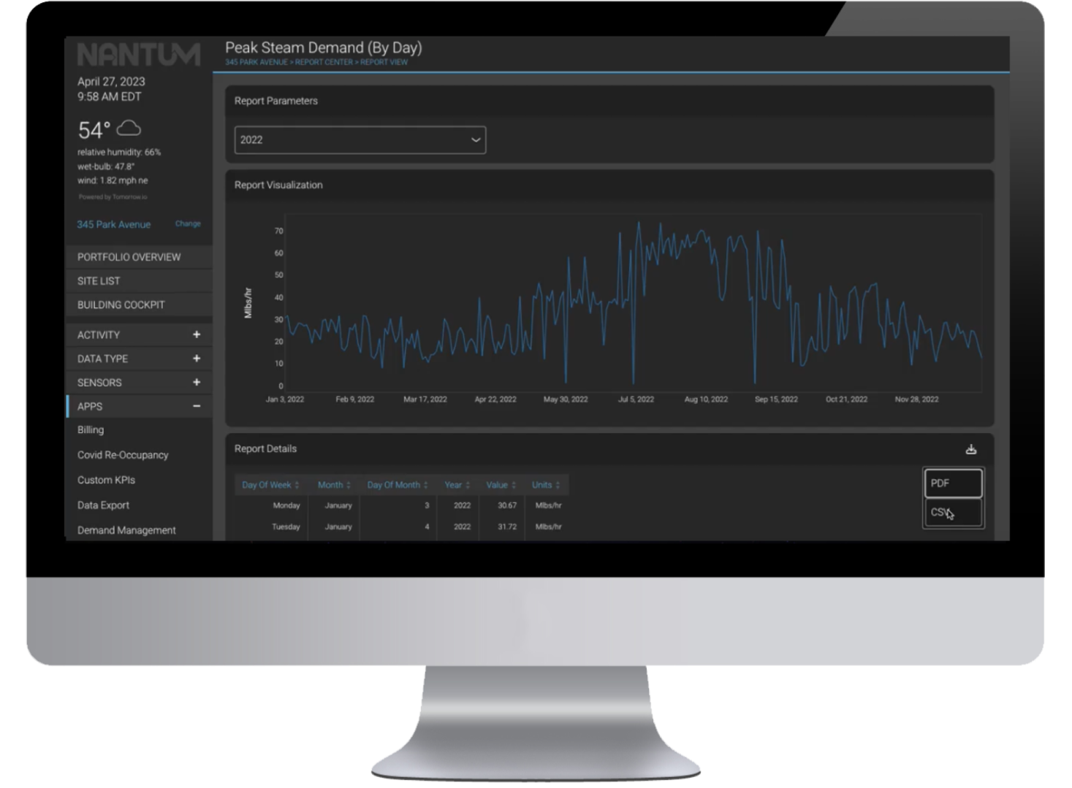
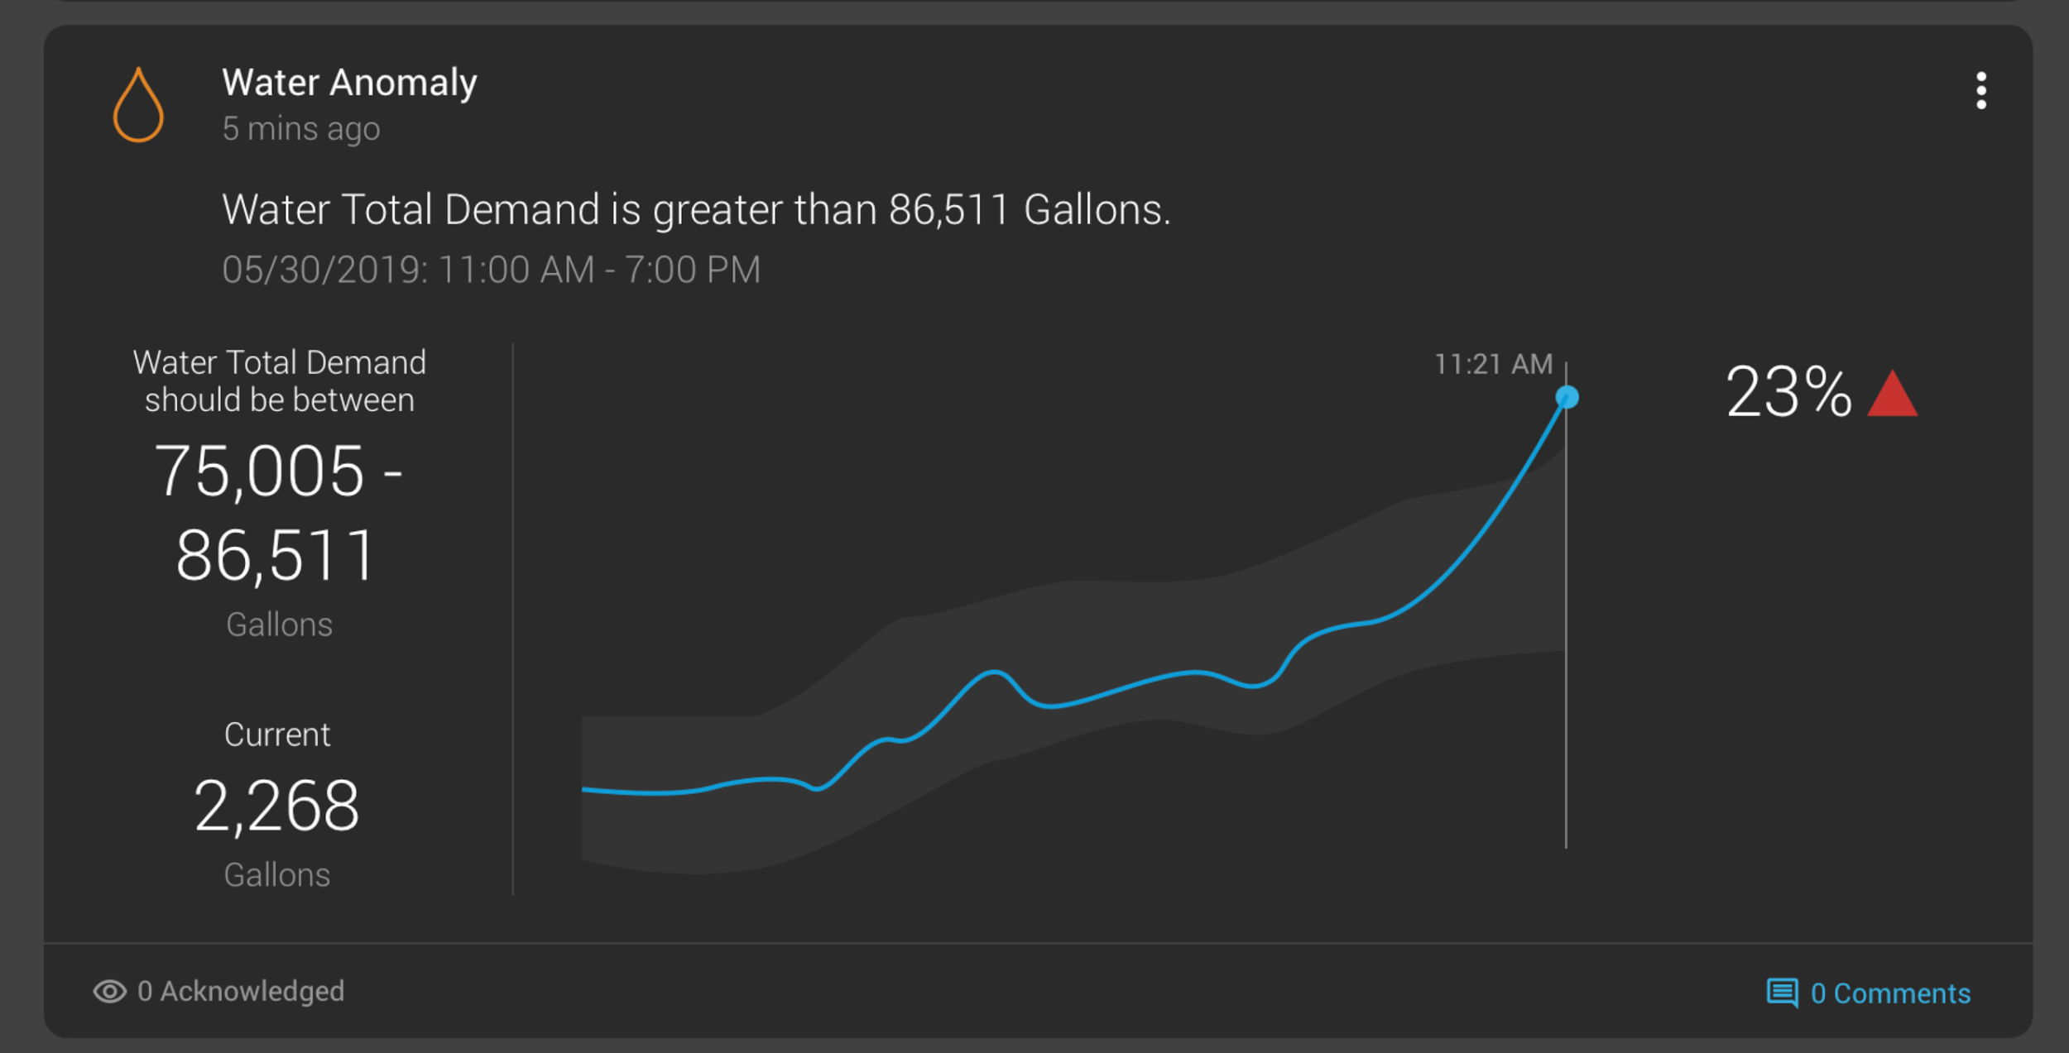
Enabling Data Visibility by Tagging
Haystack helps Nantum OS to normalize the data with tags into a single platform for visualization and historical data reporting.
The tags tell you what the data is, and allows it to be easily recognized for dealing with analytics and finding issues and problems.
ALGORITHMIC WATER LEAK DETECTION
Nantum OS tracks and predicts the daily patterns of water flowing through buildings. Building operators are alerted to unusual water behavior before it turns into a major issue.
Humidity / Moisture
Water Flow
NANTUM OS
Water Meters
Leak Detection

Slide 18
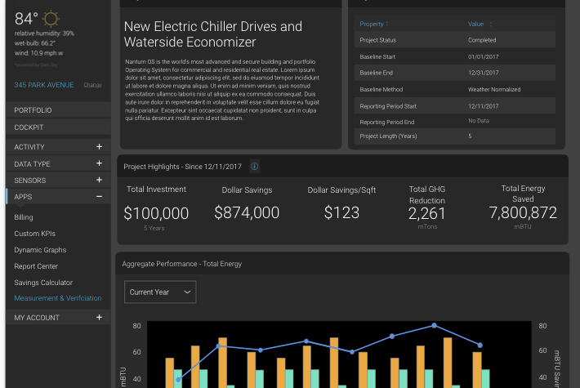
The Power of Reference Tags
Haystack Metadata is used in Nantum to streamline activities for the system integrator such as point setup, graphic creation, and programming….
Site
Equipment
Chiller#1 Chilled Water Supply Temp
id 3_times_square.chiller1.Tchws
equipRef @ 3_times_square.chiller1
siteRef @ 3_times_square
Kind “Number”
Unit “F”
chilled
water
leaving
temp
sensor
Chiller#1
id 3_times_square.chiller1
siteRef @ 3_times_square
equip
chiller
waterCooled
Electric
Point
Relational
Descriptive

Slide 19
5. What We Are Seeing In The Market

Slide 20
Not many existing buildings have tagging.
We are seeing it in new construction and some retrofits.
Owners with a dedicated “Smart Buildings Team” are leading the market and forcing adoption.
Real Estate is hesitant to invest in operational technology, slow moving, and risk averse.
Rely heavily on MEP firms. MEP firms stamp and repeat projects and are constantly pushed to keep project costs low.
Controls contractors are not including tagging for new projects unless called out in specifications.
Controls contractors are doing a better job at point naming but we are still running into generic names such as AO1, AV2, BI23 & etc….
We still can’t rely on controls contractors to tag points let alone utilize standard naming conventions.
Open protocol integrations such as BACnet & Modbus do not support tagging.

Slide 21
Boston Hotel
Poor Naming & No Tagging

Slide 22
Chicago Office Building
Good Naming & No Tagging

Slide 23
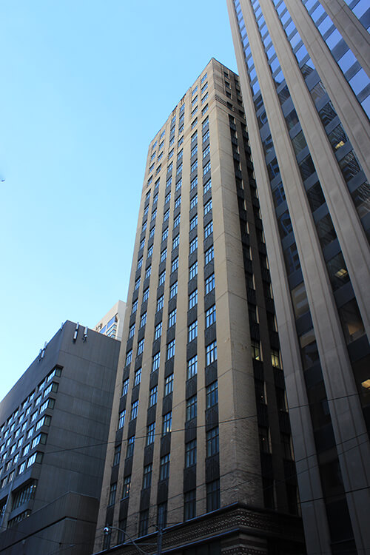
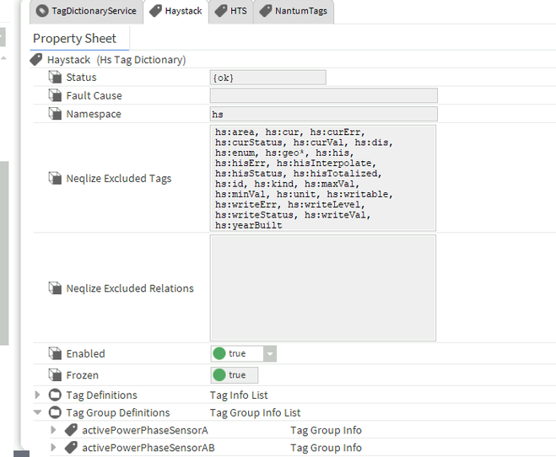
Toronto Office Building
Good Naming & Haystack Tagging

Slide 24
6. Customers’ Thoughts And Best Practices

Slide 25
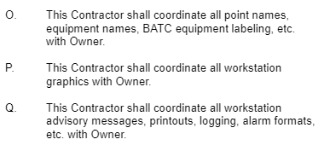
Large US REIT
1. Does your company use semantic tagging for new BMSs? No
2. Does your company have a standard BMS naming convention for new BMSs? No
3. What are your thoughts on BMS tagging and standardized naming and how does their adoption benefit you as a company? We rely on our MEP partners & preferred Controls Contractors to provide the best solutions for us.
4. Any challenges you're facing around the subject? We haven’t really paid attention to it so none
Spec for new BMS upgrade

Slide 26
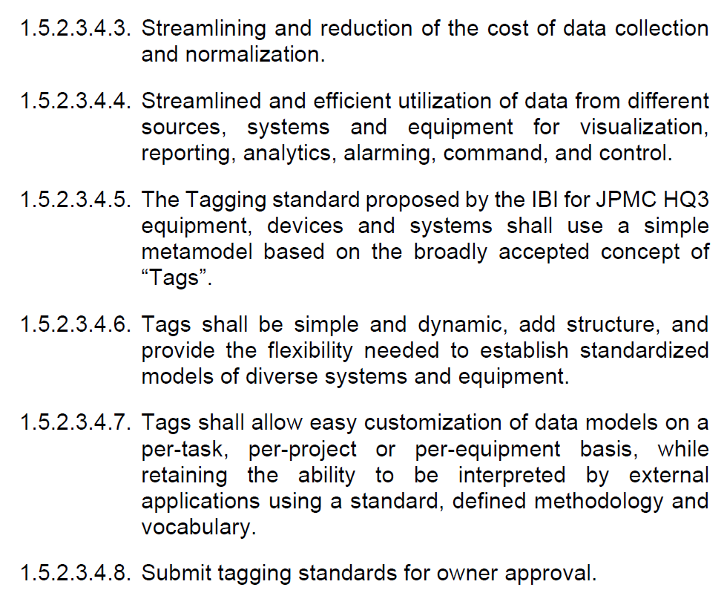
Global Real Estate Owner
1. Does your company use semantic tagging for new BMSs? Yes, starting with a new building, we will be using semantic tagging.
2. Does your company have a standard BMS naming convention for new BMSs? No. not yet.
3. What are your thoughts on BMS tagging and standardized naming and how does their adoption benefit you as a company? I think its great and will help with future integrations
4. Any challenges you're facing around the subject? No challenges yet.

Slide 27
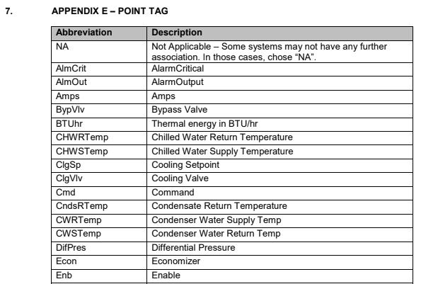
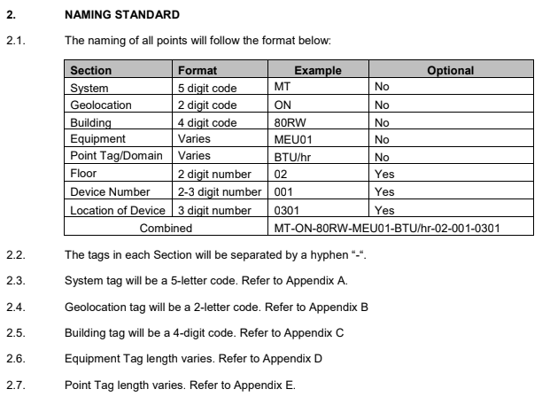
Large Canadian REIT
1. Does your company use semantic tagging for new BMSs? Yes
2. Does your company have a standard BMS naming convention for new BMSs? Yes
3. What are your thoughts on BMS tagging and standardized naming and how does their adoption benefit you as a company? It’s a requirement for us to get the most out of the systems we’re installing. Data is critical to the operations of our assets.
4. Any challenges you're facing around the subject? Vendors & manufacturer following our specifications

Slide 28
7. What PD Is Doing To Overcome Challenges

Slide 29
Industry & customers are moving too slow adopt tagging.
Tagging is critical to the speed and accuracy of onboarding, maintaining our customers and supporting third party applications.
We have an anonymized database of hundreds of buildings with tagging available to us.
We have a team of data scientists & software engineers.
We are working on solving this problem with software powered by AI & ML that gets smarter over time.

Slide 30
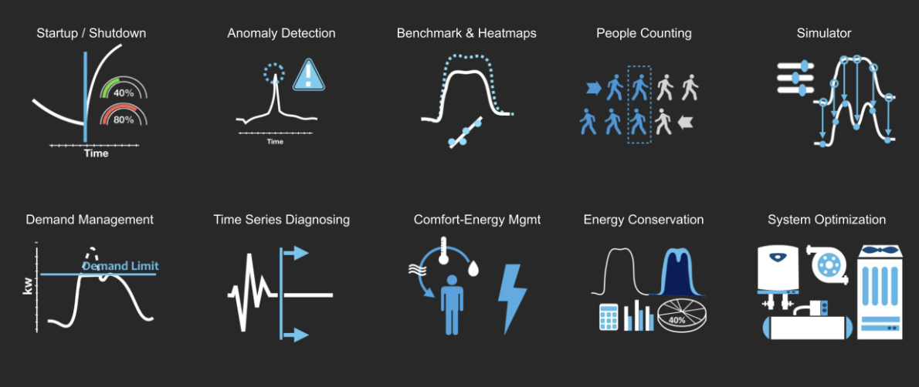
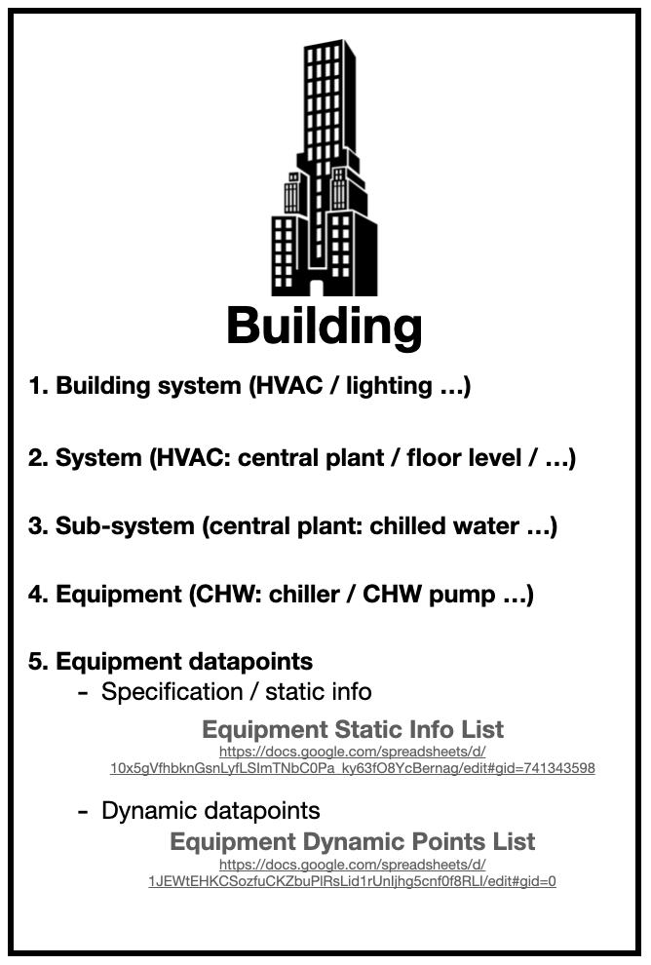
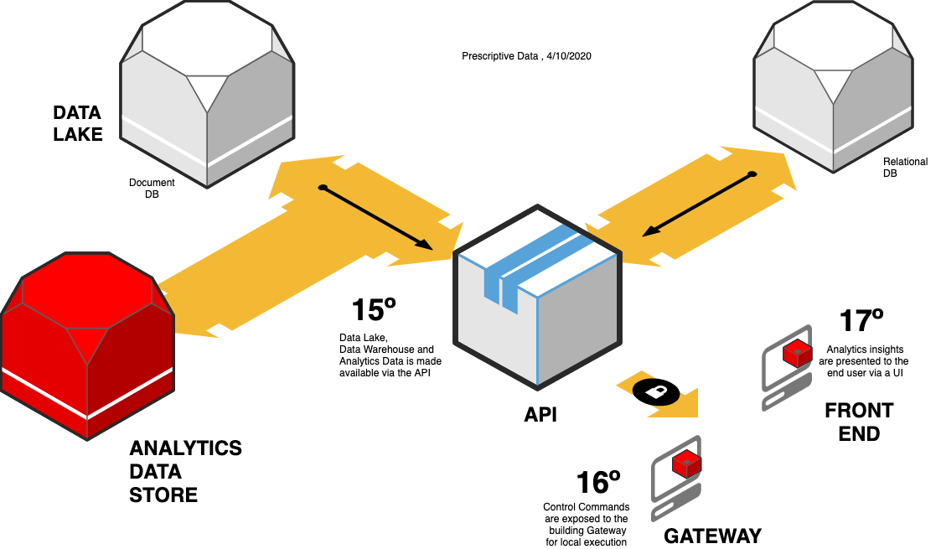
Interoperability
Nantum OS: Nantum AI
Nantum OS
Nantum OS:
Building Manifest formulated based on
3rd
Party AI

Slide 31
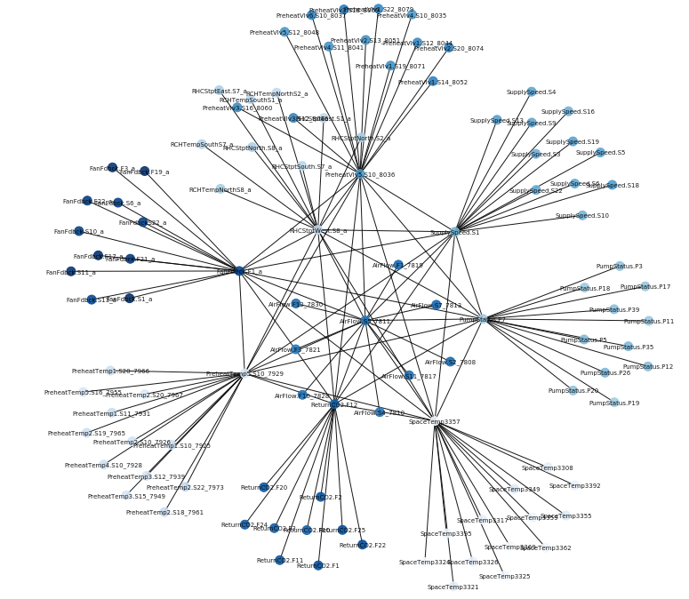
Automated Recognition and Mapping (ARM)
Nantum Automated Recognition and Mapping (ARM), based on Haystack building semantic data model, automatically learns and tags building sensor data with high fidelity and minimum human inputs.
Preheat
Valve Position
Return
Chilled W.
Temp.
Supply Fan Speed
Train Classification/ML Model :
Fan
Feedback
Air Flow
Pump
Status
Input:
- BMS Naming
- Time-series
Output:
- Labeled Data
(based on Nantum
Building Manifest)
Classification Model
Preheat
Temp.
Tagged BMS Data based on Nantum Building Manifest (Haystack)
Return
CO2
Space
Temp.
Classify Leaders :
Classification Model
Predicted
Tags
Unlabeled Leaders in
New Buildings

Slide 32
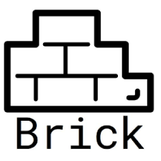
Future Ability to Support Leading Ontologies For our Customers & Third Party Applications
NANTUM OS
Global building data is integrated and when existing tagging is not in place Nantum ARM powered by AI & ML automatically learns and tags building sensor data with high fidelity and minimum human inputs.
Ontology translator/mapper built into Nantum to make data available to conform to multiple standards.

Slide 33
Questions?
www.prescriptivedata.io

