Slide 1
Managing an IoT System Haystack Compliance and Efficient Data Retention
Haystack In Practice
Corbyn Knotts
Paul Grinberg
Notes:
paul.Grinberg@daikinapplied.com

Slide 2
Efficient Device Communication
Device 1 (Flat)
Device 2 (BACnet)
Device 3 (Hierarchy)
OA_TEMP
OA_TEMP
OAT
Present_Value
PVal
OAT_Units
Units
Unit
Cloud has little control over devices
Devices prefer certain communication format
Cloud contextualization may have introduce errors
Notes:
Paul -
Talking Points
Different device communication protocols have their nuances that may imply structure
Bullet 1
devices connecting to the cloud can be anything (old/new/internal/3rd party).
Cloud cannot mandate 100% of how data should be communicated.
Bullet 2
Embedded devices have their “preferred” way to communicate stemming from how they keep track of data.
For example, some devices may consider “units” as data, while others may treat is as metadata
Bullet 3
Even if possible, forcing conformity may have unintended “context” problems
There is value in the cloud to retaining native structure
Allows access in native format
Allows cloud to make decision based historic changes in native format
Why? – Users and process of information in the cloud typically “just want the value”.

Slide 3
Atomic Information Storage
Device 1 (Flat)
Device 2 (BACnet)
Device 3 (Hierarchy)
OA_TEMP
OA_TEMP
OAT
Present_Value
PVal
OAT_Units
Units
Unit
Values are generic
Every “value” has an Id
Single Storage Format
Data Id
Value
Data Storage
Notes:
Corbyn –
Talking Points
Bullet 1 – A value is whether it be meta data, context, or sensor reading need to be accessibly atomically.
Sensor
Point
Metadata
Context
Bullet 2 – Minutia details of how the value became available are irrelevant at a high level.
No relation between values
Unique Identifier is created for
Bullet 3 – Storage supports a standard format that requires only
Unique ID
The Value
Why? – Users and process of information in the cloud typically “just want the value”.

Slide 4
Atomic Information Access
Device 1 (Flat)
Device 2 (BACnet)
Device 3 (Hierarchy)
OA_TEMP
OA_TEMP
OAT
Present_Value
PVal
OAT_Units
Units
Unit
Data Id
Standard Value
Native Value
Data Storage
Notes:
Paul –
Need to present values to users in a way that makes sense to them
Device engineers prefer the native values
Some cloud processes prefer standard values, but benefit from the extra information from native value
Need to balance the needs of
efficient communication from devices
efficient storage of native data
efficient access of standardized data
In other words, we need both formats – but that’s inefficient

Slide 5
Structed Data Access
Native Structure
Haystack Structure
Point
Point
Data Storage
Member
Tag
Value
DataId
Value
Member
DataId
Tag
Property
Value
DataId
Value
Notes:
Corbyn -
Application, integrators, user can be concerned with Haystack structure to access data
Engineers, data analysts, product development will want to access data in the native structure.
We do not duplicate data: 2 points of access to same Data Id
Resolves data conflicts
Haystack Structure

Slide 6
How can we achive this?
"All problems in computer science can be solved by another level of indirection.“
- David Wheeler
https://en.wikipedia.org/wiki/David_Wheeler_(computer_scientist)#cite_note-26
Notes:
Paul -

Slide 7
Storage Abstraction Needed
Haystack Entity Model
Data Storage
Point
?
DataId
Haystack Tag
DataId
Haystack Tag
DataId
Notes:
Paul -
Need some way to decouple the Haystack Entity Model from the underlying DataIDs in the storage
This needs to be generic, auto-computed, short lived, without data duplication, cost efficient (CPU and storage)

Slide 8
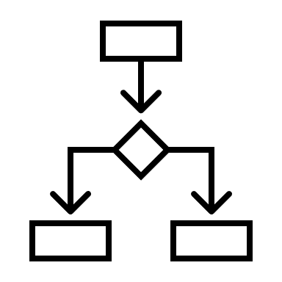
Referential Storage Abstraction
Haystack Entity Model
Referential Storage
Point
Data Storage
Point
Value Tag
Haystack Tag
DataId
Source
DataId
Haystack Tag
Value Tag
DataId
Source
Notes:
Corbyn -
Haystack Entity Model
Are maintained and reviewed
Can be swapped out if new or different models are aggreged upon
Referential Storage
only created as needed based on logic in place
No History for referential storage by design to honor current tags describing current state (history of tag changes can be tracked via an independent process.
Logic is created to allow for automated mapping to be performed and is defined on many levels as needed
Protocol (BacNet – StateText to enum)
Model
Existing tags
If there is no data source for a value tag it is not created in referential storage
Logic runs on all applicable “Events”
Updates to Haystack entity models
New data point
Update to data point value (*if defined by logic)
Value Tags
Can be Reference a Haystack Entity Model tag. If a Value tag does not reference a Haystack Tag is will not be used when haystack complaint query is performed.
There are still marker tags and other value tags available for the point

Slide 9
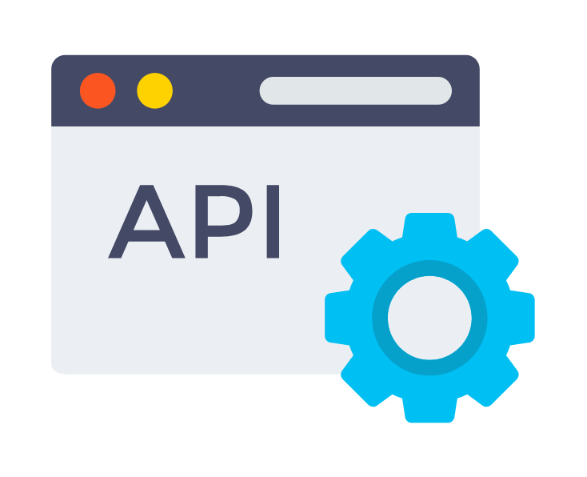
Workflow
Create
Haystack
Model
Associate
Native to Haystack Model
Create
Native
Model
Communicated Values
Available to
Users by
Haystack or
Native format
Referential Storage
Communicate
Values
Cloud stores
As DataID
Notes:
Corbyn –
Yellow – Models created and managed “globally” we do not
Red – Referential storage is short lives and created as needed – is used to create haystack model for user consumption (model itself is no stored for a specific instance)
Green – Data storage – Long Lived historical storage if “value” event, non-relational (help keep cost and query time down)

Slide 10
Use Case 1 – We now know more!
A group of devices has been sending data
We just learned more about how to understand data
Engineering units are now known
Haystack tags are now known
There is no need to re-generate nonvolatile storage
Native data format still available
Referential storage is dynamically updated as needed
Notes:
Paul

Slide 11
Use Case 2 – Support new equipment
We have user applications based off Haystack models
An equipment is connected that does not match any existing model mapping
The Native model will be created automatically
Association between this new native model to the Haystack model will be done
The Equipment will be fully functional in user applications
History is stored even if we do not yet have a Haystack model for an equipment
Haystack model is referential and will work for data sent before it was created
Haystack model will be automatic for all future equipment with the same native model
Pages and functionality based on Haystack Models
Users do not need to understand native models of equipment to work with equipment
Notes:
Corbyn

Slide 12
Questions?

Slide 13
Appendix

Slide 14
Storage Considerations
Haystack Entity Model
Referential Storage
Data Value Storage
Global models available and shareable
Changes may have fundament impact on storage structure
Large amount of same data created for multiple instances
Short Lived
Quick Access
Does not Contain Values
Describes how to build an entity model
Adaptable to changes or multiple Entity Models
Long Lived
Large amount of data
Not Relational
Notes:
Database and data concerns
Data redundancy
Retention Polices
Conflicts
Database cost and size
Processing needs

Slide 15
Single Model Data Storage
Format 2 (BACnet)
Format 1 (Flat)
OA_TEMP
OAT
Present_Value
OAT_Units
Units
Standard Format
Format 3 (Properties)
OA_TEMP
DataId
PVal
Value
Unit
Source Content Body

Slide 16
Single Value Data Storage
Format 2 (BACnet)
Format 1 (Flat)
OA_TEMP
OAT
Data Storage
Present_Value
OAT_Units
Units
DataId
DataId
Format 3 (Properties)
DataId
OA_TEMP
PVal
Unit

